Slide 1
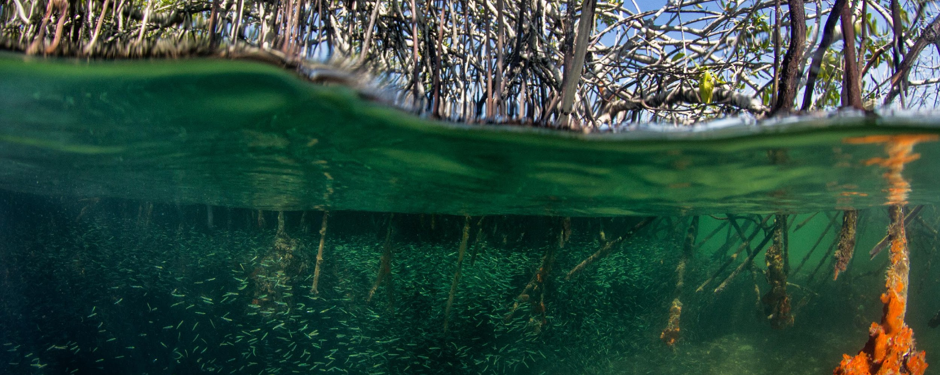
Project Steering Committee Meeting Oct 2020
Agenda Item 7:
Timeline towards the creation of the Coordination Mechanism
Catalyzing implementation of the Strategic Action Programme for the Caribbean and North Brazil Shelf LME’s

Slide 2
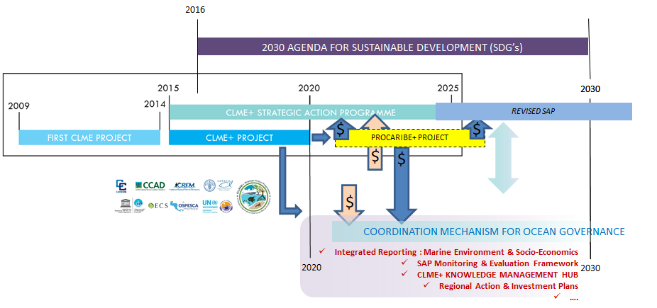

Slide 3
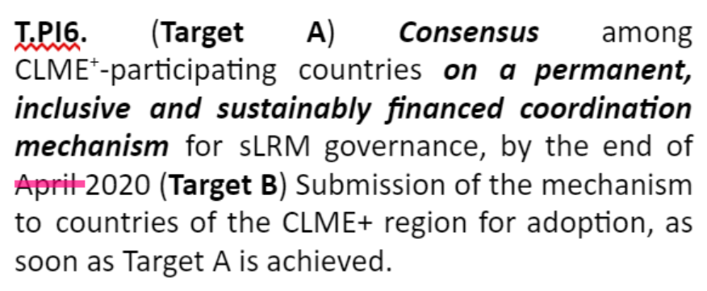
our ASPIRATIONS as a region/project,
Expressed in 2 ~plausible interpretations of the targets
O1.1 PI6 - Coordination Mechanism:
Targets as incorporated in the
(June PSCM approved) Results Framework (RF)
agreement (in principle) on the core aspects of the CM ✔
consensus on the full CM MoU, after legal review
circulation of the fully cleared MoU for signature (interpretation of Target B)
OPTION 1
agreement (in principle) on the core aspects of the CM ✔
there is a fully developed MOU, pre-cleared by the PSC at the technical level and ready to be used for further screening by legal departments of prospective Signatories" (alternative interpretation of Target B)
OPTION 2
BOTH OPTIONS CAN BE SEEN AS “MEETING THE RF TARGETS” - but with different levels of ambition

Slide 4

June PSCM decisions relative to the Coordination Mechanism
(some concern was expressed by PCU at the time…)
meaning of “finalized”: an MOU that is technically AND legally cleared?

Slide 5
RISK of OPTION 2
→ if legal clearance of final MOU is NOT (largely) achieved by CLME+ Project End, there will no longer be a Project/PCU to support further work on MOU and towards the creation of the Coordination Mechanism
→ anticipated possible approx start date of next phase (PROCARIBE+) project: end of 2022 (inception phase), Q2 of 2023, full project implementation...

Slide 6
CLME+ OUTPUT 1.1 - THE COORDINATION MECHANISM
PCU STRATEGIC PROPOSAL, with a view of taking full advantage of opportunity offered by the Project
Note on Project Role:
project can support throughout its lifespan,
but not guarantee achievement of consensus among countries/IGO’s/PSC members
different possible interpretations
of what should be achieved by Project End
PCU’S PROPOSED WAY FORWARD:
Conservative interpretation of Target B, to be achieved by March 2021: as a minimum, technically cleared MOU
2. mitigate the risk of a stall (or substantial slow-down) of the process towards CM creation, once the Project End Date is reached
CLME+ PCU keeps supporting the aspirations of having a technically AND legally cleared MOU that can be circulated for signature, BY or BEFORE Project End.
Most positive scenario: further support signing process if the above is achieved before Project End Date.
1. secure that the minimum requirements under the Results Framework are met:
Q: WHEN DO WE START LEGAL CLEARANCE?

Slide 7
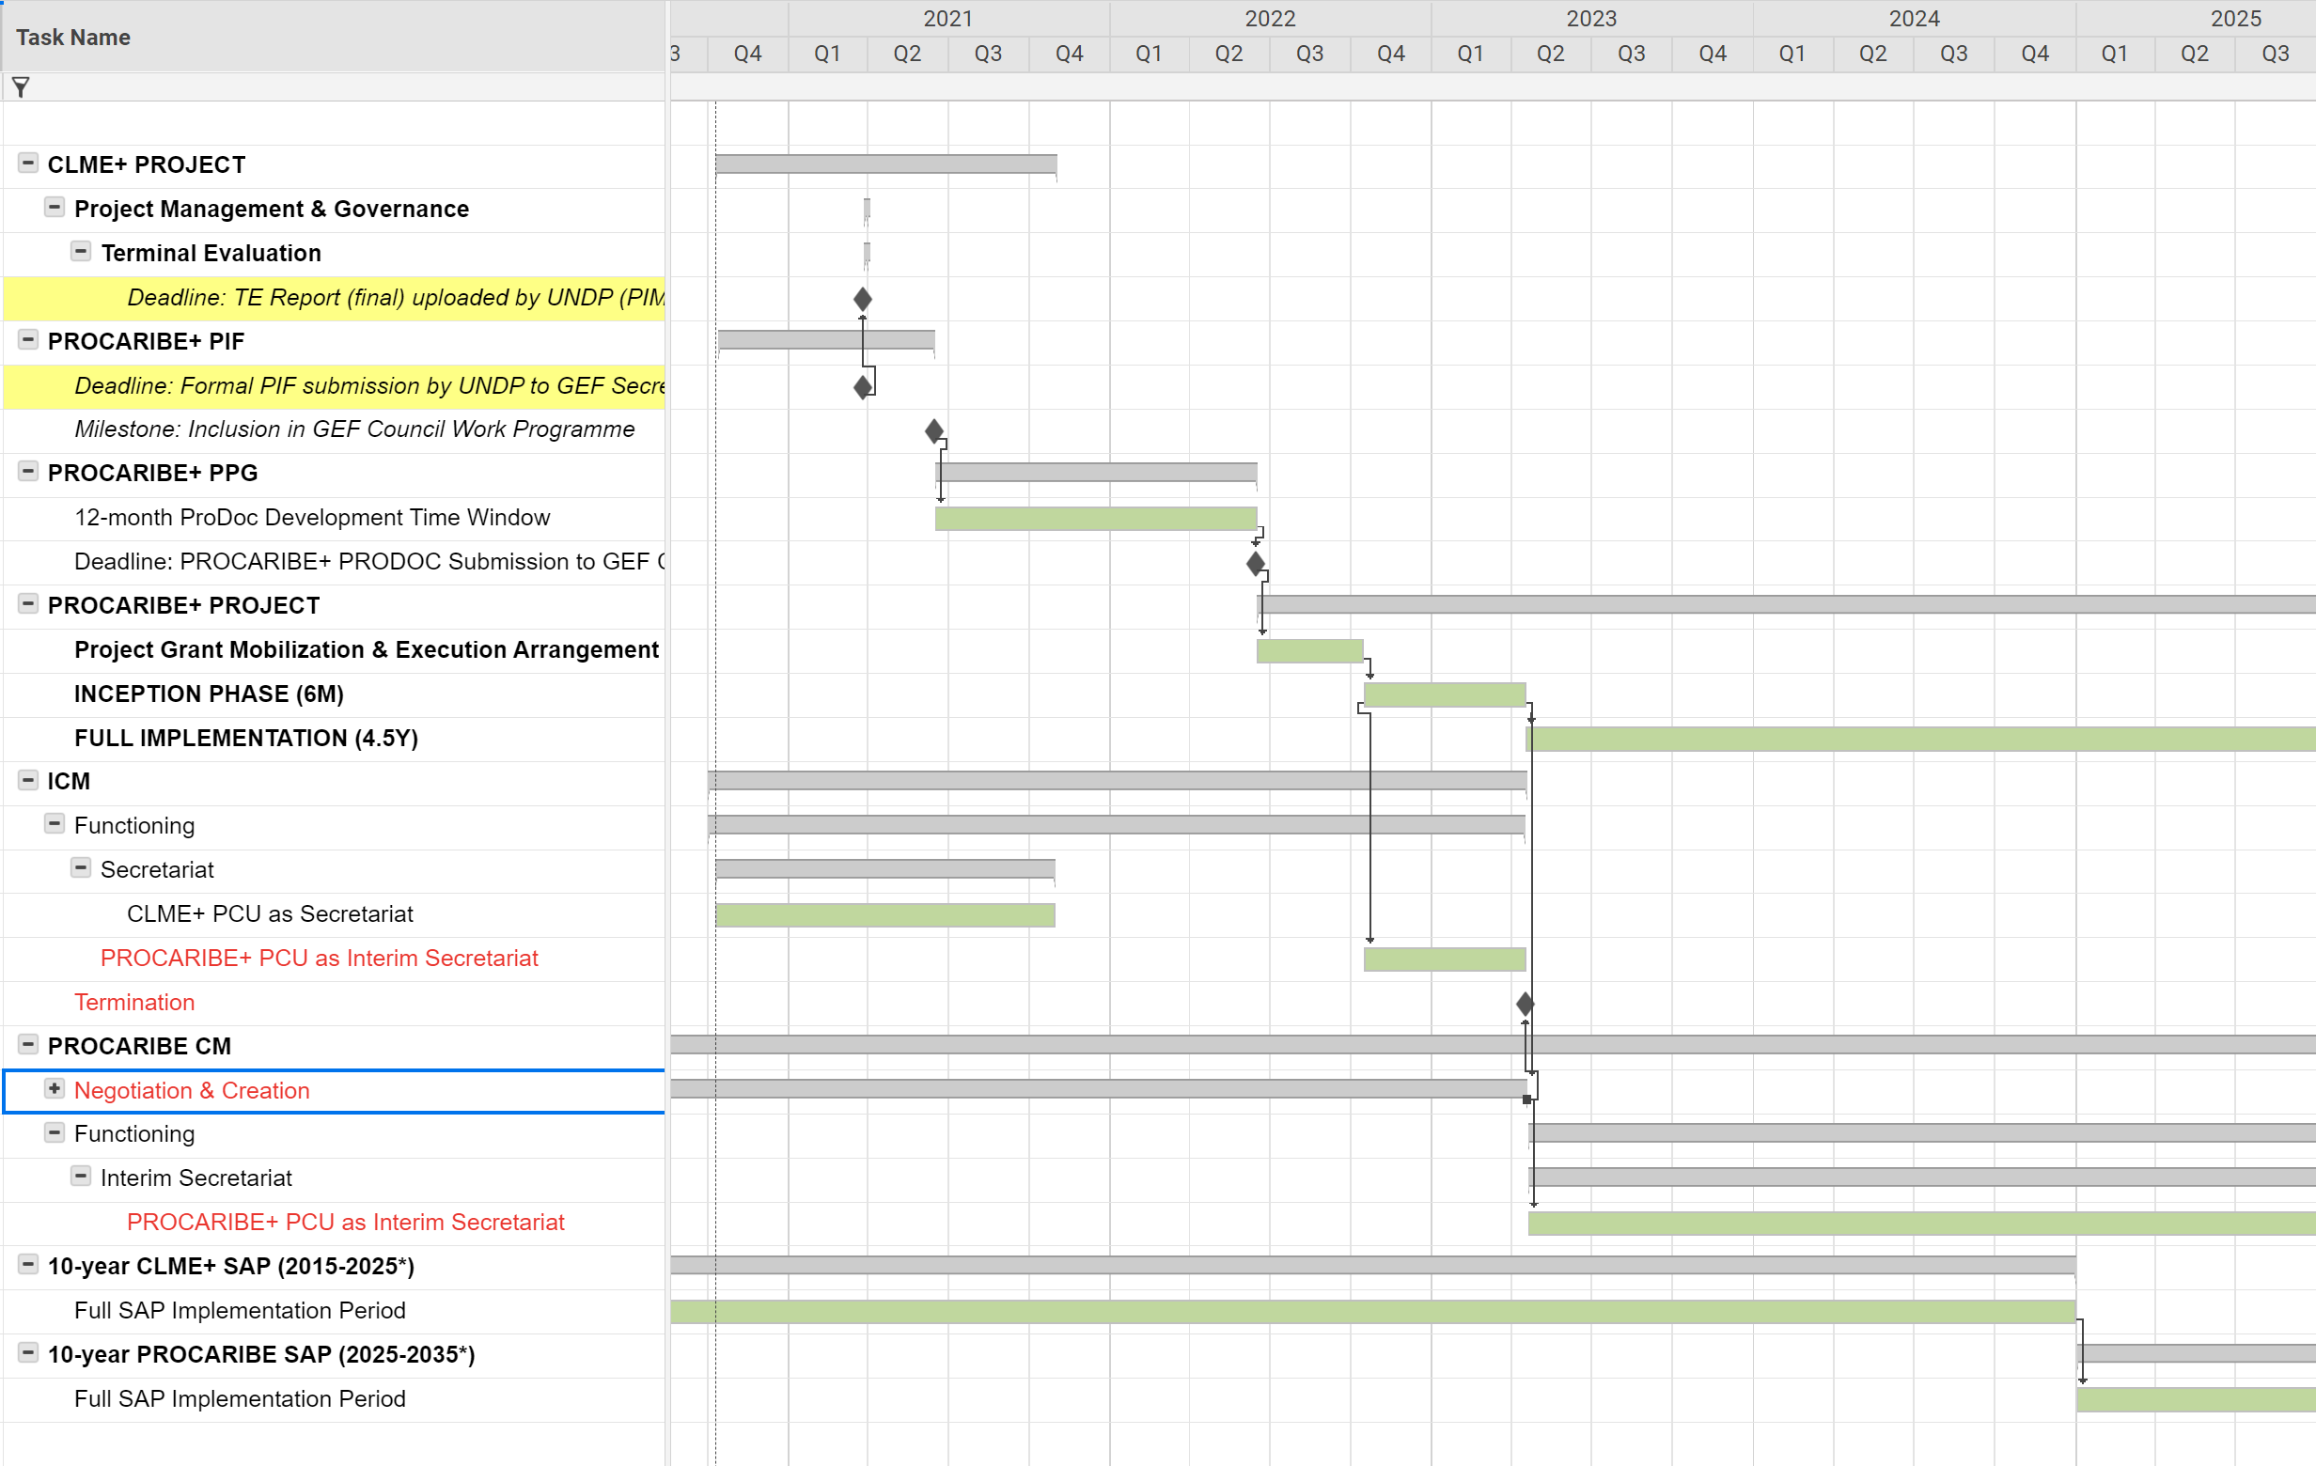
TIMELINE - “beware of the Gap!”
Potentially “dead” period with no progress on MOU if MOU not finalized by Project End
if project end kept in July
Target: have CM created by LATEST end of PROCARIBE+ Inception Phase (that’s 2+ years from now!)
TIMELINE SHOWS:
from CLME+ Project (2015-2021) to PROCARIBE+ Project (2022/23-...)
from ICM to PROCARIBE
from CLME+ SAP (2015-2024) to PROCARIBE SAP (2025-2035)
Development & endorsement of new SAP
- Coordination Mechanism must be up & running!

Slide 8
What happens after CLME+ Project End?
FROM THE ICM MOU:
IV. Core Functions of the ICM
The ICM will coordinate, cooperate and (....) to (....) implement the CLME+ SAP (...)
XIV. Entry into Effect and Duration
This MOU will enter into effect and the ICM will thereby become formally established upon the signature of this MoU by a minimum of five (5) of the Parties. It will remain in force until the termination of the UNDP/GEF CLME+ Project or as otherwise decided up by the Parties
FROM THE ICM RULES & REGULATIONS (a revision is being proposed):
11. Appointment of the Secretariat
The CLME+ PCU shall act as the CLME+ SAP ICM Secretariat throughout the lifespan of either the CLME+ Project or the CLME+ SAP ICM, whichever ends first
If the CLME+ PCU is no longer able to perform the role of the Secretariat, the CLME+ SAP ICM will, through consensus, assign the role of the Secretariat to one of its members (...)
FROM THE CLME+ PROJECT
RESULTS FRAMEWORK:
OUTPUT 1.1. Decisions on coordination & cooperation arrangements
(Target) Institutional arrangement(s) and operational mechanism to coordinate integrated ocean governance (incl. continued SAP implementation) efforts beyond project life span, consolidated before end of 2020

Slide 9
What happens after CLME+ Project End?
(tentative/”aspirational” timeline)
12 months: PIF in GEF WP on 15 June 2021,
PPG released → ProDoc to be delivered by 15 June 2022
4 months: to PROCARIBE+ Project Start (operationalize GEF Grant): October 2022
6 months: duration of PROCARIBE+ Project Inception Phase: April 2023
“GAP” to “full” implementation start date of PROCARIBE+:
If CLME+ Project End in July 20: 20 months If CLME+ Project End in October 20: 15.5 months
15.5 months “bridge period”: Keep “mini-PCU/Secretariat”/minimal support staff?
7.5M with GEF PPG grant funds ↔ (I)CM activities to the extent they contribute to ProDoc development
4M no GEF funds (other projects?)
6M with GEF PROCARIBE+ funds ↔ (I)CM activities to the extent they contribute to and do not
jeopardize inception phase core activities

Slide 10
What happens after CLME+ Project End?
Further mitigation measures:
Advance as much as possible towards CM creation during CLME+ Project (without jeopardizing timely delivery of other Project Outputs!)
ICM after-project-life plan by end of 2020 (?)
Optimize ProDoc development (institutional memory!) and Grant Operationalization and Project Inception phases
PROCARIBE+ Project Preparation Phase: tie ProDoc development to (I)CM Processes!
GAP: Keep “mini-PCU/Secretariat”/support staff?
Ask GEF for exception to cap on PPG size?
Leverage funds to bridge the gap?!!!
See (I)CM mandate & functions

Slide 11

Project Steering Committee Meeting Oct 2020
THANK YOU
Catalyzing implementation of the Strategic Action Programme for the Caribbean and North Brazil Shelf LME’s

