Slide 1

CLME+ Project Steering Committee Meeting, 16-18 June 2020
Draft PIF Concept for the Continuity of the CLME+ Initiative
Julian Roberts
Blue Resources Ltd
j.roberts@blueresources.co.uk

Slide 2
Objectives of this Session
To obtain consensus as a PSC on the specific Components, Outcomes and Outputs of the Results Framework
To discuss and confirm specific elements of the PIF that require country input

Slide 3
Session Outline
Brief introduction and context for the PIF
Overview presentation of draft PIF concept for continuity of the CLME+ project - Draft Results Framework
Specific inputs and needs from participating Countries

Slide 4

Introduction & Context for the Project Information Form (PIF)
Catalyzing implementation of the Strategic Action Programme for the Caribbean and North Brazil Shelf LME’s (2015-2020)

Slide 5
PIF Development Timelines
60th GEF Council – June 2021
Formal submission 10 weeks prior to GEF Council – March 2021
  Final PIF based on GEF comments + Response Matrix + Initiation Plan – May 2020
Full draft PIF submitted for ‘informal’ GEF feedback – November 2020
Endorsable version of the PIF agreed by October 2020 (??)

Slide 6
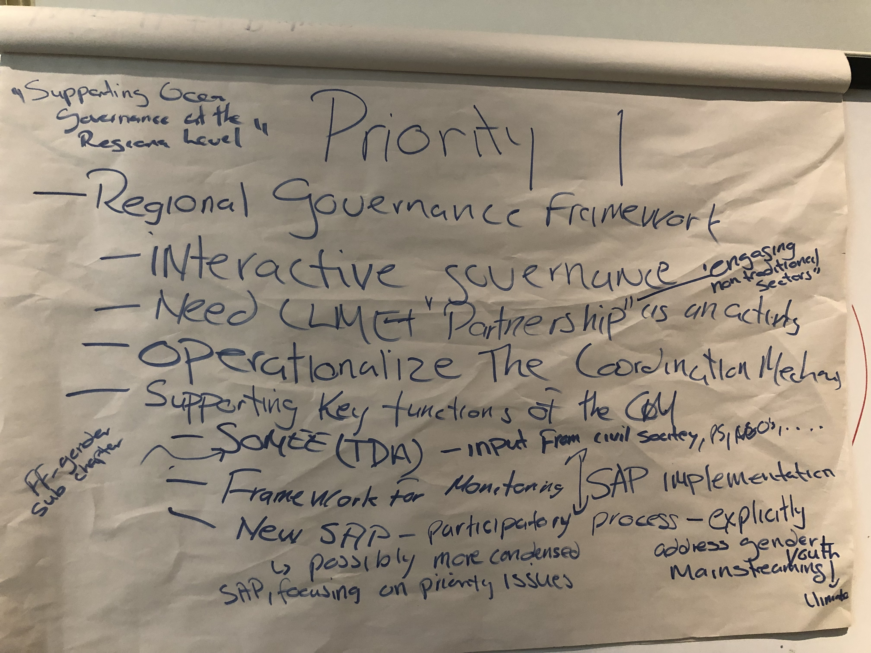
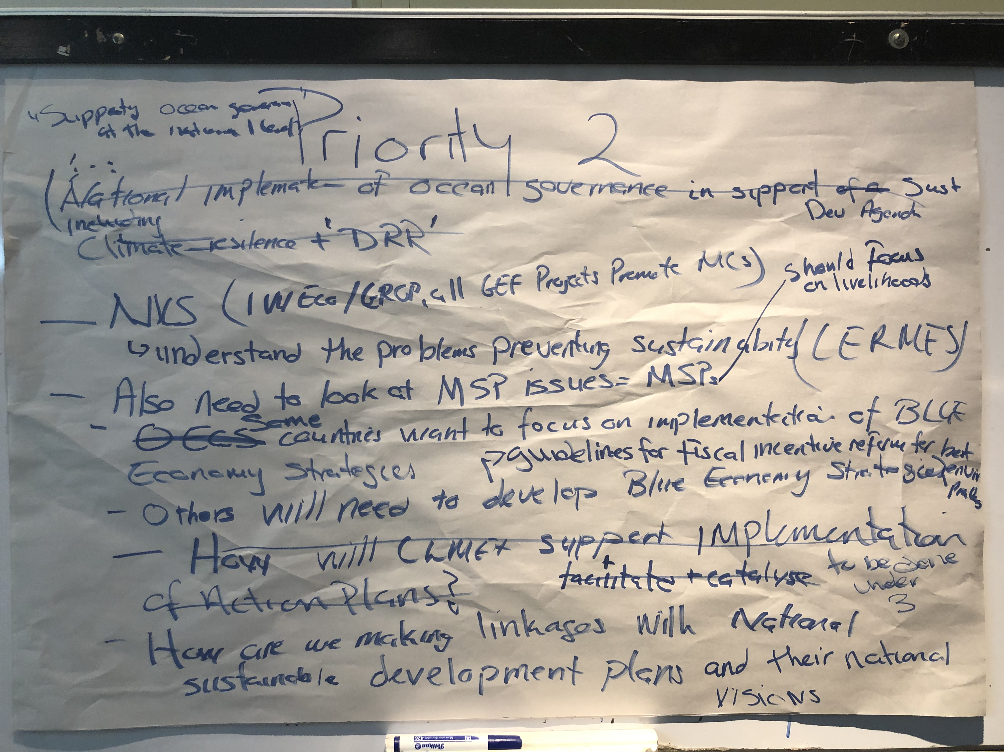
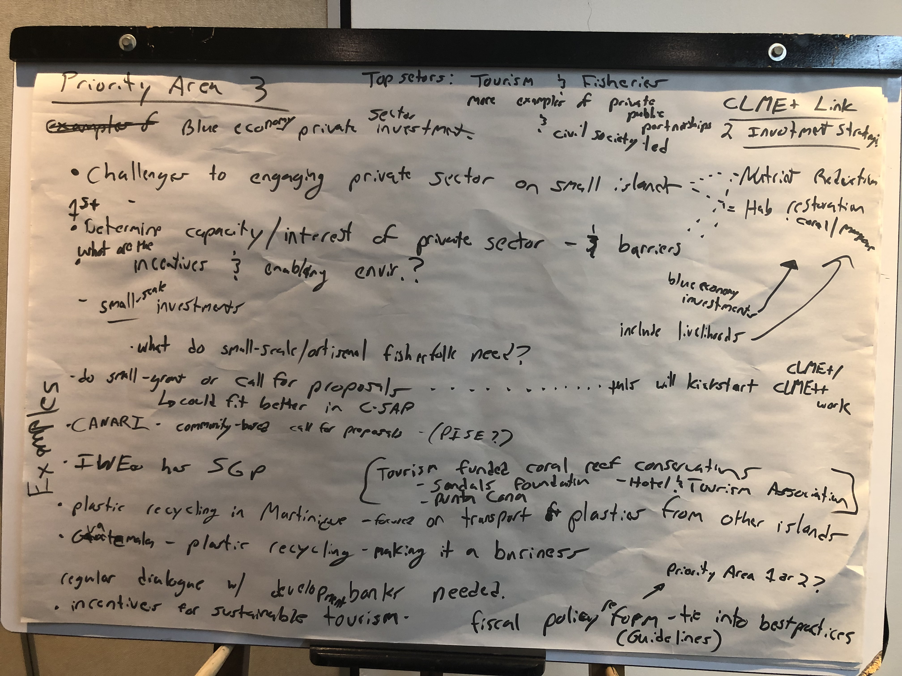
PIF Development
Primary focus on getting the Results Framework right
Synthesis of the outcomes from the SAP ICM (September 2019)
4 Priority Areas = 4 PIF Components
Reviewed by the ICM/PEG Meeting (March 2020)
Preliminary discussions with GEF-Secretariat (April 2020)

Slide 7
Draft Results Framework
Catalyzing implementation of the Strategic Action Programme for the Caribbean and North Brazil Shelf LME’s (2015-2020)

Slide 8
Participatory Regional Ocean Governance in the Wider Caribbean in Support of Sustainable Blue Socio-Economic Development (PROCARIBE+)
Title:
[Protecting and Restoring] [Protecting, Restoring and Harnessing] the Natural Coastal and Marine Capital of the Wider Caribbean/CLME+ Region Through Wide-Ranging Partnerships to Catalyze Investments in a [Sustainable Blue Economy] [ Sustainable [and Climate-Resilient] Blue-Socio-Economic Development] Through a Strengthened Regional Ocean Governance Framework and Wide-Ranging Partnership
Objective:

Slide 9
Component 1
Consolidating the regional, multi-level framework for interactive, participatory and integrated ocean governance in the [wider Caribbean/CLME+.
Component 2
Enhance the capacity of national governance arrangements for the implementation of the [ecosystem-based management (EBM)] [ecosystem-based decision-making and management] [and the ecosystem approach to fisheries (EAF)].
Component 3
Advancing marine-based sustainable socio-economic [development] opportunities through targeted stress reduction [and resilience-building] measures and enhanced investments.
Component 4
Enhanced region-wide multi-level knowledge generation, management, sharing and dissemination mechanisms in place, to facilitate awareness raising and enhanced decision-making for interactive, participatory and integrated ocean governance, in support of sustainable, climate resilient and gender-sensitive blue socio-economic development.

Slide 10
COMPONENT 1
COMPONENT 2
COMPONENT 3
COMPONENT 4
1.1
2.1
3.1
3.2
4.1
4.2
1.1.1
2.1.1
3.1.1
3.2.1
4.1.1
4.2.1
1.1.2
2.1.2
3.1.2
3.2.2
4.1.2
4.2.2
1.1.3
2.1.3
3.2.3
4.1.3
1.1.4
3.2.4
Aim to achieve 50/50 split between “Process” and “Stress Reduction” Outputs

Slide 11
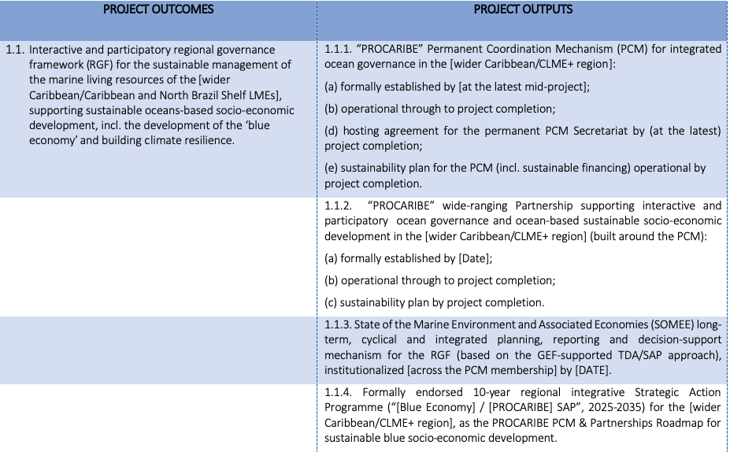
Component 1

Slide 12
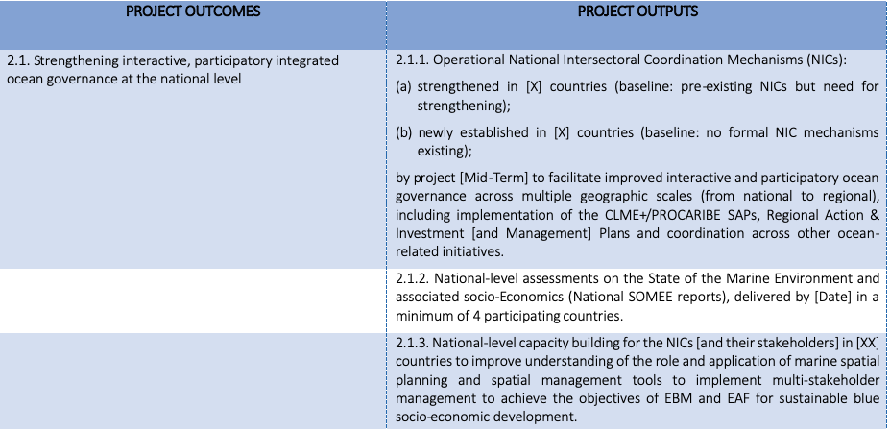
Component 2

Slide 13
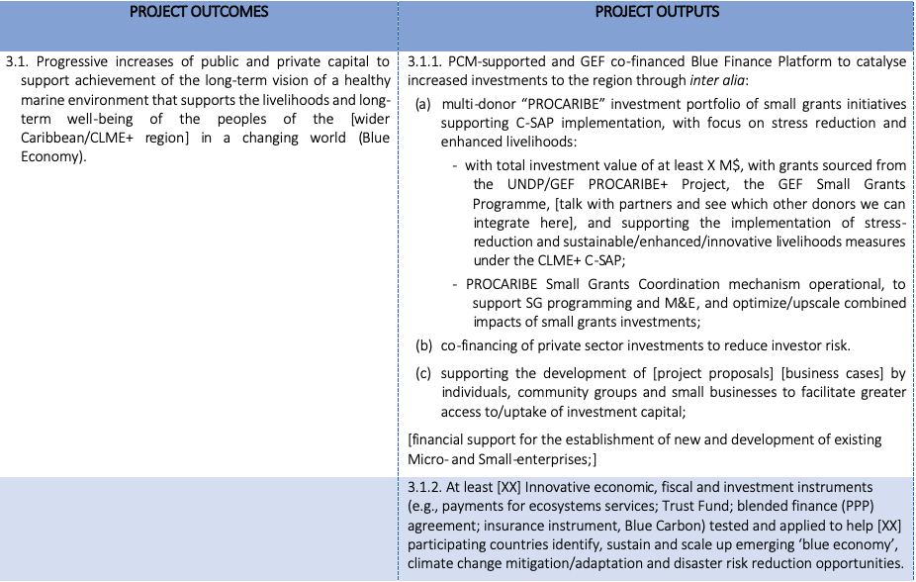
Component 3

Slide 14
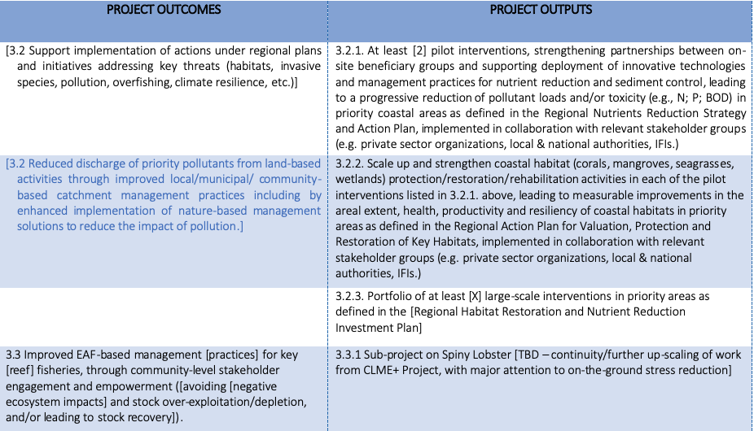
Component 3

Slide 15
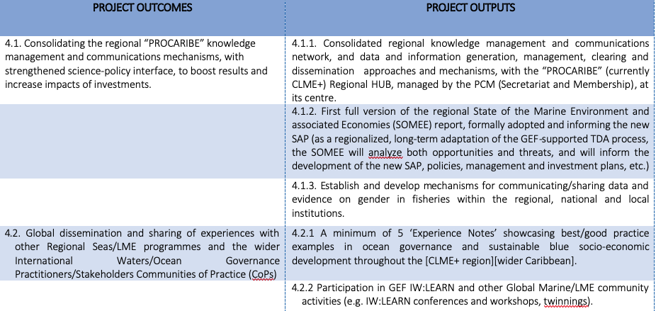
Component 4

Slide 16
Requirements from Countries
Review and input into the PROCARIBE+ Concept Note
Submission of CEO Endorsement Letters (from GEF operational focal points)
Indicative co-financing

Slide 17
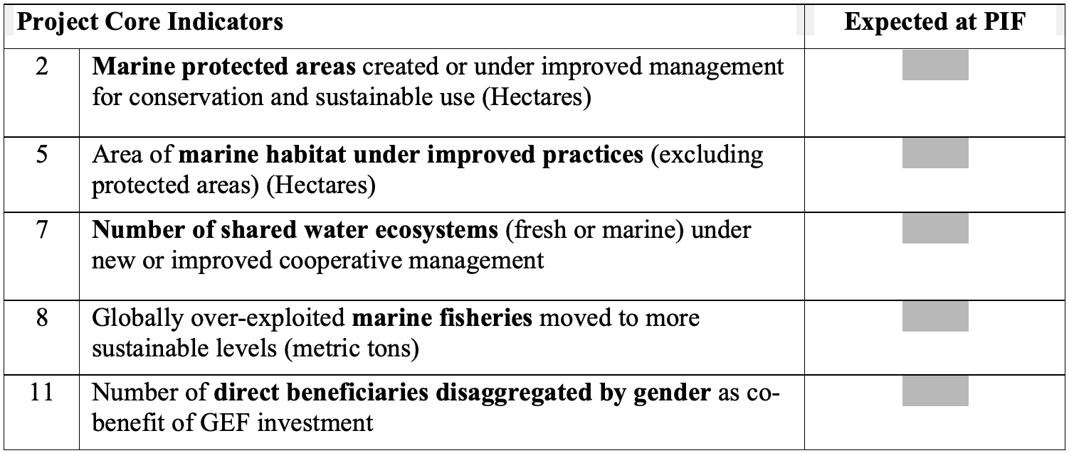
Requirements from Countries

