Slide 1

CLME+ PSC May-June 20 Work Programme, Item 5.2
Revised 2020-21 Work Plan & Budget, with timeline
and associated (proposed) PSC Decisions
Catalyzing implementation of the Strategic Action Programme for the Caribbean and North Brazil Shelf LME’s (2015-2020)

Slide 2
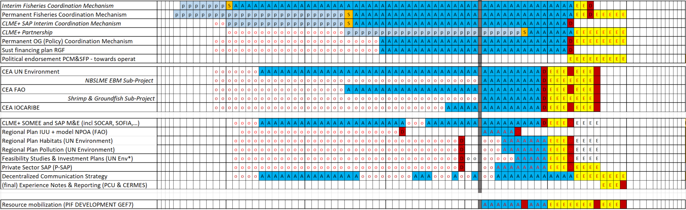
Existing CLME+ Project Timeline
as approved by the Project Steering Committee in March 2019
Notes:
This slide depicts the CLME+ Project´s current timeline, as approved by the Project Steering Committee by March 2019 (please note that the 4 months for administrative close-down of the project, from jan-april 2021 are not shown). The slide provides more details on the approved extensions of the timeframes for the completion of a number of CLME+ project flagship outputs (marked in yellow and the letter “E”), as they had been proposed as part of the February 2019 revision of the Project Work Plan. It should be noted that the May 2020 Implementation Status Review identified that some of these outputs cannot be successfully completed within the currently approved project timeframe.

Slide 3
Conclusions from the Technical Implementation Status Review
Progress continues to take place with CLME+ Project activities, with about 46.5% targets under Component 1,2 4 and 5 successfully achieved, and good progress towards many others
Two of the Outputs under component 3 have already been successfully completed (Outputs 3.1 and 3.5) and another one is in the final stages of implementation (O3.3)
Delays have been experienced with some CLME+ activities including some of the flagship outputs.
Several of these delays have either been caused and/or influenced by the COVID-19 pandemic
The current end date for technical implementation is 31 December 2020, with all co-executing partners needing to finalise technical activities by latest 30 August to allow for partner final technical reporting and consolidation of results and knowledge management by the PCU
With the current timeline a number of CLME+ Project activities will not be successfully completed
Notes:
This slide summarizes the conclusions from the CLME+ Project technical implementation status review.

Slide 4
Conclusions from Financial Implementation Status Review
Significant progress has been demonstrated in the implementation of the budget. In 15 months almost US$3 MM (30% of the budget) has been disbursed, to reach a total expenditure figure of US$10 MM (81% of the total budget). However, still US$ 3 MM remains to be executed by project end (note: some of these funds have already been disbursed to co-executing partners)
Progress in financial execution has occurred both at the PCU level and with co-executing partners. However, in this last stage of the project, it is the PCU that will face the greatest responsibility and challenges in terms of implementing their activities with the remaining funds.
The current circumstances of 2020 due to the covid-19 outbreak will not allow the remaining budget to be fully executed within the currently approved project time frame (e.g cancellation of physical meetings and events, identification and implementation of alternative working modalities, delays in recruitment process,etc). This context creates new and adds to existing delays, and implies a substantial challenge in terms of the effective execution of the budget by the currently approved project end date.
Notes:
This slide summarizes the conclusions from the CLME+ Project financial implementation status review.

Slide 5
Important Information for Consideration for GEF4 – GEF 6 Projects
Revised UNDP Policy for GEF 4 to GEF 6 Projects indicates that projects can be extended for up to 18 months (previously it was 12 months)
A 12 month extension (from 31 April 2020 to 31 April 2021) for the CLME+ Project was approved in March 2019
UNDP Policy clearly states “Projects may request a second project extension due to COVID-19 related delays for a maximum of 3 months (no extra budget). At the end of the three-month period the project will financially close and any remaining project grant will be returned to the Vertical Fund.”
Notes:
This slide outlines some important updates on the UNDP Policy related to GEF 4 to GEF 6 projects.

Slide 6
Proposed PCU Response to the current implementation status & challenges:
slides 6-22 of this powerpoint represent the
Revised 2020-21 Work Plan, Budget & Timeline
Acknowledging the conclusions from the May 2020 Financial and Technical Implementation Review, and the information provided as part of the UNDP revised policy for GEF 4 to GEF 6 Projects, the CLME+ Project Coordination Unit considers that a second and final 3 month extension of the CLME+ Project, from 30 April 2021 to 31 July 2021, will be necessary for the project successfully meeting its objective and outcomes (incl. those of stakeholder ownership, sustainability & continuity of outputs and outcomes)
The slides below will outline the CLME+ PCU proposal to address these challenges, including the rationale for why a 3 month extension is deemed essential.

Slide 7
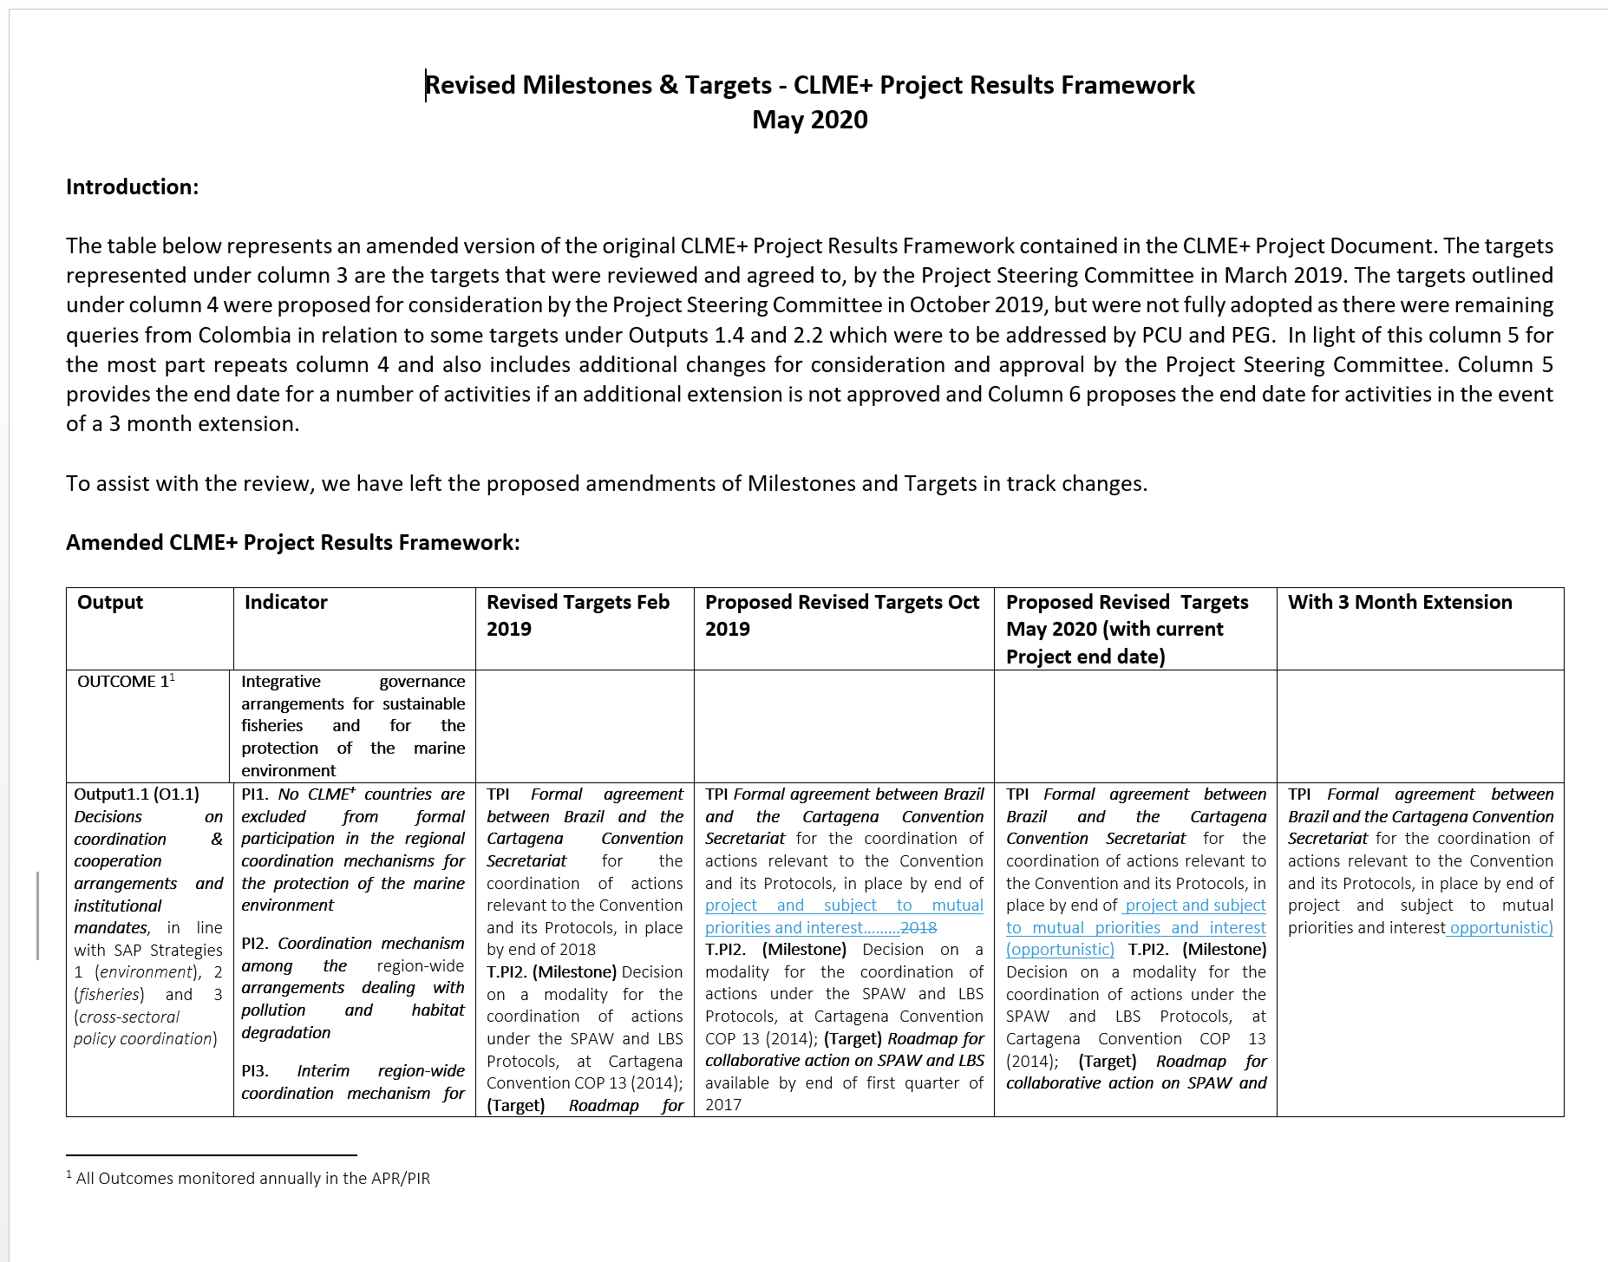
Revised Results Framework (proposal)
PSC Review of the proposed changes to Results Framework Targets
The CLME+ PSC is requested to review and express (as applicable) their agreement with the proposed changes to the CLME+ Results Framework, contained in full in the submitted Word Document
Notes:
Based on the conclusions of the implementation analysis, the CLME+ PCU also reviewed the Project Results Framework, including the changes already proposed by the PCU in October 2019 (but not yet fully adopted by the PSC due to some pending clarifications and revisions requested by Colombia relative to Outputs 1.4 and 2.2). For the most part, the proposed amendments remain the same. However there are some newly proposed amendments (mainly extensions of the timelines to achieve certain targets) as a result of further delays, the needs for (more time for) additional stakeholder engagement, or the needs for alignment with (revised) timelines for external governance processes, a number of the aforementioned issues linked to the COVID-19 pandemic. Without the currently proposed additional 3-month project extension date, all technical activities and associated participatory processes need to cease, and all outputs need to be finalized by 31 December 2020. With a 3 month extension, the end date for technical activities (e.g. PCU reporting and knowledge management, final PSC meeting, Terminal Evaluation, sustainability strategy & measures) and for the completion of some technical outputs can be put at 31 March, allowing for the standard 4 months for Administrative Project Closure processes to be scheduled from April to July 2021.
All proposed amendments were at the Output level only can be viewed through track changes. No amendments were made to any of the project outcomes. (The pending feedback relative to Output 1.4. and 2.2. will now also be provided, separately). Further no outputs, targets or milestones are being proposed to be deleted. Suggested amendments pertain to either a re-formulation, a de-scoping of some of the targets or changes in the proposed date by which the target/output is to be finalized.
The CLME+ PSC is invited to review the full Project Results Framework in the attached word document and approve (as applicable) the proposed amendments.

Slide 8
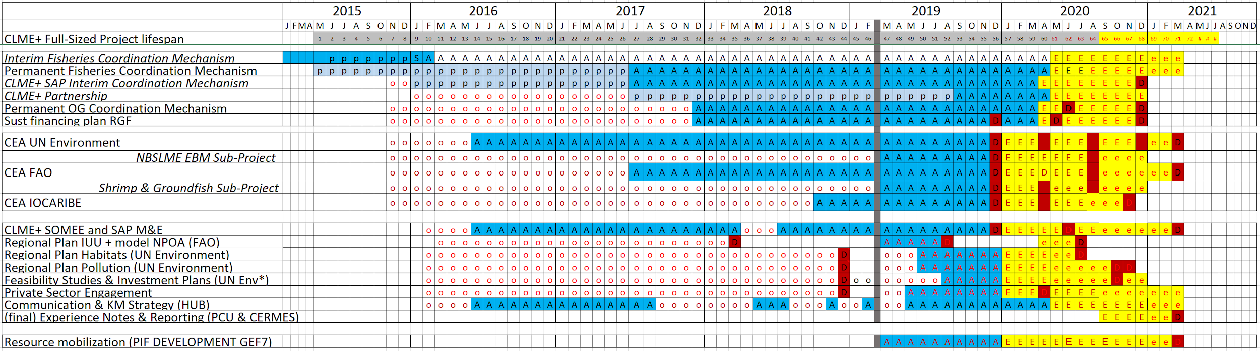
Proposed Modifications to Delivery Dates
for some of the Key CLME+ Outputs and Achievements
Notes:
This slide summarizes some of the main changes to the Project timeline for the implementation of Project activities, and delivery of Project outputs, beyond the changes already proposed and approved in the first half of 2019 (see the second slide in this PPT)

Slide 9
Revised Delivery Dates for CLME+ Project Flagship Outputs
Output | Proposed Delivery Date with the new Project End Date
O1.1 Permanent Coordination Mechanism | 31 December 2020
O1.5 Sustainable Financing Plan | 31 December 2020
O2.1 Regional Strategies & Action Plans National Plan of Action on IUU Fishing Regional Strategy and Action Plan on Coastal Habitats Regional Strategy and Action Plan on Nutrients | 31 July 2020 31 July 2020 31 November 2020
O2.2 Private Sector Engagement | 31 December 2020
O4.2 Investment Plans Fisheries Habitats and Pollution | 31 August 2020 31 October 2020
O5.2 SAP M&E and SOMEE Framework | 31 December 2020
O5.3 SOMEE developed | 31 March 2021
Notes:
This slide defines the (new) proposed delivery dates for the CLME+ Flagship Outputs, taking into account the additional 3 month extension. Without the proposed extension all technical outputs being implemented by co-executing partners would have needed to be finalized by August 2020, to allow partners and PCU time to prepare all Final Technical Project Reports by December 2020. With the proposed extension, work on all flagship outputs with the exception of 2 outputs being implement by FAO would advance beyond August 2020.

Slide 10
Decisions (consensus) on Core Aspects of the Permanent Coordination Mechanism for Ocean Governance
Although the CLME+ PCU is working towards the Project Steering Committee achieving consensus on the core aspects and establishing modality for the Permanent Coordination Mechanism (PCM) at the virtual PSC Meeting in June 2020, substantial discussions and decision-making on additional aspects, matters and practical arrangements relative to the PCM will still need to take place after the June meeting
In addition, the possibility cannot be totally pre-empted that additional discussions and negotiations may even be required on some of the core aspects of the PCM.
For this reason, the PCU deems it essential that the revised Project Timeline foresees that work on the PCM Project Output (and related outputs) can continue, as/if needed, until the end of 2020
Notes:
This slide presents the justification for why the CLME+ PCU is recommending amending the end date of the targets associated with a permanent Coordination Mechanism.

Slide 11
Component 3
Proposed Management Response for Component 3 Sub Projects
Under their current Inter Agency (project co-execution) Agreements all technical activities should be completed by:
FAO completion of technical activities in April, 2020 and Final Report in August 2020
UNEP completion of technical activities in August 2020 and Final Report in December 2020
In light of the delays being experienced as a result of COVID 19, both FAO and UNEP have indicated that completion of their activities under the Sub Projects (O3.2 and O3.4) will require an extension until 31 December 2020, allowing them 3 months to finalise their Final Project Reports by 31 March 2021.
Both FAO and UNEP have indicated that participating countries are setting to open up again and work can re-initiate on sub-project activities
Notes:
This slide details the request made by UNEP and FAO for a 4 month extension of their co-executing agreements under the CLME+ Project, which will allow for the finalization of their technical activities by December 2020.

Slide 12
Further justification for Extending the Output 3.2 and Output 3.4
FAO and Cartagena Convention (UNEP) are testing the effectiveness of EAF/EBM in the countries along the North Brazil Shelf
FAO is assisting the countries along the North Brazil Shelf develop their first ever Sub Regional EAF Management Plan to support the management of shrimp & groundfish
FAO is assisting countries along the North Brazil Shelf put in place mechanisms to address IUU fishing
Cartagena Convention Land Based Sources of Pollution Work Programme and Specially Protected Areas and Wildlife Work Programme are piloting their first integrative on-the-ground initiatives, which seek to support enhanced collaboration between the LBS and SPAW Work Programmes (EBM)
These initiatives all provide the opportunity to be upscaled/replicated in the CLME+ region, if successfully completed
Notes:
This slides outlines the importance of the activities under Component 3 being implemented by FAO and the Cartagena Convention to support EBM/EAF implementation along the North Brazil Shelf and the potential for upscaling these activities either by UNDP, FAO or UNEP.

Slide 13
Financial implementation challenges
Despite the progress, under the current project timeline, a considerable amount of the budget still needs to be executed by project end, within a context where activities are logistically more difficult to implement.
US$ 1 MM to be executed by co-executing partners, within the next 7 months
US$ 2 MM to be executed by PCU, by project end
Risk of PCU technical activities implementation (final reporting, knowledge management, TE, final PSCM) stretching into the period reserved for administrative project close-down
Remaining
technical implementation
period
Notes:
This slide shows the evolution of the expenditure rate (spent versus total Budget) and the budget pending to be executed (dotted line): 19% of the total 12.5MM GEF Grant. This steeper slope of the line represents the challenging scenario regarding financial implementation.

Slide 14
Re-allocation of funds to support the 3-month extension
A 3-month extension aligned with UNDP extension rules can be funded with the budget not used from the 2019-2020 period
 |  |  |  |  |  | PROPOSAL
 | 2019 |  |  |  |  |  | 2020 |  |  |  | 2021
 | PSC-approved Budget for 2019 | Real Expenditure by Year End |  | Difference |  |  | Currently approved Budget | PCU’s revised Budget proposal | Difference |  | Currently approved Budget | PCU’s revised Budget proposal | Difference
Staff & Consultants | 738,500 | 592,313 |  | -146,187 |  |  | 748,000 | 900,750 | 152,750 |  | 149,000 | 301,326 | 152,326
Travel (includes SCM, PEG, Meetings) | 290,000 | 252,572 |  | -37,428 |  |  | 224,500 | 137,343 | -87,157 |  | 3,000 | 8,000 | 5,000
Contractual Services | 1,584,000 | 1,424,649 |  | -159,351 |  |  | 950,000 | 1,021,111 | 71,111 |  | 2,000 | 60,917 | 58,917
Rental & Maintenance (Premises, Meeting Rooms) | 8,000 | 831 |  | -7,169 |  |  | 18,000 | 4,850 | -13,150 |  | 8,000 | 3,100 | -4,900
Equipment & Furniture (incl ICT) | 8,000 | 6,815 |  | -1,185 |  |  | 8,000 | 5,680 | -2,320 |  | 0 | 0 | 0
Audiovisuals, Printing & Translations | 34,500 | 19,095 |  | -15,405 |  |  | 29,500 | 28,977 | -523 |  | 0 | 0 | 0
Supplies | 6,000 | 5,982 |  | -18 |  |  | 6,000 | 6,000 | 0 |  | 3,000 | 2,400 | -600
Miscellaneous | 12,000 | 11,092 |  | -908 |  |  | 12,000 | 4,506 | -7,494 |  | 4,000 | 2,400 | -1,600
Total | 2,681,000 | 2,313,349 |  |  |  |  | 1,996,000 | 2,109,217 |  |  | 169,000 | 378,143
Managament Costs | 224,000 | 165,570 |  | -58,430 |  |  | 179,000 | 246,980 | 67,980 |  | 109,000 | 122,292 | 13,292
Grand Total | 2,905,000 | 2,478,919 |  | -426,081 |  |  | 2,175,000 | 2,356,197 | 181,197 |  | 278,000 | 500,435 | 222,435
2
5
1
3
6
4
Notes:
This slide summarizes the proposed budget re-allocations for the period 2020-2021, which includes the proposed 3 months project extension until July 2021. The arrows in the slide represent:
1: Unspent funds from the PSC-approved budget for 2019 (mainly due to staff turn-over and associated challenges, postponement of new recruitments, and associated delays/postponements in the execution of technical activities/contracts)
2: Proposed Increase in human resources budget for 2020 to accelerate technical implementation (using unspent funds from 2019).
3: Proposed reduction of meetings & travel budget due to covid-19 outbreak. An amount has been reserved in case travel or meetings can be reestablished before the project end and to cover the cost of the virtual meetings (platform that allows simultaneous translations and technical support). Please note that 2 Project Steering Committee Meetings are still scheduled: the June inter-sessional meeting, and the Final Project Steering Committee Meeting, towards the end of the Project Technical Implementation period
4: Proposed increase in contractual services budget for 2020 to accelerate technical implementation (using part of the unspent funds from 2019).
5 and 6: Proposed re-allocation of resources from esp. the unspent 2019 budget and from the 2020 travel budget, to fund project activities during 2021 including the additional 3 months project extension.

Slide 15
3 month-extension justification: status of Budget execution is also symptomatic (“proxy”)
of remaining technical implementation challenges
Technical and budget execution go hand-in-hand: the 3 additional months will reduce risks associated with operational aspects of budget execution, and as such also the potential associated negative impacts on technical delivery (“failing to deliver on time”)
pace of implementation reduces risk
Slightly expanded time span to execute resources

Slide 16
Budget proposal 2020-2021
Considered the context described, the PCU is proposing the following Budgets (1000s of USD)
for the period 2020-2021, which includes a 3 months project extension until July 2021.
 |  |  |  |  |  | New Budget Proposal
 | 2015 | 2016 | 2017 | 2018 | 2019 | 2020 | 2021 | TOTAL
Staff & Consultants | 211 | 426 | 461 | 571 | 592 | 901 | 301 | 3,463
Travel (includes SCM, PEG, Meetings) | 83 | 211 | 151 | 311 | 253 | 137 | 8 | 1,154
Contractual Services | 35 | 1,337 | 2,120 | 519 | 1,425 | 1,021 | 61 | 6,517
Rental & Maintenance (Premises, Meeting Rooms) | 0 | 6 | 1 | 1 | 1 | 5 | 3 | 17
Equipment & Furniture (incl ICT) | 19 | 21 | 3 | 6 | 7 | 6 | 0 | 60
Audiovisuals, Printing & Translations | 4 | 6 | 11 | 24 | 19 | 29 | 0 | 93
Supplies | 0 | 0 | 6 | 6 | 6 | 6 | 2 | 26
Miscellaneous | 2 | 7 | 5 | 7 | 12 | 5 | 2 | 40
Total | 353 | 2,013 | 2,759 | 1,445 | 2,314 | 2,109 | 378 | 11,371
Managament Costs | 47 | 195 | 198 | 154 | 166 | 247 | 122 | 1,129
Grand Total | 399 | 2,209 | 2,957 | 1,599 | 2,480 | 2,356 | 500 | 12,500
Total revised fee to cover increase in UNOPS management costs remains within limits of allowed Project Management Cost as stipulated in the CLME+ ProDoc
Notes:
This slide outlines the total Project Budget for the full project implementation period, including the revised Budget Proposal for the period 2020-2021 taking in consideration the new proposed project timeline and way forward. Unspent funds from the PSC-approved 2019 Budget Plan have been reallocated to 2020-2021 as explained in slide titled “Financial reallocation”.

Slide 17
Proposal - Final CLME+ Project Steering Committee (PSC) Meeting
The Final CLME+ PSC Meeting was originally programmed to take place in November 2020
The delays experienced, and accentuated as a result of COVID 19, and the additional work required to achieve consensus on all aspects relative to the Permanent Coordination Mechanism, mean that work on several key CLME+ Outputs will not be finalised until December 2020/early 2021
In light of this, the PCU proposes that the date for the Final PSC Meeting be moved to the first quarter of 2021 (see slide 13)
In such scenario, and in order to accommodate for any possible needs for PSC decision-making ahead of the Final Meeting, the PCU request the PSC to review, discuss and approve a proposal to facilitate inter-sessional decision-making by the PSC (see the PSC Work Programme, Item 10.2)
Such a move would allow for the Project Steering Committee to consider in its review of project implementation a number of CLME+ outputs that will be finalized by end of 2020
Notes:
The slide details how the final CLME+ Project Steering Committee can benefit from a 3 month extension.

Slide 18
Proposal - Terminal Evaluation
A number of important outputs under the CLME+ Project, such as the Regional Strategies and Action Plans and the Investment Plans were to have been completed by 30 April and August 2020 respectively, however they are experiencing delays.
Two sub-projects under Component 3 have identified delays which have been accentuated as a result of COVID-19, and are requesting an extension until 31 December 2020
SAP M&E and SOMEE development have also been delayed and extensions to support their successful finalization are being proposed
Negotiations on the Permanent Coordination Mechanism are ongoing
These delays makes it difficult for the Terminal Evaluator to undertake a full assessment of project outputs within the current timeframe of his contract. At present, the Final Draft Terminal Evaluation Report is expected to be delivered by 30 November 2020. However, a number of key CLME+ Outputs would not be finalized at this time.
A 3 month extension of the CLME+ Project will allow the project to also extend the Terminal Evaluator’s contract to allow him to successfully evaluate a number of important outputs which are to be finalized by 31 December 2020
Notes:
This slide outlines how the Terminal Evaluation efforts could benefit from a 3month extension of the CLME+ Project.

Slide 19
The critical importance of Sustainability & Continuity of the CLME+ Initiative
CLME+ Project Document, sound project management and 2019 approved Timeline (Gantt Chart) speak to resource mobilization for sustainability and continuity of CLME+ Project achievements
Successful completion of a number of CLME+ Project outputs will not be impactful to the region unless they are sustained (several outputs = “milestones” rather than “end points”)
Continuity of the CLME+ initiative through a new GEF Grant will allow to consolidate processes initiated under the CLME Project and further advanced through the CLME+ Projects, ensuring existing and future benefits from 10 years of GEF investments and from 20+ years of regional efforts towards integrated ocean governance are not lost
Continued support for the implementation of the politically endorsed 10-year CLME+ SAP; mainstreaming of the cyclical TDA/SAP process in regional ocean governance
Outputs/Achievements requiring sustainability/continuity/implementation if they are to be impactful to the people of the CLME+ region:
Fisheries and SAP Interim Coordination Mechanisms
Permanent Coordination Mechanism
Regional Strategies and Action Plans
Investment Plans
Small Grants Coordination Mechanism
CLME+ Hub
State of Marine Environment and Associated Economies Reporting mechanism
A 3 month extension of the CLME+ Project will allow for a more meaningful inclusion of findings & results from these important outputs into a new CLME+ Project Concept, supporting their continuity & sustainability

Slide 20
Summary of Rationale for Proposed Second and Final Extension
The proposed second and final 3 month extension of the CLME+ Project will allow:
Additional time to successfully achieve the Project Objective and Outcomes, through the revised targets in the Project Results Framework, particularly:
Finalization of the CLME+ Flagship Outputs (incl. those relating to the PCM and other SAP priorities)
Implementation of the EBM/EAF Sub-Projects under Component 3, testing EAF/EBM effectiveness
Additional time, acknowledging the operational aspects and challenges of budget execution
A more complete assessment by the Terminal Evaluator of Project Outputs & Achievements
A more realistic PSC Work Programme, allowing for more meaningful engagement of the PSC membership in all remaining PSC business (note: many countries and Focal Points have expressed that they are overwhelmed with work, affecting their capacity to engage in CLME+ PSC business)
More meaningful integration of key CLME+ Project results into the new proposal to give continuity to CLME+ SAP implementation and to the outcomes and outputs of the CLME+ Project and related initiatives

Slide 21
Proposed Amendments to Co-Executing Agreements End Dates
Agency | Current End Dates | Proposed New End Dates
CANARI | 30 July 2020 | 30 July 2020
CERMES | 30 October 2020 | 30 October 2020
CRFM | (GEF Funds Activities) March 2020 (Canadian Gov’t funds) December 2020 | (GEF Funds Activities) TBD (Canadian Government funds) December 2020
FAO | 30 April 2020: Finalisation of all technical activities 31 August 2020: Submission of Final Technical Report and Certified Financial Report | 31 December 2020: Finalisation of all technical activities 31 March 2020: Submission of Final Technical Report and Certified Financial Report
GCFI | 31 May 2020 | 31 May 2020
OECS | 30 August 2020 | 30 August 2020
OSPESCA | Agreement finalised | Agreement finalised
UN Environment | 31 August 2020: Finalisation of all technical activities 11 December 2020: Submission of Final Technical Report and Certified Financial Report | 31 December 2020: Finalisation of all technical activities 31 March 2020: Submission of Final Technical Report and Certified Financial Report
UNESCO-IOC | 31 August 2020 | 30 November 2020
Notes:
The slide provides the PSC with an overview of the existing and proposed new end dates, taking into account a 3 month extension, of the Co-executing Agencies Agreements.

Slide 22
Proposed Way Forward
PSC to approve the revised Project implementation plan (revised Results framework, timeline and revised budget).
PCU and Co-executing partners to amend Co-Executing Agreements as required.
Full completion of all technical activities moved from 31 December 2020 to 31 March 2021
Project Administrative Close-down of 4 months: April 2021 – July 2021
Proposed new end date for CLME+ Project: 31 July 2021
PSC to continue participating in the decision-making relative to the PCM, including inter-sessionally
PSC members to participate in/support the process towards the development of a Project Concept to give sustainability and continuity to CLME+ SAP implementation and to key CLME+ Project outputs and outcomes
Notes:
This slide outlines the PCU’s proposed way forward to address the issues outlined in the previous slides, and is presented for the review and consideration of the CLME+ Project Steering Committee.

Slide 23
Proposed CLME+ Project Steering Committee Decision
The CLME+ Project Steering Committee:
Takes note of the overview and conclusions of the analysis undertaken by the CLME+ Project Coordination Unit on CLME+ Project technical and financial implementation status till May 2020
Agrees to an extension of the project duration till 31 July 2021, to enable successful project completion and delivery of key outputs (including all relevant decisions relative to the Permanent Coordination Mechanism, Project outcome sustainability and SAP implementation continuity)
Approves the Revised Work Plan (slides 6 -22 of this Powerpoint), including the amendments to the CLME+ Project Results Framework as outlined under the document – file name “UpdatedResultsFramework_v200522”
Approves the Revised Budget for the period 2020 - 2021, as presented in the slide titled “Budget proposal 2020-2021” (slide number 16)
Urges the CLME+ Project Coordination Unit, co-executing partners and participating countries to work diligently towards achieving the (financial and technical) project implementation objectives in this final stage.

