Slide 1

CLME+ PSC May-June 20 Work Programme, Item 5.1
Analysis of CLME+ Project Implementation Progress
May 2020
Catalyzing implementation of the Strategic Action Programme for the Caribbean and North Brazil Shelf LME’s (2015-2020)

Slide 2

DEFINING PROJECT SUCCESS
CLIENT PERSPECTIVE
EXECUTING AGENCY PERSPECTIVE
  Cost recovery
  Full compliance with applicable rules & regulations
  Client and stakeholder satisfaction
Gender, social and enviro standards
Compliance with donor requirements
Stakeholder satisfaction
Project Objective & Outcomes
PCU/HR PERSPECTIVE
  Team functionality
  Personnel Health
STAKEHOLDER PERSPECTIVE
(countries, organizations)
Stakeholder engagement (capacity & opportunities)
Stakeholder satisfaction
Sustainability – Project After-Life
Catalyzing implementation of the
10-year Strategic Action Programme
for the Caribbean and North Brazil Shelf LME’s
Notes:
This slide shows that (planning for) successful implementation of the CLME+ Project is not linked only to meeting the Project outcomes and objectives, but that a multitude of additional aspects need to be given consideration – even more so in the current context of COVID (e.g. health and capacity considerations). It further notes that for Projects such as CLME+, success is also determined by ensuring the continuity of processes initiated by the Project, and the sustainabillity of many of the Project’s outcomes, outputs and achievements.

Slide 3
A REMINDER:
THE PROJECT (DEVELOPMENT) OBJECTIVE
Facilitate Ecosystem-Based Management (…) in the CLME+ region,
in order to ensure the sustainable and climate-resilient provision of goods and services from shared living marine resources.
PREPARE COUNTRIES & ORGANIZATIONS
(main Project)
TEST EBM/EAF
(Sub-Projects)
CONSOLIDATE GOVERNANCE ARRANGEMENTS
AND UPSCALE ACTIONS
(next Project(s))
Catalyzing implementation of the
10-year Strategic Action Programme
for the Caribbean and North Brazil Shelf LME’s
Notes:
This slide outlines the CLME+ Project objective which aims to facilitate Ecosystem-Based Management (EBM) and the Ecosystem Approach to Fisheries (EAF) in the CLME+ region. The Project therefore has as some of its expected outcomes: (a) creating the capacity among countries and organizations to facilitate EBM/EAF, and (b) the testing of EBM/EAF through a number of Sub-Projects. All of this with the aim of (c) consolidating the regional arrangements for integrated ocean governance. These must then in turn allow to (d) substantially upscale actions on EBM/EAF in the post-Project era. The Project therefore also contemplates to Support the mobilization of new projects/funds so that activities continue beyond the Project end.

Slide 4
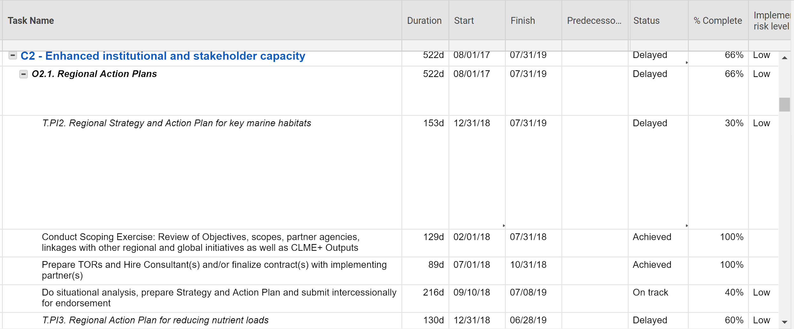
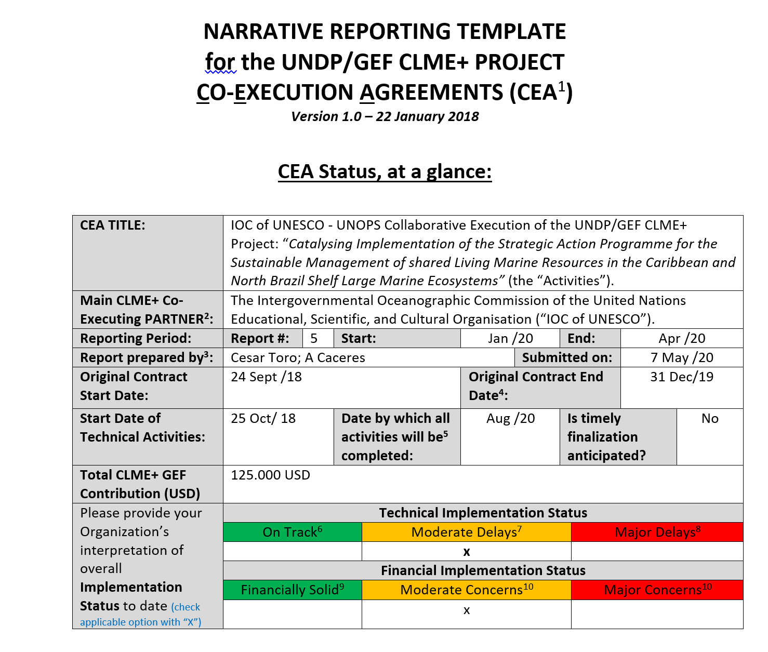
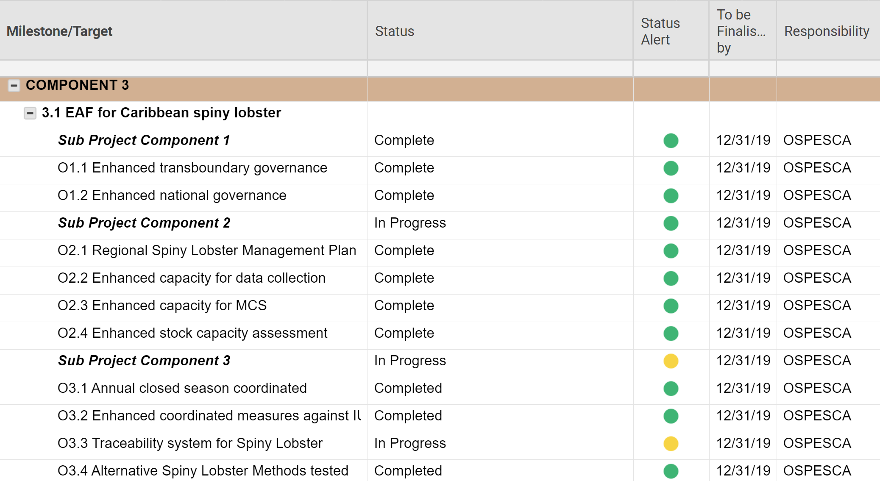
Analysis of Technical Implementation Progress
- Tools Used
CEA Logframe Smartsheet
Narrative Progress Report
Integrated Logframe Smartsheet
Integrated Logframe Smartsheet assesses both CLME+ PCU and CEAs performance
Notes:
The methodology utilized for this assessment followed a similar approach as that of the previous assessments reported on by the PCU. Like the previous assessments, the screenshots on the slide depict the tools which were used to undertake the analysis of project technical implementation progress. The online Co-executing Agencies (CEAs) Logframe “Smartsheets”, updated regularly by each agency, was analysed along with each agency’s narrative reports. The information obtained from the review of the Narrative Reports and the Logframe Smartsheets was then used to inform the Integrated Project Logframe “Smartsheet”, which includes all the milestones and targets outlined under the CLME+ Project Results Framework. The integrated Logframe “Smartsheet” which assesses both the PUC’s and CEA performance was used to undertake the technical analysis of overall project implementation status.

Slide 5
Analysis of Technical Implementation Progress:
current status
The analysis shown below includes all targets under Project Components 1, 2, 4 and 5 but excludes targets defined under Component 3 (i.e the sub-projects)
Milestone and Targets | Number | Percentage
Total number of Milestones and Targets | 71
Achieved | 33 | 46.5%
Delayed | 13 | 18%
In-Progress | 25 | 35%
At Risk and Unlikely to be met by target dates specified under the October 2019 revised timeline | 5
Notes:
This slide provides an overview of the results of the technical implementation progress analysis. The information above relates to Project Components 1, 2, 4 and 5, but excludes Component 3 – i.e. the Sub Projects. An analysis related to the Outputs under Component 3 is presented in other slides in this powerpoint. A total of 71 milestones and targets are specified in the Project Results Framework under Components 1, 2, 4 and 5. Of these, 33 targets and/or milestones had been achieved by mid May 2020. Thirteen of the milestones and/or targets were considered to be “delayed”, with “delayed” meaning that they had not been met by the target delivery date stipulated in the Project Results Framework - which is now in the past. The delayed targets were also not delivered by the time this analysis was undertaken, in May 2020. Twenty-five milestones and/or targets for which the target delivery date under the Results Framework is in the future were classified as being “in progress”. Of the 20 milestones and/or targets identified as being “in progress”, 5 of them are considered to be “at risk” – meaning that it is unlikely that the milestone and/or target will be successfully met by the target’s delivery date as currently specified in the October 2019 revision of the Project Results Framework.

Slide 6
Analysis of Technical Implementation Progress:
improvements since February
Analysis below includes all targets under Components 1, 2, 4 and 5 but excludes targets defined under Component 3
Milestone/Target | February 2019 | September 2019 | May 2020
Achieved | 19 | 25 | 33
At risk of not being met by current delivery date in Results Framework | 27 | 13 | 5
Delayed (target not achieved by date in Results Framework) | 8 | 3 | 13
Notes:
This slide compares the results of the technical analyses undertaken in February 2019, September 2019 and the May 2020 technical analysis. The results show a steady increase in the number of milestones and targets that have been achieved between February 2019 to May 2020. Between February 2019 to May 2020, 14 milestones and targets were achieved and between September 2019 and May 2020, the number of new milestones and targets achieved was 8. In relation to the milestones and targets identified as at risk an overall decrease was observed over the period. This is due to the fact that proposed changes to the milestones and targets end date reduced the risk of these activities not being achieved within the stipulated timeframe in the Results Framework. Notwithstanding the foregoing, the number of delayed targets increased by 9 between the period between September 2019 and May 2020. This is because a number of milestone and targets were to be achieved by end of April. Some of the delays to project activities have been caused and/or enhanced as a result of COVID 19.

Slide 7
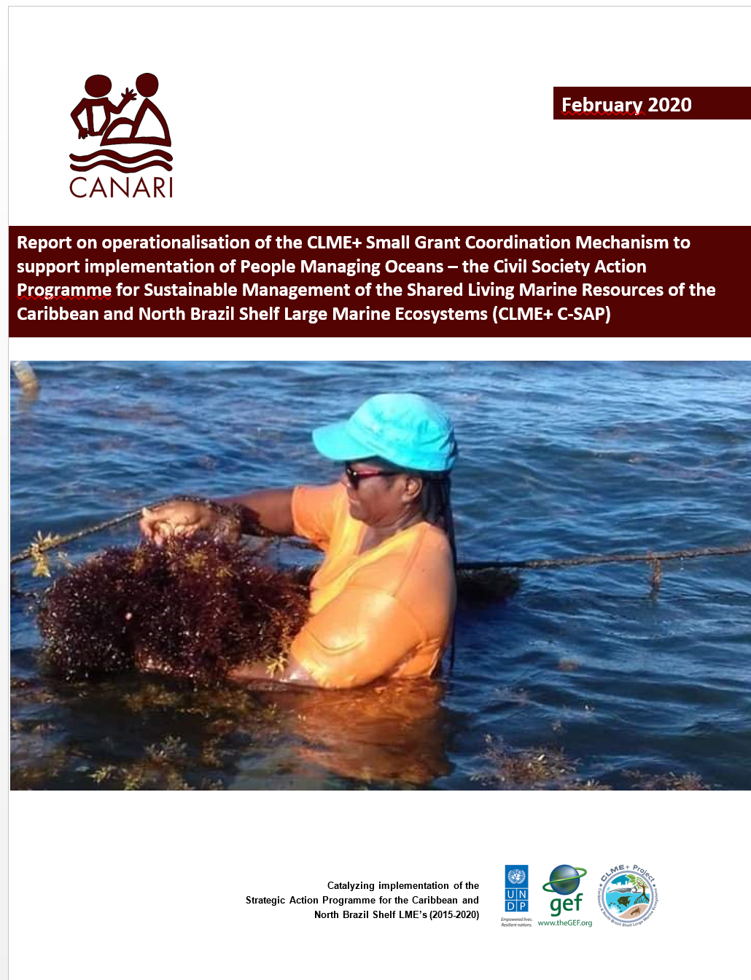

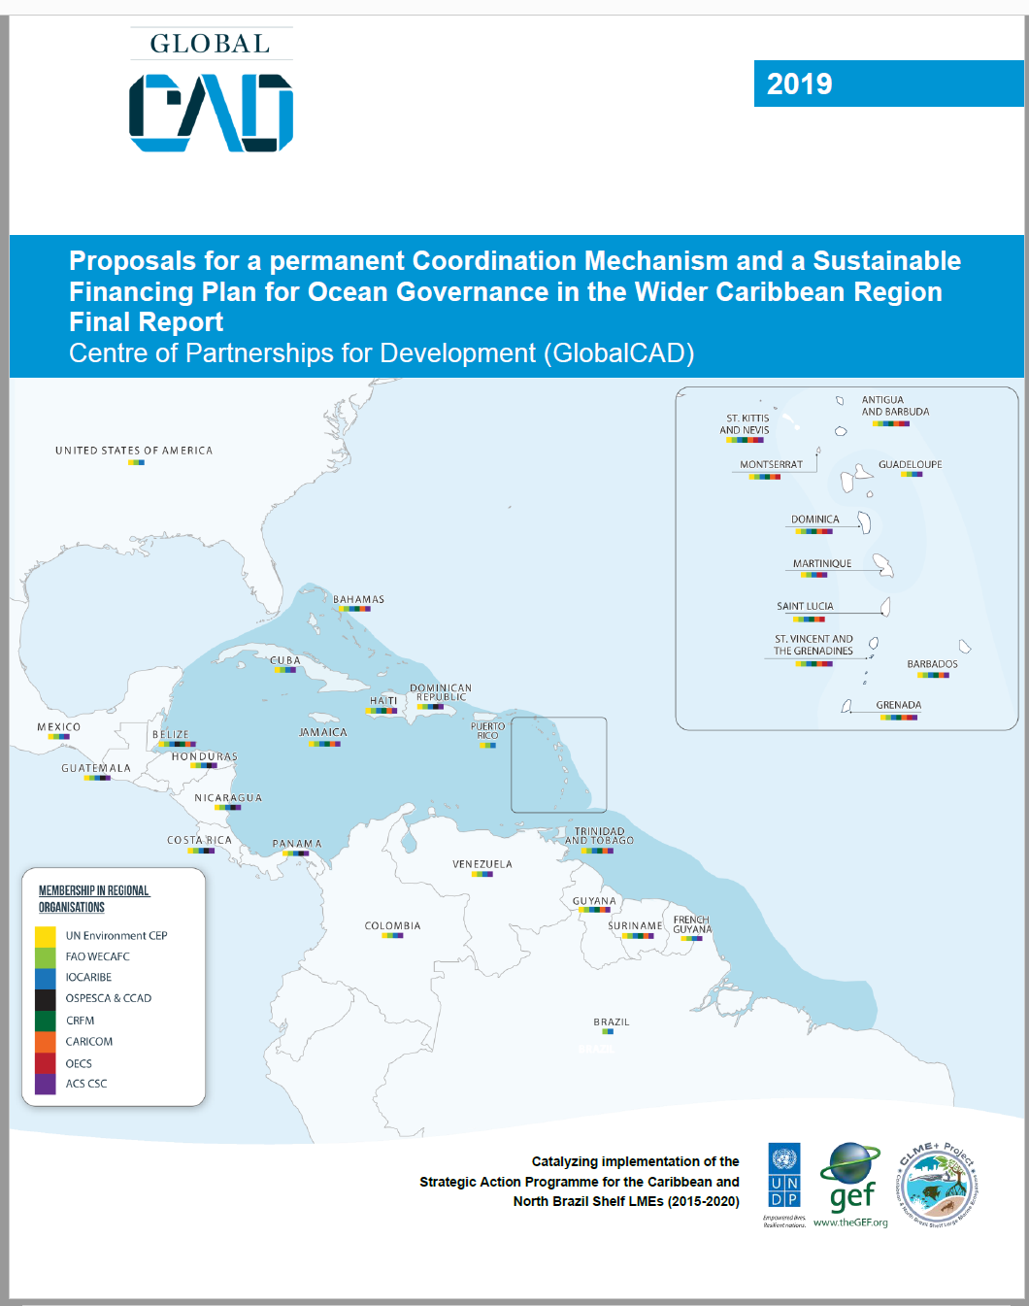


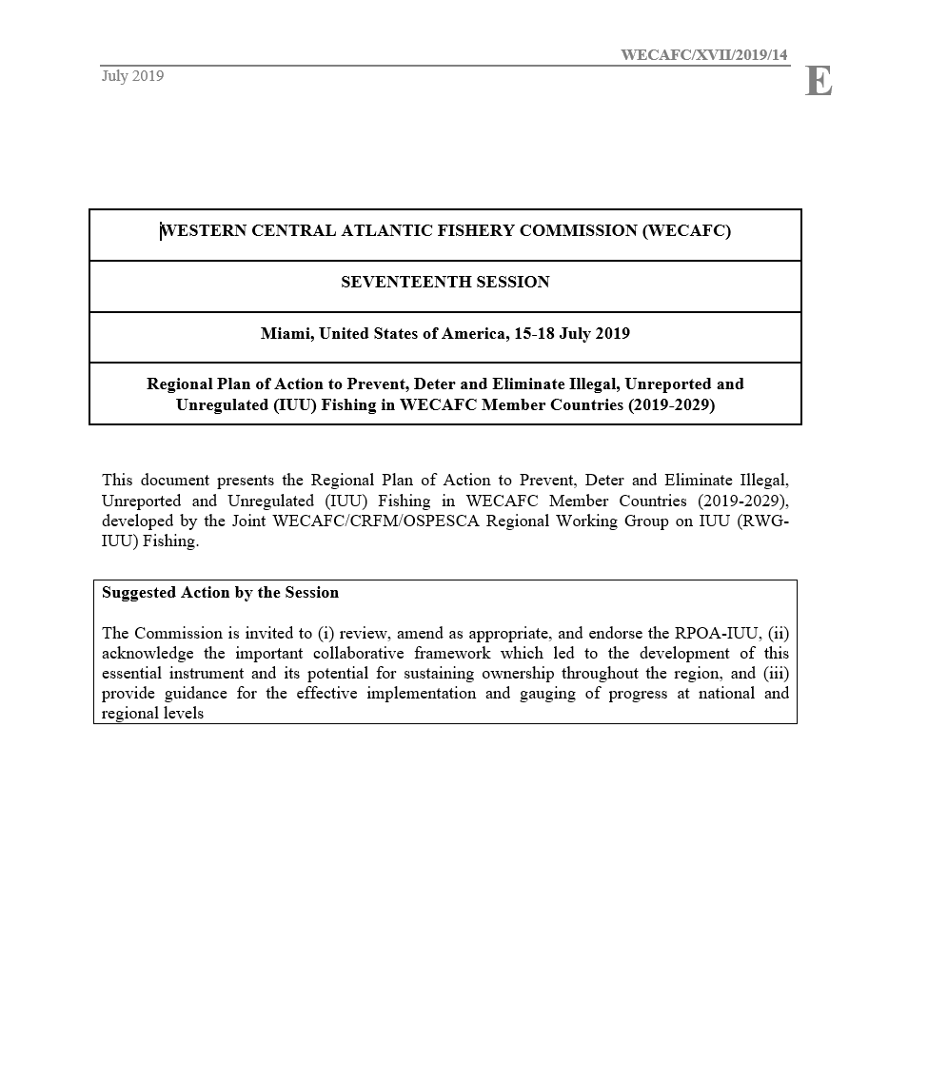

Notes:
This slide depicts some of the achieved targets, to date, under the Some CLME+ Project.

Slide 8
Technical Analysis Results - Overview
Status CLME+ Project Flagship Outputs
vis-à-vis delivery dates as per current Results Framework
Output | Status
O1.1 Permanent Coordination Mechanism | To be Determined by Project Steering Committee Meeting
O1.5 Sustainable Financing Plan | Delivered
O2.1 Regional Strategies & Action Plans Regional Strategy and Action Plan on IUU Fishing Regional Strategy and Action Plan on Coastal Habitats Regional Strategy and Action Plan on Nutrients | Delivered & adopted at WECAFC 17 Draft delivered Delayed
O2.2 Private Sector Action Programme | At risk
O4.2 Investment Plans Fisheries Habitats and Pollution | Finalised At Risk
O5.2 SAP M&E and SOMEE Framework | Delayed
O5.3 SOMEE developed | At risk
Notes:
This slide assesses the status of the CLME+ Project Flagship Outputs. The Permanent Coordination Mechanism (O1.1) will be discussed at the upcoming CLME+ Project Steering Committee scheduled for June 2020. The proposed Sustainable Financing Plan for the CLME+ Regional Governance Framework was shared with the Project Steering Committee for their review in December 2019. In relation to the Regional Strategies and Action Plans under Output 2.1, the Regional Strategy and Action Plan on IUU Fishing was adopted at WECAFC 17 in July 2019. A draft of the Regional Strategy and Action Plan on Coastal Habitats has been shared and the Cartagena Convention Secretariat will now seek to get it validated by Contracting Parties, until it can be endorsed in 2021. The Nutrients Strategy is delayed. In relation to the Investment Plans under Output 4.2, the Fisheries Investment Plans have been submitted to the CLME+ Project Coordination Unit.
At risk once again refers to the fact that it is unlikely that all targets and/or milestones under this output will be successfully met within the current timeframe stipulated under the current Results Framework.

Slide 9
Technical Analysis Findings- Component 3
Output | Status | Responsible Agency
O 3.1 EAF Spiny Lobster Sub Project | Finalised and Final Sub Project Report Submitted | OSPESCA
O3.2 EAF Shrimp & Groundfish Sub Project | Advancements made, but some delays being experienced due to COVID-19 | FAO
O3.3 EAF Flyingfish Sub Project | (GEF Funds) Sub Project close to finalisation (Canadian Government Funds) December 2020 | CRFM
O3.4 North Brazil Shelf EBM Sub Project | Advancements made, but some delays being experienced due to COVID-19 | UNEP
O3.5 Small Grant support for C-SAP Implementation | Finalised and Final Report Submitted | CANARI
Notes:
This slide assesses the status of the Outputs under Component 3. The Spiny Lobster Sub-Project (O3.1) has been finalized and the Final Sub Project Report has been submitted to the CLME+ PCU. As indicated in a previous implementation overview, co-financing was leveraged from the Government of Canada to support work on gender. The Gender associated activities are expected to be finalized in December 2020. The activities supported through GEF funds (O3.3) have been more or less been finalized and a Draft Final Sub Project Report has been shared with the CLME+ PCU. Advancements have been made with both the Shrimp and Groundfish Sub Project (O3.2) and the North Brazil Shelf Sub Project (O3.4), however both FAO and UNEP have indicated that some activities are being delayed as a result of COVID-19 restrictions.

Slide 10
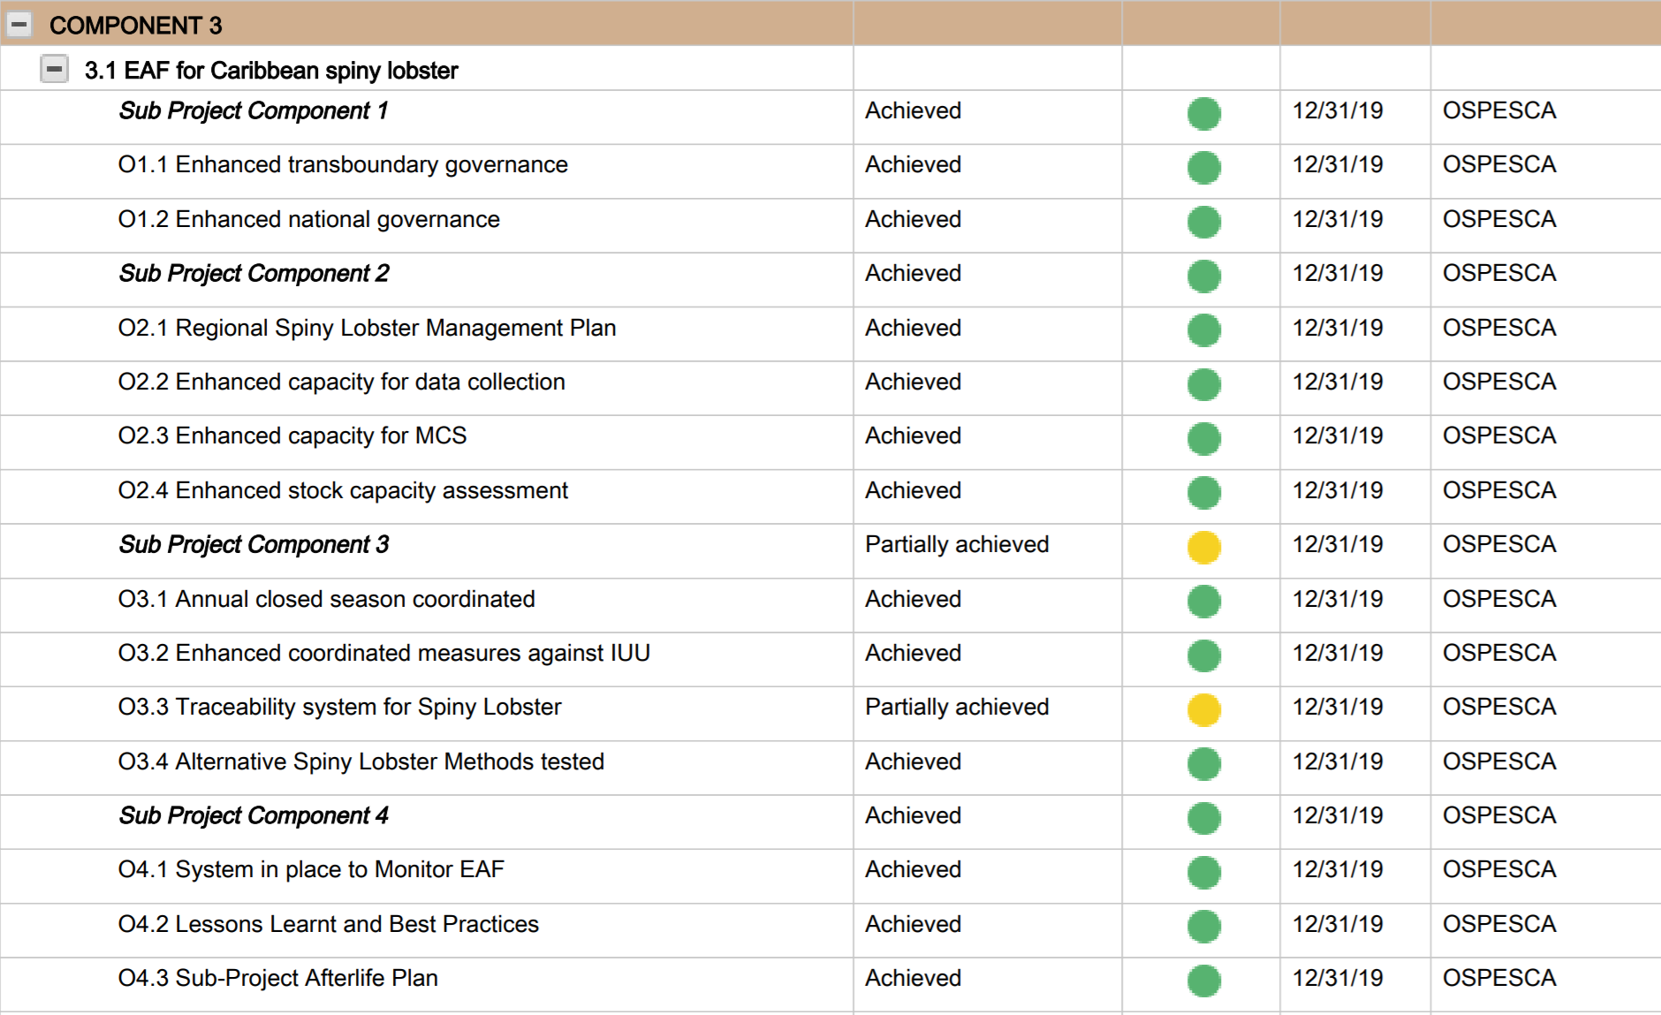
O3.1 Spiny Lobster Sub Project Status Overview
Link to OSPESCA Spiny Lobster Sub Project Final Report
Notes:
This slide provides an overview of the status of the Outputs under the Spiny Lobster Sub Project. The Sub-Project has been finalized and the Final report has been submitted to the CLME+ Project Coordination Unit. The overview shows that OSPESCA was able to achieve all the targets under the sub-project outputs with the exception of one Output which relates to 8 CLME+ countries adopting a traceability system. Whilst work has advanced with the development of a traceability plan, countries were not able to adopt a traceability system yet within the sub-project timeframe.

Slide 11
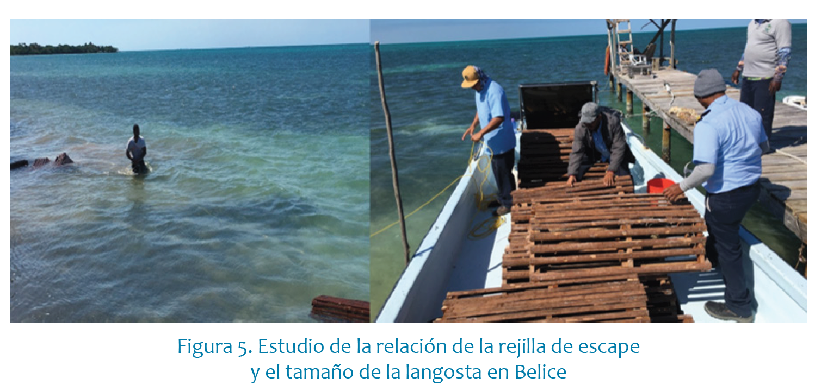
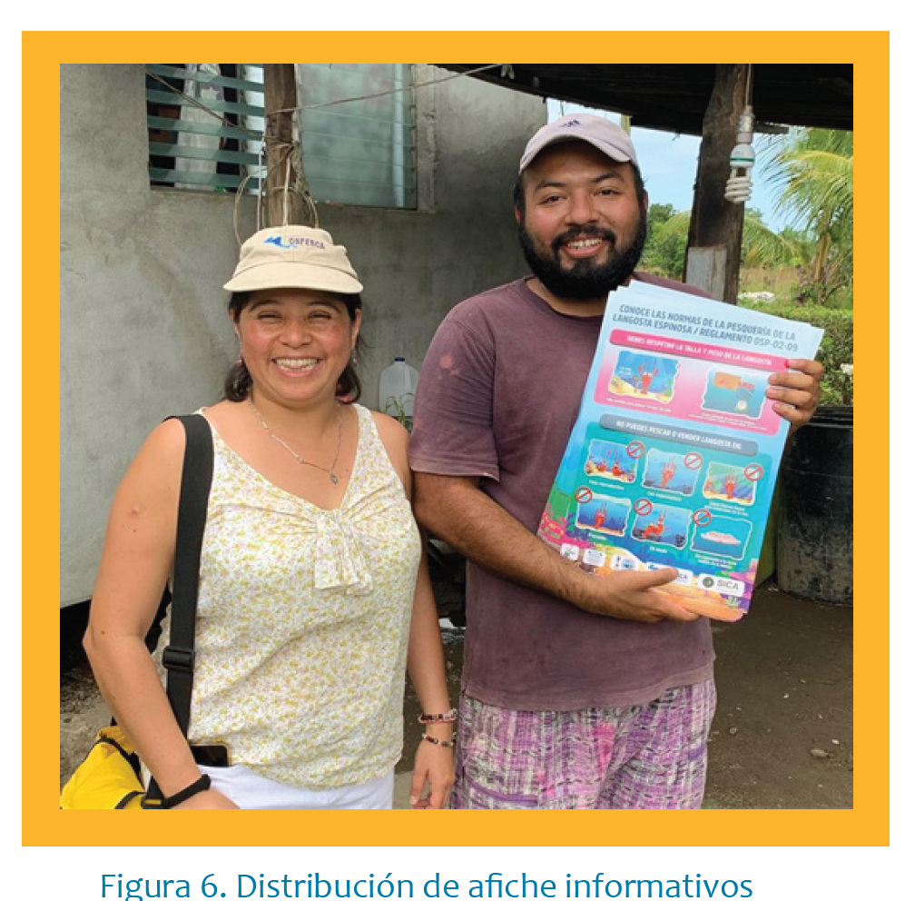
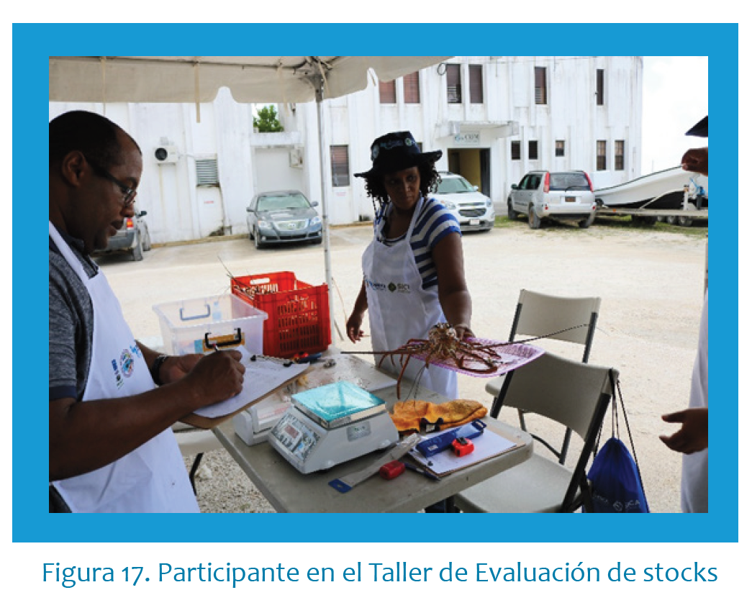
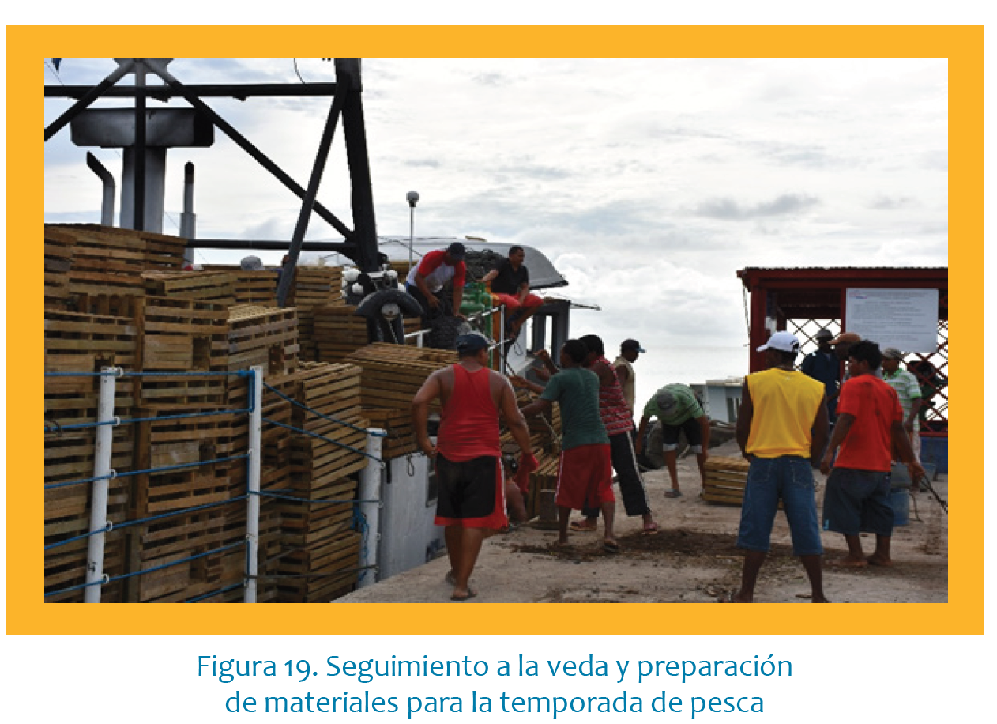
Overview of some Spiny Lobster Sub Project Activities
Notes:
The following images depict some of the activities which took place under the Spiny Lobster Fishery Sub Project (Output 3.1)

Slide 12
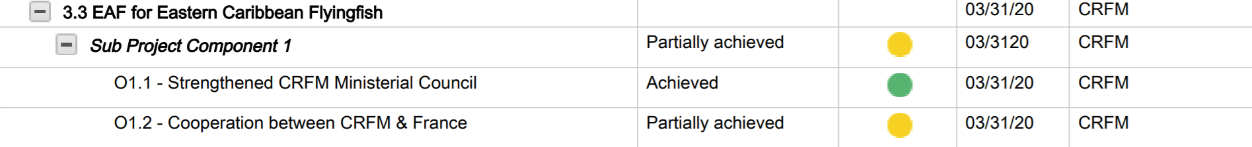
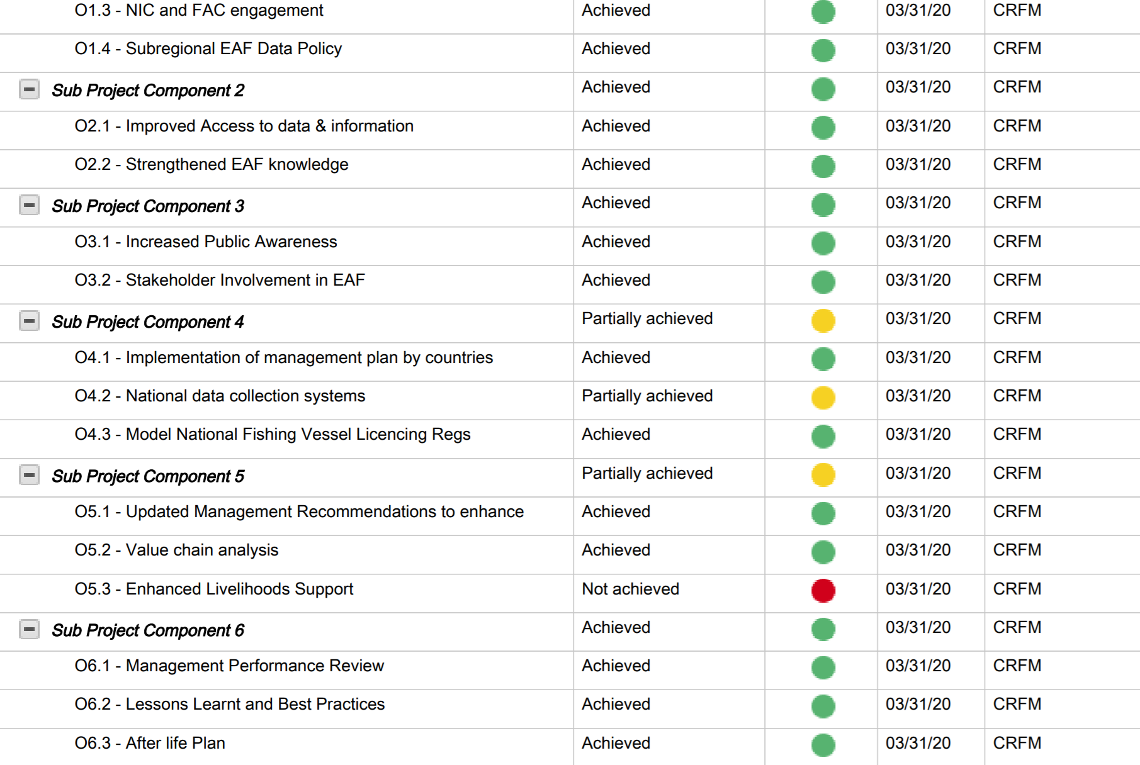
O 3.3 Flyingfish Sub Project Status Overview
Link to CRFM Flyingfish Sub Project Final Report
Notes:
This slide provides an overview of the status of the Flyingfish Sub-Project outputs. In relation to O1.2 CRFM was able to achieve cooperation at the technical level with France regarding the management of the flyingfish fishery and acknowledged that negotiations on the finalization of a cooperation agreement will continue after the end of the sub-project. As such Component 1 under the Flyingfish Sub Project was deemed to be partially achieved. For output 4.2, countries endorsed the report with proposals for update for the data collections systems during the Third Meeting of the Ministerial Sub Committee on Flyingfish. Countries are now working on implementing this system at the national level. Output 5.3, business proposals for enhancing livelihoods and well-being were developed. However CRFM has indicated that insufficient time has not allowed them to actually implement these business proposals to date. This will now happen outside of the timeline of the Flyingfish Sub Project. In light of the foregoing Component 5 under the Flyingfish Sub Project was deemed to be partially achieved.

Slide 13
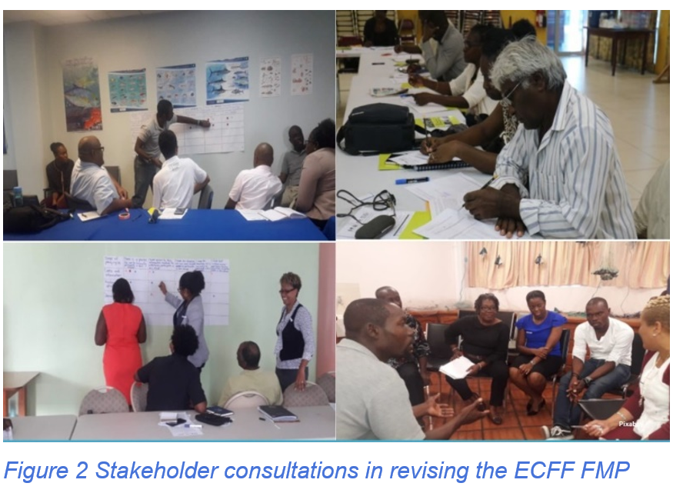
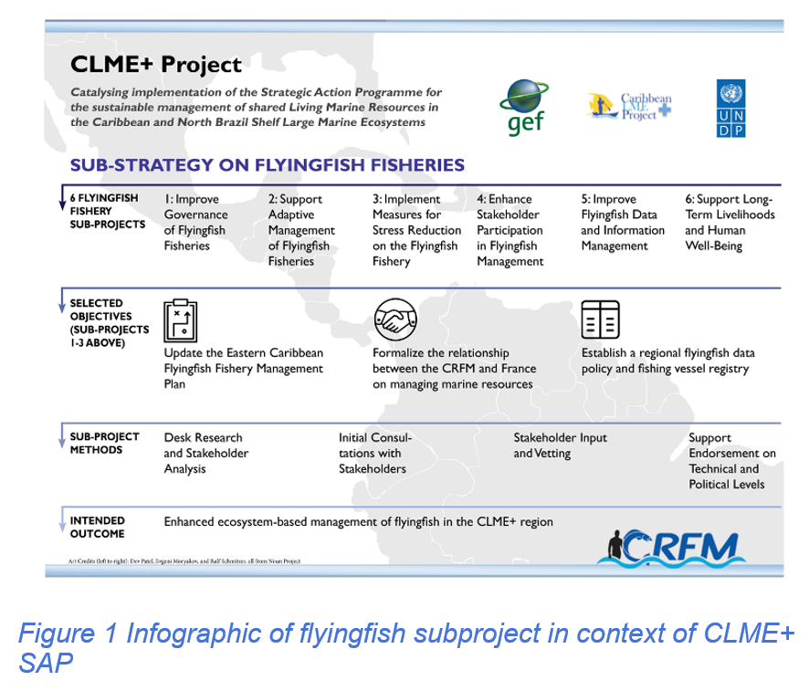
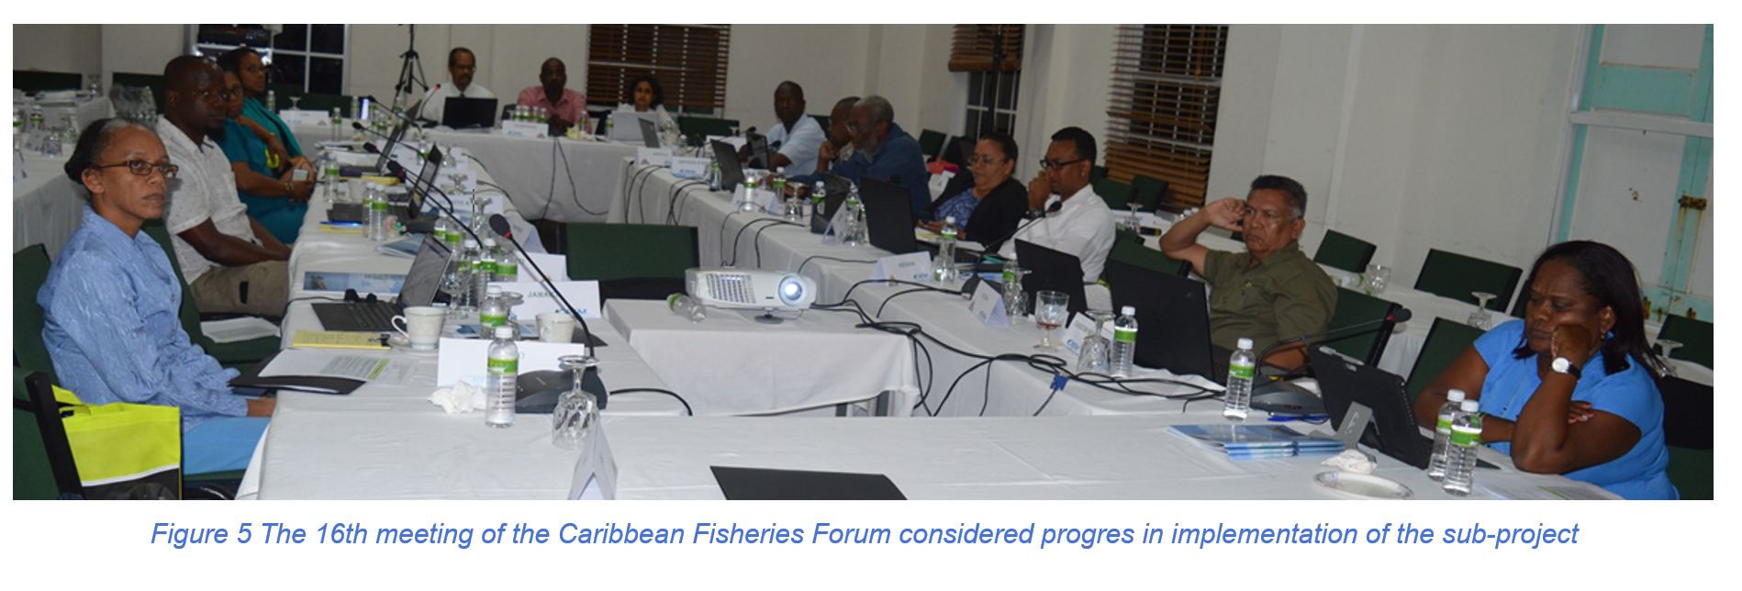
Overview of some Flyingfish Sub-Project Activities
Notes:
The above images depict some of the activities which took place as part of the Flyingfish Fishery Sub Project (Output 3.3).

Slide 14
O 3.2 Shrimp and Groundfish Sub-Project Overview
Work is advancing with the Shrimp and Groundfish sub-project implemented by FAO with the following developments:
  70% advancement with the development of a Sub Regional Data Policy
  75% advancement with the development of Sub Regional EAF Management Plan
  Completion of a stock assessment workshop on shrimp and groundfish for participating countries
  NICs in Guyana, Suriname and Trinidad and Tobago were diagnosed, and assessed. Stakeholder interviews and workshops took place in participating countries Workshop reports and NIC assessments per country were received in November 2019.
  90% advancement with a Sub Regional study on gender in the shrimp & groundfish fishery
Notwithstanding a number of activities under this sub-project are experiencing delays as a result of COVID-19
Notes:
This slides outlines the progress made with the shrimp and groundfish sub-project to date. It shows that significant progress have been made with the development of a Sub Regional Data Policy and EAF Management Plan. FAO was also able undertake a stock assessment workshop on Shrimp and Groundfish for the participating countries of the sub project. National Inter-sectoral Committees (NICs) in Guyana, Suriname and Trinidad and Tobago were diagnosed, and assessed. Stakeholder interviews and workshops were held in Trinidad and Tobago, Guyana and Suriname. Workshop reports and NIC assessments per country were received in November 2019. National gender reports of the small scale shrimp and groundfish fisheries of Guyana, Suriname and Trinidad and Tobago were presented in November 2019. A sub-regional gender report was received in March 2020 and is currently under review.

Slide 15
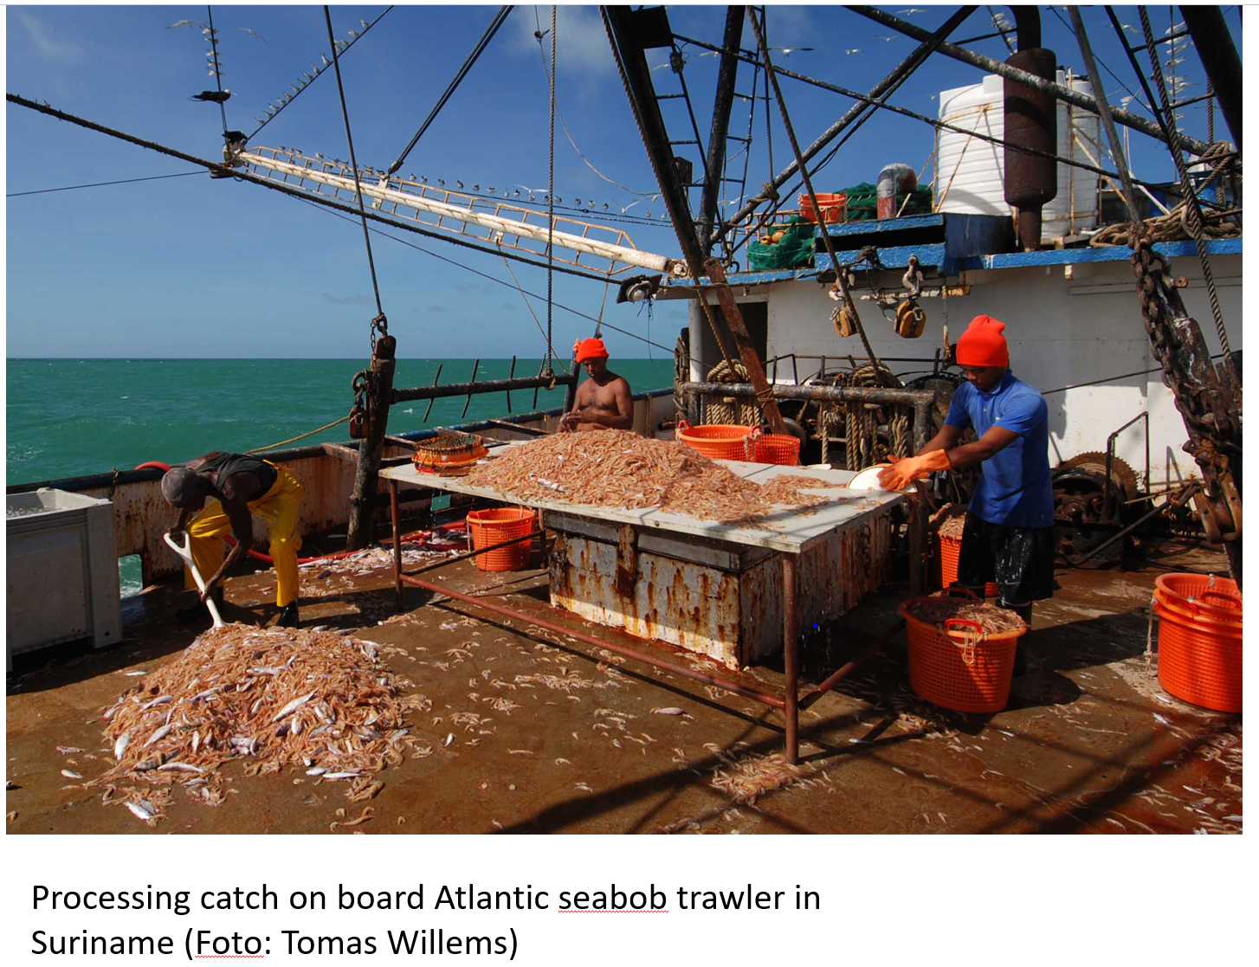
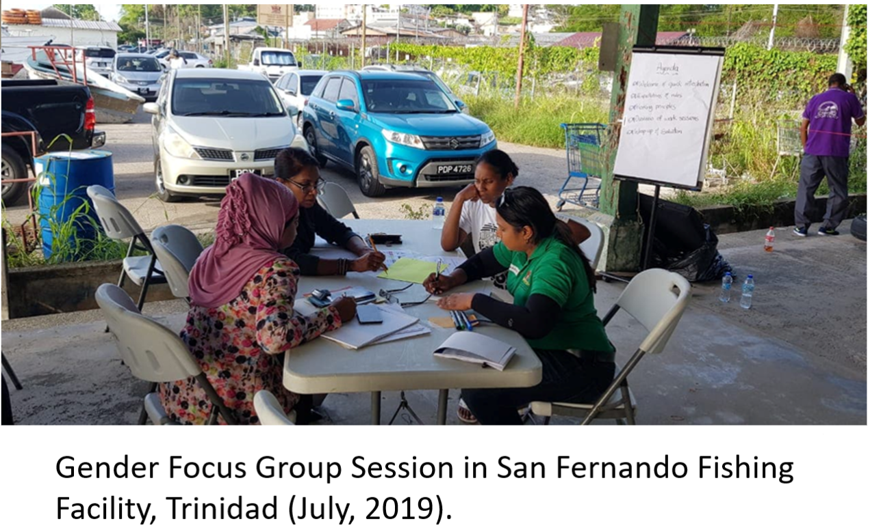
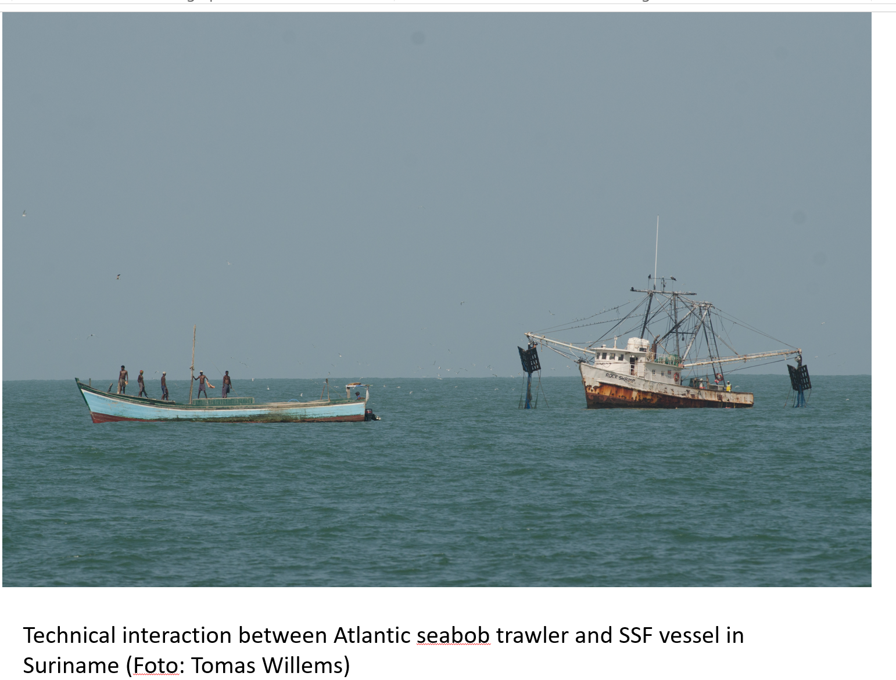
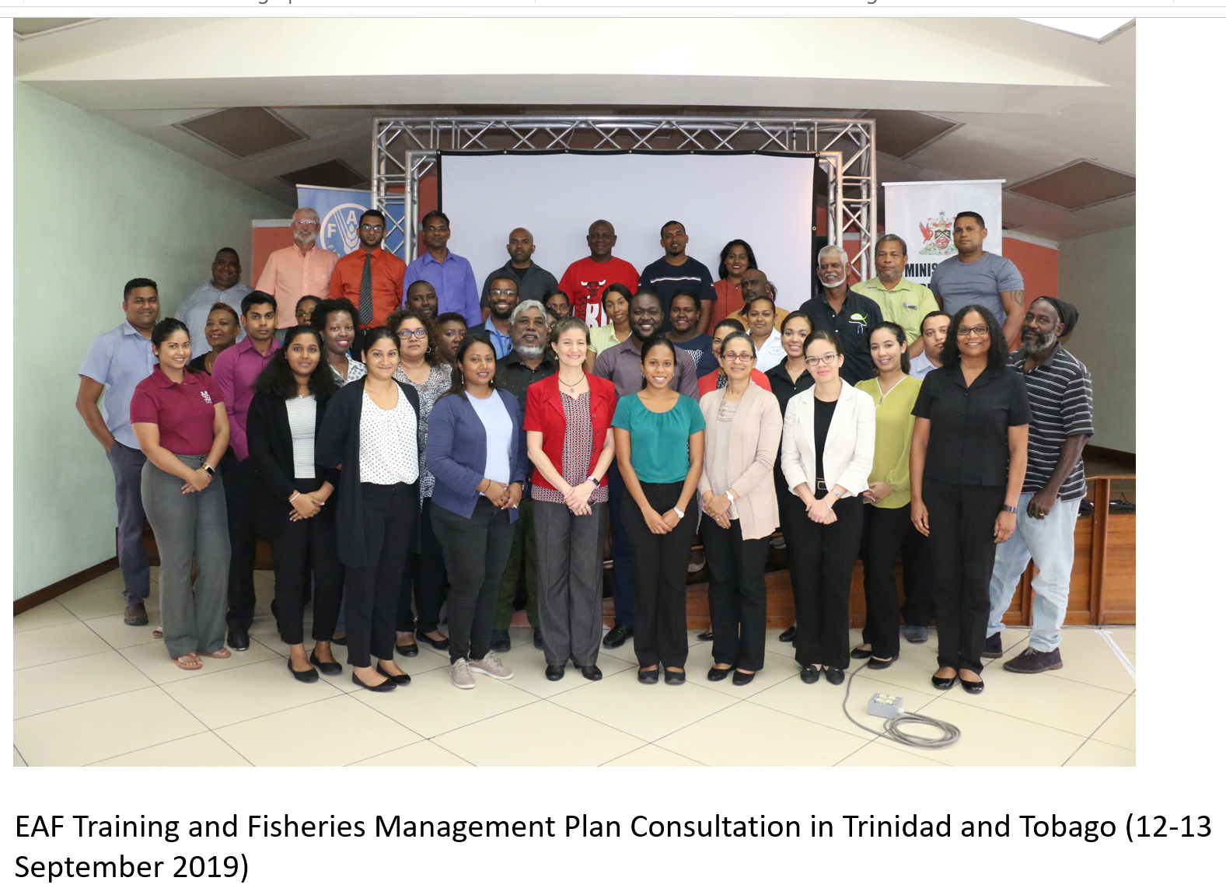
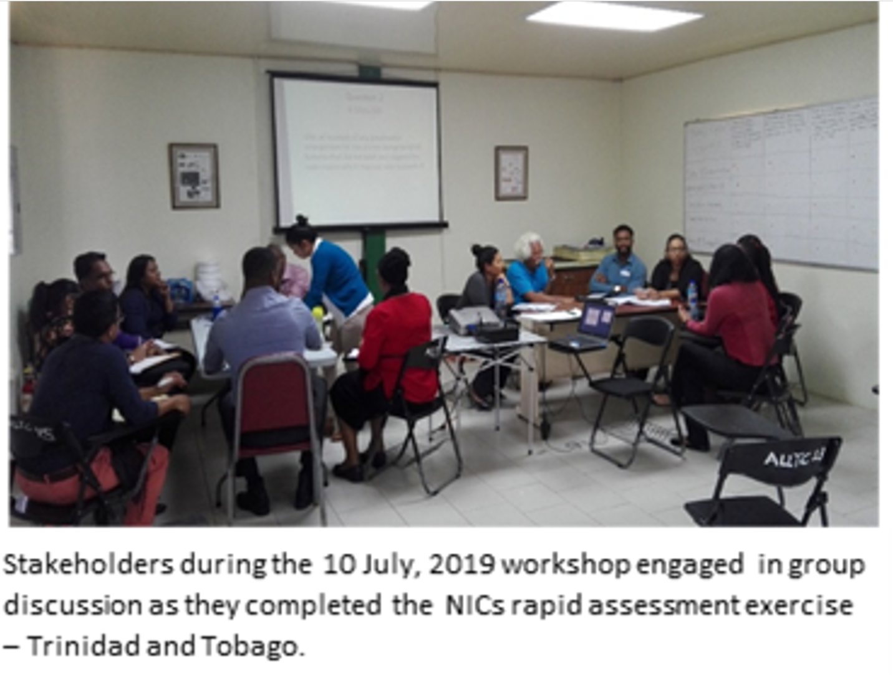
Overview of some Shrimp and Groundfish Sub Project Activities
Notes:
The above images depict some of the activities which took place as part of the Shrimp & Groundfish Fishery Sub Project (Output 3.2).

Slide 16
Component 3
Impact of COVID 19 on Activities under Output 3.2 Shrimp and Groundfish Sub Project
A number of activities associated with O3.2 Shrimp & Groundfish have been negatively impacted as a result of COVID 19 and include:
  Development of Baseline Reports on IUU Fishing
  Development of National Plan of Actions on IUU Fishing specific to the participating countries of the Shrimp & Groundfish Sub-Project
  Travel by consultants to participating sub project countries to undertake assessments of:
    Social security and working conditions
    Best practice fishing gears
  Face-to-face meetings to conduct training or of Shrimp & Groundfish Working Group and to review the draft EAF Fisheries Management Plan
Notes:
The slide outlines the activities under the Shrimp & Groundfish Sub-Project (O3.2) experiencing delays which has been heightened as a result of COVID-19

Slide 17
North Brazil Shelf EBM Sub-Project Overview
Preserving Ecosystems and Improving Human Well-being in the Wider Caribbean: a Common Goal
Trinidad and Tobago demonstration focuses on reducing organic and pesticides pollution from agricultural activities in the southern section of the Caroni Swamp through the implementation of community - based conservation interventions for rehabilitating degraded mangrove forest
Guyana demonstration focuses on Wellington Park located in Region Six - East Berbice Corentyne for the application of an EBM approach and related governance arrangements. The site was selected based on the visibly high level of pollution at the site, stemming from the sawmilling activities.
Suriname demonstration will support local communities technically and financially, implement actions to reduce pollution levels and rehabilitate degraded mangroves in the North Coronie area.
Notes:
The above outlines the areas of focus for the demonstrations under the ecosystem based management sub project in the North Brazil Shelf. Trinidad and Tobago and Guyana have advanced demonstrations. Suriname was just about to commence implementation prior to COVID-19.

Slide 18
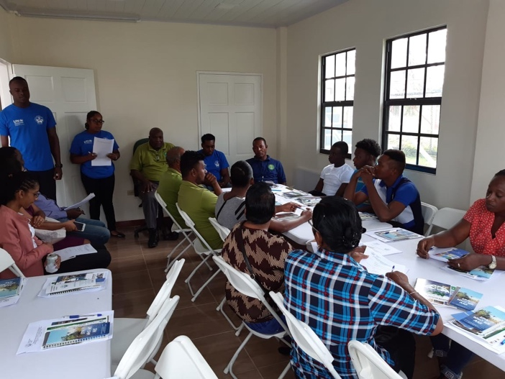
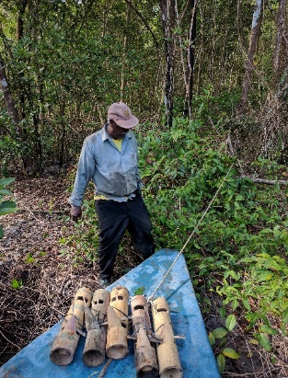
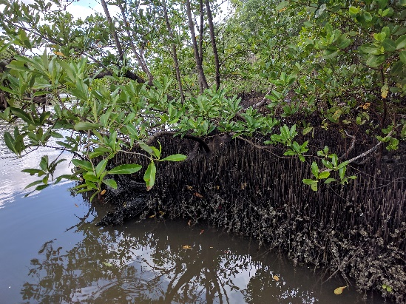
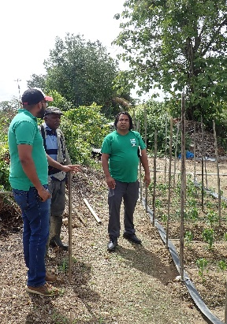
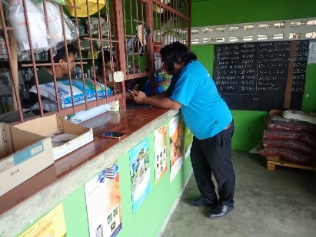
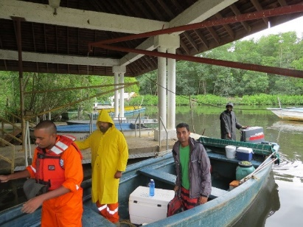
Overview of some activities associated with the EBM Sub Project
Sampling Training Workshop with Wellington Park, Guyana Community Members
Interviews with stakeholders and sampling conducted during the CLME+ EBM Sub-Component in Trinidad and Tobago. Photos courtesy IMA.
Notes:
Work has advanced with the Guyana and Trinidad Sub-Projects, although some minor delays have been experienced with planned field activities and analysis of samples a result of COVID-19. Work in Suriname was to commence in March, however due to COVID-19 the start of activities were delayed. Notwithstanding it is anticipated that work on the Suriname demo will take place between June-November 2020.

Slide 19
Component 3
Impact of COVID 19 on Activities under Output 3.4 North Brazil Shelf EBM Sub Project
Some delays have been experienced in Trinidad and Tobago and Guyana with some of their activities associated with the EBM Sub Project and include:
Collection of samples in the field
Analysis of samples as in some cases samples could only be analysed out of country
Hands on training sessions
In Suriname the Implementation of their demonstration activities were to commence in March, however COVID 19 further delayed the start of activities.
Notes:
The slide outlines the activities under the North Brazil Shelf EBM Sub-Project (O3.4) experiencing delays as a result of COVID-19

Slide 20

O3.5 Small Grant Support for C-SAP implementation
the “Enhancing Alternative Livelihoods and Food Security through the Cultivation and Commercialisation of Sea Moss, St. Kitts and Nevis” project
Worked with two sea moss groups (One in St. Kitts and one in Nevis)
Final Document Submitted in January 2020
Notes:
This Output was managed by CANARI and small grant support was provided to Liamuiga Sea moss Group (LSG) in St. Kitts and the Indian Castle Fisherfolk Association (ICFFA) in Nevis. The LSG received a US$35,170 grant to “increase the capacity of the LSG to successfully manage a small and micro enterprise while meeting the increasing demand for sea moss products” and the ICFFA received a US$17,650 grant to “develop sea moss cultivation and production as an alternate income for the ICFFA.
Each grantee had similar specific objectives for their small grant projects, they were to:
-expand their current sea moss farms by increasing the number of plots;
-build the capacity of their group members in small and micro enterprise (SME) development and management and value-added processing;
-upgrade their current processing facilities; and
-improve marketing of their sea moss products.
Small grant projects were implemented over a period of 5-6 months ending October 31, 2019.

Slide 21
Some key CLME+ Project Outputs
which constitute “milestones” and not “end products”,
hence requiring continued action after the End of the CLME+ Project
Output - Activity
O 1.1 Fisheries and SAP Interim Coordination Mechanism
O1.1 Permanent Coordination Mechanism
O2.1 Regional Strategies and Action Plans Regional Strategy and Action Plan on IUU Fishing Regional Strategy and Action Plan on Coastal Habitats Regional Strategy and Action Plan on Nutrients
O2.6 Targeted Research Agenda
O4.2 Investment Plans
O5.1 CLME+ Hub
O5.3 SAP M&E Portal
O5.3 SOMEE reporting mechanism
Notes:
The Slide outline a number of CLME+ products which need to be sustained after the end of the Project if there impact for the region is to be realised.

Slide 22
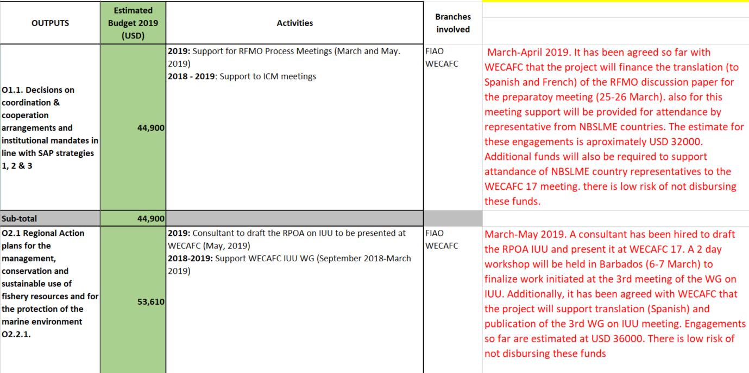
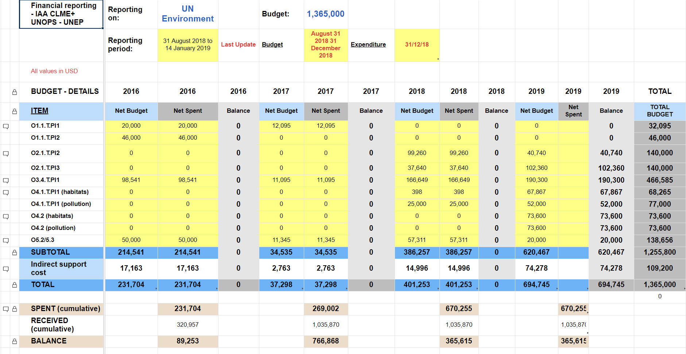
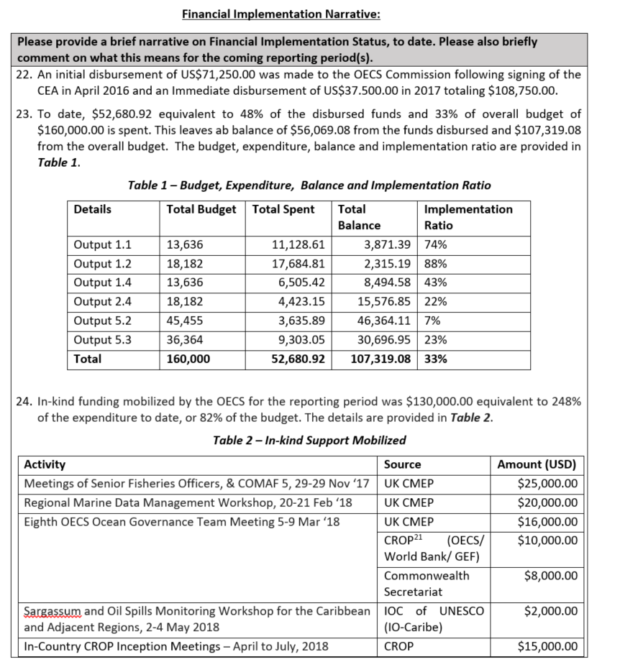
Financial Analysis - Tools
CEA Finance Smartsheet
CEA Detailed Commitments Report
CEA Narrative Report
(financial components)
Notes:
The screenshots on the slide depict the tools which were used to undertake the financial implementation progress analysis. The CEA Financial “Smartsheet”, which details expenditure performance against annual Budget items, are updated at least every 3 months and discussed with partners accordingly. Due to the risks identified, a Detailed Financial Commitments Report has also been requested, in order to have an extra level of details and commitments from partners regarding their upcoming activities, associated planned expenditures, and their related risks. With those additional details, we count with a broader scope of partners performance and we can enhance the monitoring much closer and promote further accountability. The information obtained from the review of the Narrative Report and the Financial Smartsheet was then used to complement the technical analysis.

Slide 23
Financial implementation vis-a-vis total Project budget
As of April 2020, the Project has disbursed 81% (US$ 10.1MM) of the whole GEF grant (US$ 12.5MM). Significant progress has been achieved since the last Budget revision in February 2019 and the implementation analysis in September 2019.
Expenditure evolution versus total Budget (USD)
Disbursements per year (USD)
71%
51%
57%
Project elapsed period
Notes:
The first chart shows the current expenditure up to April 2020 (10.1MM) compared to the total GEF grant and the expenditure figures of previous implementation analysis (February 2019 and September 2019). It is observed the substantial financial implementation progress in the last year from 51% to 80% of budget disbursed.
The second chart represent the expenditure figure per year since the start of the project (from 2015 to 2019), where it is shown the effort done during 2019 to allocate the resources planned (2.4MM allocated in 2019).
The third chart shows that the time elapsed under the current duration of the project represents 83% of the total duration. The current end date of the project is in April 2021.

Slide 24
Financial implementation progress per partner
Partners and PCU show a recovery in the pace of spending of their respective budgets
% Spent (cumulative)
over Total Budget
Notes:
The first chart shows the evolution of the Expenditure versus Total Budget ratio for each co-executing partner, including the Project Coordination Unit (PCU). The spent over budget ratio should be understood as an approximate indicator of a partner’s implementation effectiveness only, as it does not take into account how its implementation was planned over time. Being aware of that caveat, it can still be observed that all the partners achieved improvement in terms of financial execution, including the ones with major budget allocations like FAO and UNEP. OSPESCA has finalized its technical and financial implementation, and CRFM and CANARI are close to concluding theirs. OECS and UNESCO could face challenges to implement the remaining Budget before the current end date of their Co-Executing Agreements.
The second graph represents how the cumulative percentage of budget disbursement (Spent/Total Budget) has grown along the project’s timeline. The blue line represents the disbursement ratio related to co-executing agreements (all partners consolidated) and the orange one reflects the PCU’s expenditure levels against its own budget (i.e. excluding the budget allocated to the CEA’s). It is observed the steepest progress in the last period. Moving forward, the PCU still has 29% of its overall budget to be spent; meanwhile, overall, partners still have 17% of their budget available for expenditures.

Slide 25
Detailed budget implementation per partner
To date, 90% of the amounts already transferred (i.e. disbursed by the PCU) to co-executing partners has been spent.
This represents 83% of the total budget of all co-executing agreements.
Correspondingly, the PCU has spent 71% of the budget for which is has executing responsibility (i.e. total GEF grant minus CEA grants).
Co-executing agreements Budget status (USD)
Project Coordination Unit Budget status (USD)
Co-execution agreement | Total funds committed to partner | Disbursed to partner to data | Expenditure reported by partners to date | Spent / total | Spent / transferred | Current Agreement End date
CANARI | 350,000 | 345,100 | 334,500 | 96% | 97% | July 30th, 2020
CERMES | 188,000 | 164,500 | 147,529 | 78% | 90% | October 30th, 2020
CRFM | 996,141 | 996,141 | 885,845 | 89% | 89% | December 31st, 2020
FAO | 1,352,400 | 1,080,000 | 980,543 | 73% | 91% | August 30th, 2020
GCFI | 140,000 | 129,500 | 111,129 | 79% | 86% | May 30th, 2020
OECS | 142,500 | 108,750 | 89,494 | 63% | 82% | August 30th, 2020
OSPESCA | 960,000 | 960,000 | 960,000 | 100% | 100% | December 31st, 2019
UN Env. | 1,365,000 | 1,310,000 | 1,108,399 | 81% | 85% | December 11th, 2020
UNESCO IOC | 125,000 | 90000 | 70116 | 56% | 78% | August 30th, 2020
Total | 5,619,041 | 5,183,991 | 4,687,555 | 83% | 90%
 | Expenditure | Total Budget according to Project Document | Spent/Total
Personnel and office costs | 2,659,733 | 3,634,498 | 73%
Contracts, consultancies, communications | 523,555 | 702,987 | 74%
Events, Meetings and Travel | 1,012,394 | 1,407,111 | 72%
Management fees | 702,144 | 1,136,363 | 62%
Total | 4,897,826 | 6,880,959 | 71%
Notes:
This slide shows additional detail on co-executing agreements and PCU budget performance to date, indicating expenditure to date, original budget comparison, and percentage of spent over total budget per item.

Slide 26
Budget results 2019
Despite the clear progress obtained to date, expenditure performance during 2019 has been 426K below the planned (approved) 2019 budget due to the reasons described below. This expenditure gap is being reprogrammed for the period 2020-2021 as shown in upcoming slides.
 | 2019
 | Last Budget Approved by the PSC | Expenditure | Difference | Comments
Staff & Consultants | 738,500 | 592,313 | 146,187 | a
Travel (includes SCM, PEG, Meetings) | 290,000 | 252,572 | 37,428 | b
Contractual Services | 1,584,000 | 1,424,649 | 159,351 | c
Rental & Maintenance (Premises, Meeting Rooms) | 8,000 | 831 | 7,169
Equipment & Furniture (incl ICT) | 8,000 | 6,815 | 1,185
Audiovisuals, Printing & Translations | 34,500 | 19,095 | 15,405
Supplies | 6,000 | 5,982 | 18
Miscellaneous | 12,000 | 11,092 | 908
Total | 2,681,000 | 2,313,349
Managament Costs | 224,000 | 165,570 | 58,430 | d
Grand Total | 2,905,000 | 2,478,919 | 426,081
Staff turn-over and postponed planned recruitments
Savings on events and meetings
Delays in awarding technical contracts due to postponed procurement processes and reduced HR capacity
Proportional to total expenditure
Notes:
The slide summarizes the project expenditure per account for 2019 compared with the last 2019 Budget approved by the PSC. The spent amount was 426K lower than the approved budget. The differences in the budget execution of 2019 (versus the last approved budget) are explained by
Delays in the planned recruitments and the resignation of a team member
Approximately 37K not incurred in the implementation of project meetings and events (savings)
Delays in the procurement process and the contract awarding of planned technical services
Less management costs due to lees budget disbursed.

Slide 27
Overall expenditure 2015-2020
Total expenditure per account to date is within planned Project Document Budget (full project duration)
Detailed expenditure per year (1000´s USD)
 | 2015 | 2016 | 2017 | 2018 | 2019 | 2020 (until April) | Total 2015-2020 | Project Document Budget | Expenditure / Budget
Staff & Consultants | 211 | 426 | 461 | 571 | 592 | 186 | 2,448 | 3,574 | 68%
Travel (includes SCM, PEG, Meetings) | 83 | 211 | 151 | 311 | 253 | 10 | 1,019 | 1,407 | 72%
Contractual Services | 35 | 1,337 | 2,120 | 519 | 1,425 | 183 | 5,618 | 5,935 | 95%
Rental & Maintenance (Premises, Meeting Rooms) | 0 | 6 | 1 | 1 | 1 | 0 | 9 | 180 | 5%
Equipment & Furniture (incl ICT) | 19 | 21 | 3 | 6 | 7 | 3 | 57 | 64 | 90%
Audiovisuals, Printing & Translations | 4 | 6 | 11 | 24 | 19 | 6 | 70 | 89 | 79%
Supplies | 0 | 0 | 6 | 6 | 6 | 2 | 20 | 60 | 34%
Miscellaneous | 2 | 7 | 5 | 7 | 12 | 1 | 34 | 54 | 64%
Total | 353 | 2,013 | 2,759 | 1,445 | 2,314 | 391 | 9,276 | 11,364
Managament Costs | 47 | 195 | 198 | 154 | 166 | 47 | 806 | 1,136 | 71%
Grand Total | 399 | 2,209 | 2,957 | 1,599 | 2,480 | 438 | 10,082 | 12,500 | 81%
Notes:
This slide summarizes the expenditure to date per account and compares it with the Project Document Budget allocations per account for the full project’s duration.
Travel expenditure of the first quarter of 2020 has been severely affected due to the covid-19 outbreak.

Slide 28
Technical and Financial Implementation Overview Conclusions

Slide 29
Conclusions of Technical Implementation Progress
Progress continues to take place with CLME+ Project activities with about 46.5% targets under Component 1,2 4 and 5 successfully completed
Two of the Outputs under component 3 have been successfully completed (Outputs 3.1 and 3.5) and one is in the final stages of implementation (O3.3)
Delays have been experienced with some CLME+ activities including some of the flagship outputs.
Several of these delays have either been caused and/or influenced by the COVID-19 pandemic
The current end date for technical implementation is 31 December 2020, meaning that under this scenario all co-executing partners will need to finalise technical activities by latest 30 August to allow for, a.o., preparation of Final Technical Reports, Knowledge Management, Terminal Evaluation, sustainability/continuity, etc.
Current progress and context tells that, with this timeline, a number of CLME+ Project activities will not be successfully completed
Notes:
This slide summaries the conclusions from the CLME+ Project implementation status review.

Slide 30
Conclusions from Financial Implementation Status Review
Significant progress has been demonstrated in the implementation of the budget. In 15 months almost US$3 MM (30% of the budget) has been disbursed, to reach a total expenditure figure of US$10 MM (81% of the total budget). However, still US$ 3 MM remains to be executed by project end (0.5MM of these funds have already been disbursed to co-executing partners).
Progress in financial execution has occurred both at the PCU level and with co-executing partners. However, in this last stage of the project, it is the PCU that will face the greatest responsibility and challenges in terms of implementing their activities with the remaining funds.
The current circumstances of 2020 due to the covid-19 outbreak will not allow the remaining budget to be fully executed within the currently approved project time frame (e.g cancellation of physical meetings and events, identification and implementation of alternative working modalities, delays in recruitment process,…). This context creates new and adds to existing delays, and implies a substantial challenge in terms of the effective execution of the budget by the currently approved project end date.
Notes:
This slide summarizes the conclusions from the CLME+ Project financial implementation status review.

Slide 31
Important Information for Consideration for GEF4 – GEF 6 Projects
Revised UNDP Policy for GEF 4 to GEF 6 Projects indicates that projects can be extended for up 18 months (previously it was 12 months)
A 12 month extension (from 31 April 2020 to 31 April 2021) for the CLME+ Project was approved in March 2019
UNDP Policy clearly states “Projects may request a second project extension due to COVID-19 related delays for a maximum of 3 months (within existing budget). At the end of the three-month period the project will financially close and any remaining project grant will be returned to the Vertical Fund.”
Notes:
This slide outlines some important updates to UNDP Policy related to GEF 4 to GEF 6 projects.

