Slide 1


Virtual Project Steering Committee Meeting
16-18 June 2020
Towards the establishment of the
Permanent Coordination Mechanism:
process & timeline
info@clmeproject.org
Catalizando la implementación del Programa de Acciones Estratégicas de los Grandes Ecosistemas Marinos
del Caribe y de la Plataforma del Norte de Brasil

Slide 2
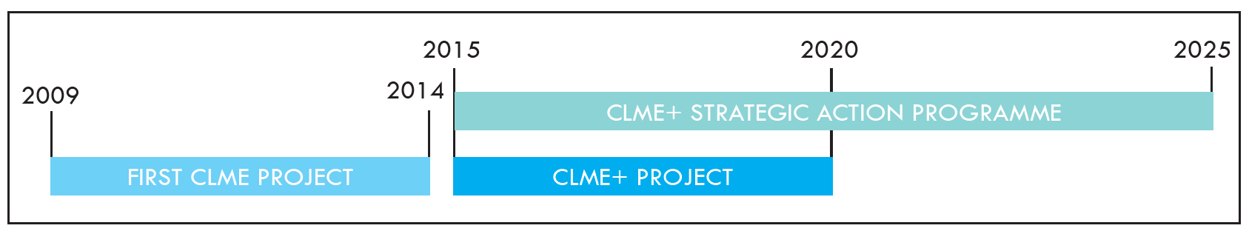

2016
2030 AGENDA FOR SUSTAINABLE DEVELOPMENT (SDG’s)
2030
2030
REVISED SAP
$
$
$
$
PROCARIBE+ PROJECT
$
Permanent COORDINATION MECHANISM FOR OCEAN GOVERNANCE
Integrated Reporting : Marine Environment & Socio-Economics
SAP Monitoring & Evaluation Framework
CLME+ KNOWLEDGE MANAGEMENT HUB
Regional Action & Investment Plans
2020
2030
The Critical Importance of the
GEF-supported TDA-SAP approach
for the Region
and of
the Coordination Mechanism

Slide 3

TOWARDS A PERMANENT COORDINATION MECHANISM
REGIONAL CONSULTATION
# 1
----
Sept 2018
REGIONAL CONSULTATION
# 2
----
July 2019
Preliminary proposals
Revised
proposal(s)
Revised
proposal(s) sent to the CLME+ countries,
first half of december
PROCARIBE
CLME+
PSC
MEETIG :
DECISION
----
16-18 JunE 2020
NATIONAL INTER-SECTORAL
CONSULTATIONS
----
Dec 19 – Feb 20
Adhesion and
OPERATIONALIZATION
2021-22-…
GEF (co-)financing
Development of the “UNDP/GEF & partners” proposal : “PROCARIBE+” : continuity of outcomes of CLME+

Slide 4
CLME+ PROJECT
PPG
PROCARIBE+ PROJECT
Post-PROJECT
?
PERMANENT COORDINATION MECHANISM
IOCARIBE
IGO? country?
IGO? country?
low-cost hosting arrangement (project duration)
low-cost hosting arrangement (project duration)
low-cost
permanet hosting arrangement
CLME+ PCU
PROCARIBE+ PCU
functions as the
interim Secretariat
for the CLME+ ICM
functions as the
interim Secretariat
for the CLME+ ICM
functions as the
interim Secretariat
for the PCM
Permanent
PCM
Secretariat

Slide 5
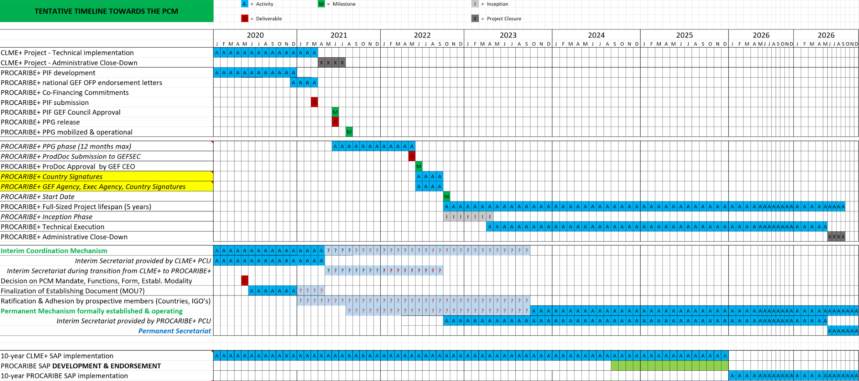
TENTATIVE TIMELINE :
From CLME+ Project to “PROCARIBE+” Project
From Interim Mechanism to Permanent Mechanism
From Interim Secretariat to Permanent Secretariat
“DANGER ZONE”

Slide 6
PRELIMINARY CALL FOR EXPRESSION OF INTEREST
for countries and IGO’s
to host
the Permanent Coordination Mechanism Secretariat
(request to fill in form)
until now:
1 EXPRESSION OF INTEREST - GOVERNMENT OF HONDURAS

