Slide 1

A Coordination Mechanism for Integrated Ocean Governance in the wider Caribbean
UNDP/GEF CLME+ PROJECT STEERING COMMITTEE MEETING
Virtual Meeting
16 - 18 June 2020

Slide 2
BACKGROUND
The CLME+ SAP calls for the establishment of a sustainable, region-wide Permanent Policy Coordination Mechanism (PPCM) for integrative ocean governance, with an initial focus on shared living marine resources
Arose from the recognition that weaknesses and gaps in transboundary and cross sectoral ocean governance arrangements, and overall lack of coordination of efforts, are among the root causes of environmental degradation and living marine resources depletion in the CLME+ region

Slide 3
BACKGROUND
Consultancy awarded to CAD in 2017
Global benchmarking and regional ocean governance and financing baseline, building on previous CLME work
Inception, Phase 1 and 2 (draft) reports prepared, plus materials
Frequent and close consultations with CLME+ SAP ICM and PCU
Regional consultations in 2018 (Cartagena) and 2019 (Panama)
Consultations with individual countries held (plus in-country consultations held)
Consultations with 15+ organizations held
Draft MoU prepared and revised based on feedback by CLME+ countries and IGOs

Slide 4
Agenda item 5.1
Core aspects of the Permanent Coordination Mechanism

Slide 5
OBJECTIVES
1. To enhance regional collaboration towards improved coordination and integration of actions and resources for the conservation and sustainable [management and] use of the marine and coastal ecosystems and their goods and services;
2. To [guide] facilitate integrated and interactive ocean governance in support of attaining ocean-based sustainable development in the wider Caribbean region [CLME+ region] [CNBSLMEs];
3. To promote the up-scaling of actions by all Signatories towards the achievement of the long-term visions of the CLME+ SAP, and other ocean-related international and regional goals and commitments of the Signatories including SDG 14.
4. To [support and] [promote and] establish partnerships with stakeholders from civil society and the private sector to facilitate and enhance efforts for the conservation and sustainable [management and] use of marine and coastal resources in the wider Caribbean region and support intersectoral agreements.
There seems to be a general convergence, with varying degrees of “ambition” towards integration.
Notes:
Comment made:The 4th Objective is better placed as a function rather than an objecitive
Response: The fourth objective has been added compared to the previous draft based on comments made by countries and IGOs highlighting the importance of engaging with non-state actors. Stakeholder engagement is one of the complementary functions of the CM.

Slide 6
GEOGRAPHIC SCOPE
The geographic scope of the Coordination Mechanism includes the Caribbean LME, the North Brazil Shelf LME [and such adjacent ecosystems as may be necessary to achieve EBM/EAF], [with the potential for expansion to include the Gulf of Mexico LME].
Why? Mandates of UNEP-CEP, FAO-WECAFC and IOCARIBE cover the Gulf of Mexico LME.
The Steering Group can identify and add geographic areas into the scope of the Coordination Mechanism.
Notes:
UNEP-CEP and FAO-WECAFC will also be involved in the GEF GOM SAP implementation project.
Differing perspectives that (a) including the GoM would make the scope too big for the PCM, basically biting off more than can be chewed and (b) the GoM is within the mandate of several regional organisations and is ecologically linked and therefore should be included. Including it does not bring in any additional countries or regional organisations, and it has its own LME initiative which could be merged into the CM.
Comment: In terms of geographic scope I think that it would suffice to say that international cooperation will be supported to take into consideration these interactions between the LMEs

Slide 7
THEMATIC SCOPE
The thematic scope of the Coordination Mechanism includes land and marine based sources of pollution of the marine environment, marine and coastal habitats and biodiversity, marine and coastal fisheries and the implications of climate change and disasters for these [and for the peoples and societies that depend on them], and encompasses all sectors [whose] [to the extent to which their] use of the marine environment is relevant to achieving [the objectives of the SAP] [and] [EBM/EAF] [for attaining sustainable [ocean-based] blue economies].
Why? The CLME+ SAP calls for involvement of additional key sectors such as shipping, tourism, and oil and gas in order to achieve fully integrative governance in the long term.
The Steering Group can identify and add thematic areas into the scope of the Coordination Mechanism.
Notes:
Comment It would be relevant to extend the thematic scope to the blue economy (i.e marine renewable energies, aquaculture, marine genetic resources, blue tourism, shipping ...).

Slide 8
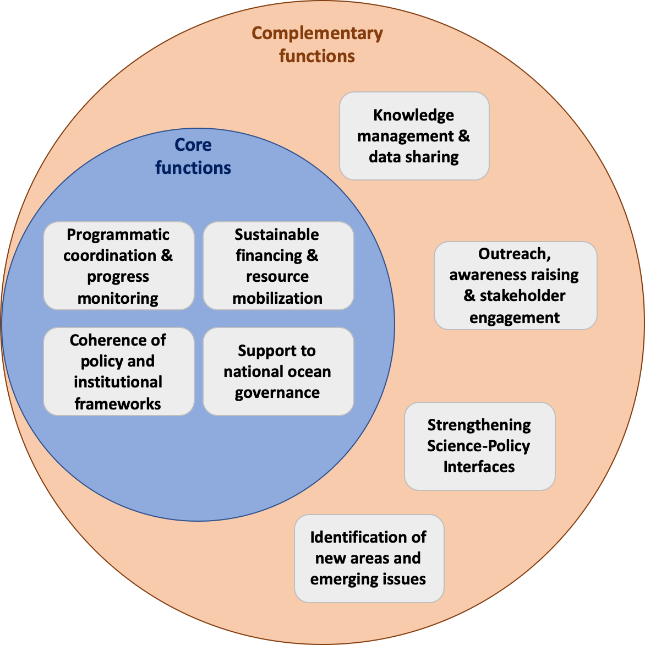
FUNCTIONS
undertake additional activities that are necessary to support the objectives of the Coordination Mechanism, as determined by the Signatories.
There seems to be a general convergence on core and complementary functions.
Notes:
The SG to approve changes to the status of the functions of the Coordination Mechanism, from complementary to core, or vice versa;

Slide 9
CORE FUNCTIONS
1. Coordinate programmatic approaches of IGOs for ocean governance and support the monitoring of progress with ocean sustainability instruments, goals and commitments.
2. [Support] Strengthen the sustainable financing and coordinated resource mobilization for ocean governance.
3. [Promote] Enhance the coherence of the regional institutional and policy framework for ocean governance.
The CM’s role is not to dictate policy to IGO Signatories. It is to help them to develop collectively more coherent policy and programmatic positions through recommendations.
4. Support national ocean governance, including national level coordination for oceans.
Notes:
[Support coherent regional ocean governance including through more harmonized regional policy and institutional frameworks]
[Foster a coordinated approach to regional ocean governance]

Slide 10
COMPLEMENTARY FUNCTIONS
5. Coordinate knowledge management and facilitate data and information sharing.
6. Coordinate outreach, awareness raising and stakeholder engagement.
7. Strengthen science-policy interfaces.
8. Explore new areas for collaboration [and emerging issues].
Notes:
Complementary Function 3, it is considered relevant to note that it will seek to be in line with the UNESCO initiative that declared the "decade for ocean research and science 2021-2030".

Slide 11
FORMAT/STRUCTURE
Steering Group
(national representatives and EG Chair )
Countries
NICs
Working Groups
(IGO/country/other experts)
Executive Group
(representatives of IGO Secretariats)
IGOs
Secretariats
Secretariat
(technical and administrative staff)
Why? A structure that allows countries and IGOs to work together in an efficient and organized way towards their common goals.

Slide 12
GOVERNANCE
The Steering Group provides guidance to the Executive Group and has final authority over substantive decisions and recommendations
The SG does not direct the individual IGOs; decision making is by consensus non-binding
The Executive Group advises and makes recommendations to the Steering Group, executes decisions by the Steering Group and directs and oversees the Secretariat
The EG makes recommendations to SG by consensus
Substantial work is executed through the IGO’s work programmes

Slide 13
GOVERNANCE
The Secretariat provides technical and administrative support to the Coordination Mechanism
The Secretariat carries out activities as determined by the members of the Coordination Mechanism, and does not enter into competition with the IGO Secretariats
It represents the Coordination Mechanism on behalf of its members
Working Groups can be set-up by the Steering Group or the Executive Group with specifically defined tasks
Flexibility exists in the set-up of Working Groups: they can be permanent or ad-hoc, and the ToRs are defined for each WG;
The Coordination Mechanism can also promote alignment and synergies among existing working groups in the region

Slide 14
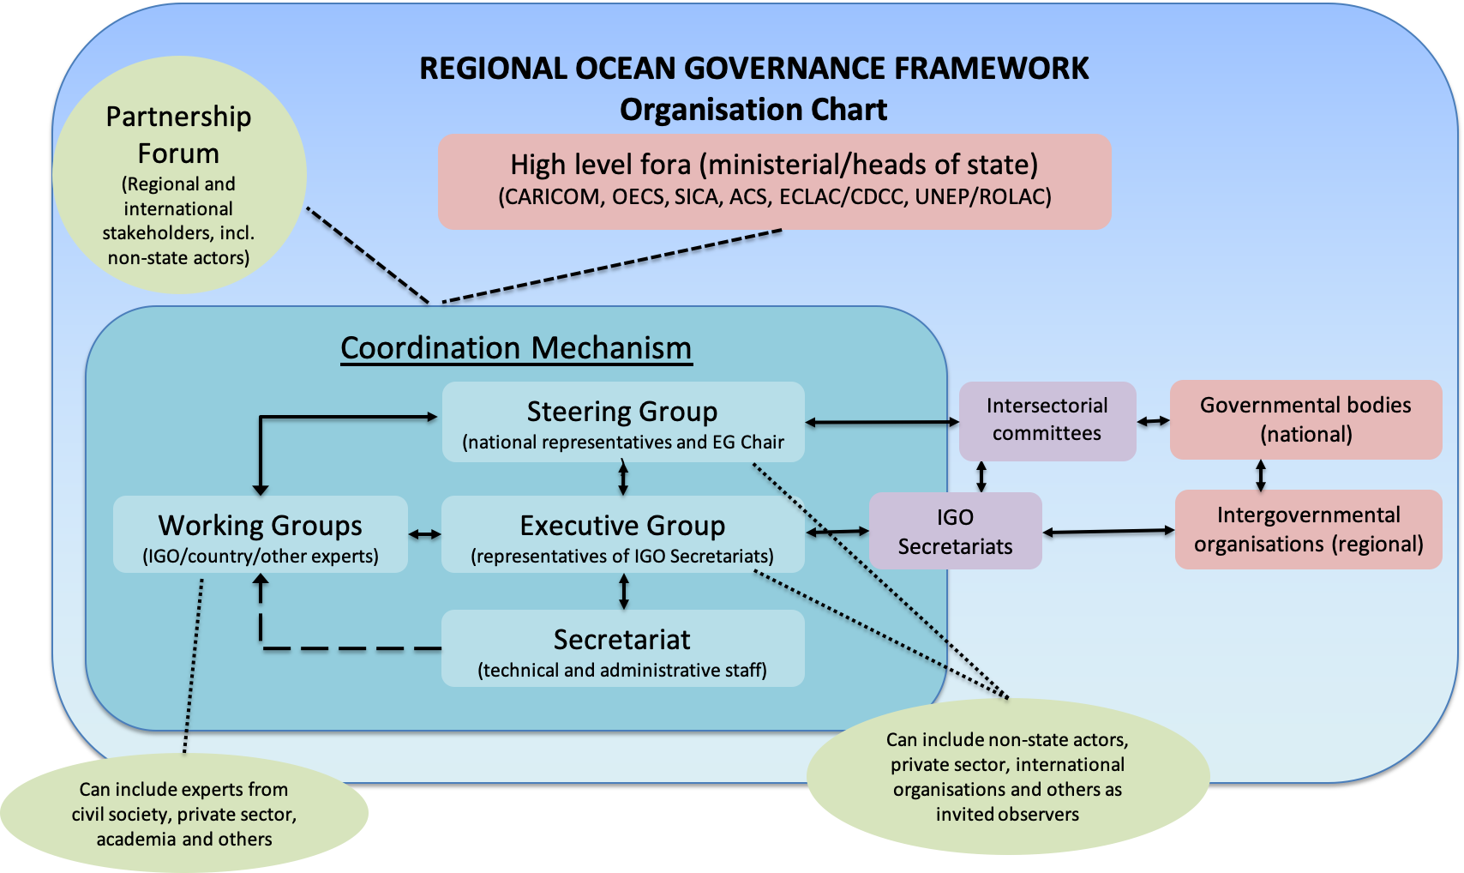
FORMAT/STRUCTURE
The proposed Coordination Mechanism is part of the wider regional ocean governance framework

Slide 15
Agenda item 5.2
Establishing Modality of the Permanent Coordination Mechanism

Slide 16
MOU AS ESTABLISHING INSTRUMENT
Precedent of the 2017 MoU Establishing the CLME+ SAP ICM
agreed by IGO signatories after extensive negotiations
functioning effectively
MoU
format for creating a cooperative arrangement between different types of entities
not imposing legally binding requirements
consistent with international standards

Slide 17
MOU AS ESTABLISHING INSTRUMENT
Language used in the Draft MoU
particular words do not determine the nature of the MoU
“legalistic” terms (e.g. “shall” and “Parties”) have been avoided
express wording highlights the non-binding nature of the MoU

Slide 18
MOU AS ESTABLISHING INSTRUMENT
Clarity and precision are essential and have guided the drafting, and a structure different to bilateral MoUs to meet requirements:
broad and diverse set of entities, wide-ranging scope
entities to work together on a permanent basis
clarify essential issues and procedures in order to avoid uncertainties in the future
leave open the possibility of future development

Slide 19
Agenda item 5.3
Hosting Arrangements for the Coordination Mechanism

Slide 20
HOSTING THE CM
Three possibilities discussed for hosting the CM:
Hosting by a participating country
Hosting by an intergovernmental organisation (IGO)
Sharing office space with an IGO
Giving legal personality to the CM is considered critical for the it to be able to effectively perform the proposed functions.

Slide 21
HOSTING THE CM
Hosting by a participating country
CM
International agreement between
Host country
National law
legal personality created for CM in host country legal system

Slide 22
HOSTING THE CM
Hosting by an IGO
CM
International agreement between
Host IGO
Host IGO
International agreement (modification needed) between
Host country
National law
legal personality created for CM in host country legal system

Slide 23
HOSTING THE CM
Sharing office space with an IGO
CM
International agreement between
Host country
CM
International or national (contractual) agreement between
IGO
National law
legal personality created for CM in host country legal system

Slide 24
HOSTING THE CM
Checklist of Considerations
Consultation with Ministry of Foreign Affairs
Privileges and Immunities
Interim Arrangements/Financing
Practical Needs
Benefits

