Slide 1


Virtual Project Steering Committee Meeting
16-18 June 2020
Progress towards integrated Ocean Governance over the past 20 years in the CLME+ region
info@clmeproject.org
Catalizando la implementación del Programa de Acciones Estratégicas de los Grandes Ecosistemas Marinos
del Caribe y de la Plataforma del Norte de Brasil

Slide 2
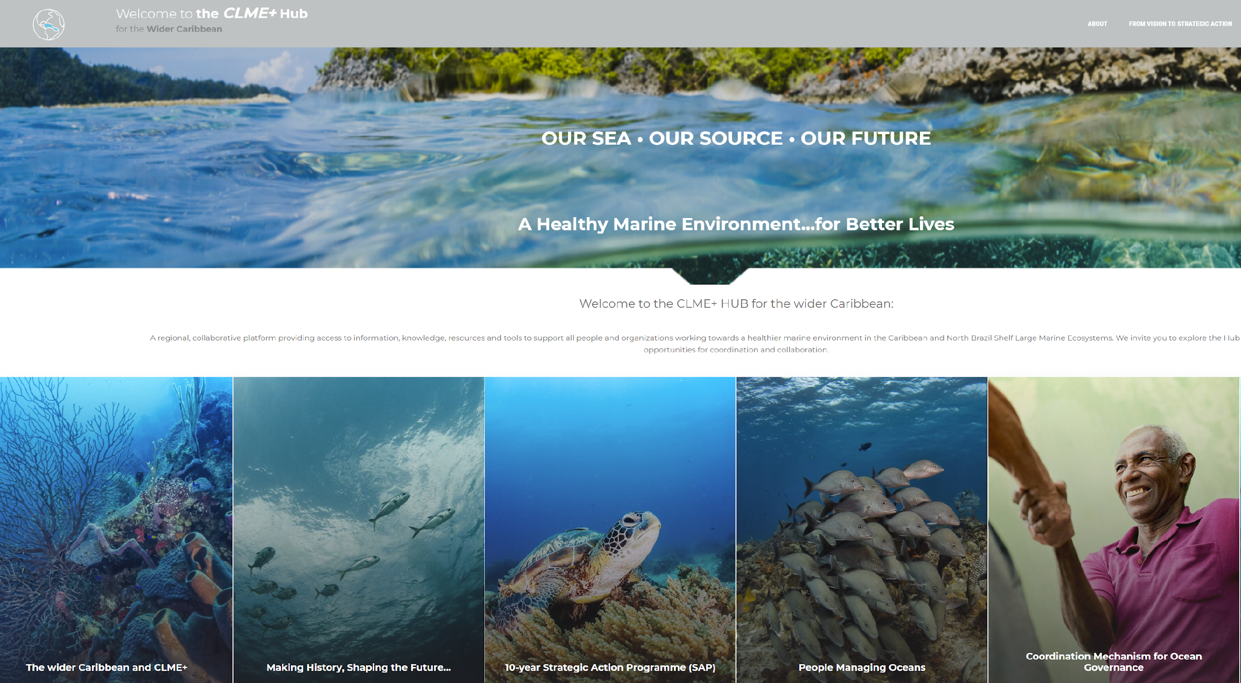

clmeplus.org

Slide 3
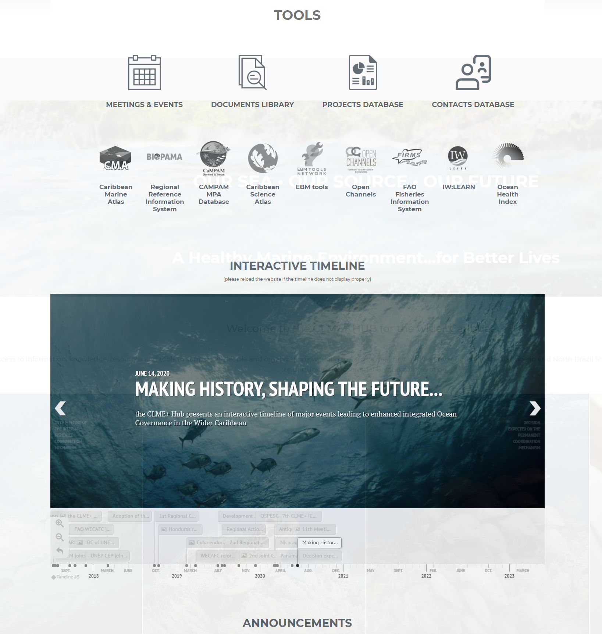

Slide 4
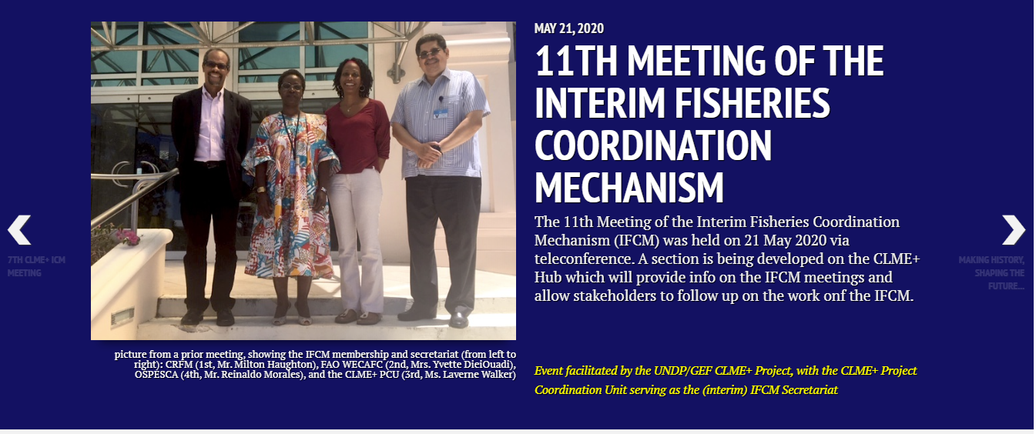
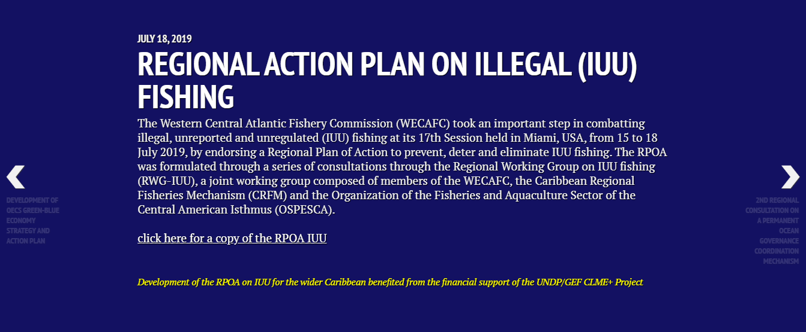
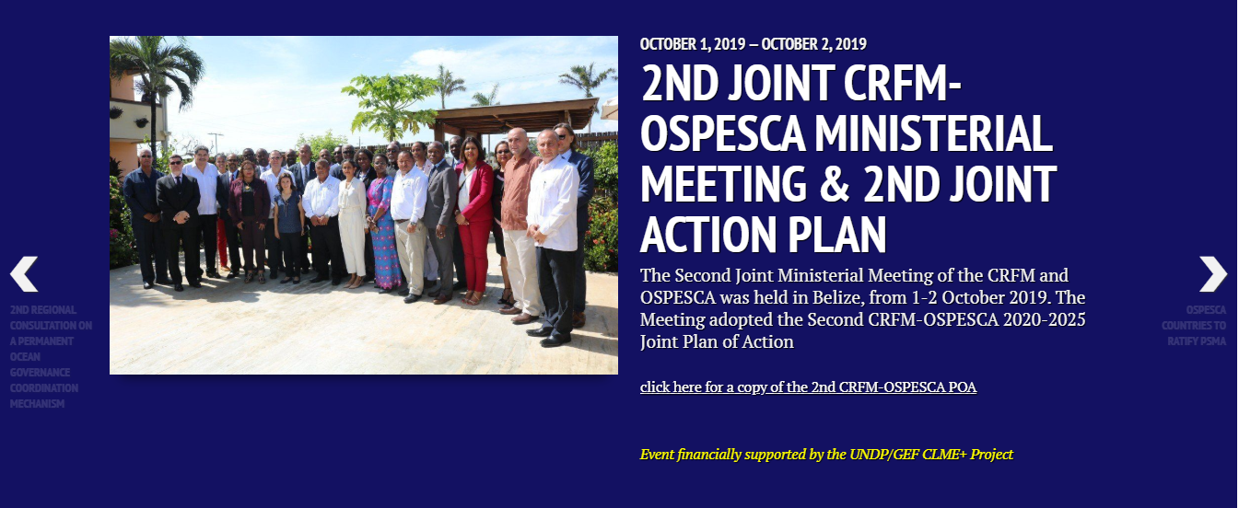
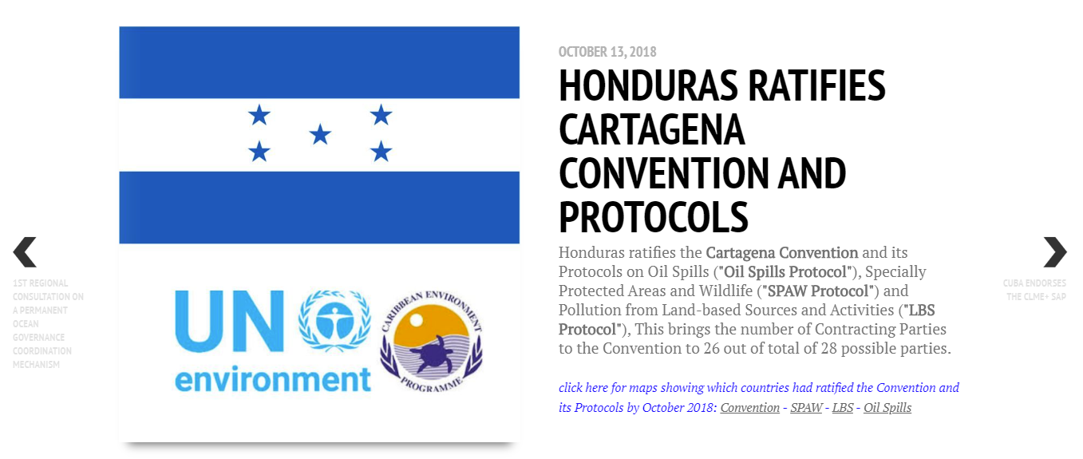
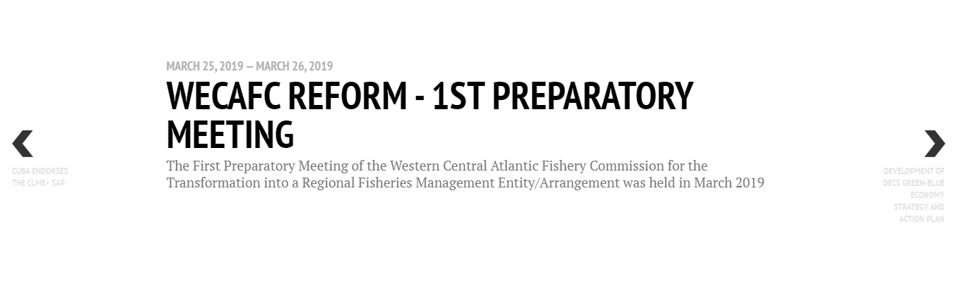
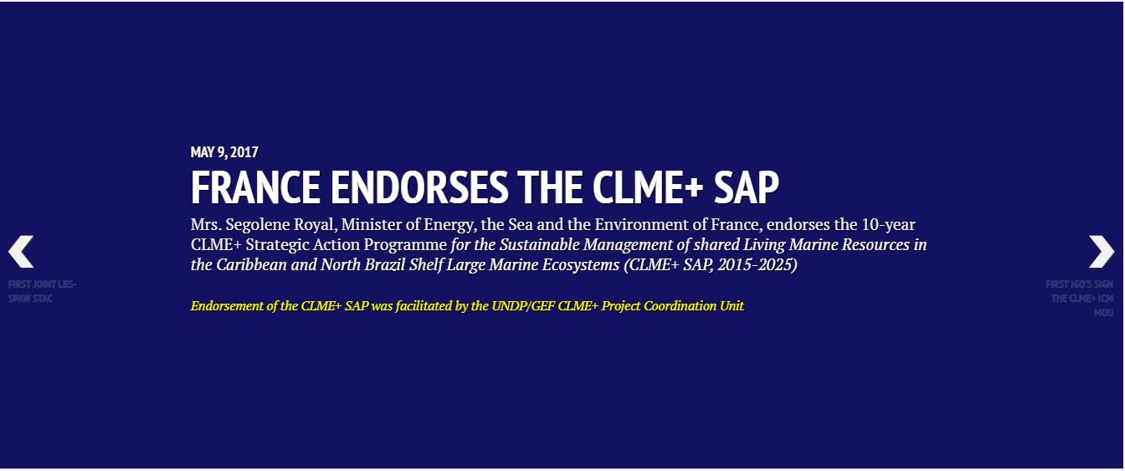
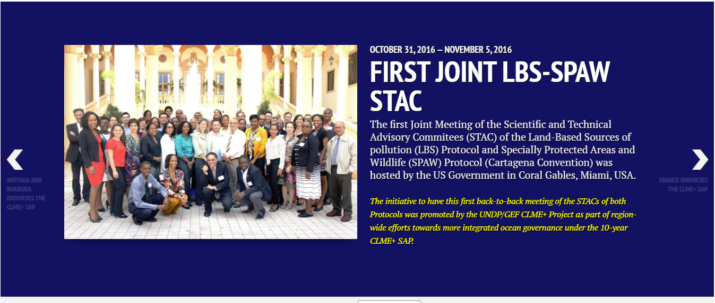
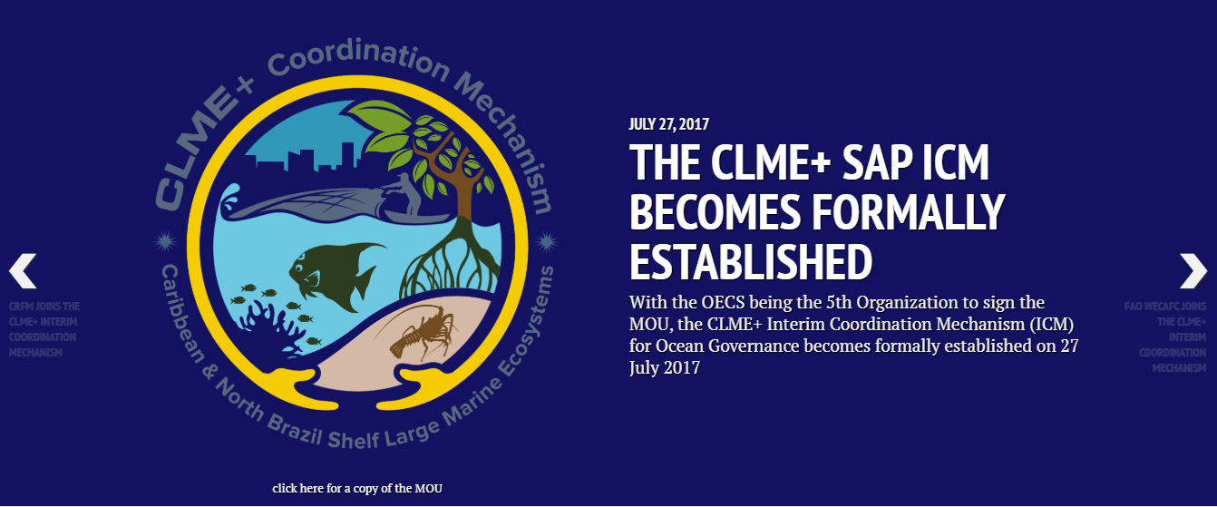

Slide 5
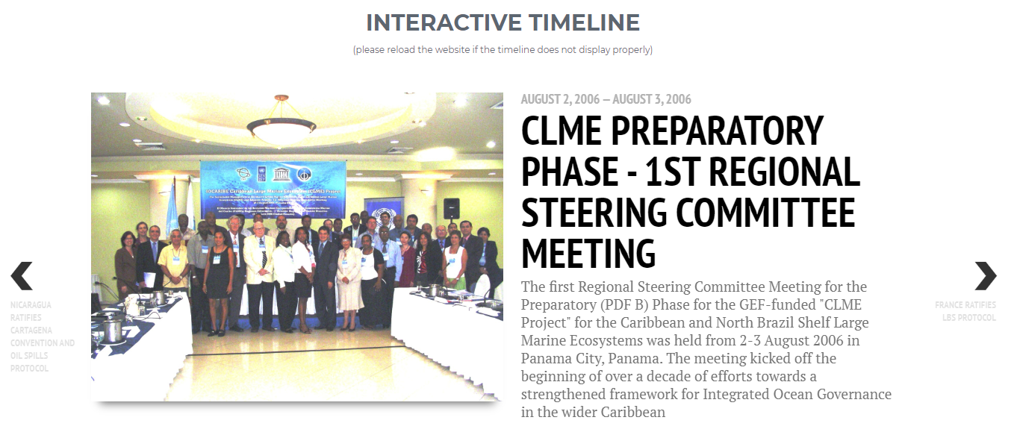
AUGUST 2006!
JUNE 2020:
SEEKING TO DECIDE ON THE COORDINATION MECHANISM
…under Panama’s Chairmanship

Slide 6
FIRST-TIMERS FOR THE REGION – CATALYZED THROUGH/SUPPORTED BY THE CLME+ INITIATVE
Region-wide, cross-sectoral Strategic Action Programme
First joint high-level CRFM-OSPESCA Ministerial Meeting
First ever joint SPAW-LBS STACs
Joint SPAW-LBS work programme
Interim Coordination Mechanisms
  globally, talks about RFB’s and Regional Seas (and LME’s) working together are HOT. We already established the ICM!
incipient “programmatic approach” to GEF IW projects for the region
First regional geonode covering info on marine governance
Prototype regional Knowledge Management Hub on Ocean Governance
First SOCAR LBS
First State of Habitats
…

Slide 7
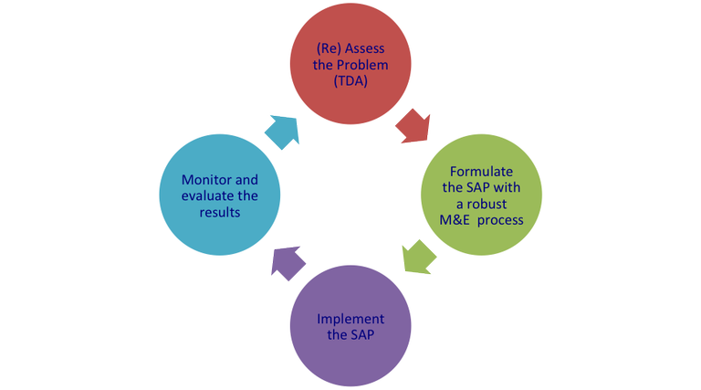
GEF “INTERNATIONAL WATERS” FOCAL AREA
Resolve the (governance) problems
of transboundary aquatic and marine resources
TDA-/SAP PROCESS = CYCLICAL

Slide 8
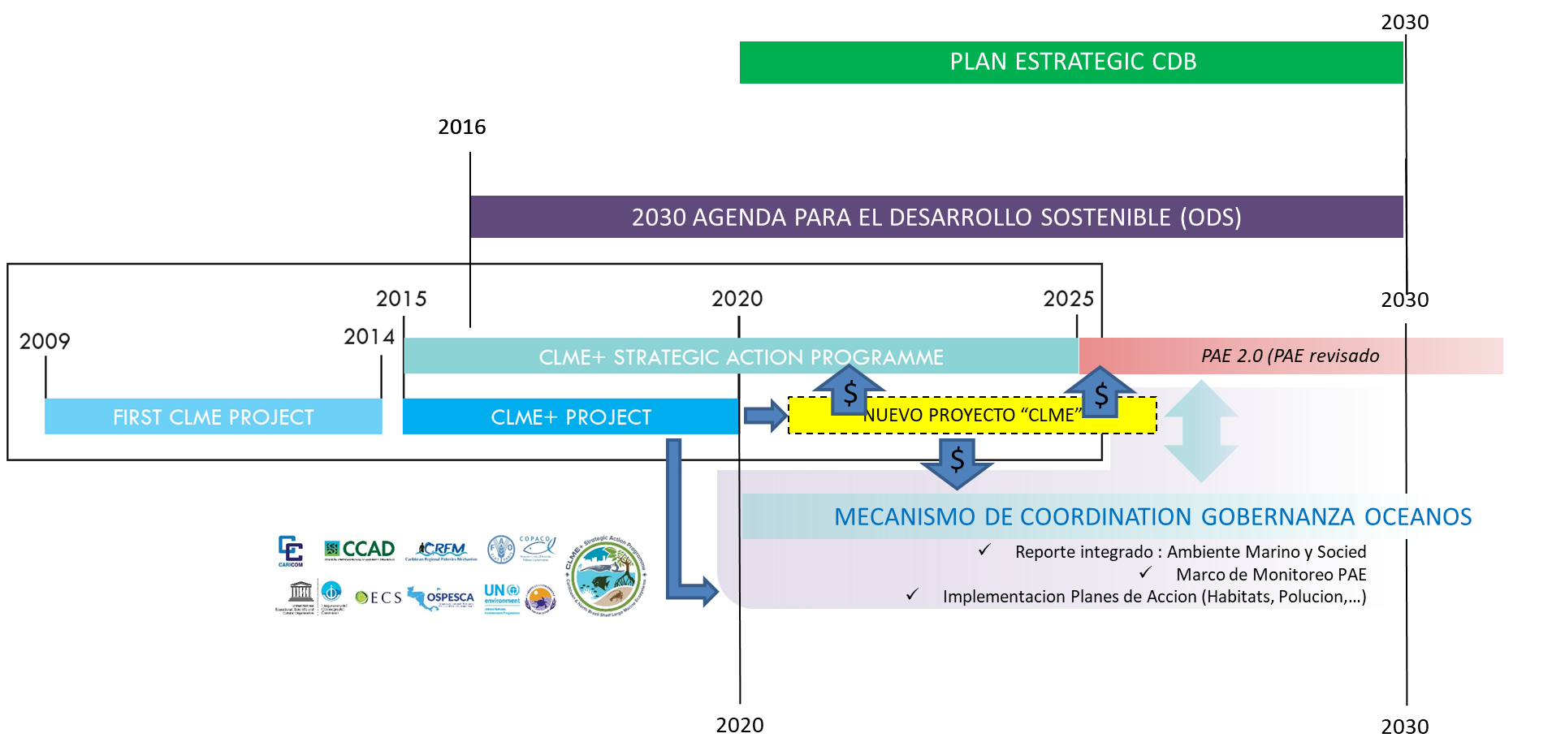
CCAD ERAM 2020-25
MIC CLME+
Manejo de
Conocimientos / Informacion
CLME+ HUB

Slide 9
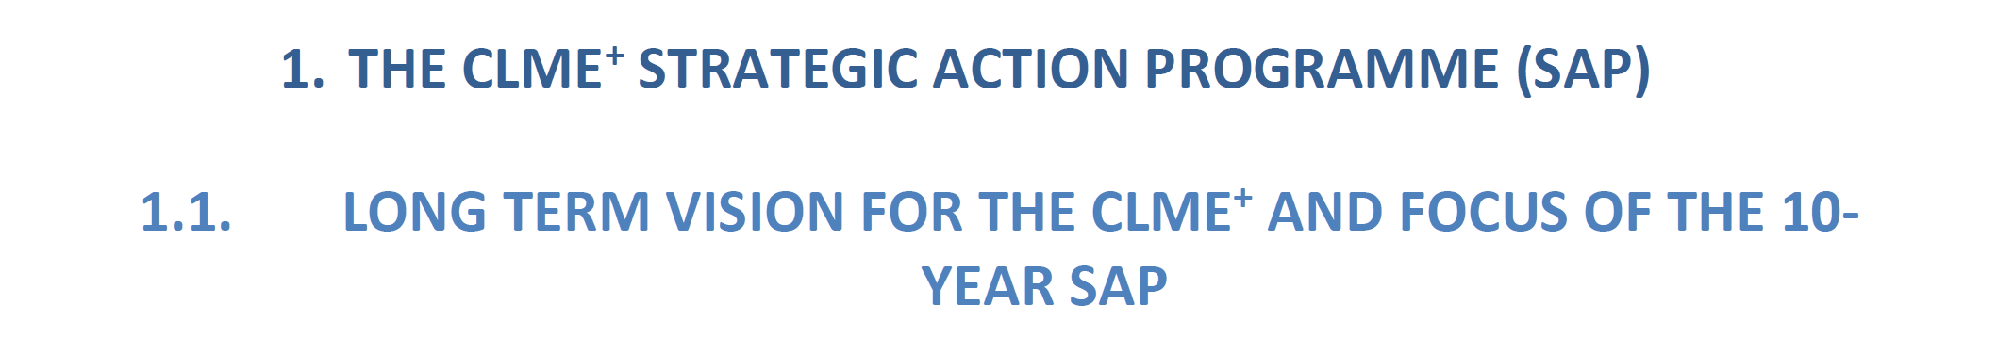
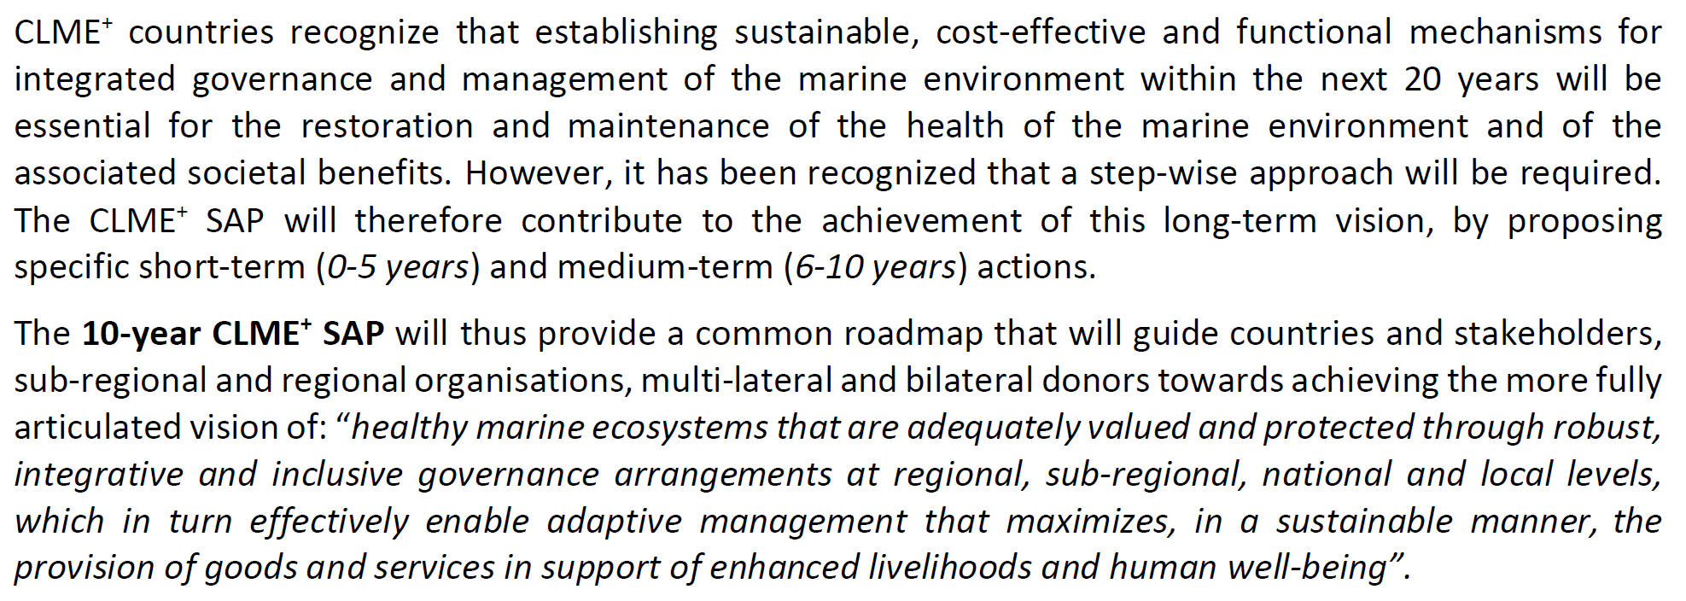

Slide 10
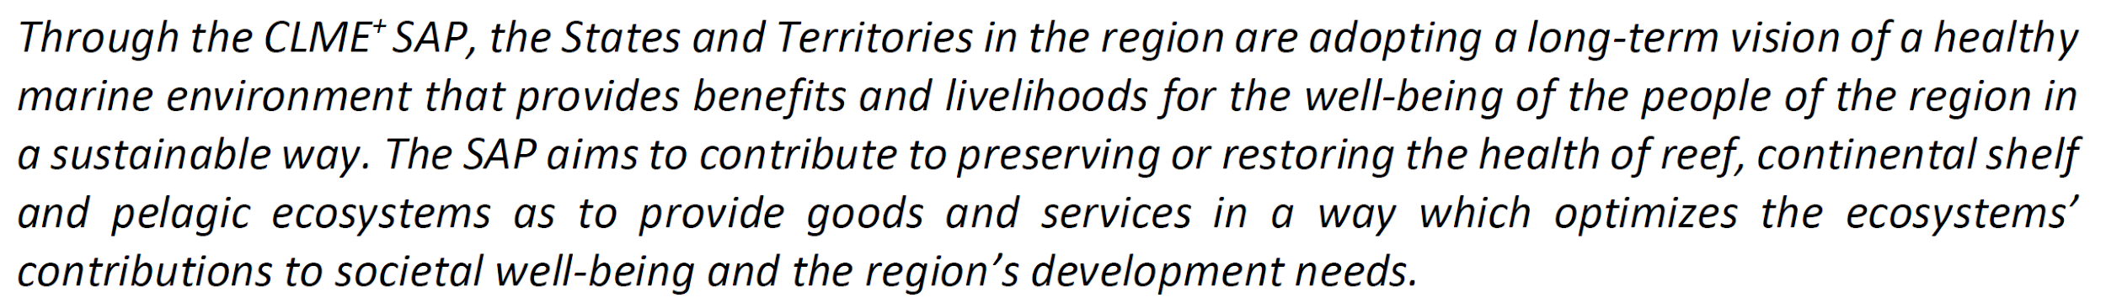
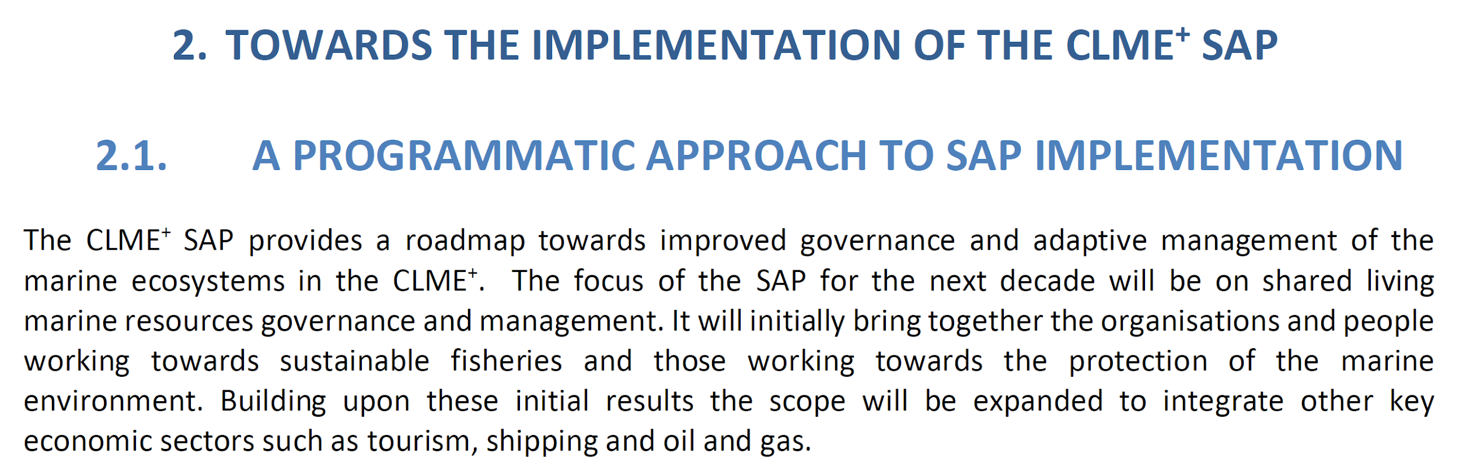
FROM THE SAP EXECUTIVE SUMMARY

Slide 11
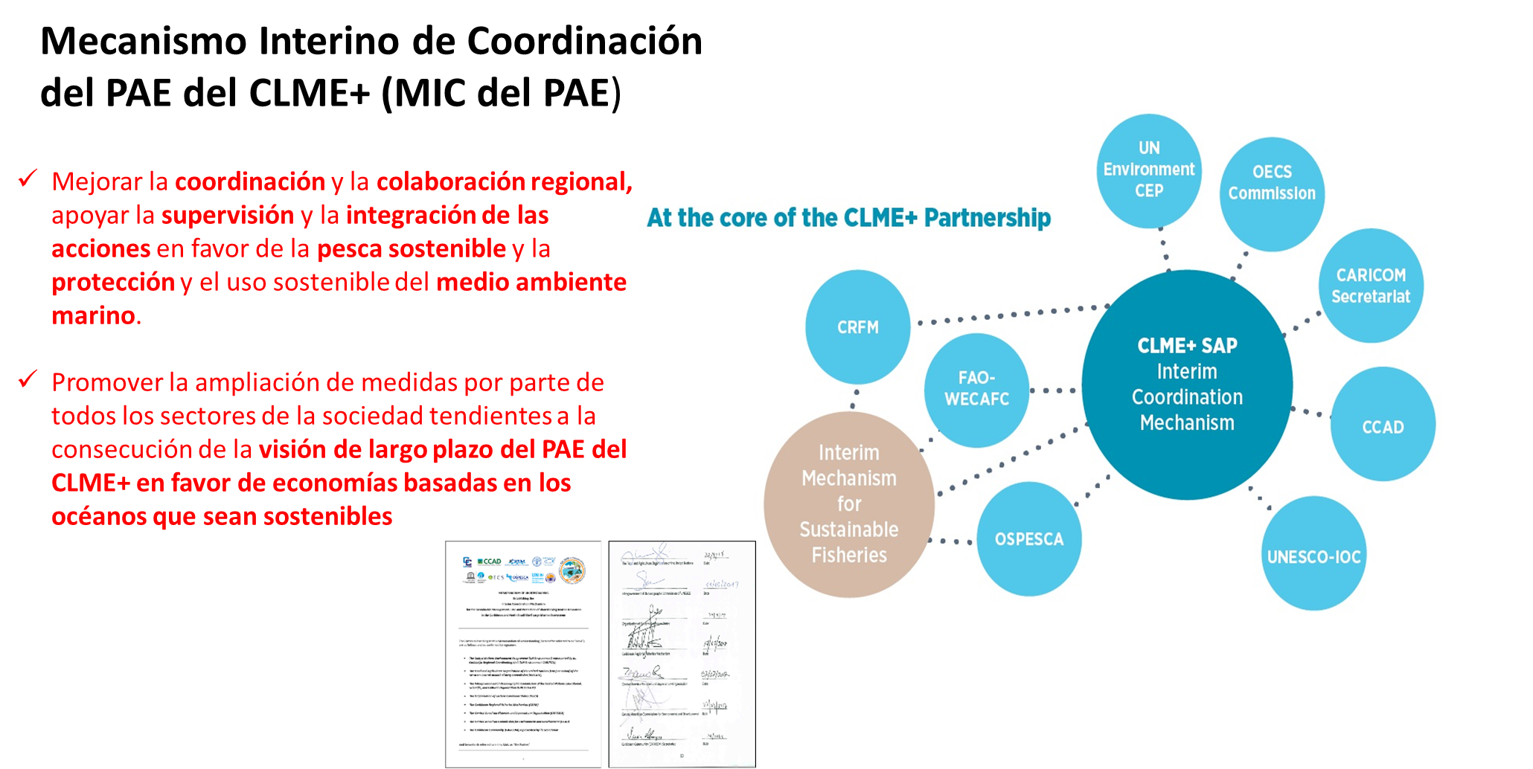
UCP del Proyecto CLME+ = Secretaria (interina)
Membresia OIG’s MPC: puede ser basada en, pero no debe ser necesiaramente restringida a OIG’s del MIC

Slide 12
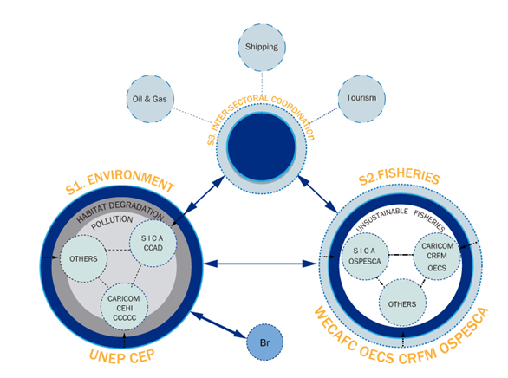

Slide 13
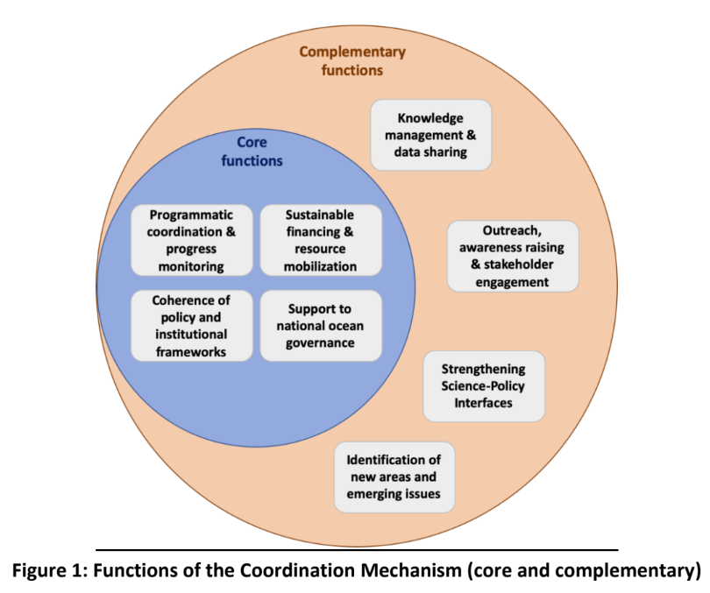
Knowledge Management!
Knowledge & data drives TSDA-SAP Development!

Slide 14
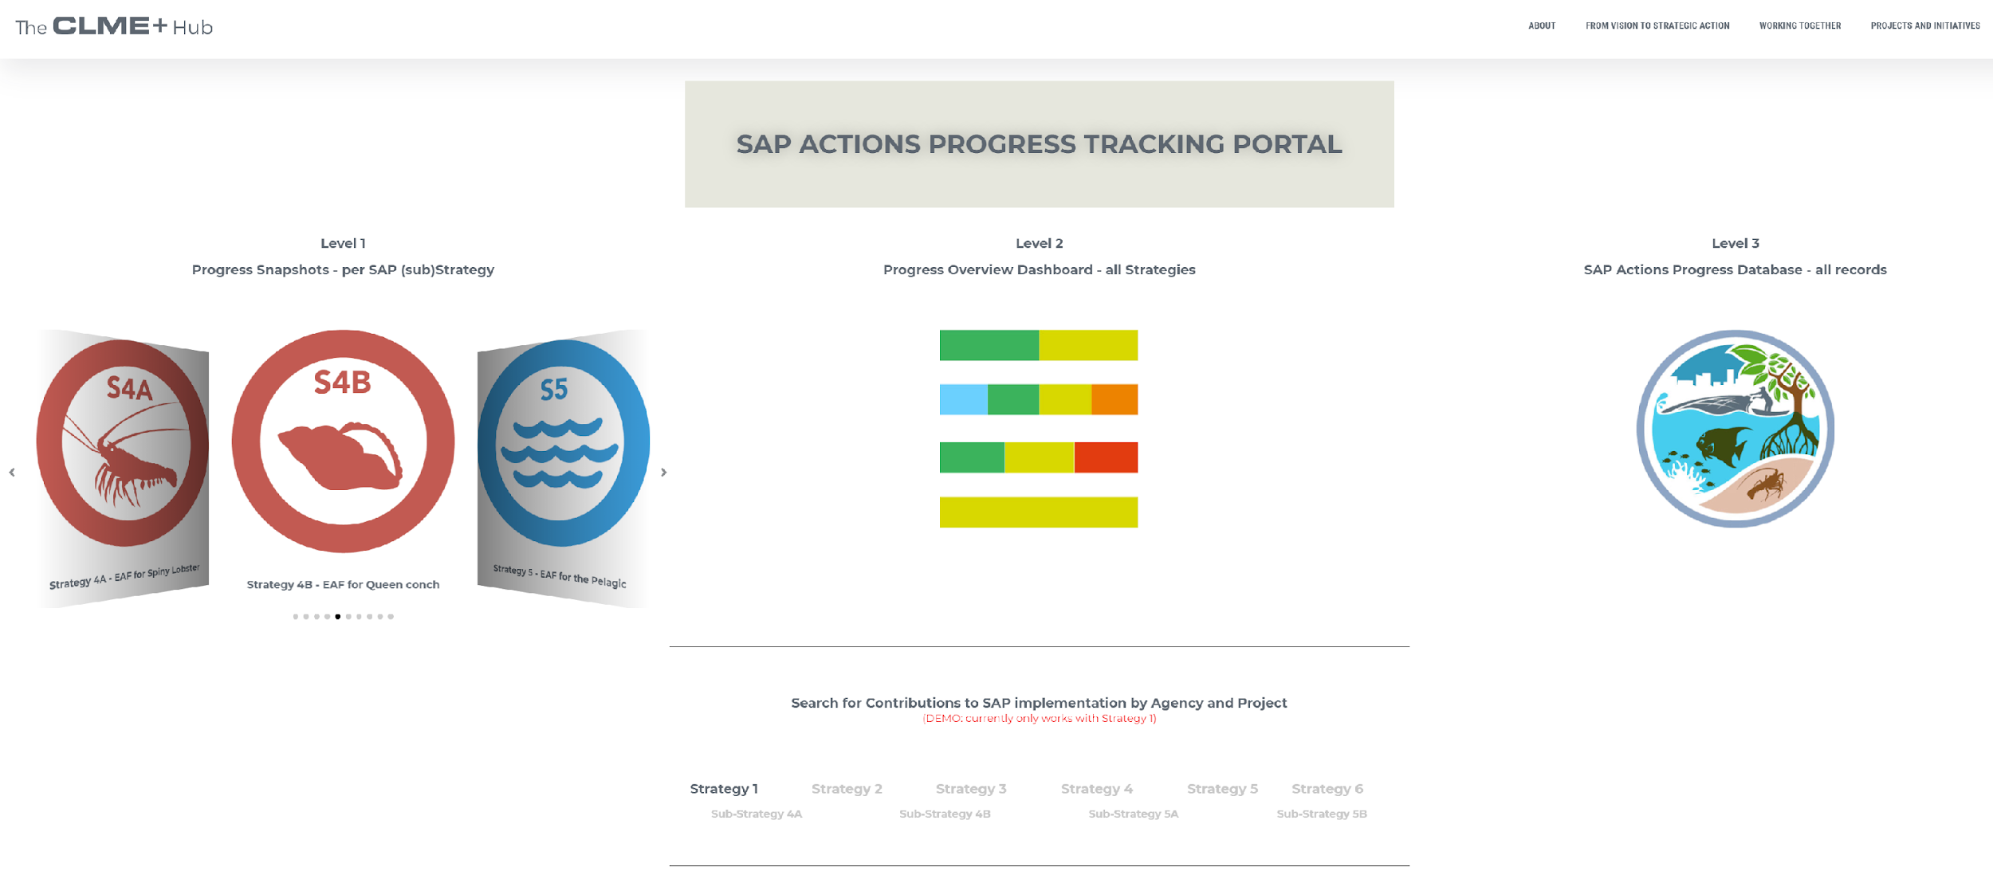

Slide 15
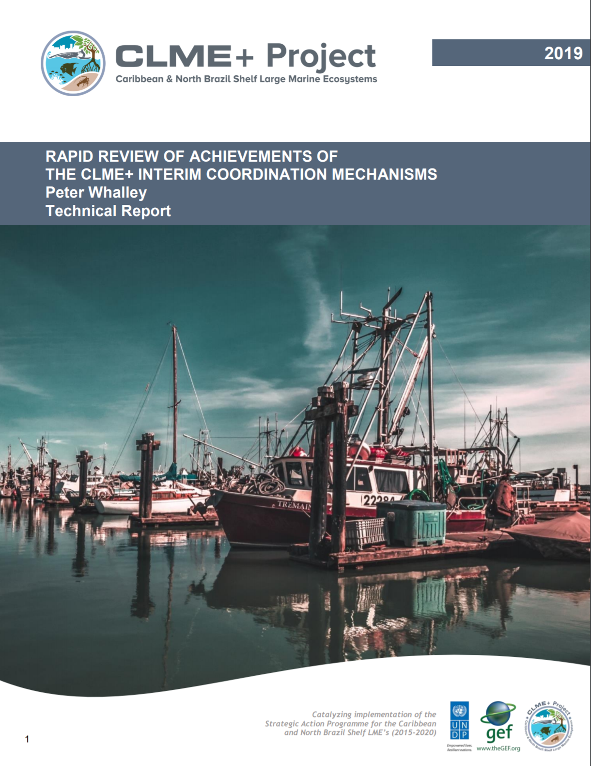
Available through link in the PSC Work Programme
Also permanently available on the CLME+ HUB Documents Library

