Slide 1

CLME+ PPCM Regional Consultation GEF 7 and IW
José Vicente Troya
Regional Technical Advisor
Water and Oceans
Cartagena, September 26th, 2018

Slide 2
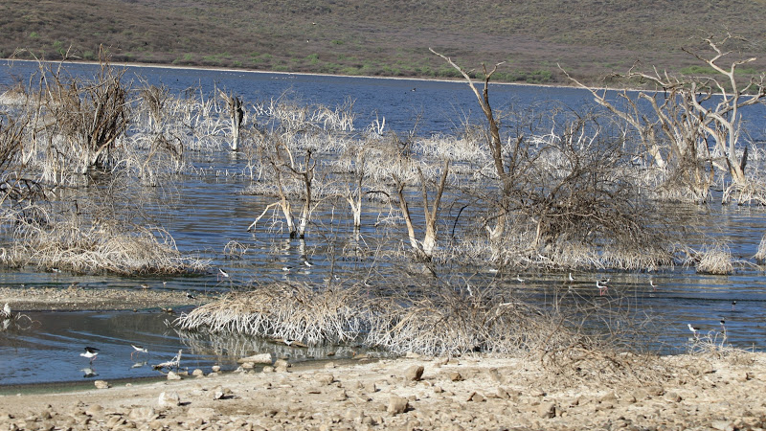
Outline
Context
IW Objectives
Delivery mechanisms
Private sector
CLME+ SAP and GEF 7

Slide 3
GEF 7 INTERNATIONAL WATERS
Ocean ecosystems under anthropogenic pressure from climate change, acidification, habitat loss, pollution, fishing, shipping and seabed mining
A number of valuable coastal ecosystems and open oceans lack sustainable governance structures resulting in continued degradation
Need for multi-national cooperation supported by regional organizations to address multifaceted threats to transboundary marine ecosystems
Regional organizations need to function as hubs for harnessing, coordinating and channeling political and economic interest from public and private sectors

Slide 4
GEF 7 INTERNATIONAL WATERS Objectives
Strengthening national Blue Economy opportunities to reduce threats to marine and coastal waters
Improving management in the Areas Beyond National Jurisdiction
Enhancing Water Security in freshwater ecosystems

Slide 5
GEF 7 INTERNATIONAL WATERS Objective 1
Blue Economy opportunities in countries will be strengthened through three areas of strategic action under GEF 7 addressing key stressors:
Sustaining healthy coastal and marine ecosystems
Catalyzing sustainable fisheries management
Addressing pollution reduction in marine environments

Slide 6
GEF 7 INTERNATIONAL WATERS Sustaining Healthy Coastal and Marine Ecosystems - potential investments
Develop & implement environmentally sustainable Blue Economy Strategies
Establish and support existing MPAs in key hot spots and coastal habitats
Restore degraded key habitats
Mainstream marine areas based management and spatial tools in regional entities
Formulate and formalize cooperative legal and institutional frameworks built on TDAs/SAPs approach, towards addressing anthropogenic pressures
Stimulate private sector engagement, through relevant industry roundtables and industry groups
Engage with national, regional and global stakeholders to increase collaboration and cross support to investments and processes
Foster collaboration among LMEs, Regional Seas conventions and RFMOs to protect and restore these key habitats

Slide 7
GEF 7 INTERNATIONAL WATERS Catalyze Sustainable Fisheries Management - potential investments
Policy reforms to end IUU, overfishing and sustainably manage marine capture fisheries
Implementation of market mechanisms to support sustainable fisheries value chains
Standard setting for sustainable aquaculture to enhance marine ecosystem health and improving food and nutrition security
Strengthening and creating policy frameworks, including working with countries to eliminate harmful incentive structures

Slide 8
GEF 7 INTERNATIONAL WATERS Addressing pollution reduction in marine environments - potential investments
Catalyze national policy development coupled with investments in innovative approaches through regional process, to address nutrients and emerging pollution issues along source to sea
Support common fact finding between public and private sectors to ensure that priority actions will lead to transformed practices in both sectors
Stimulate private sector engagement, through relevant industry sectoral roundtables and industry groups
Increase understanding of marine noise in a transboundary context
Support & engage with national, regional and global stakeholders to increase collaboration and cross support to investments and processes
Support a few strategic global and regional investments to transform plastic life cycles that emphasize PPPs and significantly address global marine plastic pollution

Slide 9
GEF 7 INTERNATIONAL WATERS Regional and national investments via endorsed SAPs
Regional projects will need to leverage substantial co-financing, e.g. through blended financing
National investments implementing regionally endorsed SAP priorities need to adhere to the following criteria:
National investments will need to align with priorities of regional endorsed SAP
New national investments would need to be coordinated with the relevant regional institution responsible for regional agreed frameworks
Need to include GEF STAR financing, loan and/or national budget financing
Gender issues, gender considerations will be mainstreamed into all processes and investments

Slide 10
GEF 7 INTERNATIONAL WATERS GEF IW 7 and Private Sector
Stimulate engagement along the different supply chains towards reducing impacts on marine ecosystems –e.g. small pelagic
Working with large scale commercial fishing fleets
Development of marine spatial plans to identify investments opportunities for private & public sectors
Advance private engagement to increase food, energy, environmental security through industry round tables and interest groups
Reuse, reduce point and non-point sources of pollution
De-risking innovative investments within the marine sectors, through support to testing of innovative approaches and technologies

Slide 11
GEF 7 INTERNATIONAL WATERS CLME+ and GEF 7
Partially financing the operation of the PPCM
Ensure up to date data & information and reporting on the CLME (SOMEE)
Identify emerging threats requiring priority actions (tourism, shipping, oil and gas)
Establish public-private partnerships for addressing these new threats and contributing to the CLME+ region long term goal sLMRM
Support implementation of investment plans of the three CLME+ regional strategies (fisheries, habitat degradation, pollution)
Advance some of them by national interventions

Slide 12

Thanks!

