Slide 1
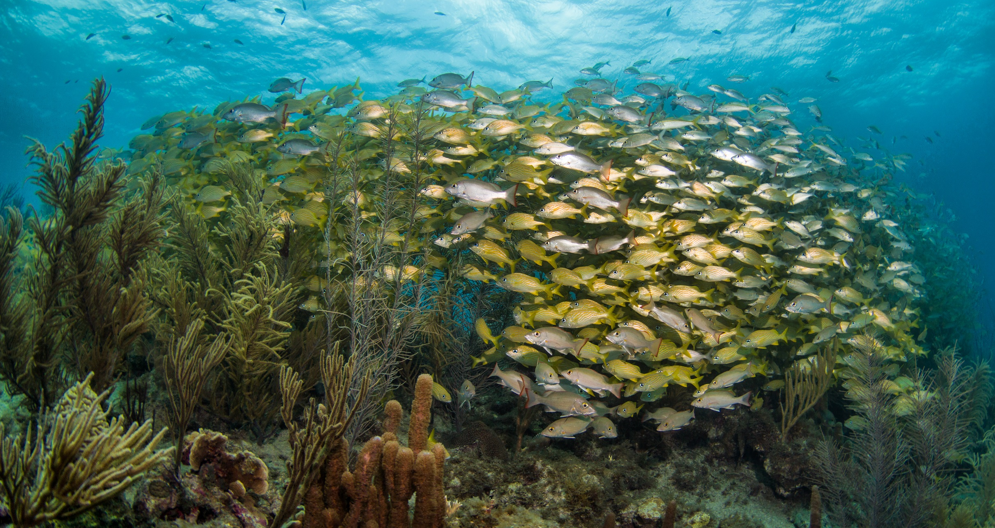
1st Regional CLME+ Consultation: Strenghtening Ocean Governace
Cartagena, 25-26 September 2018
The CLME+ initiatives*:
Towards Strengthened Ocean Governance
in the Wider Caribbean/CLME+ region
Patrick Debels
Regional Project Coordinator
PatrickD@unops.org
Catalyzing implementation of the 10-year Strategic Action Programme for the Caribbean and North Brazil Shelf LME’s (2015-2025)

Slide 2

What’s
at
stake?
Catalyzing implementation of the
10-year Strategic Action Programme
for the Caribbean and North Brazil Shelf LME’s

Slide 3

Large Marine Ecosystems (LMEs)
66 Large Marine Ecosystems or LME’s
LMEs contribute an estimated US$28 TRILLION annually to the GLOBAL ECONOMY.
SUSTAINABLE USE OF LMEs can make a
SIGNIFICANT CONTRIBUTION to the achievement of the
UN Sustainable Development Goals, especially
HUNGER (SDG #2), POVERTY REDUCTION (SDG#1), and
THE OCEAN (SDG#14)
Catalyzing implementation of the
10-year Strategic Action Programme
for the Caribbean and North Brazil Shelf LME’s

Slide 4
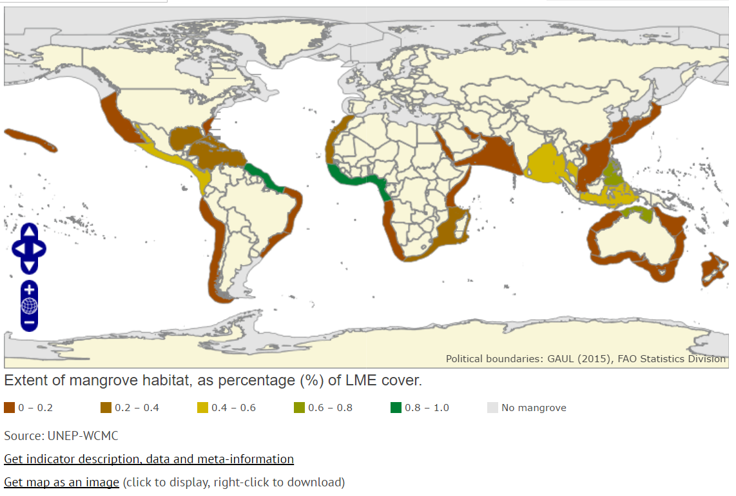
Large Marine Ecosystems (LMEs)
LME’s constitute a meaningful geo-spatial unit for ecosystem-based management of shared ocean space (NOAA, GEF…)
UN Environment’s Regional Seas Programmes are legal arrangements for enhanced governance of the marine environment
RFBs have mandate for fisheries management within determined geographic scopes
scientific concept
Catalyzing implementation of the
10-year Strategic Action Programme
for the Caribbean and North Brazil Shelf LME’s

Slide 5
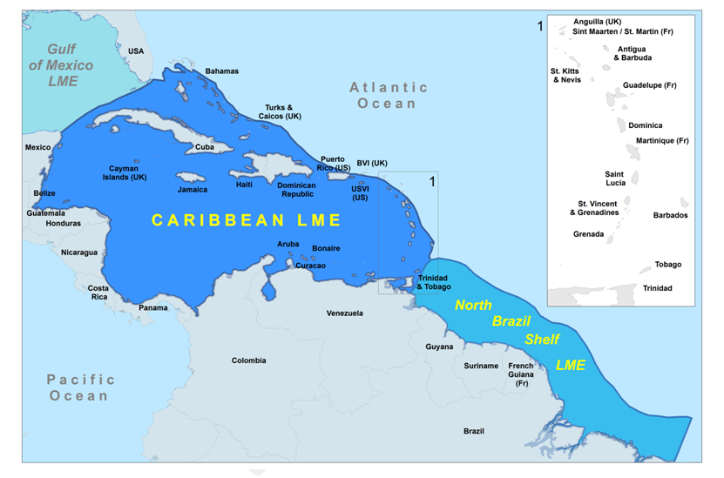
CLME+ : Caribbean & North Brazil Shelf LMEs
geopolitically diverse and complex
26 independent States and 18 overseasterritories
Very ≠ country sizes, development status
Caribbean Sea contains approx. 10% of the world coral reefs
CLME+ - 20% of world remaining mangrove forests – most in NBSLME
BIODIVERSITY – ENDEMISM
FISHERIES
TOURISM
SHIPPING
OIL & GAS
SIDS
Catalyzing implementation of the
10-year Strategic Action Programme
for the Caribbean and North Brazil Shelf LME’s

Slide 6
“Wider Caribbean”
(Regional Seas)
Caribbean LME
North Brazil Shelf LME
Gulf of Mexico LME
UNDP/GEF CLME+ Project CLME+ SAP

Slide 7
Catalyzing implementation of the
10-year Strategic Action Programme
for the Caribbean and North Brazil Shelf LME’s

Slide 8
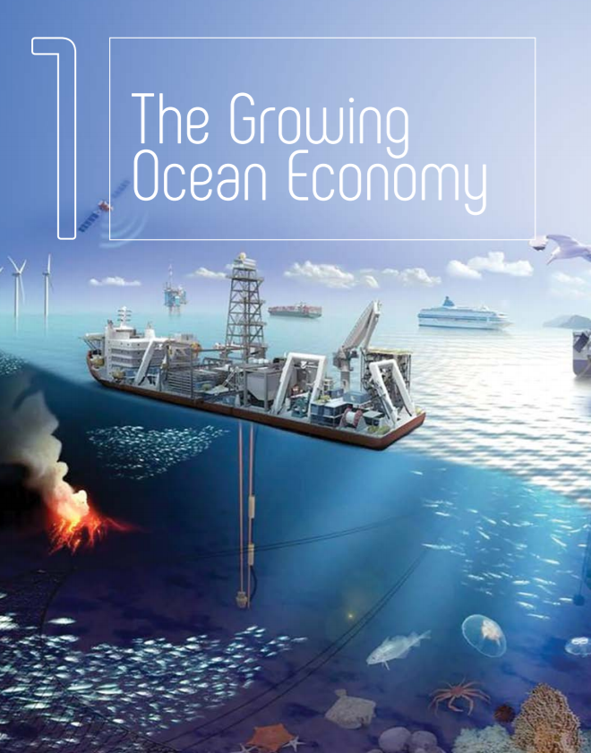
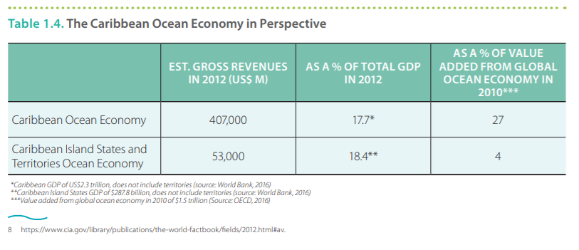
Catalyzing implementation of the
10-year Strategic Action Programme
for the Caribbean and North Brazil Shelf LME’s

Slide 9
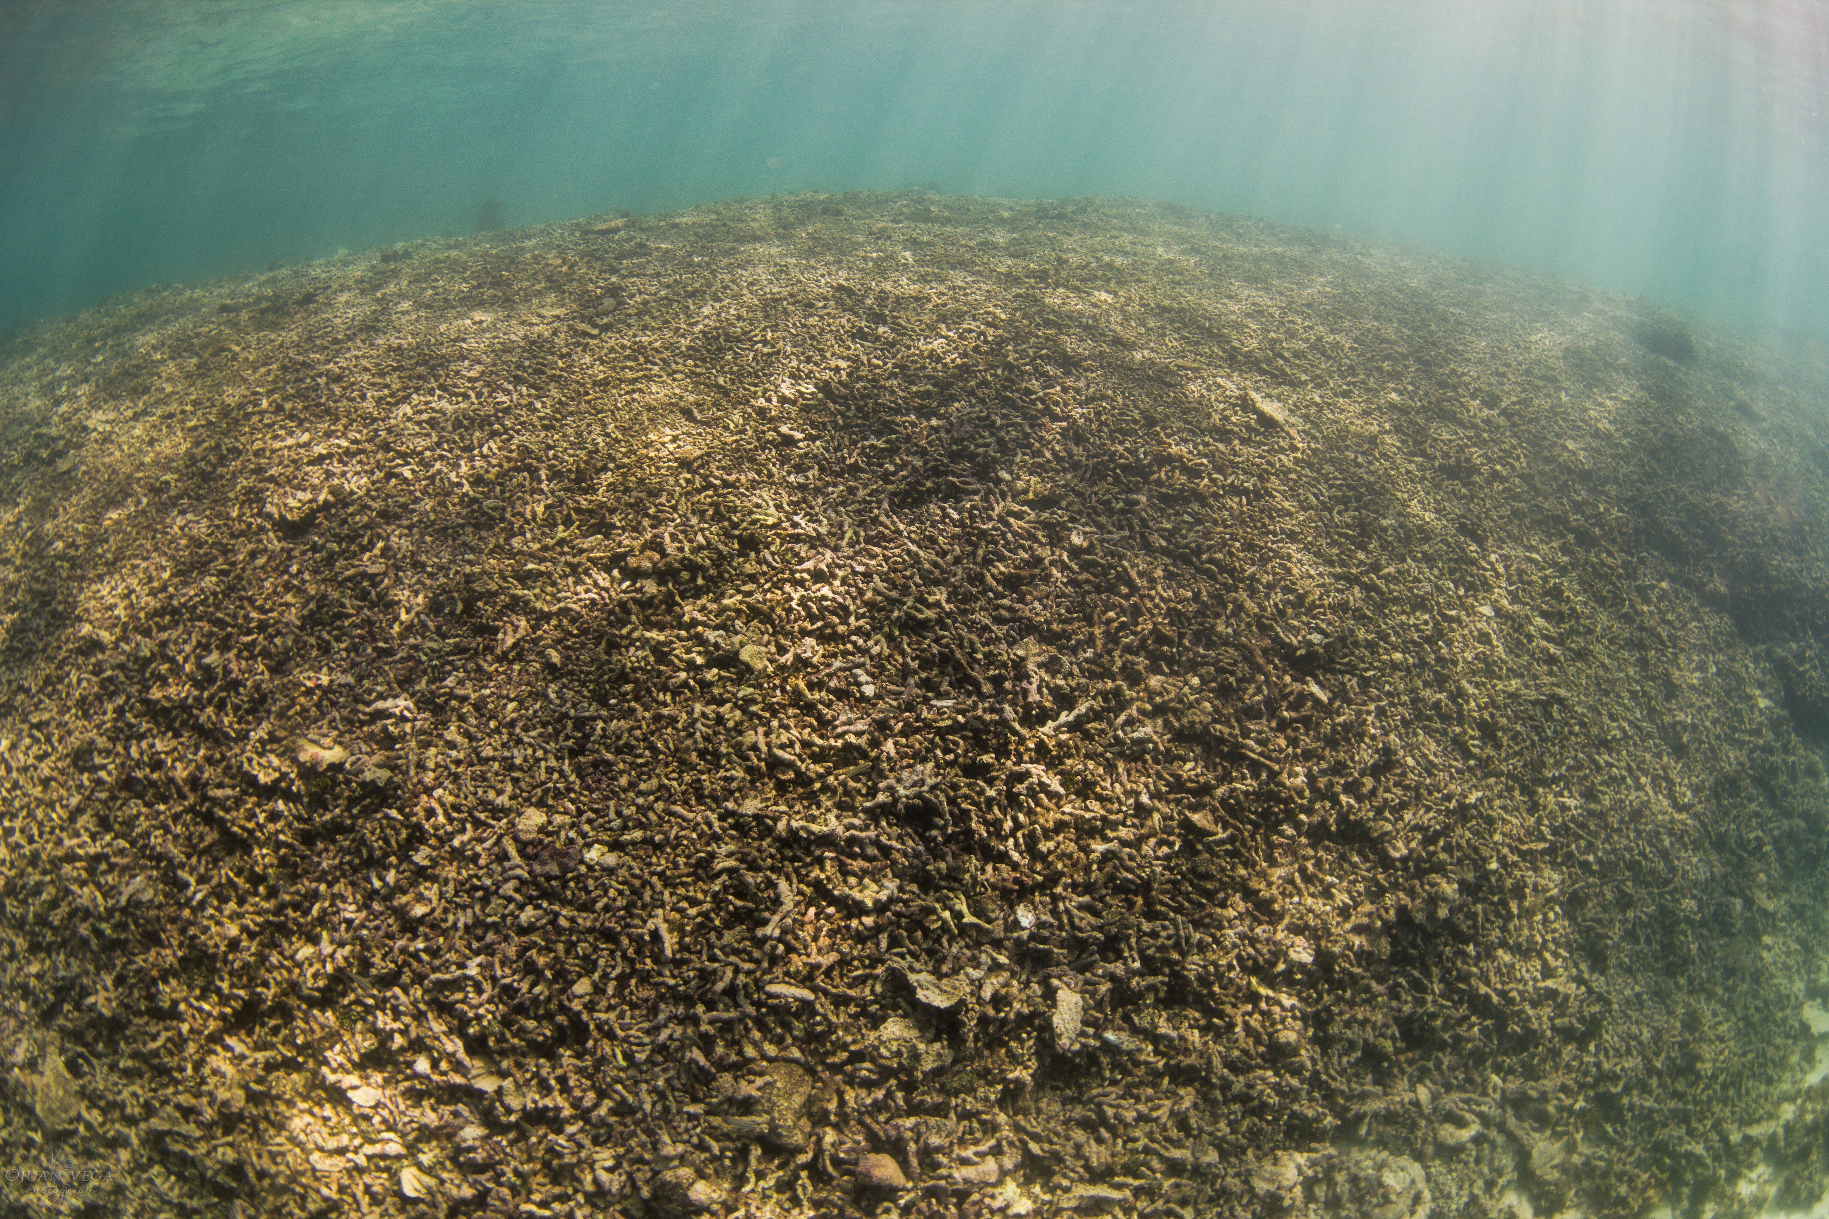
…
…A REALISTIC SCENARIO
(“business as usual”)
Catalyzing implementation of the
10-year Strategic Action Programme
for the Caribbean and North Brazil Shelf LME’s

Slide 10

…but we can make
the difference
(if timely and adequate actions is taken)
…
Catalyzing implementation of the
10-year Strategic Action Programme
for the Caribbean and North Brazil Shelf LME’s

Slide 11
CLME+ “initiatives”
BACKGROUND
(what came before – what lays ahead)
Catalyzing implementation of the
10-year Strategic Action Programme
for the Caribbean and North Brazil Shelf LME’s

Slide 12
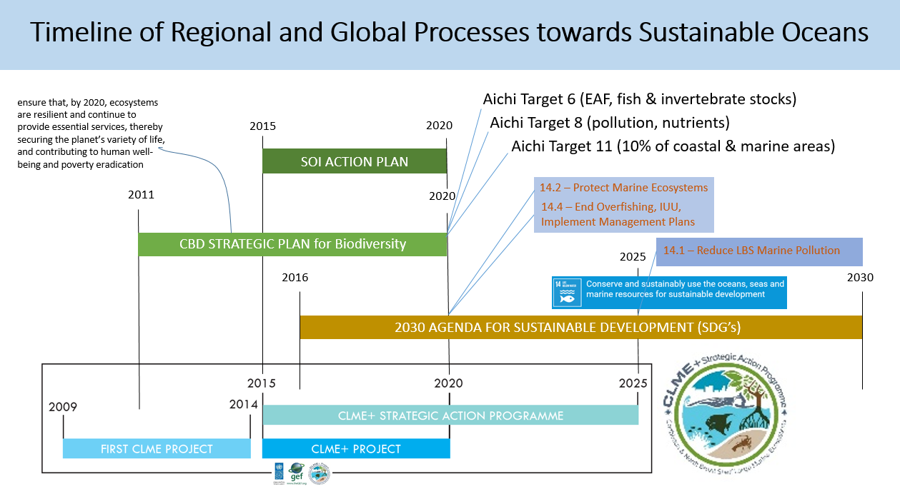

GEF FUNDING AS A CATALYST TO MEET
NATIONAL, REGIONAL AND GLOBAL TARGETS
2030 AGENDA FOR SUSTAINABLE DEVELOPMENT (SDG’s)
GEF4
GEF5
GEF7!!!
(GEF6)
Catalyzing implementation of the
10-year Strategic Action Programme
for the Caribbean and North Brazil Shelf LME’s

Slide 13
CLME+ SAP
ENHANCED & INTEGRATED
OCEAN GOVERNANCE
UN 2030 Sustainable Development Agenda
CBD Aichi Targets
Sendai Pathway (DRR)
Samoa Pathway (SIDS)
Catalyzing implementation of the
10-year Strategic Action Programme
for the Caribbean and North Brazil Shelf LME’s

Slide 14
KEY ISSUES
UNSUSTAINABLE FISHERIES
POLLUTION
HABITAT DEGRADATION
Climate change
Catalyzing implementation of the
10-year Strategic Action Programme
for the Caribbean and North Brazil Shelf LME’s

Slide 15
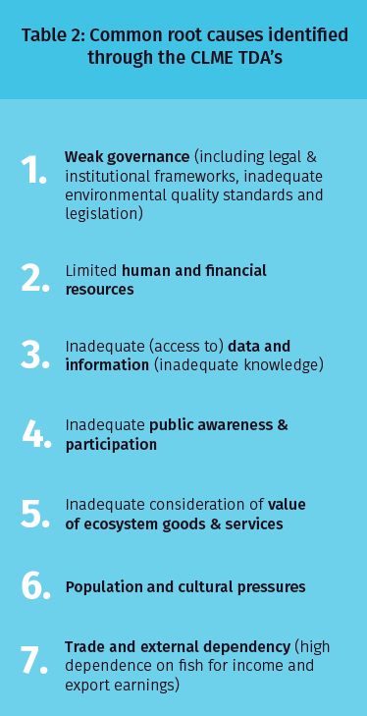
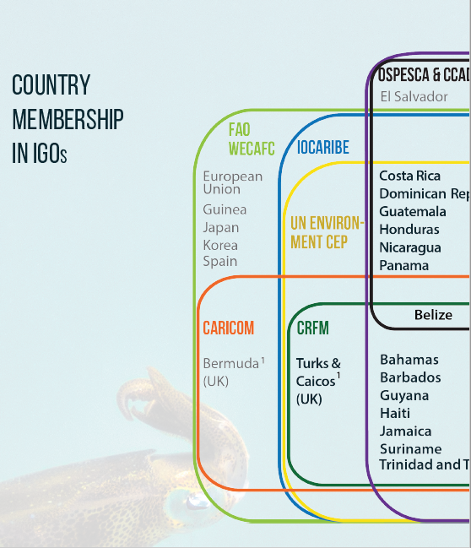
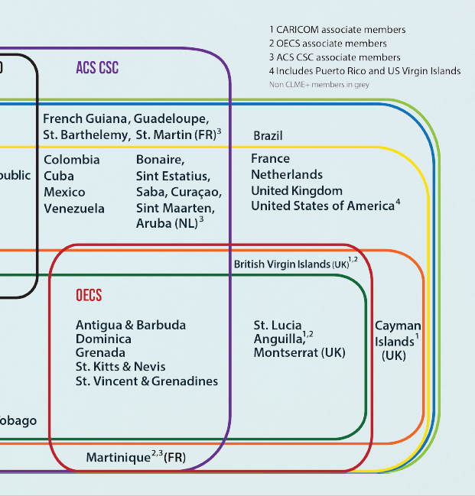
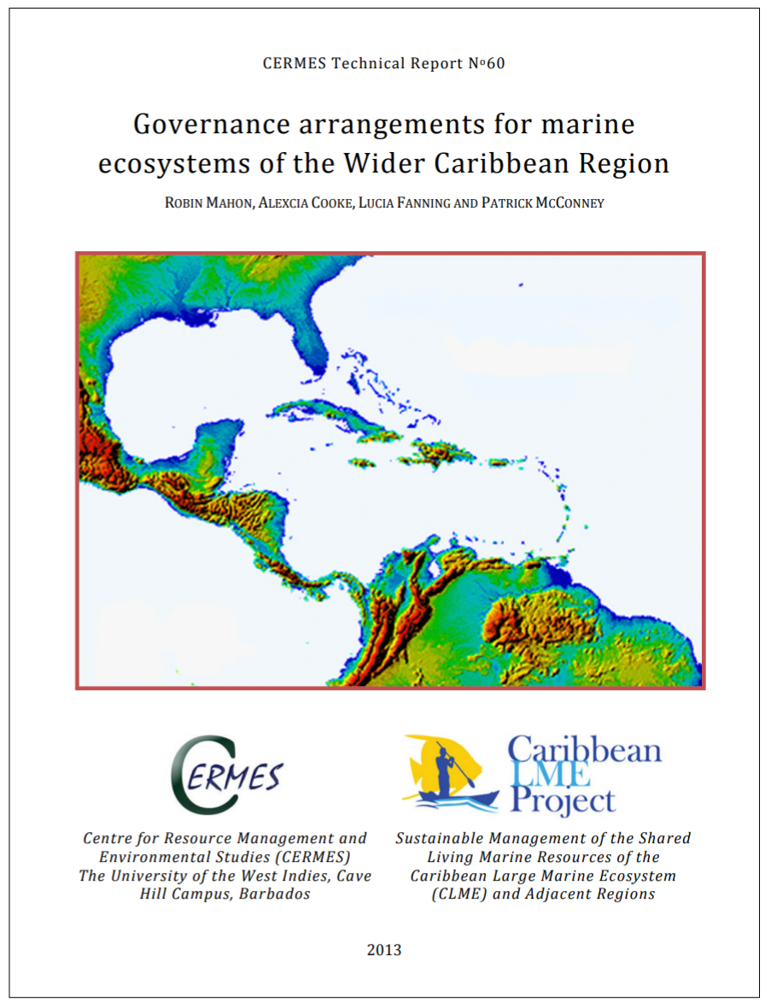
Catalyzing implementation of the
10-year Strategic Action Programme
for the Caribbean and North Brazil Shelf LME’s

Slide 16
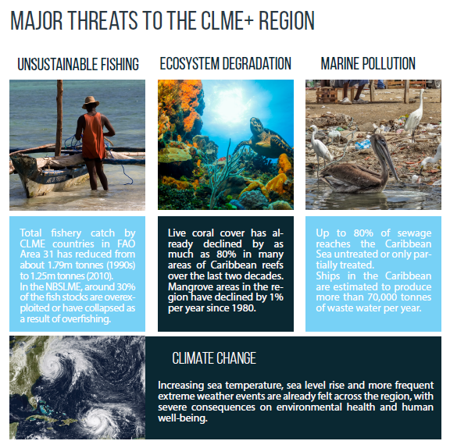
10-year CLME+
Strategic Action Programme for the Sustainable Management of Shared Living Marine Resources
(2015-2025)
signed (to date) by 35 Ministers,
representing 25 countries
and 6 Overseas Territories
MAIN ROOT CAUSE: WEAKNESSES IN OCEAN GOVERNANCE
Catalyzing implementation of the
10-year Strategic Action Programme
for the Caribbean and North Brazil Shelf LME’s

Slide 17
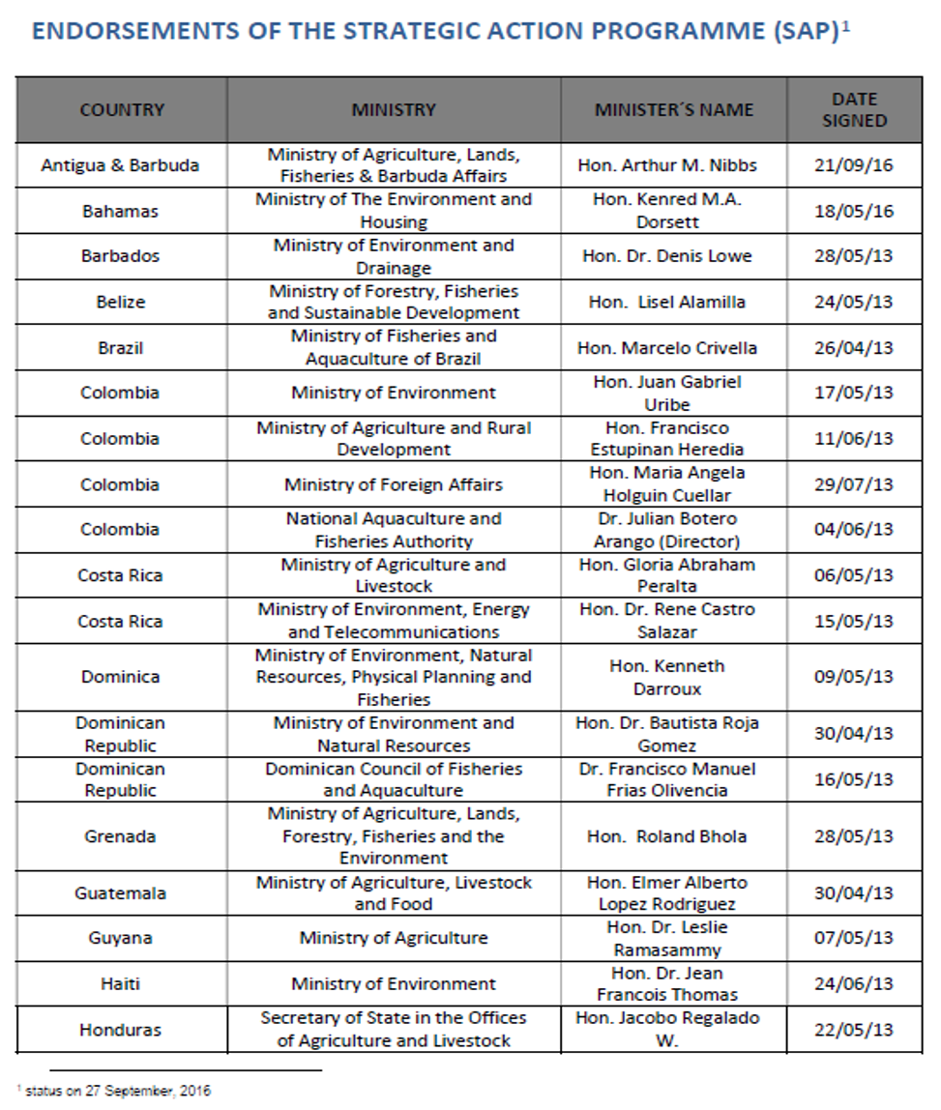
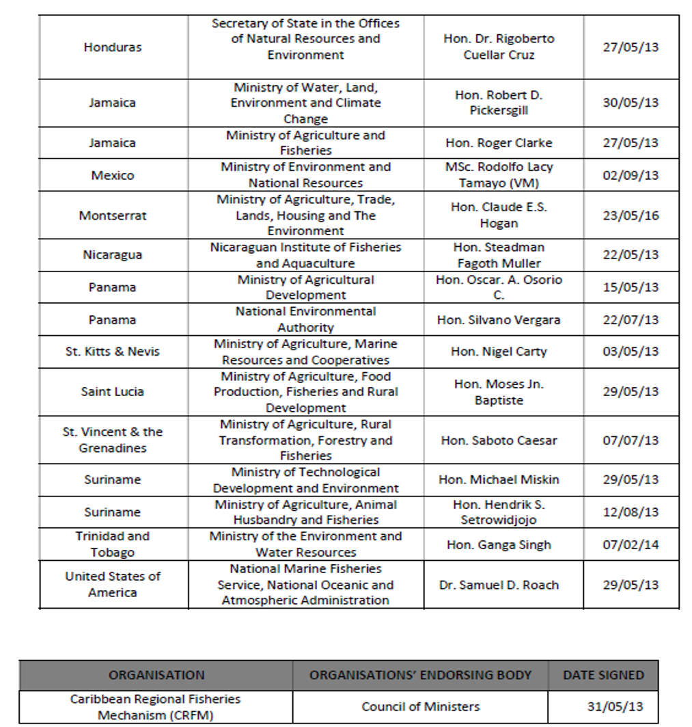
Status of CLME+ SAP endorsements: 35 Ministers, 26 countries + 8 OTs
+ France (2017)

Slide 18
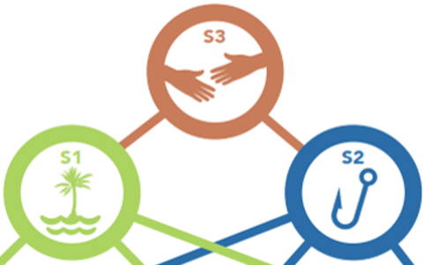
GEF-supported TDA/SAP Process for the CLME+ region:
FACILITATOR: UNDP GEF - mandate: Sustainable Development
UNDP involved in GEF IW Projects for 13 of the World’s LME’s
Strategy 3:
Policy Coordination Mechanism
Interim Body (during Project)
Permanent Body (decision by Project end)
Strategy 1:
Protection of the Marine Environment (EBM)
UN Environment
Cartagena Convention
+ native IGO’s
with sub-regional
mandate
Strategy 2:
Sustainable Fisheries (EAF)
FAO WECAFC
+ native RFB’s with
sub-regional mandate:
CRFM, OSPESCA
Support: IOCARIBE (IOC of UNESCO) (mandate: capacity building, ocean science,…)
Catalyzing implementation of the
10-year Strategic Action Programme
for the Caribbean and North Brazil Shelf LME’s

Slide 19

The CLME+ SAP = an umbrella programme
Comprehensive road-map towards sustainable living marine resources management
“UMBRELLA” SAP
The CLME+ STRATEGIC ACTION PROGRAMME
( CLME+ SAP * 2015 – 2025)
REQUIRES CO-OPERATION & COORDINATION → GLOBAL CLME+ PARTNERSHIP/ALLIANCE
Existing Projects,
Initiatives
New Projects,
Initiatives
Catalyzing implementation of the
10-year Strategic Action Programme
for the Caribbean and North Brazil Shelf LME’s

Slide 20
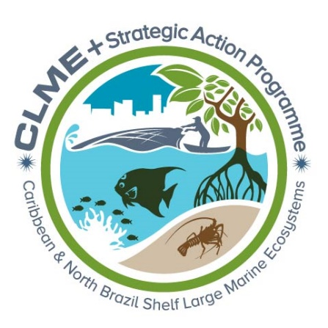
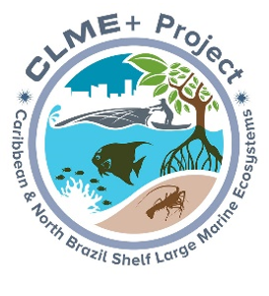
2015-2020
UNDP/GEF Project
Multiple Co-Executing Partners
Catalyzes SAP implementation
GEF grant: USD 12,5 millon
2015-2025
Endorsed by 35 Ministers
representing
25 Countries and 8 Territories
Catalyzing implementation of the
10-year Strategic Action Programme
for the Caribbean and North Brazil Shelf LME’s

Slide 21
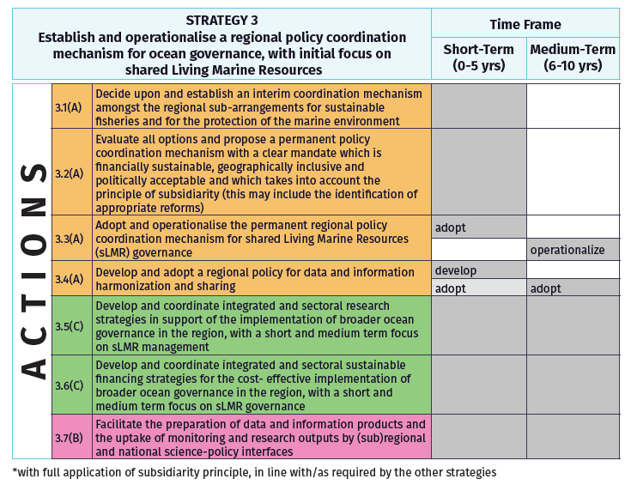
Catalyzing implementation of the
10-year Strategic Action Programme
for the Caribbean and North Brazil Shelf LME’s

Slide 22
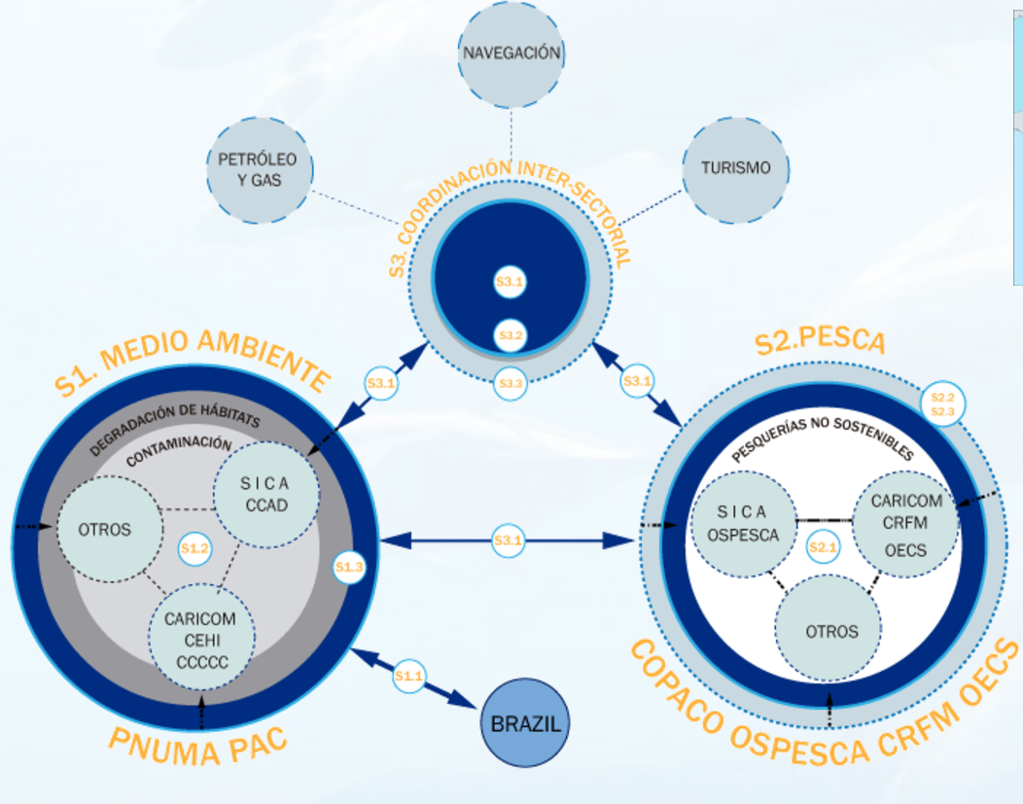
Catalizando la implementación
del Programa de Acciones Estrategicas a 10 años (2015-2025)
para los Grandes Ecosistemas Marinos del Caribe y Plataforma Continental del Norte de Brasil

Slide 23
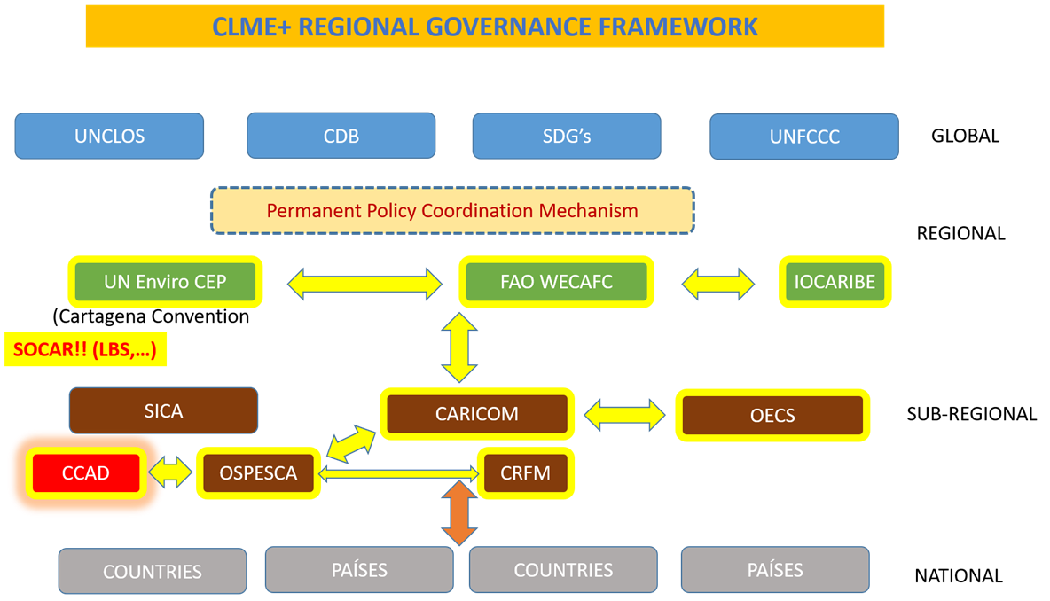
Consolidating the multi-level Regional Framework
for Ocean Governance (incl. Sustainable Financing)
CLME+ PROJECT CONSULTANCY
Institutionalizing
SOMEE
Assign responsibilities
Formalize mandates
Develop Sustainable Financing Mechanisms
Consolidate online platforms

Slide 24
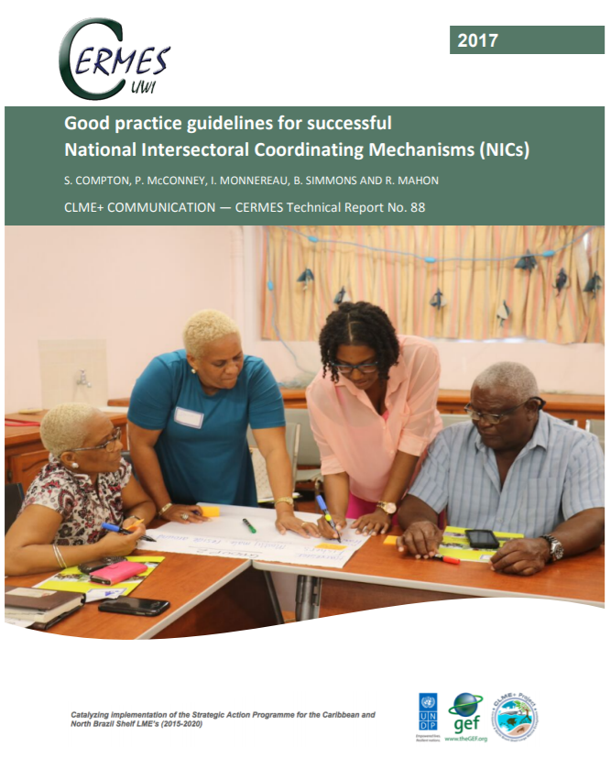
Catalyzing implementation of the
10-year Strategic Action Programme
for the Caribbean and North Brazil Shelf LME’s

Slide 25

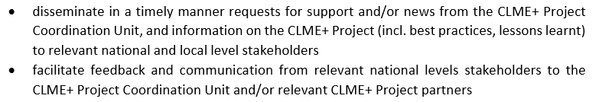
RESPONSIBILITIES OF THE
CLME+ PROJECT NATIONAL FOCAL POINTS
…
Catalyzing implementation of the
10-year Strategic Action Programme
for the Caribbean and North Brazil Shelf LME’s

Slide 26
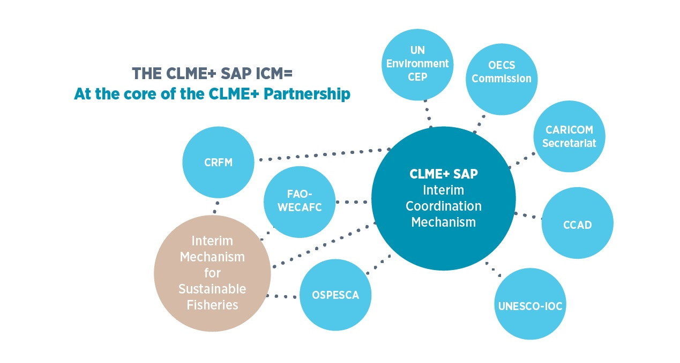
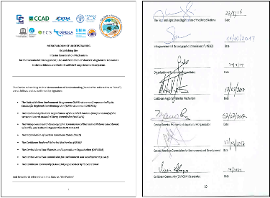

CLME+ SAP INTERIM COORDINATION MECHANISM (ICM)
Enhance regional coordination and collaboration, support oversight and integration of actions for sustainable fisheries and the protection and sustainable use of the marine environment
Promote up-scaling of actions towards the CLME+ SAP by establishing and overseeing a global “CLME+ Partnership”
SUB-REGIONAL GEOPOLITICAL INTEGRATION MECHANISMS
REGIONAL SEAS
REGIONAL FISHERIES BODIES
Catalyzing implementation of the
10-year Strategic Action Programme
for the Caribbean and North Brazil Shelf LME’s

Slide 27
Responsibilities of the CLME+ SAP ICM
Contribute to consolidation of REGIONAL FRAMEWORK for OCEAN GOVERNANCE by supporting the process for the identification and adoption of a Permanent Policy Coordination Mechanism and Sustainable Financing Plan
Collaborative development and institutionalization of the “STATE OF THE MARINE ENVIRONMENT AND ASSOCIATED ECONOMIES” (SOMEE) reporting mechanism
Progressive promotion and expansion of the global CLME+ PARTNERSHIP
Support the region in the delivery of SDG 14 and other relevant international commitments
Promote coherent communication, data and information sharing, outreach and dissemination of information
Catalyzing implementation of the
10-year Strategic Action Programme
for the Caribbean and North Brazil Shelf LME’s

Slide 28
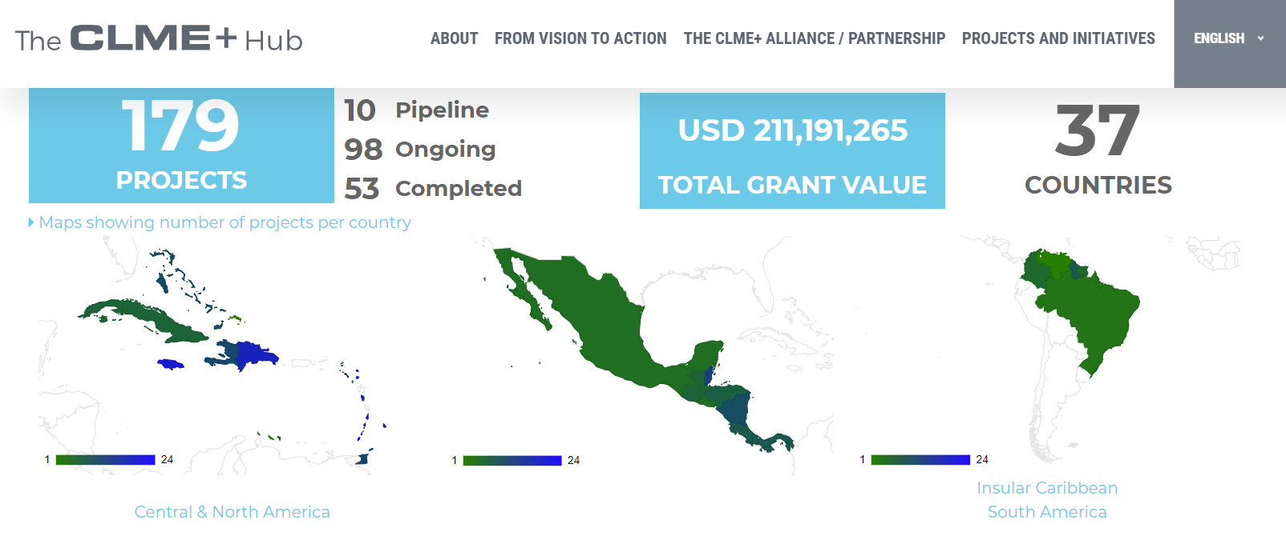
Catalyzing implementation of the
10-year Strategic Action Programme
for the Caribbean and North Brazil Shelf LME’s

Slide 29

Partnerships in Environmental Management
of the Seas of East Asia
A partnership of public, civil society, corporate and other stakeholders.
25 YEARS of Experience

Slide 30
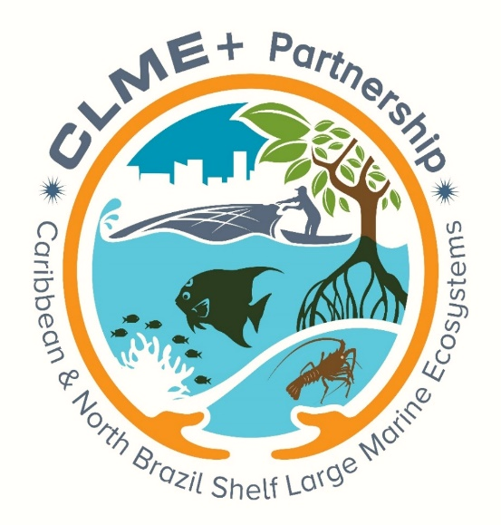
The Global Partnership
for the
Protection, Sustainable Management and Use of the
Caribbean and North Brazil Shelf LME’s
An incipient coalition expecting to bring together Governments,
Inter-Governmental Organizations, non-Governmental Organizations, Private Sector,
Multi-lateral Banks and Development Organizations,
…

Slide 31
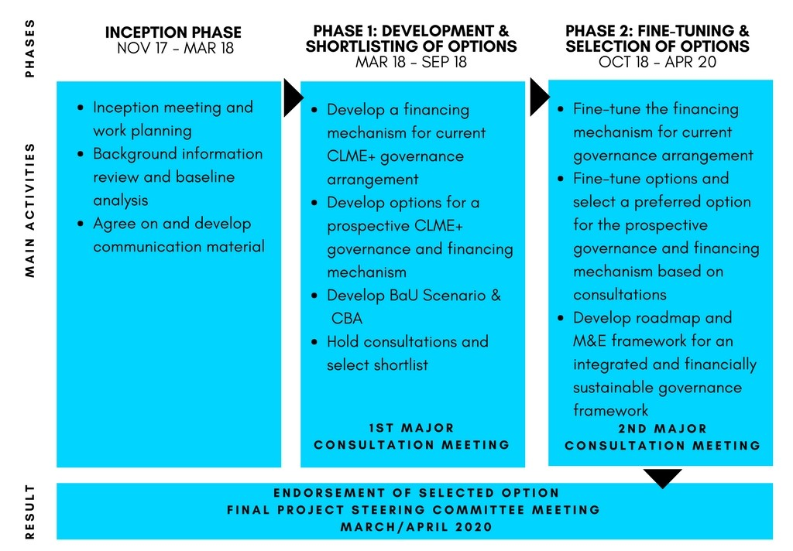
METHODOLOGICAL APPROACH & STATUS
FROM INTERIM TO PERMANENT – PPCM & RGF-SFP
Approach: Three consecutive phases
November 2017-March 2020
Will build on the experiences of existing co-ordination bodies and on the extensive existing baseline in the region on governance of fisheries and the marine environment
Inception phase: Completed 18th March
Phase 1: In progress
Options Paper

Slide 32
institutionalizing a
STATE OF
THE MARINE ENVIRONMENT
and associated ECONOMIES
(SOMEE)
in the Wider Caribbean/CLME+ region
collaborative reporting mechanism
…TOWARDS A SUSTAINABLE BLUE ECONOMY
through integrated regional ocean governance
Catalyzing implementation of the
10-year Strategic Action Programme
for the Caribbean and North Brazil Shelf LME’s

Slide 33
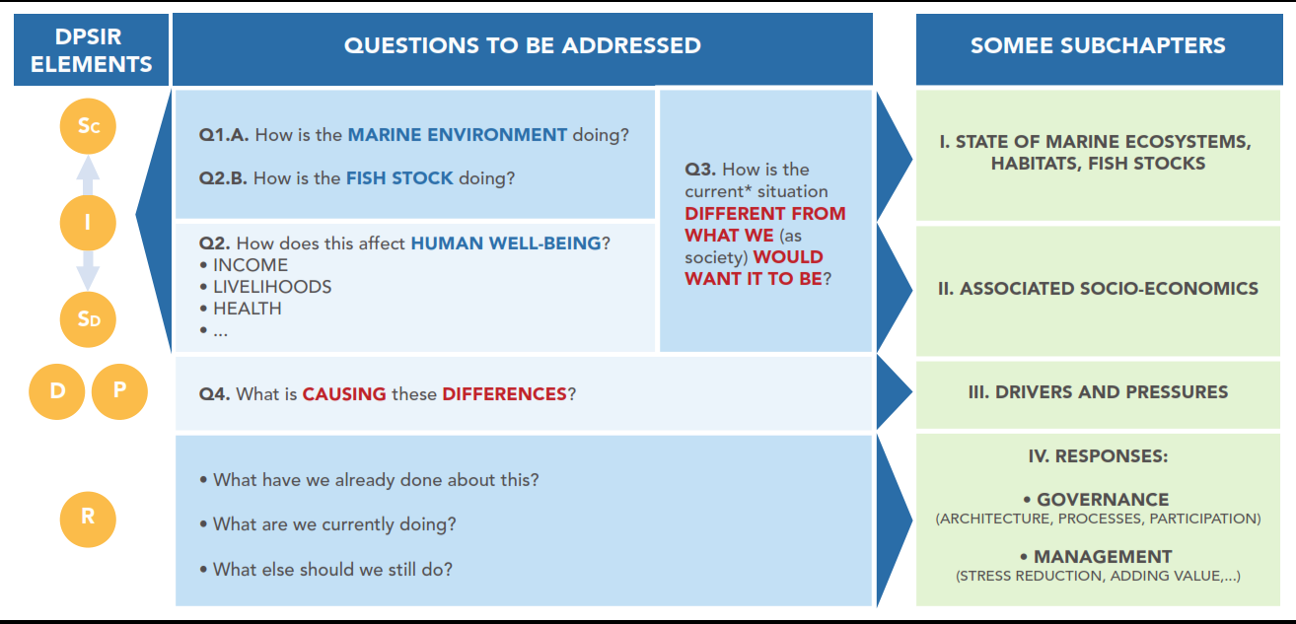
RGF/ PPCM/SOMEE/SFP:
Institutionalizing and giving continuity to TDA-SAP approach
Catalyzing implementation of the
10-year Strategic Action Programme
for the Caribbean and North Brazil Shelf LME’s

Slide 34
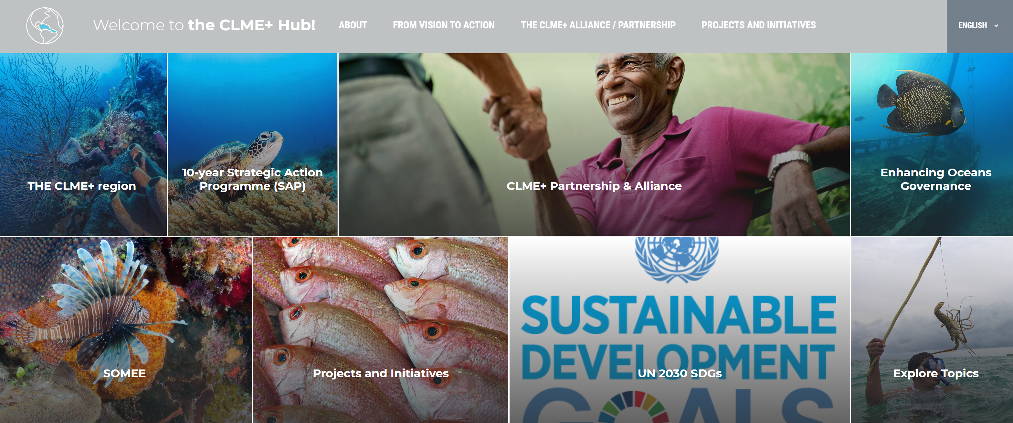
THE CLME+ HUB: A SHARED PLATFORM FOR ORGANIZATIONS COLLABORATIVELY WORKING ON OCEAN GOVERNANCE
IN THE WIDER CARIBBEAN/CLME+ REGION
Catalyzing implementation of the
10-year Strategic Action Programme
for the Caribbean and North Brazil Shelf LME’s

Slide 35
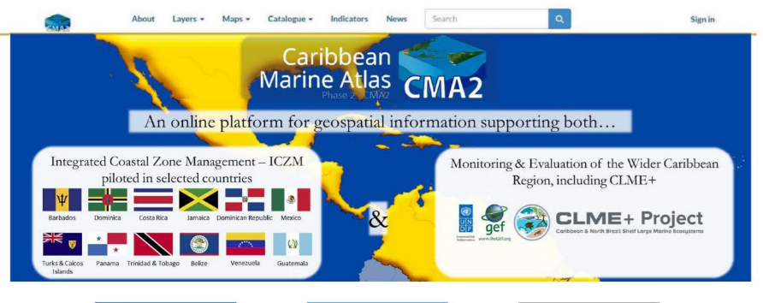
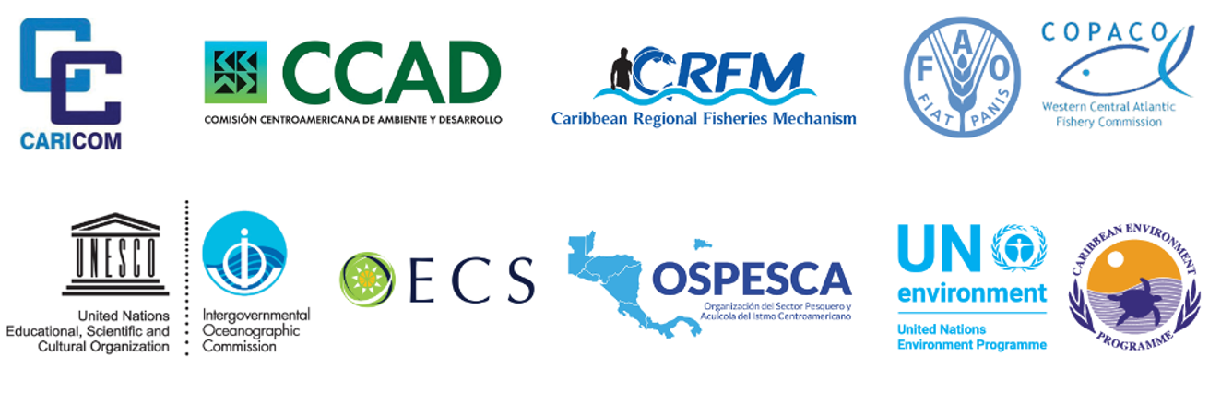

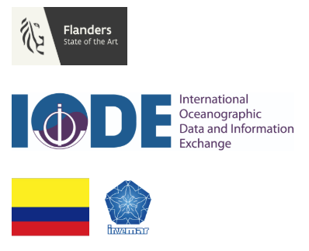

Links with the Caribbean Marine Atlas – Phase 2
Assessment of the State of the Marine Environment and associated Economies
in the Wider Caribbean/CLME+ region
*DEMO*
http://www.caribbeanmarineatlas.net/
Catalyzing implementation of the
10-year Strategic Action Programme
for the Caribbean and North Brazil Shelf LME’s

Slide 36

1st Regional CLME+ Consultation: Strenghtening Ocean Governace
Cartagena, 25-26 September 2018
THANK YOU
Patrick Debels
Regional Coordinator, CLME+ PCU
CLME+ SAP ICM Secretariat
PatrickD@unops.org
Catalyzing implementation of the 10-year Strategic Action Programme for the Caribbean and North Brazil Shelf LME’s (2015-2025)

