Slide 1

Mid-Term Project Steering Committee Meeting, 18-20 June 2018, Panama
Agenda Item 11
SAP Monitoring & Evaluation
Sub-Item 1: Monitoring progress with SAP Actions implementation
Catalyzing implementation of the Strategic Action Programme for the Caribbean and North Brazil Shelf LME’s (2015-2020)

Slide 2

CLME+ SAP M&E
SAP calls for a SAP Monitoring & Evaluation Framework
M&E Framework to be composed of:
Monitoring of SAP implementation this presentation
At the level of the individual SAP Actions
Evaluation of SAP performance next presentation
(GEAF Framework)
Overall
At level of the individual SAP (Sub)Strategies
→ CLME+ Project: Output 5.2: SAP implementation M&E mechanism

Slide 3
Governance Effectiveness Assessment Framework
Agenda Item 11.2
GEAF
Agenda Item 11.1
Agenda Item 11.3
SAP M&E
SOMEE
State of the Marine Environment
& associated Economies
10-year Strategic Action Programme

Slide 4
The UNDP/GEF supported process of
Transboundary Diagnostic Analysis (TDA) and
Strategic Action Programme (SAP) development
is cyclical
Ensure continuity of TDA/SAP approach beyond the CLME+ Project lifespan
Institutionalization of the integrated “SOMEE” reporting mechanism
Through Intergovernmental Organizations with a mandate on the protection of shared living marine resources
“REGIONAL GOVERNANCE FRAMEWORK”

Slide 5
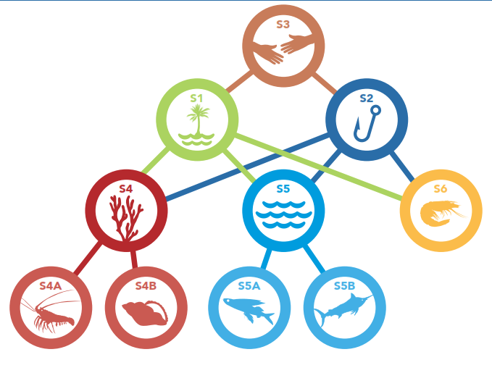
CLME+ SAP: 76 Actions structured under 6 Strategies and 4 Sub-Strategies
Regional Policy Coordination Mechanism
region-wide
Protection of the marine environment
Sustainable fisheries
sub-ecosystem
level
Reef Sub-ecosystem
Continental Shelf Sub-ecosystem
Pelagic Sub-ecosystem
species level
(fisheries)
Spiny Lobster fisheries
Queen Conch fisheries
Flyingfish fisheries
Large pelagic fisheries

Slide 6
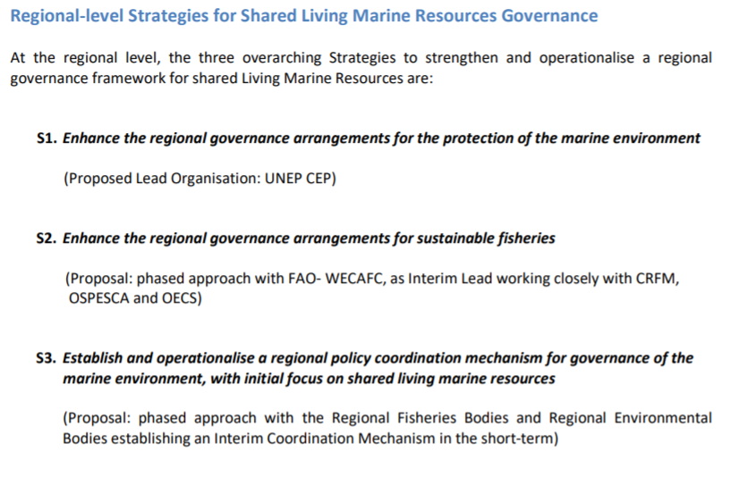
FROM THE POLITICALLY ENDORSED SAP DOCUMENT:

Slide 7
Multi-level, nested Regional Governance Framework for the CLME+ region
DOALOS
CBD
SDG
UNFCCC
GLOBAL
CLME+ Permanent Policy Coordination Mechanism
REGIONAL
UNEP CEP
FAO WECAFC
IOCaribe
ACS/CSC
(Cartagena Convention)
SICA
CARICOM
OECS
SUB-REGIONAL
CCAD
OSPESCA
CRFM
COUNTRIES
COUNTRIES
COUNTRIES
COUNTRIES
OTs
NATIONAL

Slide 8
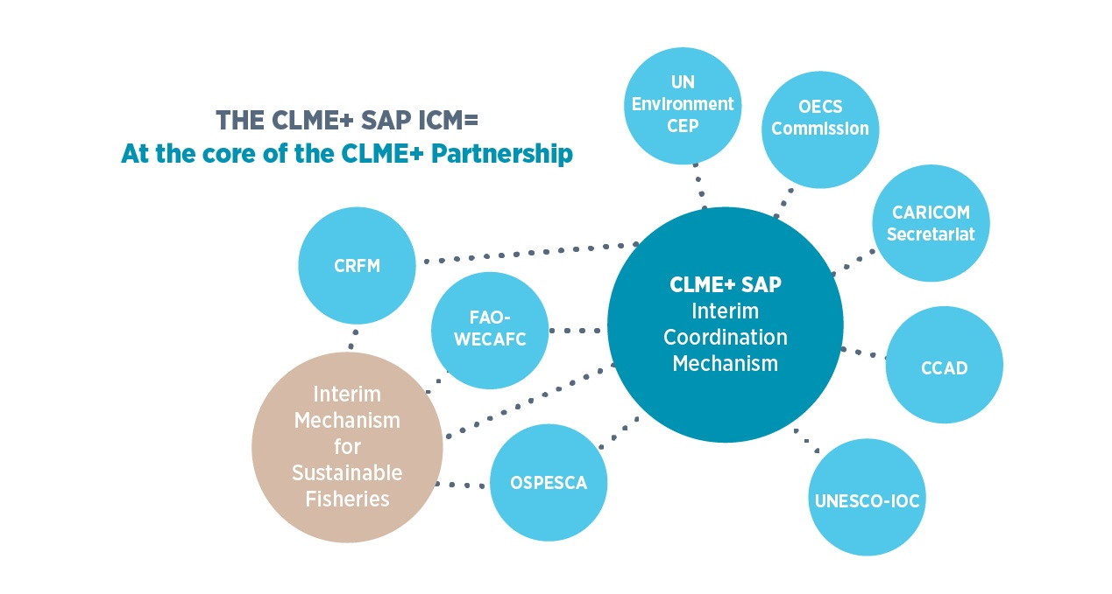
CLME+ SAP INTERIM COORDINATION MECHANISM (ICM)
MILESTONE OF HAVING 5 (OUT OF THE 8) PARTIES SIGNING THE “CLME+ SAP ICM” BY JULY 2017 FORMALLY ESTABLISHED THE COORDINATION MECHANISM
(ALL 8 SIGNED BY DECEMBER 2018)

Slide 9
CLME+ REGIONAL GOVERNANCE FRAMEWORK, CLME+ SAP INTERIM COORDINATION MECHANISM, AND THE SAP M&E FRAMEWORK
The CLME+ SAP ICM MOU specifies as one of the core functions of the ICM:
“to coordinate, cooperate, and, where feasible and appropriate, take action to implement, monitor and evaluate, in a cost-effective and synergistic manner, the CLME+ SAP”

Slide 10
CONCEPTUAL APPROACH TO THE MONITORING OF SAP ACTIONS
Identification/Definition of the Indicators
Development of Methodological Sheets
Identification of:
Baseline
Current value(s)
Target value(s) (where possible/desirable)

Slide 11
SAP ACTION MONITORING – CONCEPTUAL APPROACH
a number of considerations…
Can/should the action be monitored and evaluated with one single indicator?
Should the indicator(s) be quantitative? Or qualitative?
(number, percentage, binary (1/0; YES/NO, categories, descriptive)
4. What level of objectivity/subjectivity will be associated with the indicator?
5. Are targets clear?
(specified in the SAP? Related regional/global commitments?)

Slide 12
Draft EXAMPLES
Action | Action description | F/P | OA/P | TYPE | SUBTYPE | Description, comments | Level of objectivity | Indicator
3.1 | Decide upon and establish an interim coordination mechanism amongst the regional sub-arrangements for sustainable fisheries and for the protection of the marine environment | F | OA | Semi-numeric | Discrete integer (categories) | highly desirable | highly objective | Status of the ICM establishment (0=not initiated; 1=options proposed; 2=final option identified; 3=ICM established)
2.5 | Establish and/or enhance the capacity of the regional, sub-regional and national fisheries institutions to develop and implement harmonized management and conservation measures, with special focus on Illegal, Unreported and Unregulated Fishing (IUU) and Monitoring, Control & Surveillance (MCS) | P | OA | Quantitative | Discrete integer | desirable | highly objective | Number of countries which have endorsed an IUU NPoA
F = Full Coverage
P = Partial coverage
OA = Over-Arching (status of Action as a whole)
P = Partial (distinct aspects of the Action)

Slide 13
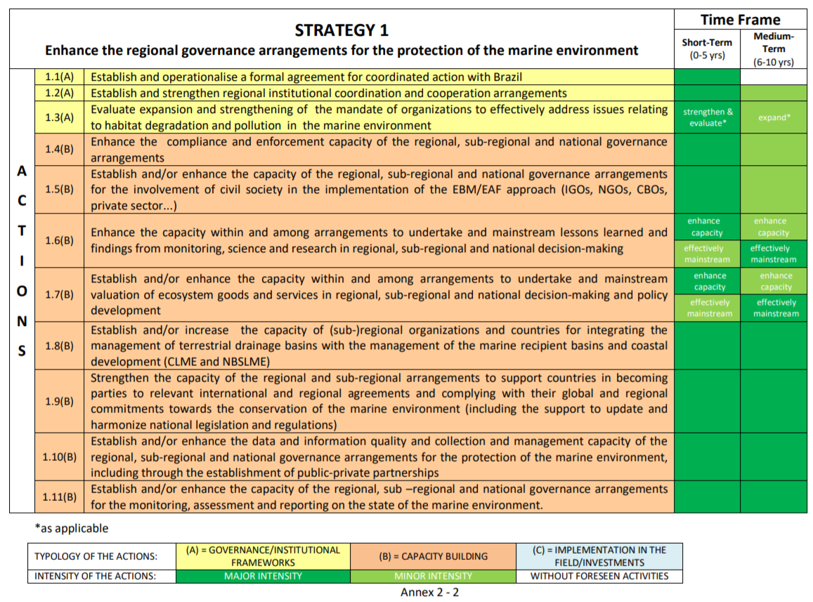
10-year CLME+ SAP: 2015-2025

Slide 14
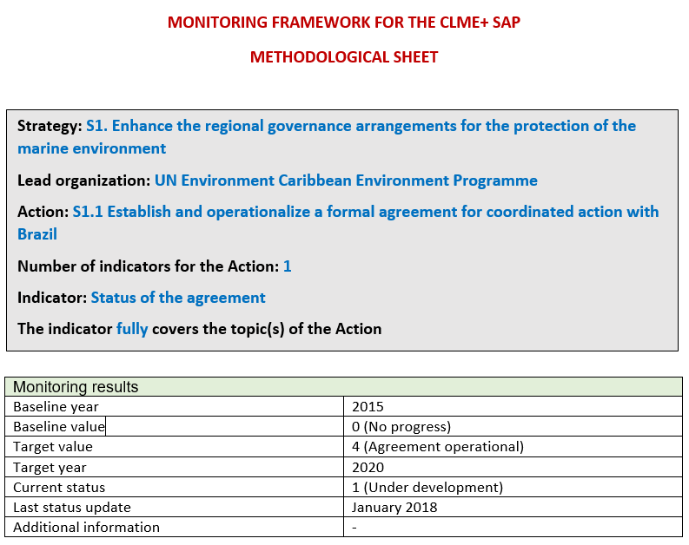
10-year CLME+ SAP: 2015-2025

Slide 15
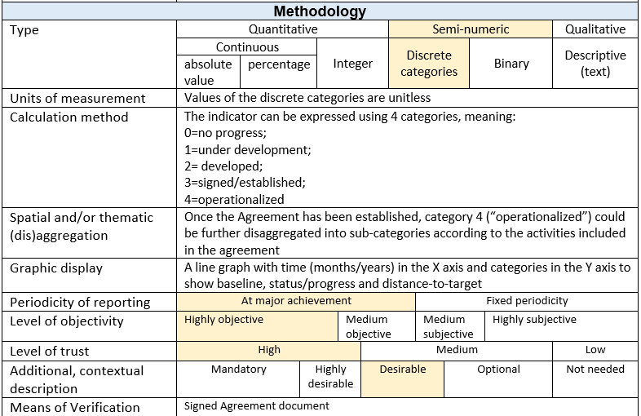
10-year CLME+ SAP: 2015-2025

Slide 16
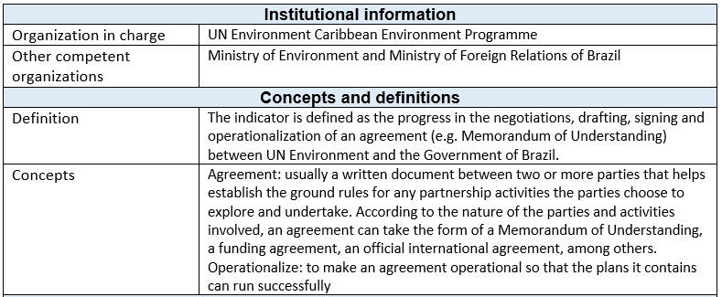
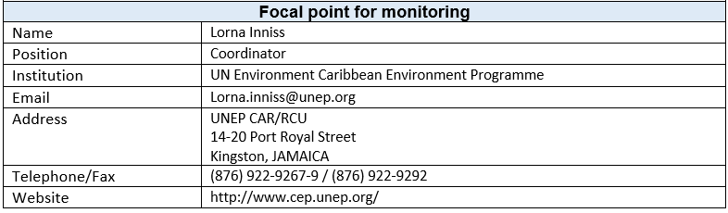
10-year CLME+ SAP: 2015-2025

Slide 17
DEVELOPMENT & ADOPTION PROCESS
FOR THE SAP M&E FRAMEWORK
pre-endorsement and adoption of Conceptual Approach by PEG and ICM
endorsement of Conceptual Approach by countries (CLME+ PSC)
PCU, PEG, ICM, JWG work on Monitoring Framework (indicators, sheets,…)
pre-endorsement by ICM of
Indicators
Sheets
Target Value
Baseline, current value
Final Endorsement of Indicators by ICM
Note: Targets not directly harvested from SAP or other international commitments may need to be submitted to countries for their approval (meetings of relevant IGO’s,…)
whenever posible, to be derived from SAP and/or other existing regional/global commitments

Slide 18
TIMELINE – PROGRESS TO DATE
2016 Recruitment of CLME+ Environmental Mapping & Reporting Specialist (EMRS)
July 2017 CLME+ SAP ICM established, mandate includes: support SAP M&E
2017 Conceptual approach developed
2017 Draft indicators (partial set) prepared by PCU discussed with PEG and ICM
2017 Development of methodological sheets
January 2018 SAP M&E Workshop, Cartagena, Colombia (PEG, ICM members,..)
Progress to date:
indicators for 34 SAP Actions at the January M&E workshop
baseline and target values for 29 Actions
Methodological Sheets for 11 SAP Actions
February 2018 Resignation of EMRS
June 2018 Recruitment of CLME+ Senior Environmental Reporting Specialist (SERS),
Mrs. Sherry Heileman
Recruitment of CLME+ Monitoring & Mapping Specialist (MMS),
Mr. John Knowles

Slide 19
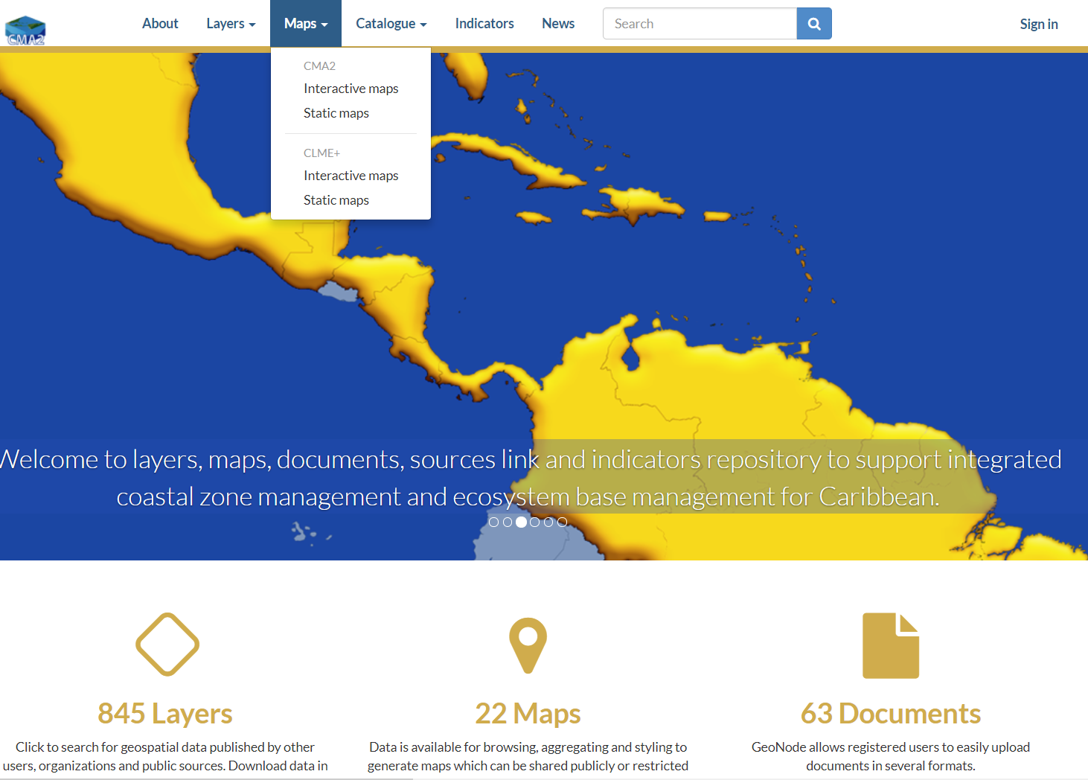

LINKAGES WITH CARIBBEAN MARINE ATLAS 2
http://www.caribbeanmarineatlas.net/

Slide 20
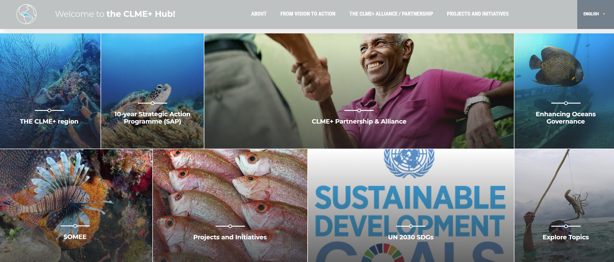
ONLINE VERSION OF THE SAP M&E FRAMEWORK ON THE CLME+ HUB
www.clmeplus.org
(under development!)

Slide 21

WELCOMING JOHN KNOWLES
CLME+ MONITORING & MAPPING SPECIALIST
(CLME+ MMS)
JohnK@unops.org

Slide 22
THANK YOU
Patrick Debels
CLME+ Regional Coordinator
PatrickD@unops.org
Catalyzing implementation of the Strategic Action Programme for the Caribbean and North Brazil Shelf LME’s (2015-2020)

