Slide 1

Second CLME+ Project Steering Committee Meeting
Development of a Permanent Policy Coordination Mechanism for Ocean Governance and Sustainable Financing Plan
in the CLME+ region
June 2018

Slide 2
BACKGROUND AND OBJECTIVES
The CLME+ Strategic Action Programme (endorsed by over 30 countries), calls for the establishment of a sustainable, region-wide Permanent Policy Coordination Mechanism (PPCM) for integrative ocean governance, with an initial focus on shared living marine resources
In November 2017, the UNDP/GEF CLME+ Project awarded a consultancy to the Centre of Partnership for Development (CAD), to develop and present proposals, for selection and adoption by the CLME+ Countries, for the following:
A PPCM, to also include specifications of the mandate of the mechanisms and of their constituents, and a Regional Governance Framework (RGF).
A Sustainable Financing Plan to support and optimise the operations of the different organisations and (inter-)organisational arrangements that make up the CLME+ governance arrangements including the PPCM
Notes:
Arose from the recognition that weaknesses and gaps in transboundary and cross sectoral ocean governance arrangements, and overall lack of coordination of efforts, are among the root causes of environmental degradation and living marine resources depletion in the CLME+ region

Slide 3
CONSULTANCY TEAM
Coordination: Centre of Partnerships for Development (Global CAD), Barcelona
Consultants: A multi-disciplinary team of experts with extensive experience in the CLME+ region and globally
Advisory Group: Centre for Resource Management and Environmental Studies (CERMES-UWI)
STAKEHOLDERS
(to be actively engaged)
CLME+ Countries, ICM members, and the CLME+ Project Coordinating Unit, among others
Engagement through various forms of consultations
Participation in regional meetings
Countries: organize consultations on the options with relevant government ministries and other stakeholders
ICM Members: use their appropriate forums to discuss the proposed options with their constituents

Slide 4
Definition of the Key ConceptS
The following terms are defined and used in the consultancy:
Ocean Governance
Blue Economy
Regional Governance Framework (RGF)
Permanent Policy Coordination Mechanism (PPCM)
Sustainable Financing Plan (SFP)
Notes:
Definition:
Ocean Governance: The principles, processes, rules and institutions that guide how we manage and use our oceans. Ocean governance spans public and private spheres, multiple levels (from the local to the global) and all relevant sectors.
Blue Economy: An economy that is based on ocean resources while ensuring a sustainable resource use and conservation. The Blue Economy is also referred to as a sustainable ocean-based economy.
RGF – Regional Governance Framework: The entire set of ocean governance issues, the organisations with responsibility for ocean governance, their policy processes and the interactions among them.
PPCM – Permanent Policy Coordination Mechanism: A regional mechanism through which various parties with a mandate for ocean governance cooperate to improve the synergy, efficiency and impact of their actions
SFP – Sustainable Financing Plan:
A plan that helps to determine the funding requirements of an organisation (in terms of amount and timing) and to identify income sources for the different needs (such as institutional costs and programme budgets)

Slide 5
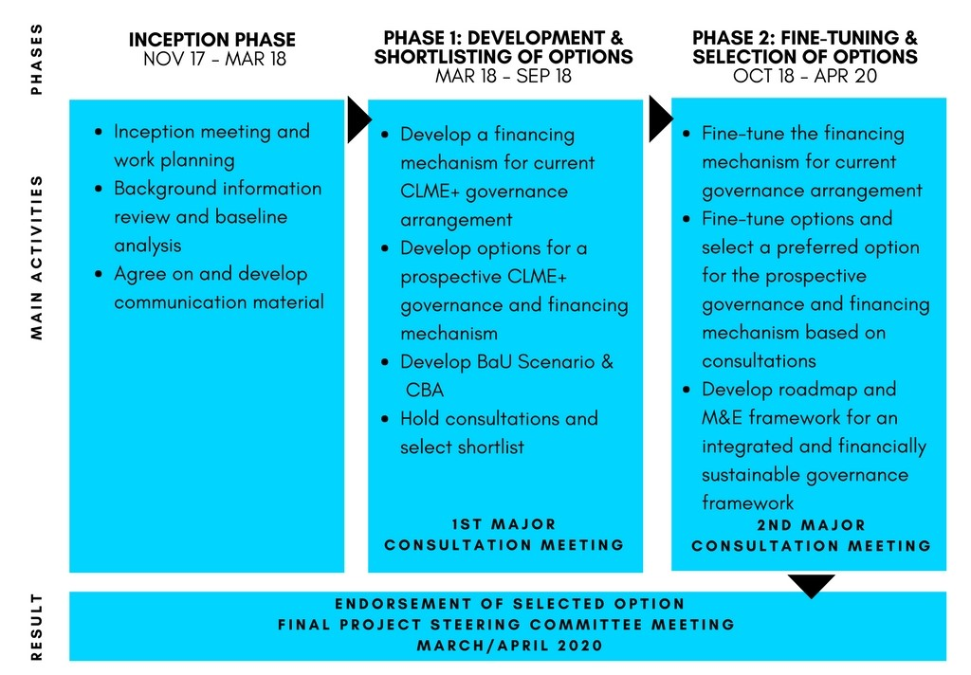
METHODOLOGICAL APPROACH & STATUS
Approach: Three consecutive phases
November 2017-March 2020
Will build on the experiences of existing co-ordination bodies and on the extensive existing baseline in the region on governance of fisheries and the marine environment
Inception phase: Completed 18th March
Phase 1: In progress
(Draft report submitted)

Slide 6
INCEPTION PHASE
Main activities:
Interviews with ICM representatives
Baseline analysis & description of the existing Regional Governance Framework
Strengths, Weaknesses, Opportunities, & Threats (SWOT) analysis of the technical/institutional and financing aspects of the ocean governance arrangement in the CLME+ region
Production & dissemination of communication material
Notes:
No comprehensive financing baseline had been established prior to this consultancy (in contrast to the institutional and policy aspects of the existing Regional Governance Framework)
The baseline is the first compilation of available information (as reported by the IGOs)
Information gaps will be filled during Phase 1, which will build on the results of the baseline assessment
SWOT analysis:
Highlighted key strengths that are expected to alleviate perceived weaknesses identified, and on which this project will build
Assisted in refining the consultancy’s approach in recognising the maturity of the concepts and activities towards a RGF and thereby allocating additional resources to identifying and quantifying potential sustainable financing mechanisms
These assessments will be further developed & elaborated during Phase 1
*These activities were carried out with participation of the Project Coordination Unit and the eight IGOs that make up the Interim Coordination Mechanism for the CLME+ Strategic Action Programme)

Slide 7
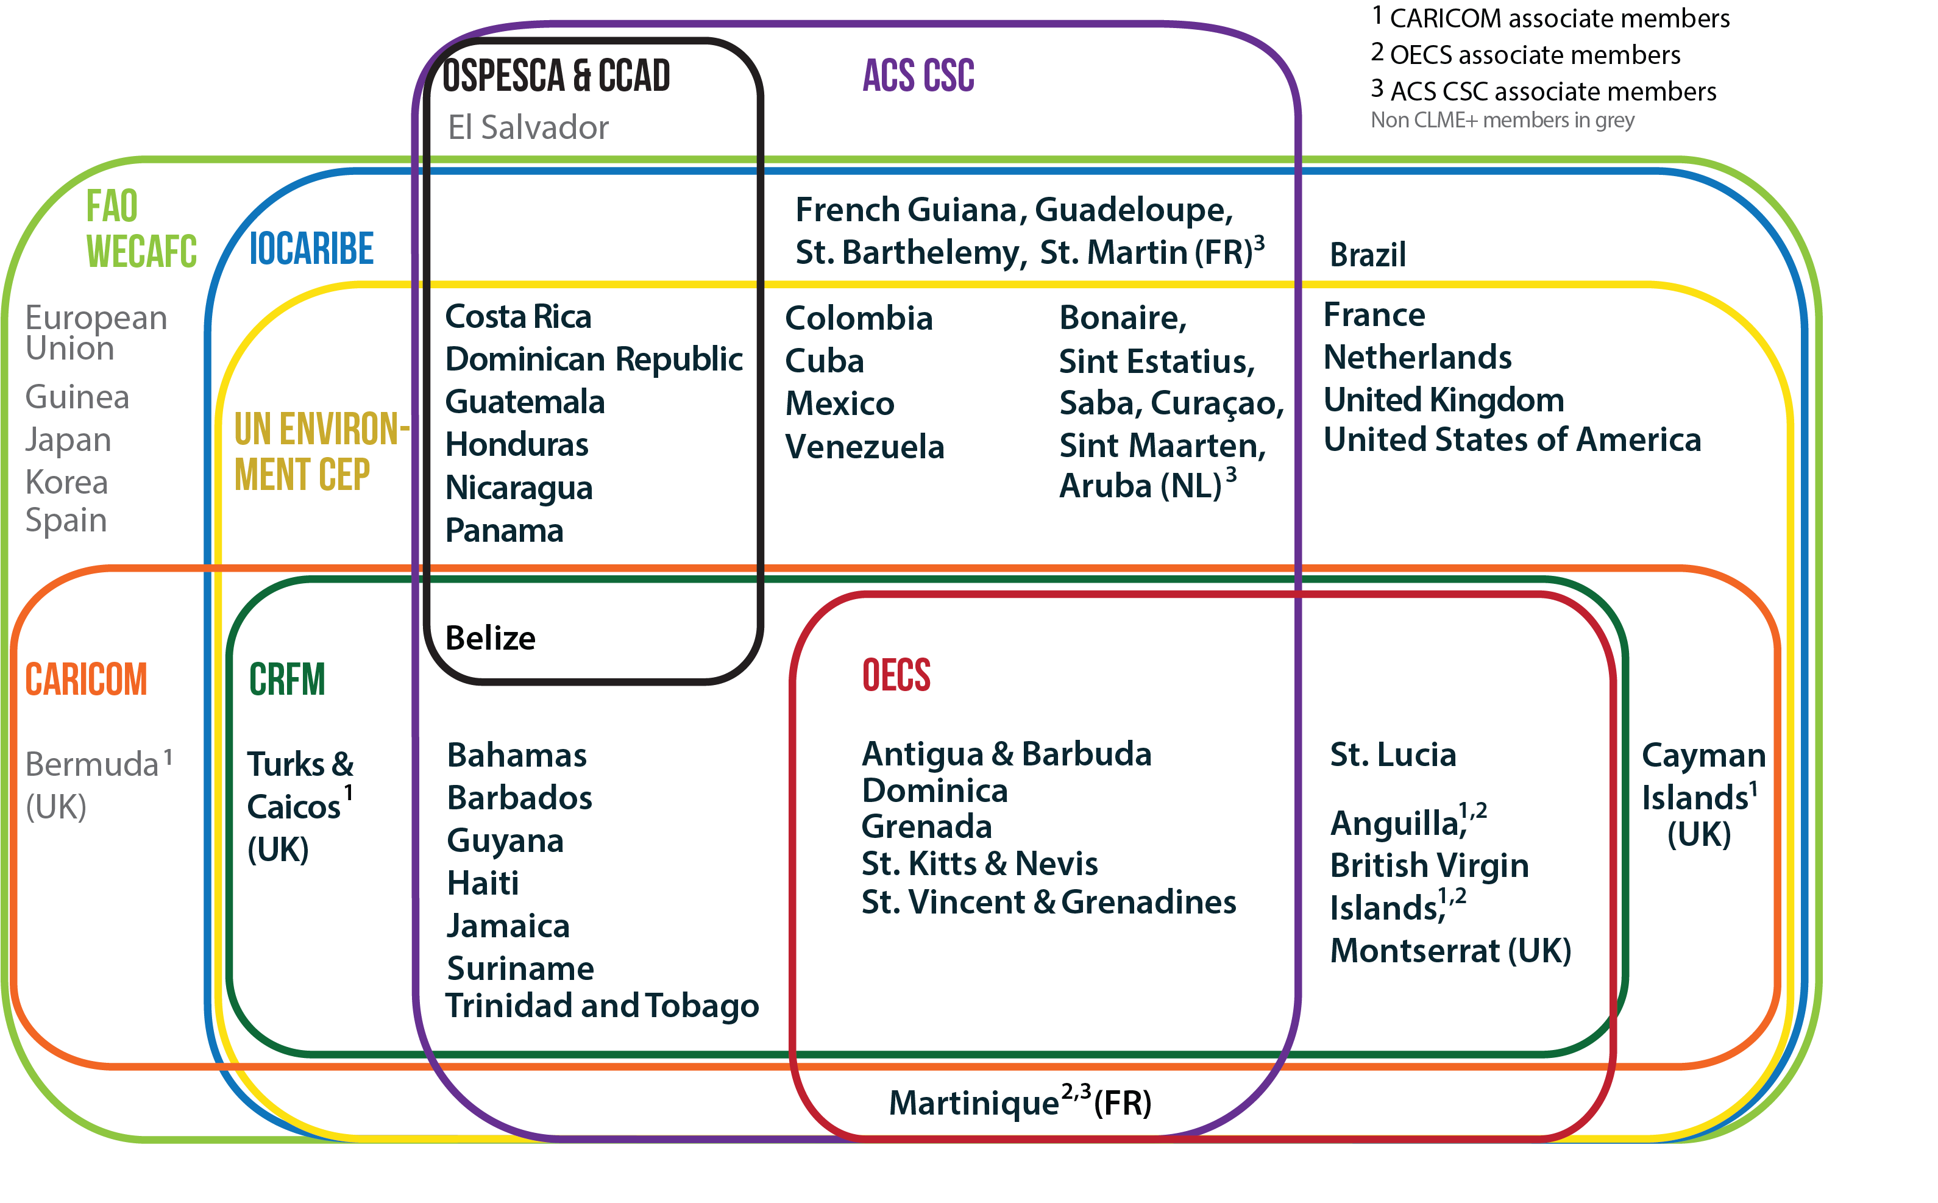
MEMBERSHIP OF THE CLME+ INTERIM COORDINATION MECHANISM

Slide 8
PHASE 1
Main activities:
Interviews with ICM representatives, and preliminary discussions with ACS/CSC
Business as Usual Analysis
Including review of other LME governance approaches
Proposal development and pre-screening of:
- 4 generic options for a PPCM (including cost estimation)
with associated Sustainable Financing Plans (SFP)
- 2 options for a SFP for the RGF
Production & dissemination of communication material
Notes:
These activities were carried out with participation of the Project Coordination Unit and the eight IGOs that make up the Interim Coordination Mechanism for the CLME+ Strategic Action Programme)
BaU analysis, looks at scenario between 2015 – 2050

Slide 9
Proposal of the PPCM Options
The interviews with IGOs indicated strong support for a PPCM with an emphasis on:
Low-cost but delivering real benefits
Not require the creation of a new organization
Be based on the current ICM and MoU
Provide sustainability to the ICM beyond the CLME+ project, replacing/replicating the functions of the CLME+ PCU of the current ICM.
Consider the potential inclusion of additional IGOs to be party to the PPCM where appropriate
Further build trust in terms of relationships between IGOs, their responsibilities, jointly attracting external resources, etc.
Begin with non-binding arrangement with the possibility to evolve to be part of an existing Convention/Commission
Identify criteria to assist IGOs and countries to select options and decide location of a PPCM secretariat
Include the principles and possibilities for a PPCM financing mechanism

Slide 10
Proposal of the PPCM Options
Option 1: The ‘Base Model’ – continuing with the existing MoU/ICM arrangement with a simple secretariat to replicate functions currently provide by the CLME+ PCU
Option 2: The ‘Enhanced Base Model’ - Providing the PPCM/secretariat with enhanced capabilities in addition to those envisaged with the ‘Base Model’
Option 3: ‘PPCM within an existing IGO model’
Option 4: The ‘WCR Commission model’
In the report, options are presented with:
Advantages/disadvantages
Staffing level
Brief summary of potential mandate/functions to be performed
Preliminary cost-estimates for each option

Slide 11
PPCM Options
Each option contains of:
a Permanent Coordination Body (PCB) that performs a ‘secretariat’
function
a Steering Committee (SC) that represents all CLME+ countries through the
8 IGO members of the ICM, or directly by member states delegates,
depending on the option.

Slide 12
Benefits of establishing the PPCM
For the preliminary Cost-Benefit Analysis, the benefits categories are:
Quality of decision making (“taking the right decisions”)
Effectiveness of implementation toward achieving SAP and SDG objectives (“increasing volume of implemented actions”)
Awareness building potential (“changing minds”)
The benefits of the PPCM are expected to materialize in the improvements of protection of marine environment and sLMR in the region, with significant economic benefits that outweigh the costs of a PPCM.
In the context of this consultancy, the expected improvements will be estimated in a qualitative way

Slide 13
Sustainable Financing Plan for PPCM
Aimed at securing funding for the PPCM in the short, medium and long term to enable its full functioning according to the selected option
Establishment phase (short term, 1-5 years)
Options for funds: Grant financing and country contribution
Consolidation and Evolution phase (5 years and beyond)
Options for funds: Country contribution and revenue from services provision

Slide 14
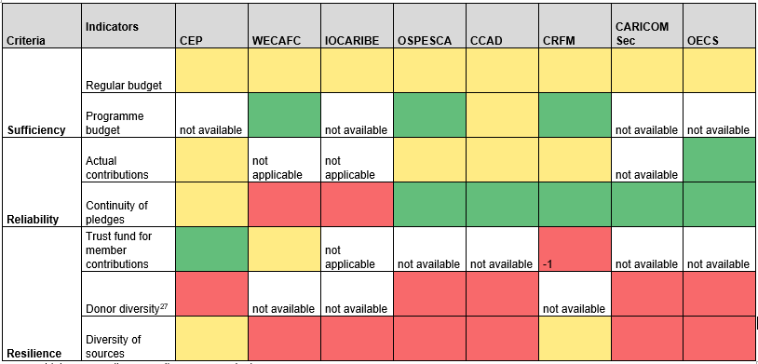
Sustainable Financing Plan for the RGF
green – high score; yellow – medium score; red – low score
Notes:
In the context of the RGF, financial sustainability is understood as: Funding being sufficient, reliable and resilient
The results presented on the table was developed based on the information provided by the IGOs during the Inception phase and Phase 1. The collected information can partially be used here, but may require further clarification and validation of the figures.
Definition of the criteria:
Sufficiency: This criterion is met if the amount of financing an IGO receives is sufficient to fully carry out its work in accordance with its mandates. It is assessed using indicators for both the regular budget as well as the programme budget.
Reliability: This criterion is met if regular budget is secured and allocated reliably. This is indicated by whether the agreed regular contributions to an IGO vary over time, and by the extent to which they are actually paid.
Resilience: This criterion is met if an IGO can flexibly react to and cope with (unplanned) budget fluctuations. This is indicated by whether it has an adequate mechanism in place to cope with the uncertainty of member states’ contributions, and by the diversity of donors and overall diversity income sources.

Slide 15
Sustainable Financing Options for the RGF
Option 1: Donor centred approach – Strategic planning to enhance grant acquisition
Phase 1: IGOs enhance their individual and joint grant acquisition potential, while increasing donor diversity
Phase 2: Intensifying coordination and cooperation among IGOs, while assuring that resources for ocean governance are allocated efficiently at IGO and RGF level
Option 2: Beneficiary centred approach – Combining a “business planning” with EBM revenue generation
Phase 1: IGOs explore and strengthen their potential to generate revenue from their intrinsic activities, as well as increasing partnership with the private sector
Phase 2: Recurring voluntary contributions and/or revenue from user charges replenish a revolving trust fund managed by the PPCM, and private sector cooperation emerges into a regional scale.
Notes:
Two general options: a) Donor centred option and b) Beneficiary centred option. These two are potentially complementary and can be combined over time.
Expectation in the long-term for RGF financing: The large proportion of ocean governance financing is provided by the direct beneficiaries of the marine resources, both public and private

Slide 16
BENEFITS TO CLME+ COUNTRIES AND ICM MEMBERS
Expected benefits include:
Higher impact of policies, programmes and projects on the regional level by working towards common goals and SAP and SDG objectives
Better monitoring of the progress made toward achieving SAP and SDG objectives and tracking distance to targets
More efficient use of resources by maximizing synergies and minimizing duplications in the work of IGOs, countries and other stakeholders
Higher leverage effect for financing and a stronger position toward funding partners through design of joint programmes and projects
Better oversight of the status and return of investments in the marine environment
More informed decision making and allocation of resources based on timely shared information and knowledge

Slide 17
NEXT STEPS
Phase 1:
Revision of the PPCM and SFP proposals based on input received
ICM meeting in August 2018
First Major Consultation Meeting in September 2018 (selection of 1 or 2 priority options to progress further)
Phase 2:
Fine-tuning of the selected PPCM and SFP option/s and development of the roadmap
Second Major Consultation Meeting to select final option (June 2019)
Endorsement of the selected options (March/April 2020)

Slide 18
FOR FURTHER INFORMATION
UNDP/GEF CLME+ Project Coordination Unit Email: info@clmeplus.org Tel: (+57) (5) 664 82 92 https://clmeplus.org | Steffen Schwörer Centre of Partnerships for Development (CAD) Barcelona, Spain Email: sschwoerer@globalcad.org Tel: (+34) 93 495 0383 http://globalcad.org

Slide 19
Second CLME+ Project Steering Committee Meeting
Thank you
Gracias
Obrigado
Merci
Dank u

