Slide 1


Second CLME+ Project Steering Committee Meeting
UNOPS-UNEP Collaborative Execution of the CLME+ Project
UN Environment/LOA/DEPI/2016/MCEB-CEP/002
Catalyzing implementation of the Strategic Action Programme for the Caribbean and North Brazil Shelf LME’s (2015-2020)

Slide 2
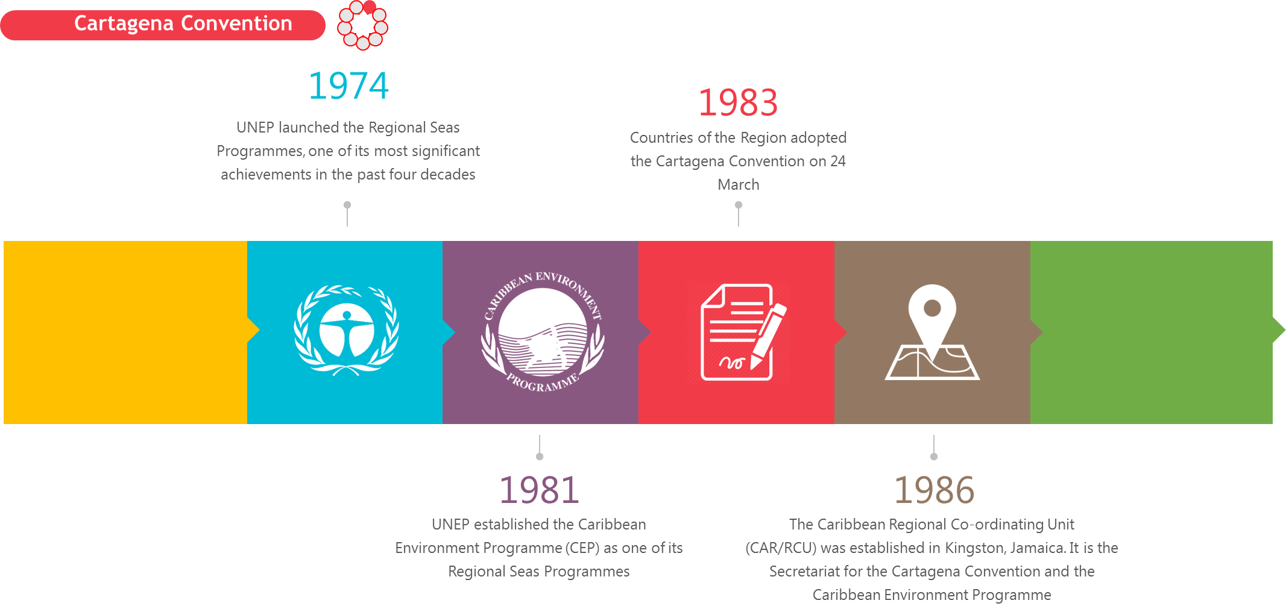

Introduction

Slide 3
Introduction
…acts as administrative and coordination executing agency
Responsibilities:
Supports joint implementation of actions under different Protocols of the Cartagena Convention
  Elaborate a formal agreement between Brazil and UNEP CEP (O.1.1)
  LBS/SPAW Joint STAC and Roadmap (O.1.1)
  Regional Strategies and Action Plans for Nutrients & Habitats (O.2.1) - ongoing
  Baseline assessment reports for Nutrients & Habitats (O.4.1) - ongoing
  Investment plans/Case Studies for Nutrients and Habitats (O.4.2) – to start in 2019
  Create web portals and report relevant information through them – State of Pollution & State of Habitat Reports (O.5.2 & 5.3) - ongoing
  Develop/Implement sub-project(s) for North Brazil Shelf & Eastern Caribbean (O.3.4) - ongoing

Slide 4
Status technical implementation:
Status financial expenditure
On Track | Moderate Delays | Major
 | X
On Track | Moderate Delays | Major
 | X

Slide 5
Project Implementation Overview
Category | Ratio
Completed | C 1: 1 of 2 C 3: 0 of 3 C 5: 2 of 7 C 2: 0 of 2 C 4: 0 of 7
On track | C 1: 1 of 2 C 3: 0 of 3 C 5: 5 of 7 C 2: 2 of 2 C 4: 5 of 7
Low risk of not completing on time | C 1: None C 3: 3 of 3 C 5: None C 2: None C 4: 0 of 7
High risk of not completing on time | C 1: None C 3: 0 of 3* C 5: None C 2: None C 4: 2 of 7
High risk of target not being achieved | C 1: None C 3: 0 of 3 C 5: None C 2: None C 4: 2 of 7

Slide 6
Achievements to Date
Milestone/Output | Target | Briefly describe (full or partial) achievement
Output 1.1 | T.PI1 | Areas of Cooperation agreed with the Government of Brazil; Decision of 2016 IGM for Secretariat to establish cooperation agreement with Brazil; MOU Framework proposed and agreed; Draft MOU prepared and shared with Brazil for review; Signature expected by end May 2018.
 | T.PI2 | LBS SPAW Road Map approved by LBS and SPAW COPs and IGM; Will form an integral part of revised CEP Strategy to be presented to IGM in Dec 2018 for approval.
Output 2.1 | T.PI3 | Approach to develop Regional Nutrients Strategy and Action Plan Defined and major stakeholders identified. Workshop planned for July 2018 and to be endorsed at 4th LBS STAC.
Output 3.4 | T.PI1 | EBM Project for North Brazil Shelf defined and joint Inception Workshop convened in Nov 2018. Contracts to be finalized by June 2018 and Implementation to begin by July 2018.
Output 5.2 | T.PI1 | Indicators and Monitoring Frameworks for State of Pollution Report defined.
 | T.P12 | Table of Contents for State of Pollution Report approved. Draft Report to be presented at 4th LBS STAC in July 2018.

Slide 7
High Risk Targets
Output | High risk of not completing on time | High risk of target not being achieved
Output # 3.4 | Caribbean EBM considering that the implementing Government Partner has still not been defined despite over a year of discussions with the original country – Barbados.
Output # 4.2 | At least USD 25 million committed to initiate implementation Potential financing sources identified for at least 33% of the required budgets | At least USD 25 million committed to initiate implementation Potential financing sources identified for at least 33% of the required budgets
Output #

Slide 8
Challenges Being Experienced
# | Challenge | Mitigative Measure | By When
1 | Caribbean EBM under O3.4 has still not been defined despite over a year of discussions with the original country – Barbados. | Re-allocate resources from O3.4 to O.2.1 and O.5.2 will significantly reduce the risk of not being able to deliver in the time remaining | Immediately subject to PCU approval
2 | Delays in recruitment of SPAW Programme Officer & P2 under IWCAM | SPAW PO on board; Selection for P2 completed – on board by September; Reallocation of staff duties & priority to be given to CLME+ | Immediately
3 | Tracking of Expenditure & Processing of Contracts | Internal Tracking System developed; Detailed updates to Logframe on SmartSheet; Training of FMO; | Immediately
4 | Slow response from countries | Communication protocol established for more regular interaction | Immediately

Slide 9
Financial Implementation
Agency name | 2018 Budget (May to Dec, 2018) | Amount spent up to April 2018 | 2019 Budget | Risk of not achieving budget objective | Proposed remedial actions
UNEP | $ 723,029 | $ 297,719 | $ 344,252 | Low to moderate | (1) Use of fewer partners for multiple outputs (2) Transferring funds to the following outputs: 0.2.1 Develop a regional strategy and action plan & 0.5.2 CLME+ ecosystem status and the "State of the Marine Ecosystems;

Slide 10
Crosscutting Recommendations for Successful Project Implementation
Need to recognize level of effort required to implement activities for agencies to prioritize accordingly
Some of the outputs need to be refined to reflect what is financially feasible under the project
Given the close linkages as many partner activities move into full implementation, there will be need to be even closer collaborations between CLME+ executing agencies
CLME+ PCU is well placed to assist in furthering country support and commitment for implementation of sub-project activities
In order to ensure seamless integration of the State of ..reports in the SOMEE – very close collaboration will be needed over the next 12-15 months
The on-boarding of the Communications support of the PSC should be used to help raise the visibility of the project in the region.

Slide 11
Second CLME+ Project Steering Committee Meeting
THANK YOU
Catalyzing implementation of the Strategic Action Programme for the Caribbean and North Brazil Shelf LME’s (2015-2020)

