Slide 1

Second CLME+ Project Steering Committee Meeting
OVERVIEW OF THE REVISED CLME+ PROJECT COMMUNICATIONS STRATEGY
Second UNDP/GEF CLME+ Project Steering Committee Meeting
18- 20 June
Panama City
Catalyzing implementation of the Strategic Action Programme for the Caribbean and North Brazil Shelf ME’s (2015-2020)

Slide 2
Background to the Existing Communications Strategy
Inadequate public awareness as identified root cause under CLME+ TDA
A CLME+ Communications Strategy was developed in 2016 addressing the need for centralized and decentralized communications
Moving forward
Notes:
The CLME+ Strategic Action Programme recognizes that addressing the cross-cutting root causes to unsustainable fisheries, habitat degradation and pollution – the three inter-linked key priority environmental problems requires dealing with the issue of inadequate public awareness and involvement, as but one of the seven key root causes identified.
A CLME+ Communications Strategy was developed in 2016 with an ambitious implementation plan. However, capacity and time constraints led to a limited number of initial successes under the central component of the Strategy.
In recognition, the CLME+ Communications Strategy is now being refined to address communication arrangements among the CLME+ Partnership, general awareness building among the broader CLME+ stakeholder community and experience exchange with LME Practitioners through much more practical and targeted communications. Andrea the mid term evaluator has identified the breakdowns in communication which require addressing.

Slide 3
1. Goals, Outcomes and Objectives
Overarching Goal: Contribute to the materialization of the long-term Vision and the Objectives of the CLME+ SAP and the attainment of the SDGs as these relate to the marine environment of the CLME+ region, in particular SDG 14.
Outcome 1: Support the successful and timely delivery of key CLME+ Project Outputs – by facilitating awareness among primary stakeholders (e.g. country NFP’s, Ministers, Permanent Secretaries, PEG and ICM Members) and promoting and ensuring country / stakeholder buy-in and ownership.
Objective 1: CLME+ Countries and Project partners (including co executing agencies and relevant IGOs) are aware and actively engaged in fulfilling CLME+ Project outcomes as evidenced by Project Output progress
Notes:
Want to make clear that in all we do we are responding to the information needs from NFP and Partners and how we can best communicate with them.

Slide 4
A Perceived challenges to achieving Project Outputs
There may appear to be a perception of a low level of awareness in the CLME+ SAP as well as low engagement with and ownership over project activities among some of the CLME+ countries.
It is to be noted, however, in this context, that in many instances engagement of CLME+ countries in the project activities occurs through sessions and/or meetings organized by CLME+ Project co-executing partners, several of which are Intergovernmental Organisations.
Country representatives at these fora do not necessarily coincide with the CLME+ Project designated National Focal Points (NFPs). This, combined with weaknesses/capacity constraints in the initial implementation of the CLME+ Communication Strategy, may have contributed to reduced awareness/appreciation among CLME+ NFPs about how the project is supporting the agenda and programmes/activities of participating countries.
The following diagram gives an overview of where potential breakdowns / lack of communication protocols are occurring.

Slide 5
CLME+ Project Results Framework
PCU
Main Project Outputs
PEG
Other Co-executing Agencies
Main Project Outputs
Sub-project – Sub project Outputs

Slide 6
CLME+ Project
Project National Focal Points (pNFP + liaison, Country NFP
PCU
UNDP UNOPS
PEG
CERMES, CANARI, GCFI
Disconnect in Communications
IOCARIBE, UNEP OEP, OECS, FAO WECAFC, CRFM, OSPESCA
Sub project National Focal Points (NFPs)
Disconnect in Communications
CARICOM, CCAD
Institutional National Focal Points
CLME+ SAP Interim Coordination Mechanism

Slide 7
CLME+ SAP 2015 - 2025
CLME+ Project 2015 - 2020
Countries
pNFP / liaison/ aNFP
NICS
Project Steering Committee
UNOPS, PCU, UNDP
Project Executive Group
IOC / IOCARIBE,
UNEP CEP,
FAO WECAFC
OECS, CRFM, OSPESCA
GCFI
CERMES
CANARI
CARICOM
CCAD
CLME+ SAP ICM

Slide 8

National Focal Points TORs
Specific to Communication:
Disseminate in a timely manner requests for support and/or news from the CLME+ Project Coordination Unit, and information on the CLME+ Project (incl. best practices, lessons learnt to relevant national and local level stakeholders
Facilitate feedback and communication from relevant national level stakeholders to the CLME+ Project Coordination Unit / and or relevant CLME+ Project Partners
Promote the adoption at the national level of EBM / EAF and encourage its integration into national development plans
Notes:
These are just a sample more relevant to the role of NFPs in terms of interfacing with the PCU Communications Unit

Slide 9
Objective 1: By March 2019 NFP’s PEG and ICM are aware and actively engaged in fulfilling CLME+ Project outcomes as evidenced by Project Output progress.
Assess Issues and Audience Perceived lack of full awareness and buy in from critical stakeholders. Audience: PEG, ICM and other CLME+ National Focal Points supporting the CLME+ SAP | Behavior All NFP’s to start actively promoting the CLME+ Project and associated key outputs | Content NFP’s play a critical role in the overall project design and the Project relies on them for country liaison and enhanced buy-in. | Delivery Quarterely E-newsletter with material harvested from: Partner news Blog on the HUB Quarterly formal CLME+ Project Progress and Status Report Direct Communications with NFPs and other partners when required Marketing material | Engagement Direct engagement E-news and HUB. | Follow up Survey sent quarterly to all NFP’s assessing their level of CLME+ Project and SAP awareness and issues requiring attention.
Notes:
Content: For countries to acquire maximum benefits from the CLME+ Project and its key outputs, country ownership over these outputs is essential. Such requires awareness about the outputs and their country relevance as well as country’s participation in and development of and endorsement of outputs. Idea is to start creating an on-going dialogue leading to enhanced buy in and engagement.

Slide 10
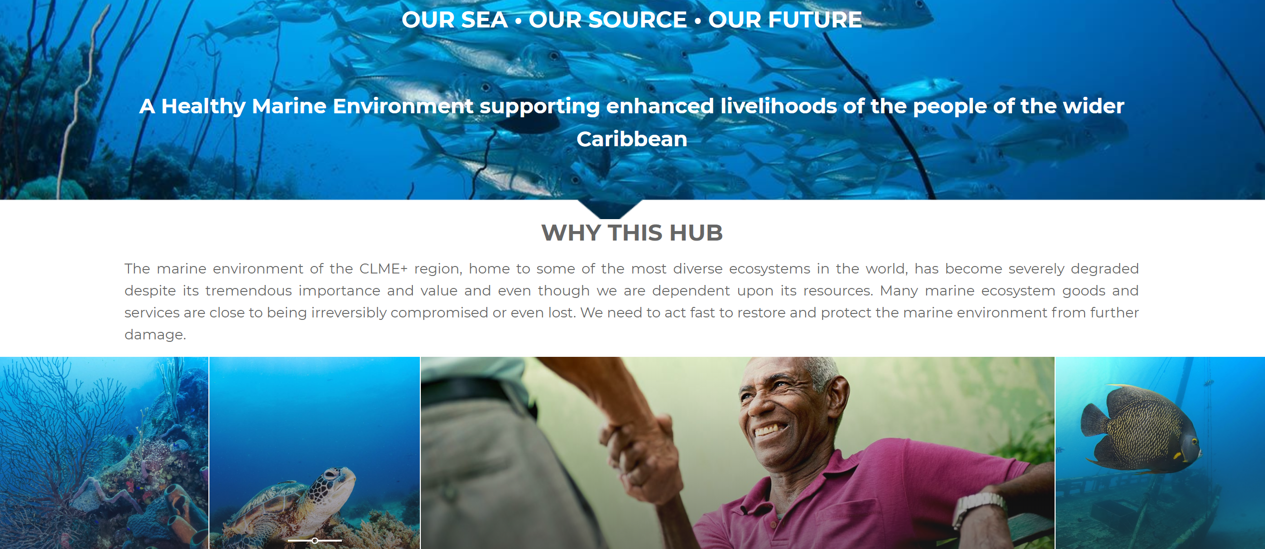
Activity 1: Implementation Plan leading to the following communication platforms
Development of the HUB and Blog
Notes:
A centralized Blog on the new HUB will enable NFP’s, ICM and PEG partners to contribute short insightful updates on Progress being made under respective Project Outputs. Information can be harvested for input into one section of the proposed new e-news bulletin for all to see project status.

Slide 11
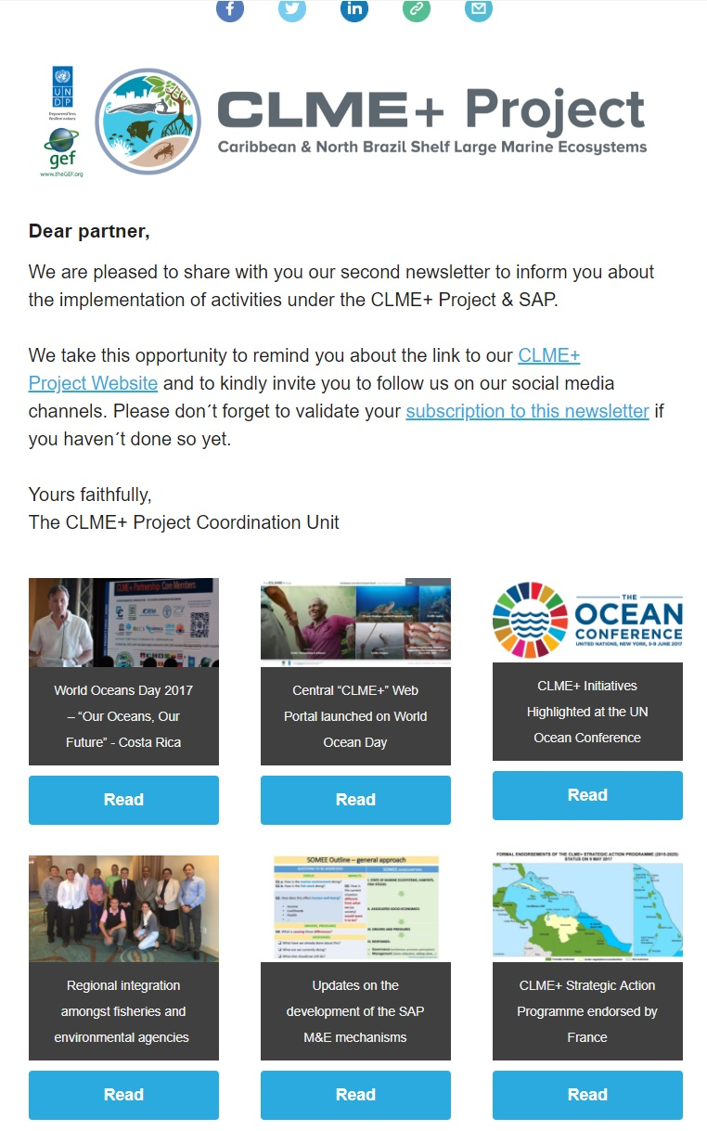
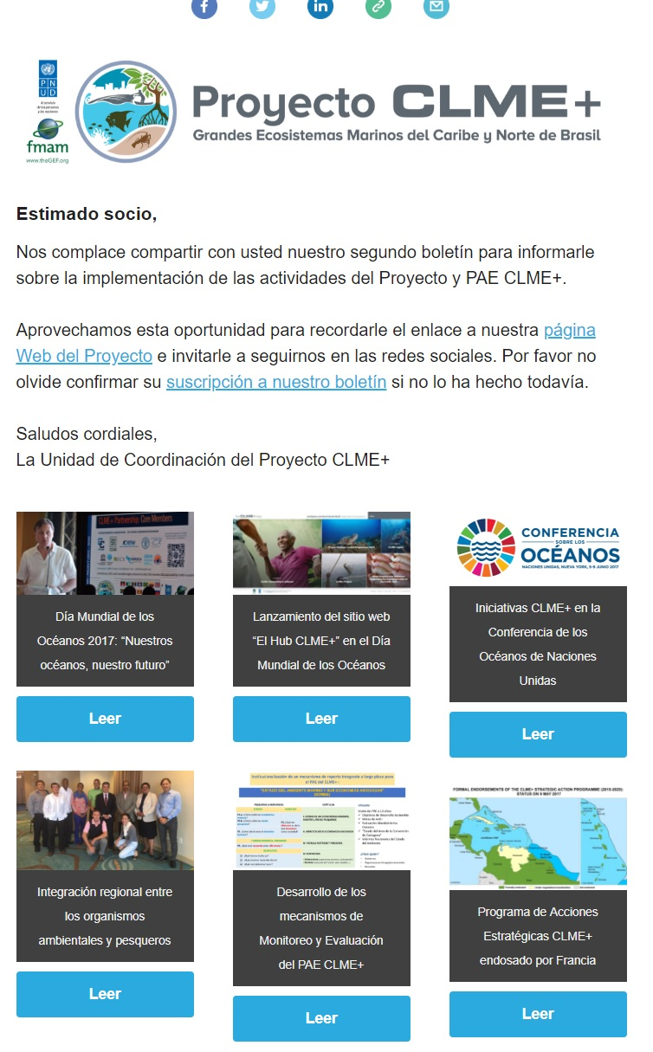
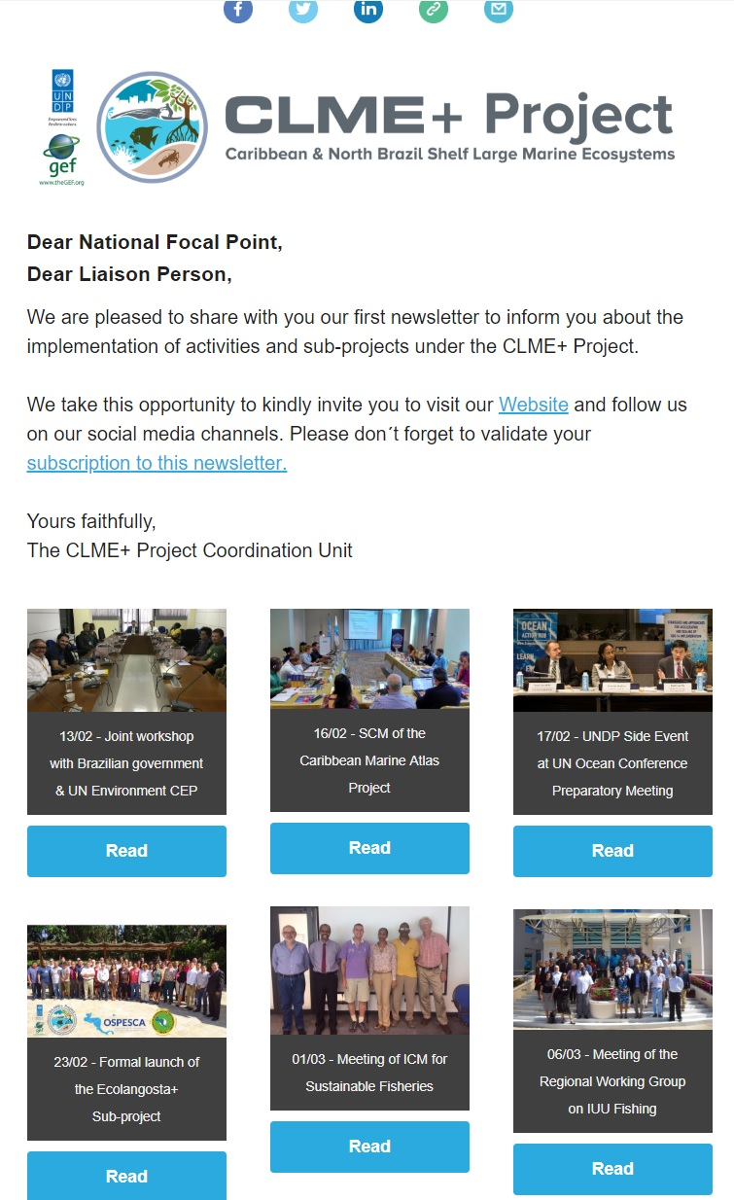
Activity 2: Implementation Plan leading to the following communication platforms
Quarterly E-Newsletter combined into one e-news bulletin with distinct sections tailored to audience needs + tracking
Notes:
Previously had different iterations of an e-news bulletin, proposal to combine into one clear easy to read bulletin with three distinct sections:
1.
2.
3.
Ability to enter into a comms agreement with partners to utilize their news (from their newsletters, social media etc and for them to on-promote our news) and the ability to track results and outreach.

Slide 12
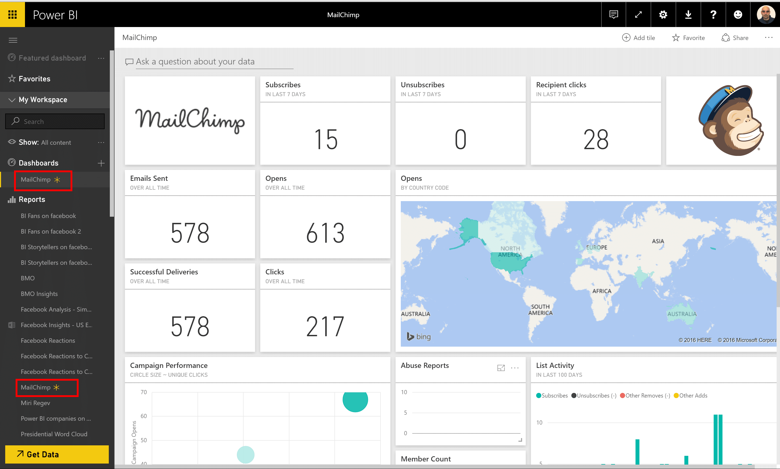
New E-news bulletin has in-built tracking and performance metrics
Notes:
All partners can receive progress reports as to where news is being picked up, who is viewing what etc.

Slide 13
E-news bulletin ‘Communicating as One’ albeit with different identities
Harvesting Project Updates from all stakeholders
NFP
PCU
Produces centralized communications harvesting all updates
- E-news bulletin
- Quarterly Status Reports
- Direct Communications
Partner
ICM
PEG
NFP
Notes:
E-news bulletin sent to all stakeholders so everyone is on the same page. Its success depends on how active partners update the blog with Project updates.
Newsletter to contain section on:
Project Updates
National Updates
Alliance Partnership
In addition to:
1. Quarterly Formal CLME+ Project Progress and Status Reports
2. Direct Communications
DECENTRALIZED ACTIVITIES
PEG Members to produce communication materials to support overall Project narrative e.g. C-SAP.
NFP’s to liaise with the PCU on a regular basis in between sessions of the CLME+ Project Steering Committee, as needed for the successful implementation of the CLME+ Project and to on-send formal reporting to key stakeholders
NFP’s to collate and forward national progress updates to the PCU for targeted media promotion in-country
NFP’s to facilitate feedback and communication from relevant national level stakeholders to the PCU and Project Partners for input into the Social Media Platform

Slide 14
2. Goals, Outcomes and Objectives
Overarching Goal: Remains the Same
Outcome 2: The mobilization of additional major stakeholders and resources (e.g. through the global CLME+ Alliance and Partnership), and the up-scaling of positive action on the marine environment in the CLME+/wider Caribbean region. (This is in support of full-scale CLME+ SAP implementation and region-wide progress towards regional and international commitments, e.g. Cartagena Convention, CBD Aichi Targets and the SDGs).
Objective 2: By the end of 2019 a combination of at least 10 globally recognized Development Organizations, NGOs, Civil Society Organizations and Private Sector have formally joined the CLME+ Partnership / and or financial support provided for on-going actions.

Slide 15
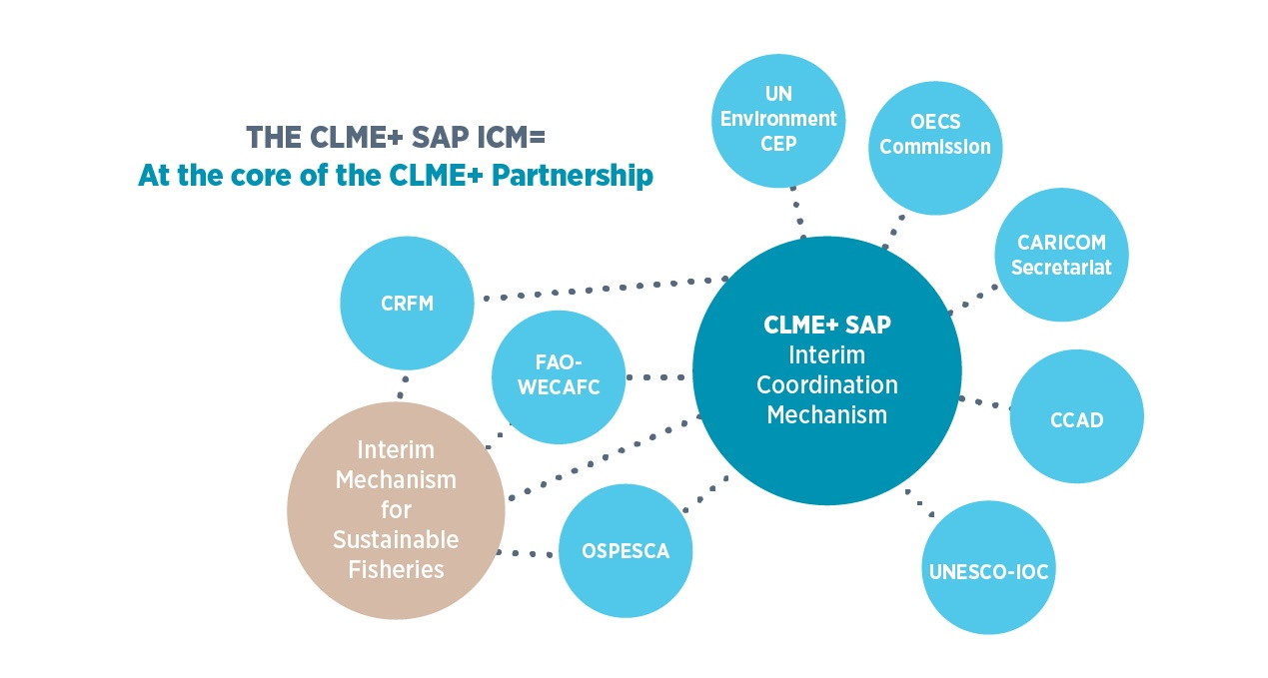
CLME+ SAP ICM

Slide 16
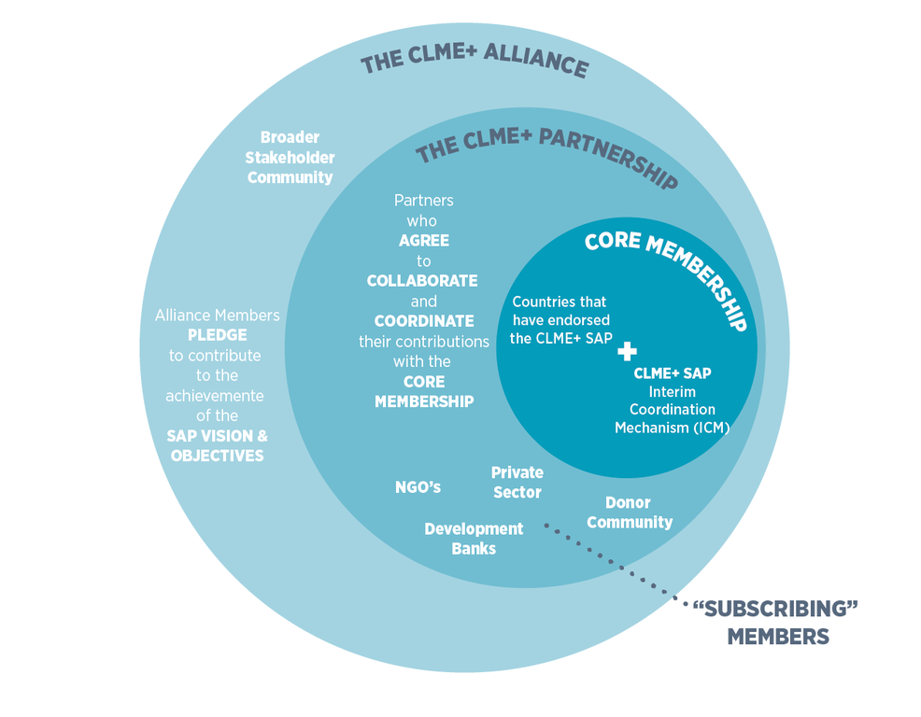
CLME+ Alliance
CLME+ Partnership

Slide 17
Objective 2: By the end of 2019 a combination of at least 10 globally recognized Development Organizations, NGOs, Civil Society Organizations and Private Sector have formally joined the CLME+ Partnership / and or financial support provided for on-going actions.
Audience ICM and major international development partners, NGOs, Civil Society, Private Sector Organizations and influential individuals | Behavior Identified audiences to actively seek out further information on the CLME+ Partnership / Alliance with a view to officially joining | Content A SAP for the wider Caribbean region has been politically endorsed. The SAP to deliver on the 2030 Sustainable Development Agenda | Delivery Dedicated Partnership Section on the CLME+ HUB Dedicated Alliance section in Quarterly E-news-bulletin Social Media Marketing Plan Direct News Dissemination and Global Media Outreach Invitation to the Partnership Forum | Engagement Direct communication and formal representations Traditional and Social Media Partnership Forum Direct Contact | Follow up Direct contact with those who have engaged on Social Media and / or responded to direct e-news marketing Formal media metrics
Notes:
Behavior: Partnership Members to actively behave as Members as per the Partnership pledge and associated TORS
Content: The SAP is an instrument to deliver regionally on the 2030 Sustainable Development Agenda in Particular SDG 14 and other global and regional commitments relevant to the marine environment

Slide 18
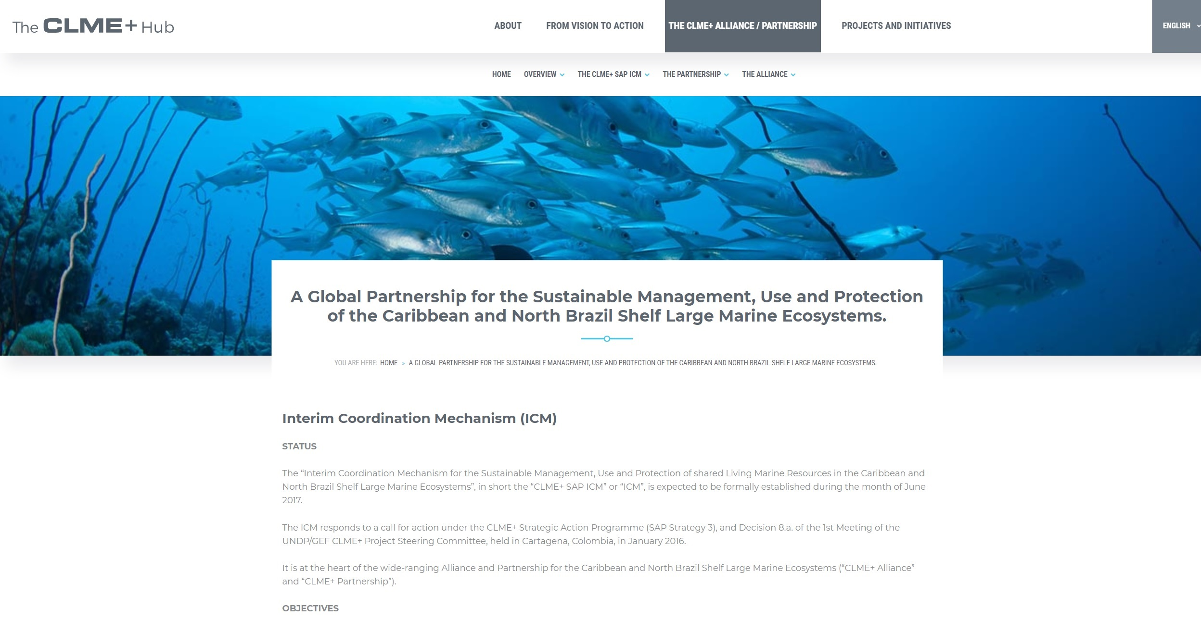
Activity 1: Development of Partnership / Alliance Narrative
Notes:
Development of a strong case for Partnership with a clear plan for promotion of partner Program, Projects and Initiatives on the HUB.

Slide 19
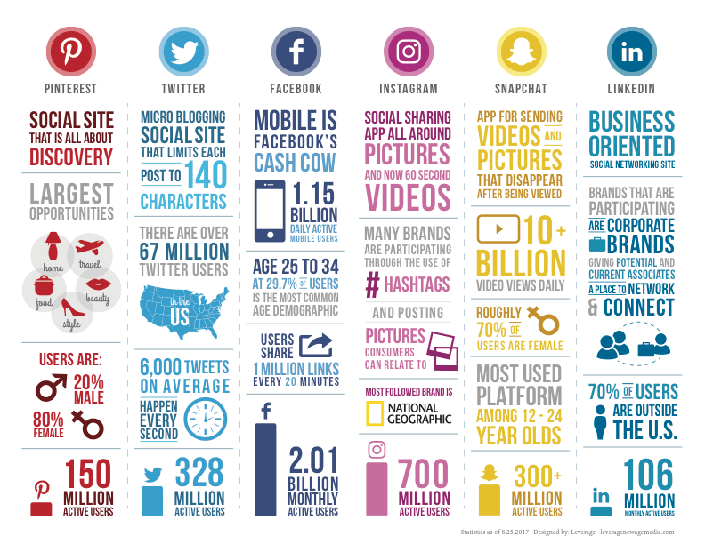


Activity 2: Implementation of Social Media Plan
Notes:
Content is king when it comes to social media and this platform should be used to tailor CLME+ content to reach potential new followers on how positive impacts for everyday citizens are being made. It should not be used to inform of project progress in technical terms.
A Social Media Plan has been developed to narrate the overall architecture of the CLME+ Project and SAP as a an initial avenue to ensure wider stakeholder buy-in.

Slide 20
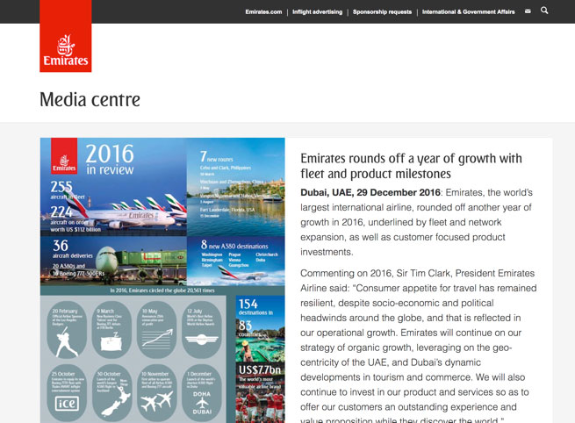
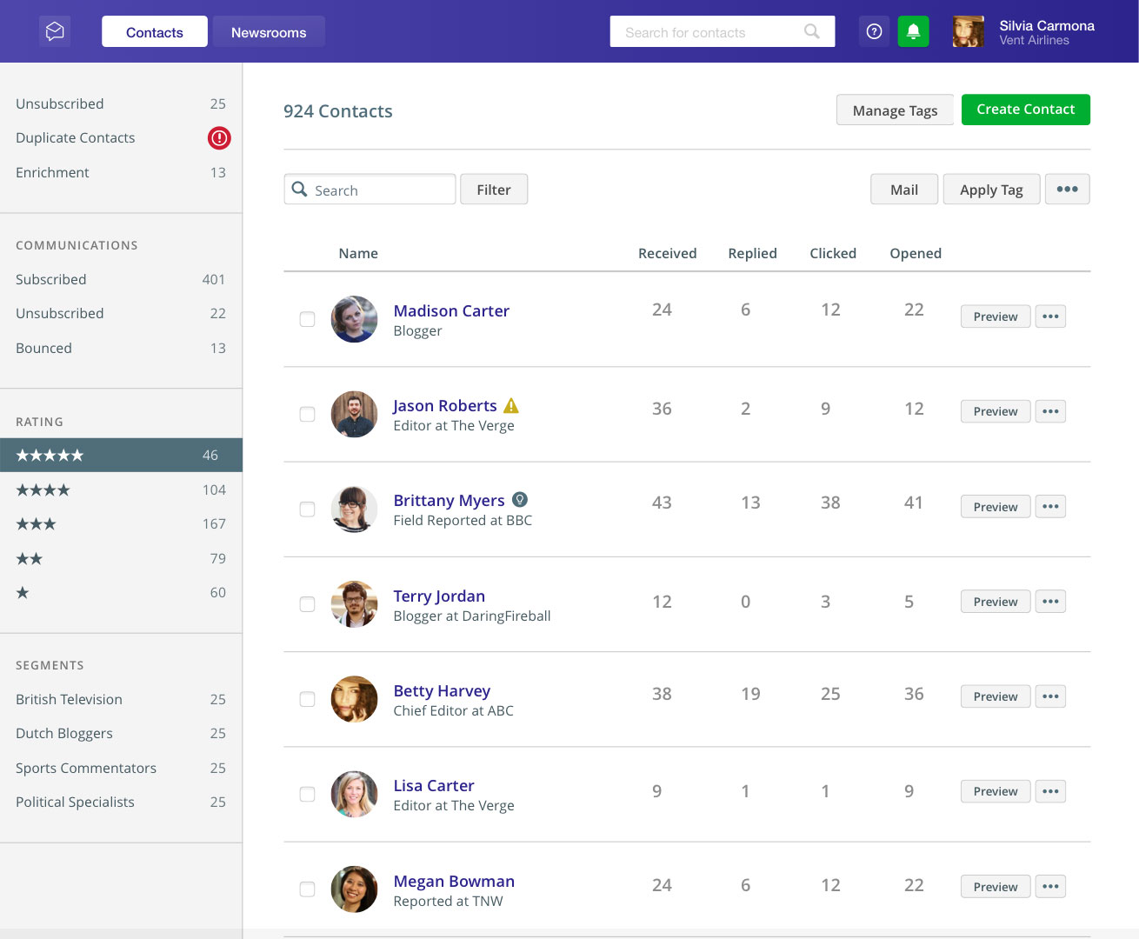
Activity 3: Implementation of CLME+ Newsroom with regional
Global Outreach
Notes:
Embedded into the HUB is a leading newsroom with a back end that has the ability to reach over a million journalists, influencers and bloggers. Partners can utilize this service to promote their news contextualized to the CLME+ Project to relevant global media and to then see results on a daily basis.
https://pressroom.oecs.org/exploring-nuclear-technologies-to-foster-agriculture-sustainability-in-the-eastern-Caribbean

Slide 21


Ability to Reach Regional and Global Media
Via CLME+ HUB all partners can send news to the regional and global media in multi-media format used by some of the worlds leading brands.
Example from OECS Commission.
https://pressroom.oecs.org/exploring-nuclear-technologies-to-foster-agriculture-sustainability-in-the-eastern-caribbean
Ability to target relevant journalist, influencers and bloggers and to track responses through a range of metrics.
Notes:
We have extensive media lists by all nations, by subject both in English and Spanish. So if a partner wanted to get granular and just target the media in Panama or Jamaica or El Salvador on Fisheries we can target just those likely to report on that matter. For maximum newsworthy pick up the PCU can assist partners to craft messages.

Slide 22
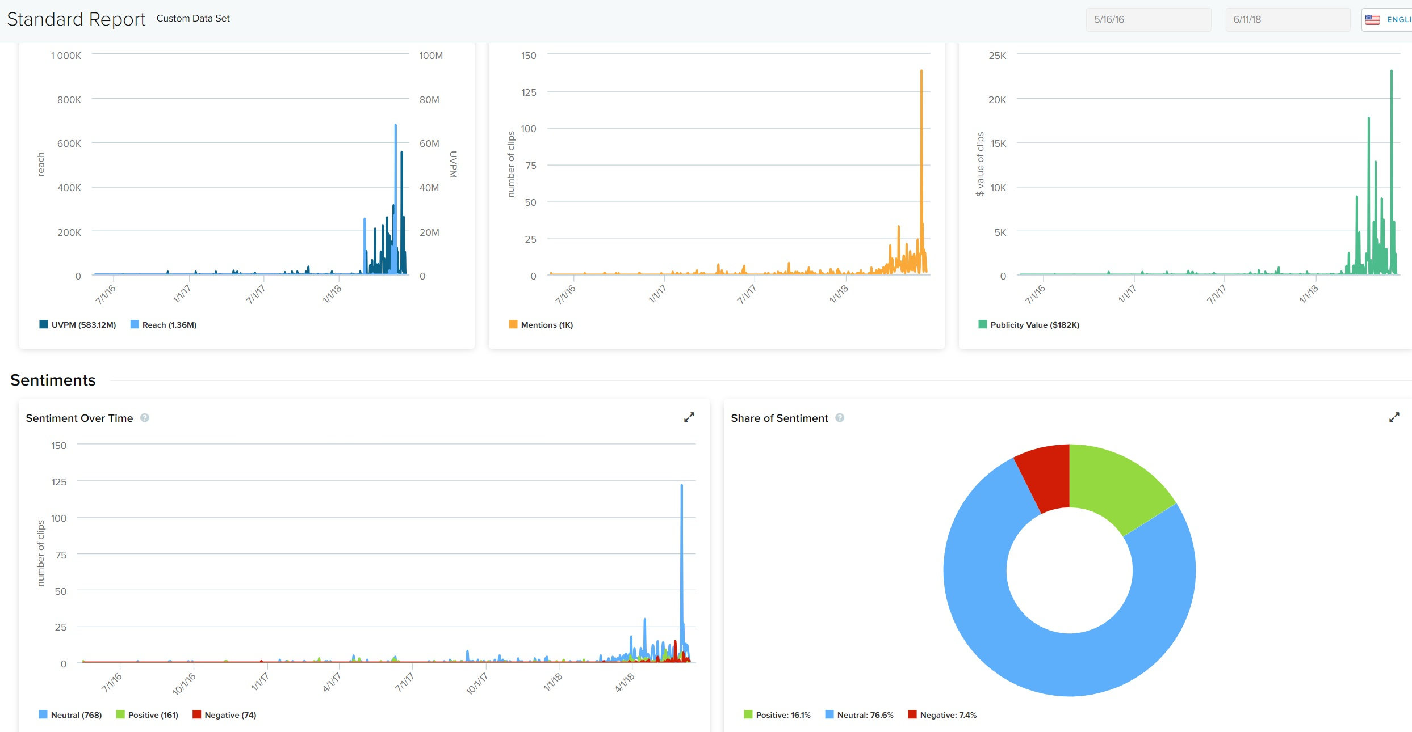
Media Outreach and Tracking
Sample Media Intelligence Report
Notes:
Decentralized: ICM to assist in communicating to confirmed and prospective non-core partnership members and to utilize communication outputs developed by the PCU.

Slide 23
3. Goals, Outcomes and Objectives
Overarching Goal: Remains the Same
Outcome 3: The exchange of knowledge and best practices among the global LME Community and the creation of an enhanced awareness among the public at large of the CLME+ SAP.
Objective 3: The CLME+ SAP and Project positioned globally as flagship initiatives to facilitate EBM / EAF in the CLME+ region.
Notes:
Using existing tools e.g. LME Learn etc.

Slide 24
Objective 3: The CLME+ SAP and Project positioned globally as flagship initiatives to facilitate EBM / EAF in the CLME+ region by the end of December 2019.
Audience LME Practitioners (via LME Learn) CLME+ Media Sector UNDP / GEF General Public | Behavior LME practitioners recognize and promote the CLME+ SAP as a global model of a politically endorsed instrument in which to manage shared living marine resources through EBM / EAF approaches. Active publics within the CLME+ region | Content The CLME+ SAP was the first politically endorsed SAP for a region of the magnitude of the wider Caribbean. | Delivery Quarterly e-news update on overall SAP implementation and SOMEE updates Media releases / opinion pieces Social Media Plan implemented | Engagement Opportunity for LME practitioners to contribute to the HUB blog Liaison with regional and global media | Follow up Google analytics Media metrics
Notes:
Content: Every member of the public has a role to play in contributing the sustainable management of shared living marine resources across the wider Caribbean.
Decentralized: Partners to provide content for quarterly e-news bulletin.

Slide 25
Summary Overview of the Revised Communications Strategy
The revised communication strategy has been developed through a framework that identifies the most critical audiences in the achievements of Project Outputs and tailoring communication to their individual needs. A framework used by USAID, Proctor and Gamble and other leading organisations has been employed, commonly known as the ABC Communications Model for Influencing Behavior
ABC Communications Framework
Assess Issues and Audience The assess / research phase of the process involves identifying a problem or potential problem to be solved, which involves one or more audiences. | Behavior What do you want your audience to do? | Content What key messages are persuasive to your audience? What tone will resonate with your audience and make content ‘stick’. | Delivery How will the message be delivered, who will deliver and when? | Engagement How will you encourage a two way conversation with your audience? How will discussion be sparked? | Follow up What are the ways to measure success? Are there any follow up messages, how will you continue the conversation?
Notes:
Assess Issues and Audience: The assess / research phase of the process involves identifying a problem or potential problem to be solved, which involves one or more audiences. Who is your primary audience? Develop a profile of them including attitudes and motivations. The Comms Strategy states it did not have the luxury of doing so, but the mid-term evaluator Andrea has been conducting qualitative research from partners and other bodies which is informing needs.
Behavior: What do you want your audience to do? Needs to be specific and actionable.
Content: What key messages are persuasive to your audience? What tone will resonate with your audience and make content ‘stick’.
Delivery: How will the message be delivered, who will deliver and when?
Engagement: How will you encourage a two way conversation with your audience? How will discussion be sparked? What questions can you ask your audience?
Follow up: What are the ways to measure success? Are there any follow up messages, how will you continue the conversation?

Slide 26

CLME+ Technical Translations Reviser (retainer), Multiple positions
Job categoriesClimate
Vacancy codeVA/2018/B5002/15624
LevelICS-8
Department/officeECR, EOC, Water and Energy Cluster
Duty stationHome based
Contract typeInternational ICA
Contract levelIICA-1
Duration1 year duration, on retainer basis
Application period25-May-2018 to 16-Jun-2018
Applications to vacancies must be received before midnight Copenhagen time (CET) on the closing date of the announcement.
jobs.unops.org

Slide 27
Second CLME+ Project Steering Committee Meeting
Thank you
Catalyzing implementation of the Strategic Action Programme for the Caribbean and North Brazil Shelf ME’s (2015-2020)

