Slide 1

Mid-Term Project Steering Committee Meeting, 18-20 June, Panama
SUB-AGENDA ITEM 7.2 – CLME+ STRATEGIC ACTION PROGRAMME INTERIM COORDINATION MECHANISM

Slide 2
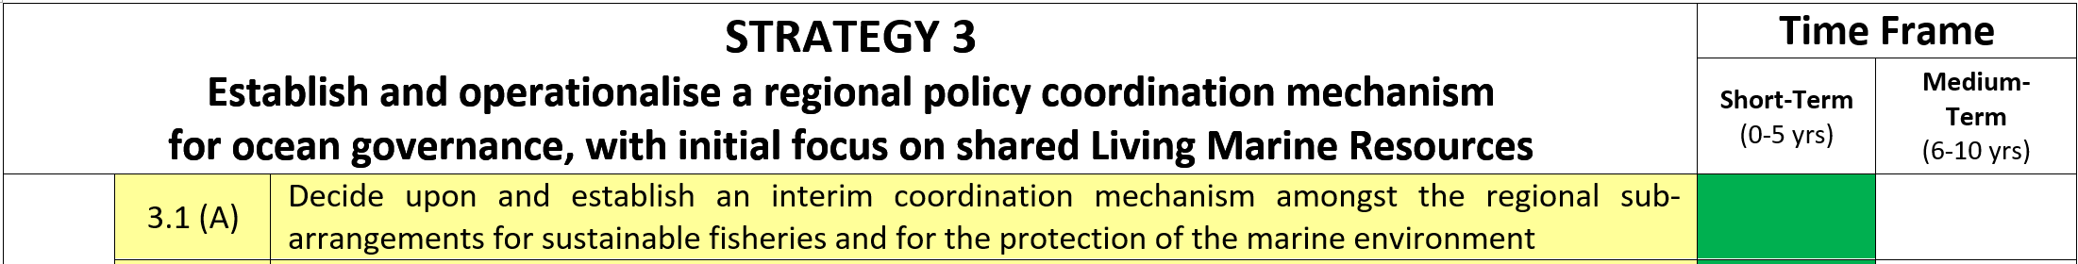
The SAP Interim Coordination Mechanism:
the Food and Agriculture Organisation represented by the Western Central Atlantic Fisheries Commission
the UN Environment represented by its Caribbean Regional Coordinating Unit and Secretariat to the Cartagena Convention
the Intergovernmental Oceanographic Commission of UNESCO
the Organisation of the Central American Fisheries and Aquaculture Sector
the Central American Commission for Environment and Development
the Caribbean Community Secretariat;
the Caribbean Regional Fisheries Mechanism
the Organisation of Eastern Caribbean States (OECS) Commission.

Slide 3
SAP Interim Coordination Mechanism
Interim SAP Coordination Mechanism
UNEP-CEP
OECS Commission
CCAD
Interim Mechanism for Sustainable Fisheries
CRFM
OSPESCA
FAO – WECAFC
CARICOM Secretariat
UNESCO-IOC

Slide 4
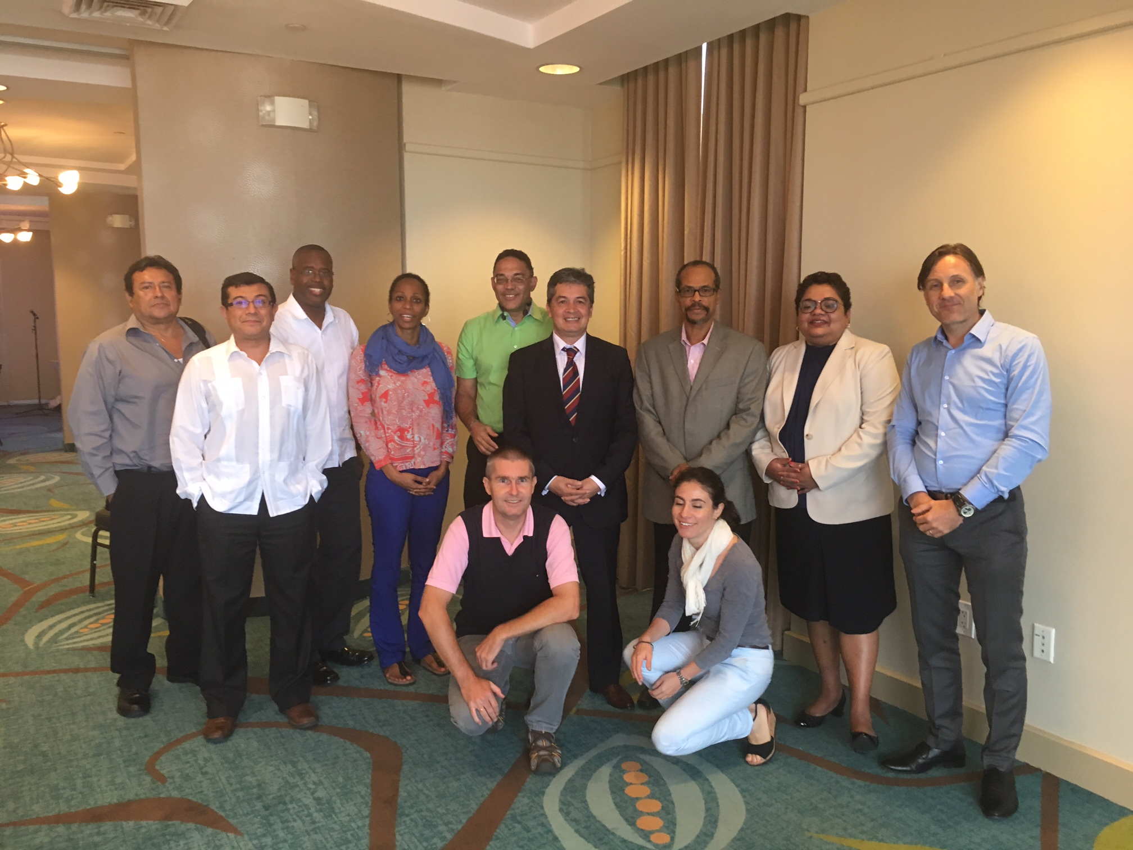
SAP Interim Coordination Mechanism
Objective: Enhance regional coordination and collaboration, support oversight and integration of actions for sustainable fisheries and the protection and sustainable use of the marine environment.
Also: Promote up-scaling of actions towards the CLME+ SAP through the establishment of a global “CLME+ Partnership”
Meeting of the SAP ICM – Organisations represented: (Left to right)
OSPESCA, CCAD, OECS Commission, CLME+ PCU, UN Environment, UNESCO-IOC, CRFM, CARICOM Secretariat, CLME+ PCU
(front row) FAO-WECAFC, CLME+ PCU

Slide 5
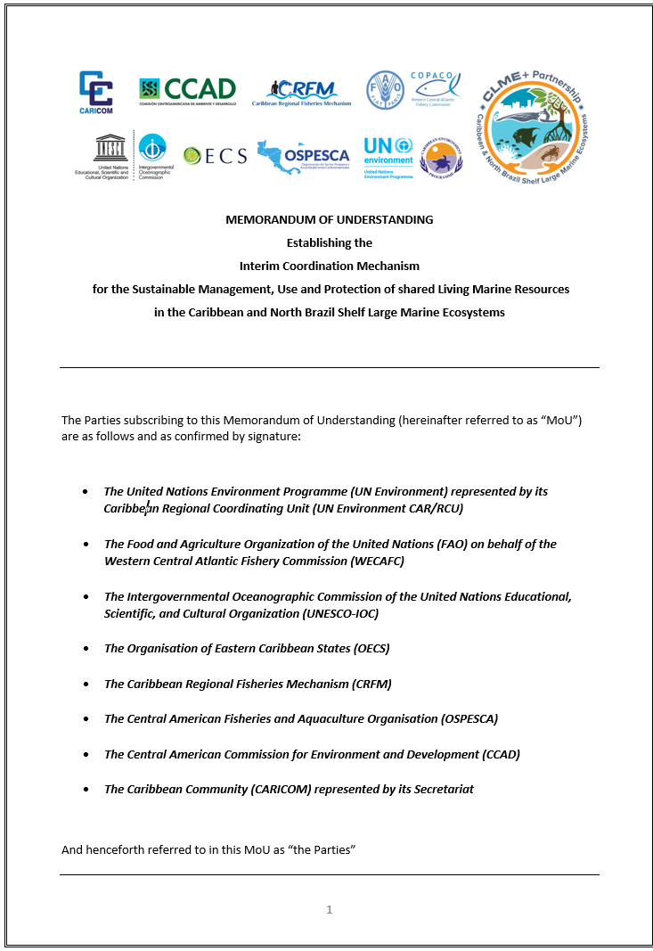
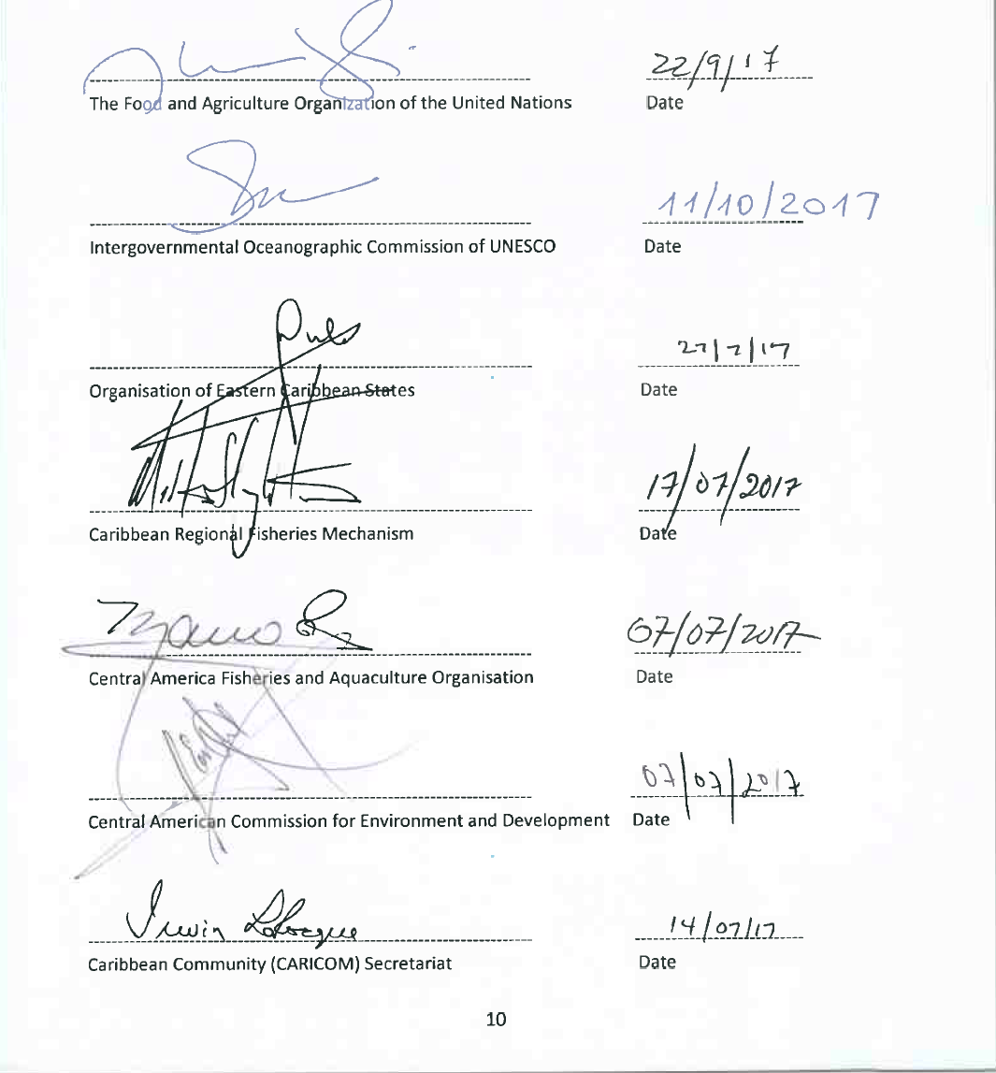
Status SAP Interim Coordination Mechanism
SAP Interim Coordination Mechanism formally established on 27 July 2017
By December 2017 all eight IGOs had signed MOU.
Three meetings of the CLME+ SAP Interim Coordination Mechanism to date

Slide 6
Action Required
The CLME+ Project Steering Committee is being asked to (a) acknowledge the status of the CLME+ SAP Interim Coordination Mechanism and, (b) express their continued support for the interim coordination mechanism.

Slide 7
Reunión del Medio Término del Proyecto CLME+, 18-20 Junio, Panamá
Thank You
Catalyzing implementation of the Strategic Action Programme for the Caribbean and North Brazil Shelf LME’s (2015-2020)

