Slide 1

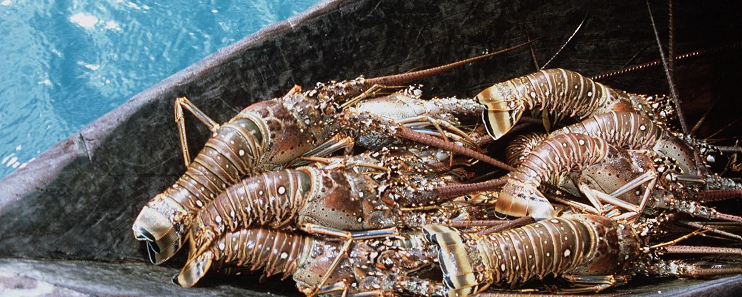

Mid-Term Project Steering Committee Meeting, 18-20 June, Panama
Development of Research Strategies to address the CLME+ Science-Policy Gap
In the countries sharing the Caribbean and North Brazil Shelf Large Marine Ecosystems
Catalyzing implementation of the Strategic Action Programme for the Caribbean and North Brazil Shelf LME’s (2015-2020)

Slide 2
Introduction
Founded in 1947, the Gulf and Caribbean Fisheries Institute is dedicated to advancing the goals of sustainable use, wise management, conservation, and restoration of fisheries and marine resources in the Gulf of Mexico and Caribbean region.
The mission of GCFI is to advance the goals of sustainable use, wise management, conservation, and restoration of fisheries and marine resources in the Gulf of Mexico and Caribbean region by providing a forum for the exchange of information and perspectives among decision-makers, scientists, managers, educators, students, and resource users.

Slide 3
Introduction
Component # 2: Enhancing the capacity of key institutions and stakeholders to effectively implement knowledge-based EBM/EAF for sustainable shared marine living resources (sLMR) use in the CLME+ region
Identify CLME+ Outputs Responsible For (or contributing to): Enhanced institutional and stakeholder capacity for sustainable and climate-resilient sLMR management at regional. Subregional, national, and local levels with special attening to regional and subregional organisations with key roles in SAP implementation
Targeted research strategies to address scientific demands from organizations dealing with fisheries and the protection and sustainable use of the marine environment

Slide 4
Status technical implementation:
Status financial expenditure
On Track | Moderate Delays | Major Delays
 | √
On Track | Moderate Delays | Major Delays
 | √

Slide 5
Project Implementation Overview
Category | Percentage
Completed | 0/3
On track | 2/3
Low risk of not completing on time | 1/3
High risk of not completing on time | 0/3
High risk of target not being achieved | 0/3

Slide 6
Achievements to Date
(Please outline, any achievements, including relevant activities implemented towards achieving a milestone and target as defined in the CLME+ Project, as well as any targets and/or milestones achieved)
Two workshops were conducted which address 2 of the 3 strategies (LBS pollution and EAF approach). Reports of the meetings were developed.
Electronic surveys were developed for distribution to relevant email distribution lists. In addition, the surveys were distributed to specific target audiences such as 1) members of the WECAFC and 2) the Marine Spatial Planning DSS workshop participants at the 2017 GCFI in Panama.
A Table of Contents was developed in coordination with the PCU and consultants which was informally endorsed by the PCU at the and April 2018.
Subject experts have been identified and hired.

Slide 7
Challenges Being Experienced
# | Challenge | Mitigative Measure | By When
1 | Hiring subject experts: The scope of the expectations for the final report was not clear to us until only very recently. Because there were many different iterations of the outline for the final report, the ‘approval’ for the scope was only recently endorsed. Therefore, subject experts for the chapters could not be employed until we received the endorsement. | Now that we have received the endorsement for the structure of the report, several experts have been contacted to participate in the development of this report. We will also be engaging other subject experts from the CLME+ PEG partners and others. | Subject experts will be identified and employed by 15 June 2018.
2 | Two interim research strategies were not completed. Information gathering was completed; the results are still being analyzed for a final report in the format agreed upon between the PCU and GCFI. | The issue was how to present the information in a form that was consistent with the expectations of the PCU. We will distribute the electronic questionnaires to additional email distribution list for feedback on the issues. | 1 July 2018

Slide 8
Financial Implementation
Agency name | 2018 Budget | Amount spent up to April 2018 | 2019 Budget | Risk of not achieving budget objective | Proposed remedial actions
GCFI | $64,674 | $4,647 | $43,016 | N/A | No-cost extension was requested to the end of 2019. Now that subject experts are hired, funds will be disbursed more rapidly.

Slide 9
Crosscutting Recommendations for Successful Project Implementation
Better and faster use of existing knowledge from different disciplines
There is a wealth of scientific knowledge available throughout the region on many different aspects of the marine environment. The challenge is how to make this knowledge easily visible and available to policy makers.
Act as a clearing house and establish a repository of information of key activities and people in the marine and maritime science-policy interfaces. Including information from Member States, regional and sub-regional level.
The development of a common vision and actions for marine research infrastructure use and access
This would ensure cost effective coordination between science, monitoring needs and research infrastructure support.
Human Capacity building
To fund projects for training in specific emerging issues in marine sciences. This initiative should be aligned with the needs of environment, marine and maritime sectors.
It should consider the need to bridge the gap between education/training and the labor market and actively promoting the attractiveness of marine and maritime jobs.

Slide 10
Mid-Term Project Steering Committee Meeting, 18-20 June, Panama
Thank you
Catalyzing implementation of the Strategic Action Programme for the Caribbean and North Brazil Shelf LME’s (2015-2020)

