Slide 1
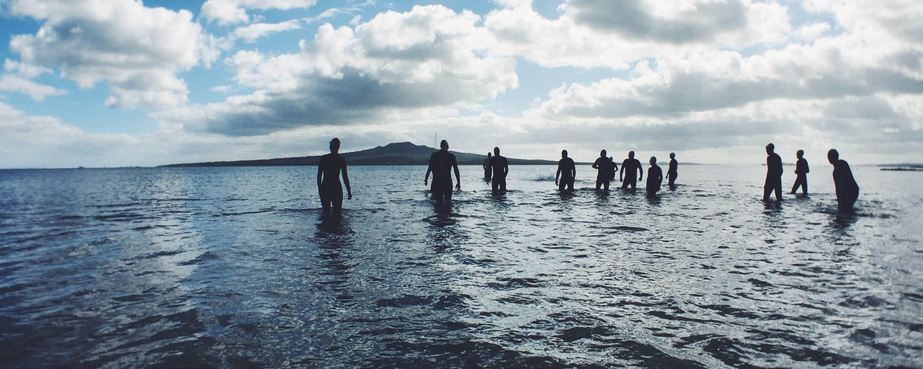

Mid-Term Project Steering Committee Meeting, 18-20 June, Panama
ENGAGING CIVIL SOCIETY IN CLME+ SAP IMPLEMENTATION
Catalyzing implementation of the Strategic Action Programme for the Caribbean and North Brazil Shelf LME’s (2015-2020)

Slide 2
About CANARI
Caribbean Natural Resources Institute (CANARI):
is an independent regional technical institute with 30+ years of experience in facilitating and promoting participatory approaches to natural resource governance to:
      conserve biodiversity
      improve ecosystem goods and services
      enhance livelihood benefits and well-being of the poor and marginalised in the Caribbean
places strong emphasis on multidisciplinary research, capacity building, partnerships and communication to build awareness and influence policy
works with the full range of stakeholders in the Caribbean who have rights to, interests in, or responsibilities for natural resources, to facilitate their equitable and effective participation in decisions about the use and management of these resources

Slide 3
CLME+ Project outputs
Component # 2: Enhancing the capacity of key institutions and stakeholders to effectively implement knowledge-based EBM/EAF for sustainable shared living marine resources use in the CLME+
The specific outputs included in the CLME+ Project to address this are:
Output 2.2 - Process Indicator 1 – Civil Society Action Programme (C-SAP)
Output 2.2 - Process Indicator 3 – Small Grants Coordinating Mechanism
Output 3.5 - Process Indicator 1 - Modest small grants support for the implementation of actions under the C-SAP and/or Private Sector Action Programme (P-SAP), developed under Output 2.2.

Slide 4
Status technical implementation:
Status financial expenditure
On Track | Moderate Delays | Major Delays
 | X
On Track | Moderate Delays | Major Delays
 | X

Slide 5
Category | Ratio
Completed
On track | 5/5
Low risk of not completing on time
High risk of not completing on time
High risk of target not being achieved

Slide 6

Achievements to Date
During the reporting period, under the Engaging Civil Society in CLME+ Strategic Action Programme Implementation – Implementation Strategy and Work Plan 2017 - 2019, CANARI achieved the following:
Output 2.2 - Process Indicator 1 – Civil Society Action Programme (C-SAP)
Developed a Microsoft Access database which includes data/information on:
  existing civil society organisations (CSOs) (formal and informal) and community small and micro-enterprises (SMEs) which are playing, have a role to play and/or are likely beneficiaries in the achievement of the long-term vision for the marine environment in the CLME+ region;
  existing civil society awareness raising and capacity building initiatives and mechanisms currently operational within the CLME+ region.
2. Convened regional workshop to develop the Civil Society Action Programme for Sustainable Management of the Shared Living Marine Resources of the Caribbean and North Brazil Shelf Large Marine Ecosystems (CLME+ C-SAP), January 16 – 19, 2018, Trinidad and Tobago, and prepared the workshop report
3. Prepared and disseminated first draft of the CLME+ C-SAP

Slide 7
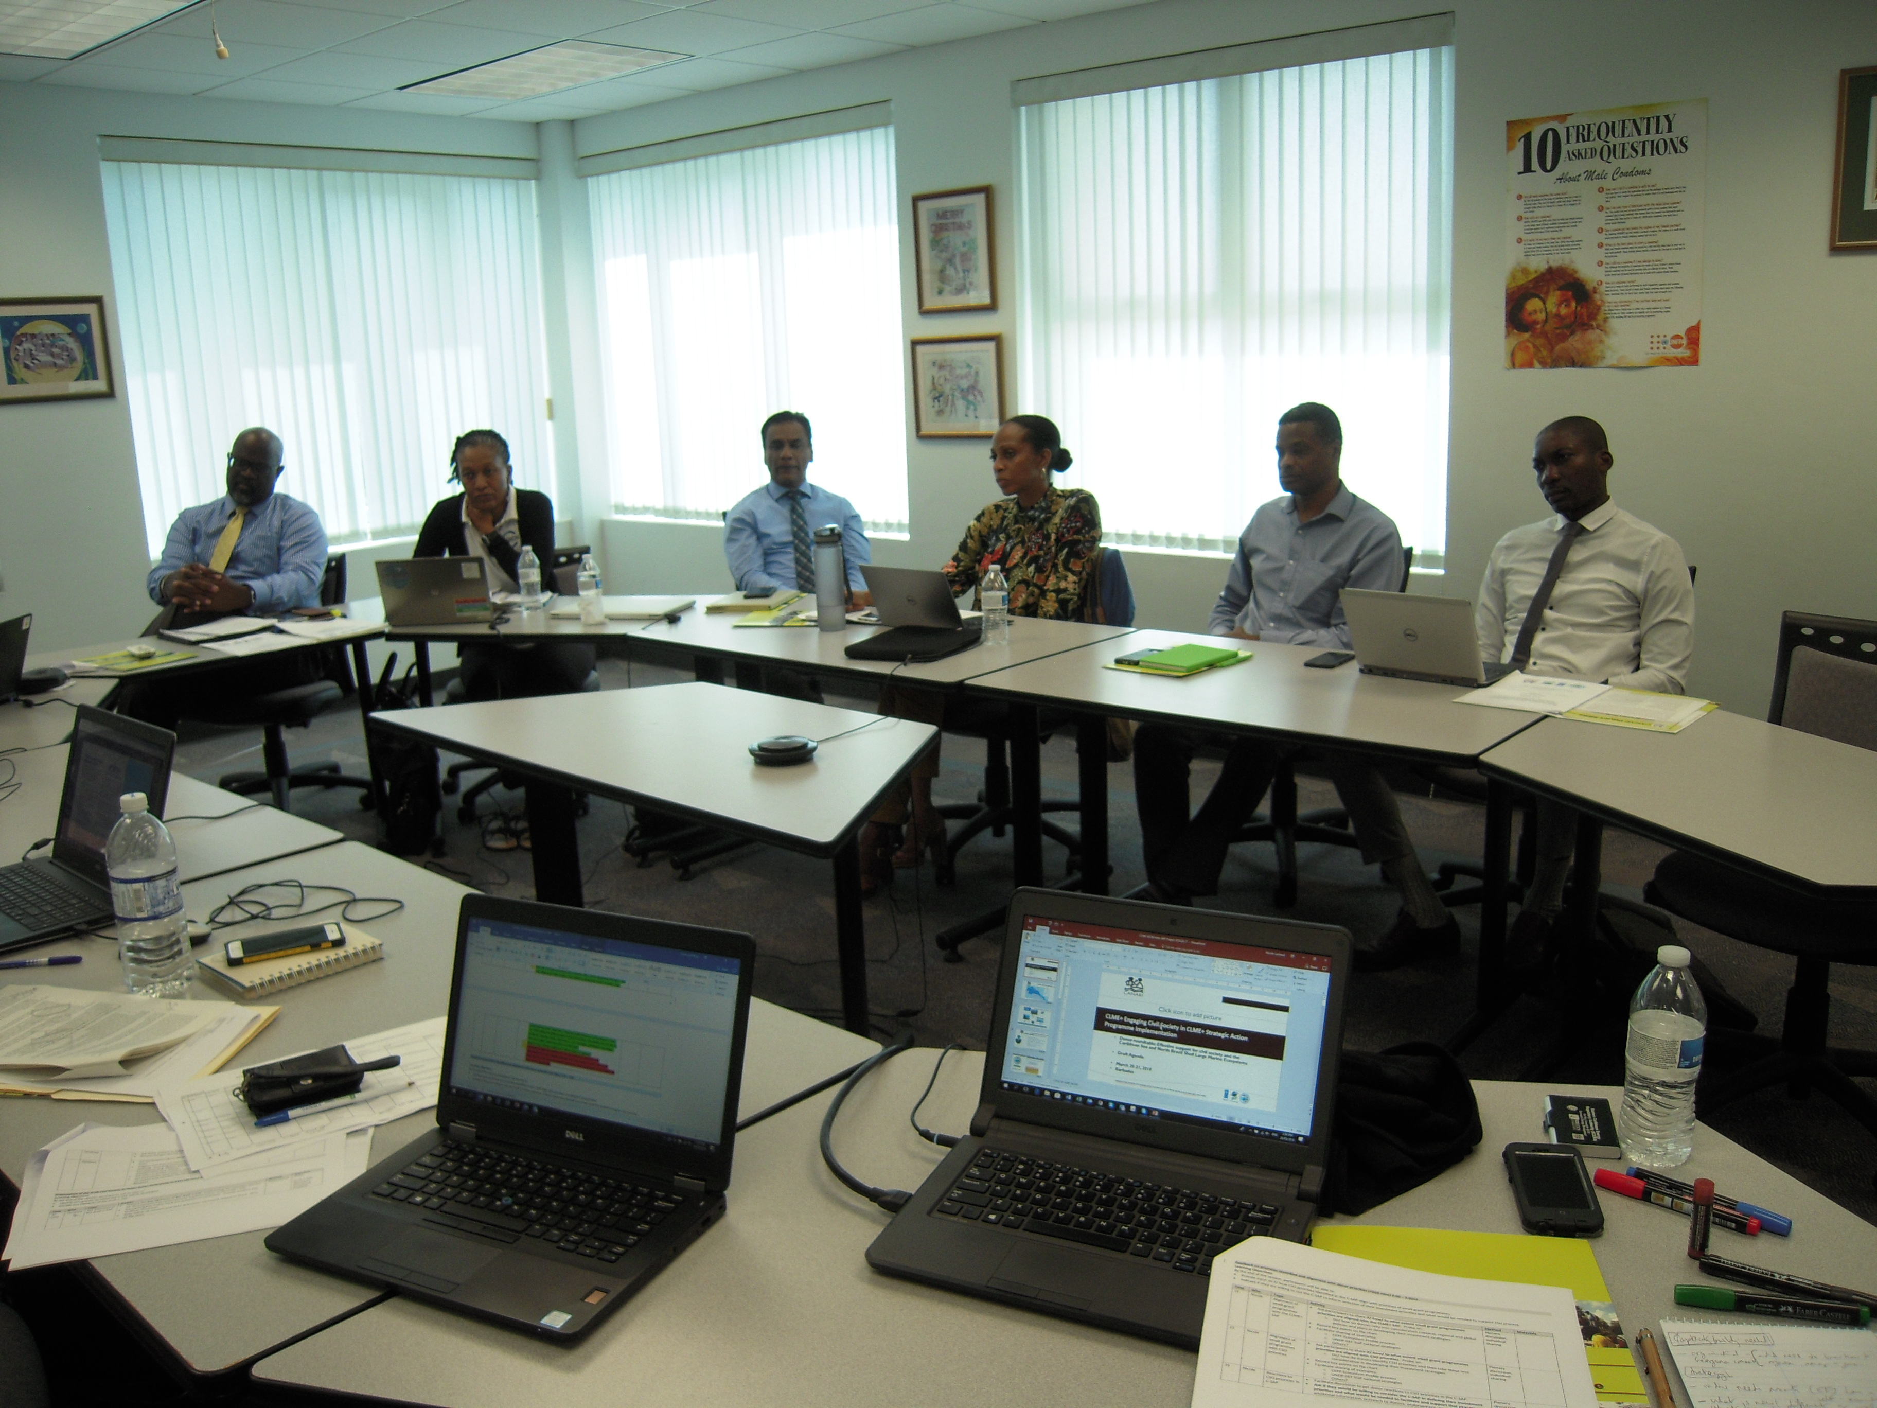
Achievements to Date
Output 2.2 - Process Indicator 3 – Small Grants Coordinating Mechanism
Developed a Microsoft Access database which includes data/information on:
  existing small grant programmes that are operational within the CLME+ region and that can contribute to the objectives of the CLME+ SAP and CLME+ Project
2. Convened a Donor roundtable: Effective support for civil society and the Caribbean Sea and North Brazil Shelf Large Marine Ecosystems, March 20 – 21, 2018, Barbados, and prepared the Donor Roundtable report

Slide 8
Achievements to Date
Output 3.5 - Process Indicator 1 - Modest small grants support for the implementation of actions under the C-SAP and/or Private Sector Action Programme (P-SAP), developed under Output 2.2.
Strengthened capacity of key stakeholders in St. Kitts and Nevis in sea moss farming, as a demonstration of an alternative livelihoods initiative within the concept of EBM:
Convened national workshop to develop a strategy and action plan to build the capacity of fisherfolk and technical support agencies to cultivate sea moss and commercialise its production, July 11 – 12, 2017, St. Kitts and Nevis, and prepared the Workshop Report, with Strategy and Action plan
Convened two one-day workshops to promote the development of two community based groups in St. Kitts and Nevis to cultivate sea moss and commercialise its production, January 22 & 23, 2018.

Slide 9
Financial Implementation
CANARI | 2018 Budget | Amount spent up to April 2018 | 2019 Budget | Risk of not achieving budget objective | Proposed remedial actions
 | 315,215 | 166,005 | 24,500

Slide 10
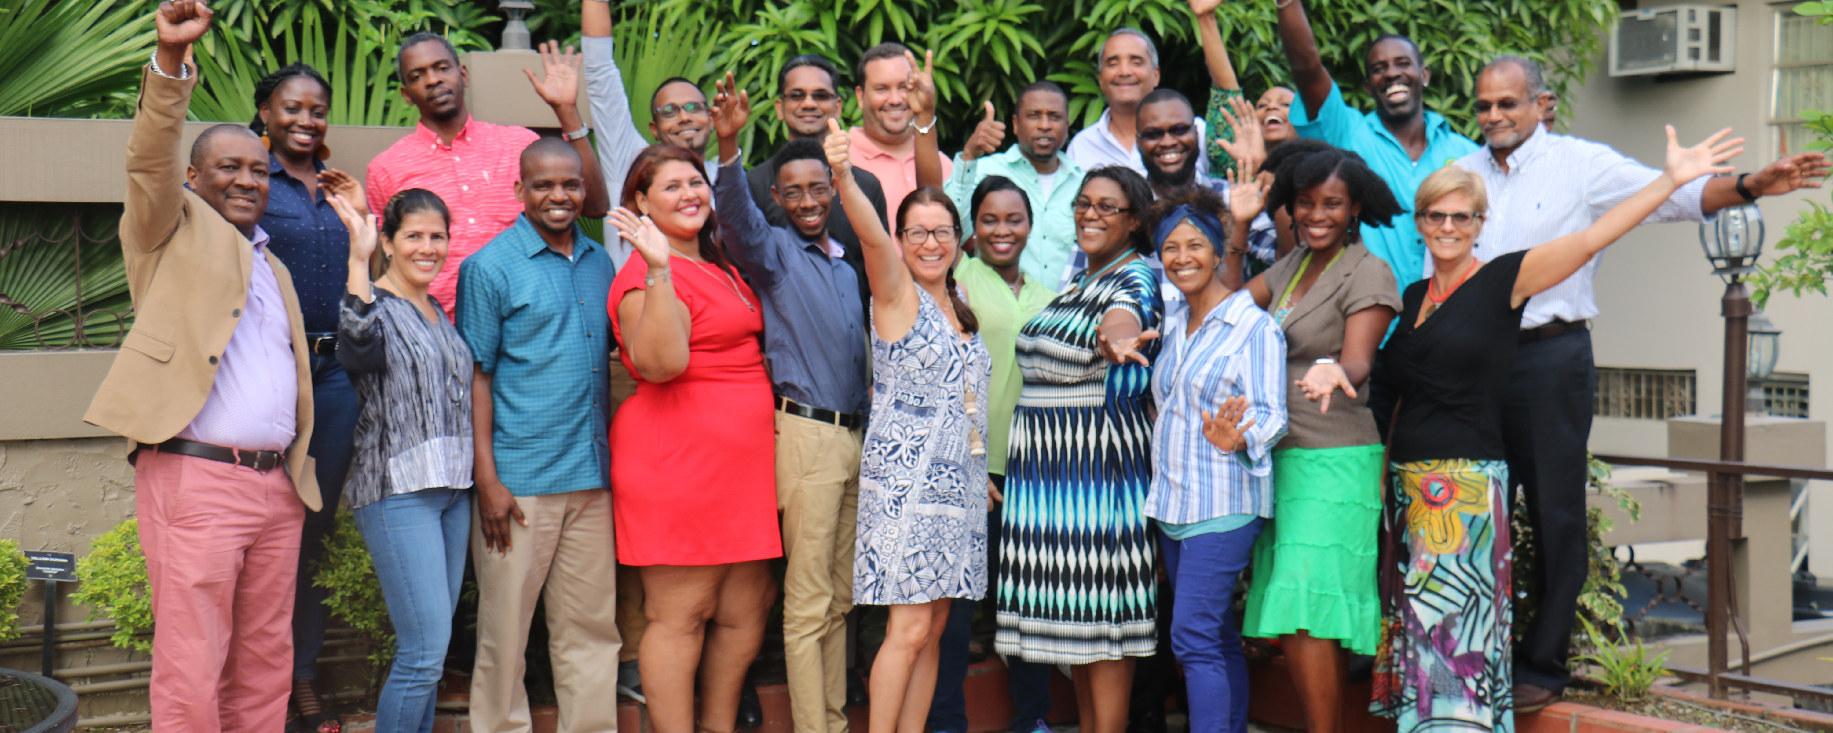
Mid-Term Project Steering Committee Meeting, 18-20 June, Panama
Thank you
Catalyzing implementation of the Strategic Action Programme for the Caribbean and North Brazil Shelf LME’s (2015-2020)

