Slide 1
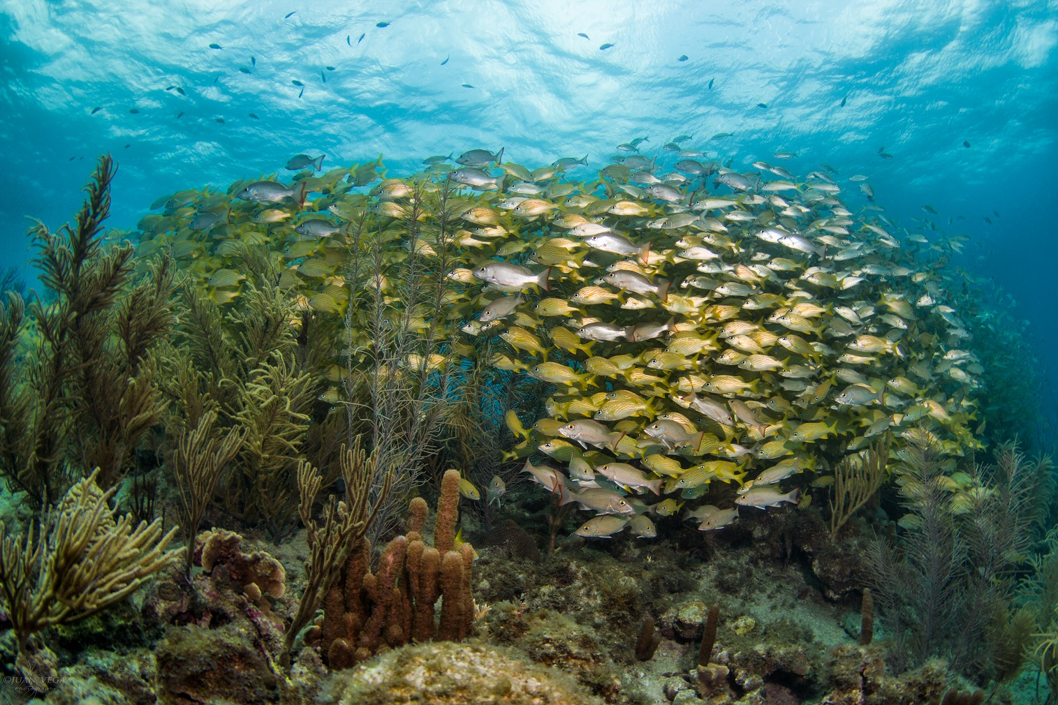
Mid-Term Project Steering Committee Meeting, 18-20 June, Panama
Sub-Agenda Item 11.3
State of the Marine Environment and Associated Economies (SOMEE) Reporting Mechanism
Catalyzing implementation of the Strategic Action Programme for the Caribbean and North Brazil Shelf LME’s (2015-2020)

Slide 2
Presentation Outline
What is SOMEE?
SOMEE Mandate, Rationale & Value added
Overall aims of SOMEE
Institutionalizing SOMEE
How it all fits together: SOMEE and the TDA/SAP cycle & Policy Cycle
General approach
Assessment frameworks (Governance Assessment Framework and DPSIR)
SOMEE Process and Production Team
Report outline
Current status (as at 2nd PSC Meeting)
Next steps
Timeline
Budget
Actions (CLME+ Project Steering Committee)

Slide 3
What is SOMEE?
A comprehensive, collaborative, and integrated regional mechanism for the periodic assessment of the state and governance of the CLME+ marine environment, its ecosystem goods and services and related socio-economic aspects, which will inform decision-making to ensure sustainable benefits and livelihoods for the well-being of the people of the region
To be institutionalized within the Intergovernmental Organizations that form the foundation for the CLME+ Regional Ocean Governance Framework
FOR WHOM?
Governmental & Non-governmental audiences with a formal mandate for, or key role in living marine resources governance and management in the wider Caribbean/CLME+ region
IGOs
Donors
Private sector
NGOs & other supporting organizations
REPORT
POLICY SUMMARY
DYNAMIC ONLINE PLATFORM

Slide 4
Why SOMEE?
The current UNDP/GEF CLME+ Project is catalyzing implementation of SAP Strategies and Actions to achieve the SAP Objectives and its over-arching Vision of a “healthy marine environment benefiting the people of the region”…….
SOMEE MANDATE
SAP Strategy Action 1.11 (Establishment and enhancement of the capacity for monitoring, assessment, and reporting on the state of the marine environment)
CLME+ Project (Monitoring and assessing progress and results of implementation of the SAP, and experience sharing with the global LME practitioners community)
Partners’ mandates & inputs (e.g., UN-Env SOCAR, FAO SOFIA)
ICM Member States (endorsements)
But, how will we know whether SAP actions are having the desired impact, and where better performance is needed?
SOMEE MECHANISM!

Slide 5
Value added of SOMEE (SAP and beyond)
What do we have?
What’s missing?
GLOBAL
State of Fisheries (FAO)
World Ocean Assessment (UN)
SUBREGIONAL-
REGIONAL
WCR SOCAR Landbased sources of pollution (UN-Env CEP)
WCR State of Habitat Report (UN-Env-CEP)
NATIONAL
Reporting to Conventions
National State of Environment reports
Latin America & Caribbean Env. Outook (UN-Env)
Transboundary Waters Assessment LME Component (GEF/UN-Env/IOC-UNESCO)
Integrated overview of progress towards global & regional/sub-regional commitments & targets
Facilitate & harmonize existing reporting obligations & initiatives
Integrated assessment of governance & environmental state in the context of a blue economy
Support regional organizations to execute their mandates; foster synergies with non-gov’t partners
Regionally shared understanding of impact of human activities on the marine environment and living resources & how impacts affect industries, local livelihoods, & human well-being
Consolidate the CLME+ Regional Governance Framework, & facilitate a more coordinated approach to policy development
Regionally integrated synthesis of the ecosystem approach for management of human activities in the CLME+ region
Formally adopted reporting structure allows to periodically assess progress
THEMATIC
Biodiversity Outlook (CBD)…
SOMEE MECHANISM

Slide 6
Overall aims of SOMEE
Inform Governments, IGOs, donors, private sector, and others about the status of the marine environment, its governance, and associated economies
Integrate the different sectoral reporting mechanisms in the WCR (e.g., under the Cartagena Convention and Regional Fisheries Bodies,…), in order to promote policy coherence and provide a more holistic status overview
Support periodic tracking of progress and visualize distance-to-target, e.g., achievement of the vision and long-term objectives of the SAP and other relevant sub-regional, regional, and global goals (including the SDGs)
Provide early warning and analysis of potential environmental problems
Provide a credible scientific basis for decision making and leveraging support from donors
Build institutional capacity in the region for environmental monitoring, assessment, and reporting
Trigger action among decision-makers and others to address current and emerging issues relating to the sustainable use of the marine environment

Slide 7
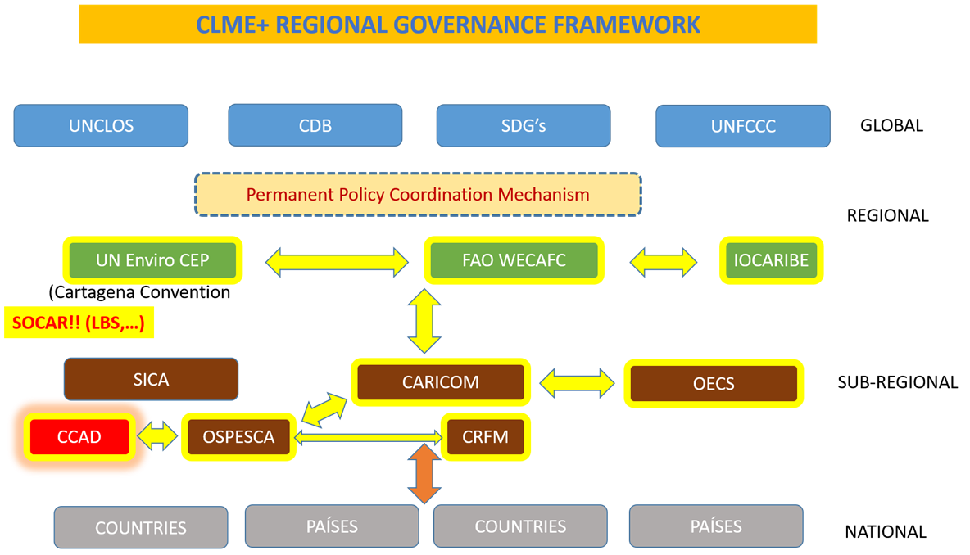
Institutionalizing SOMEE
SOMEE will be embedded within and led by the SAP ICM/PPCM, with contributions from members of the wider CLME+ Partnership
Each ICM organization to contribute to SOMEE according to its mandate, expertise, and available resources
Sub-regional and national efforts to also feed into SOMEE

Slide 8
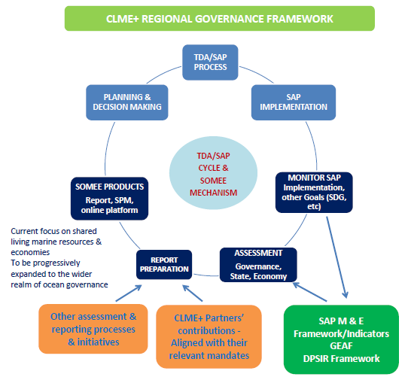
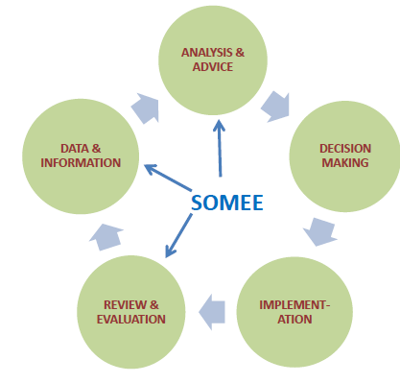
SOMEE & TDA/SAP Cycle / Policy Cycle
(Fanning, L., Mahon, R., & McConney, P. 2013)

Slide 9
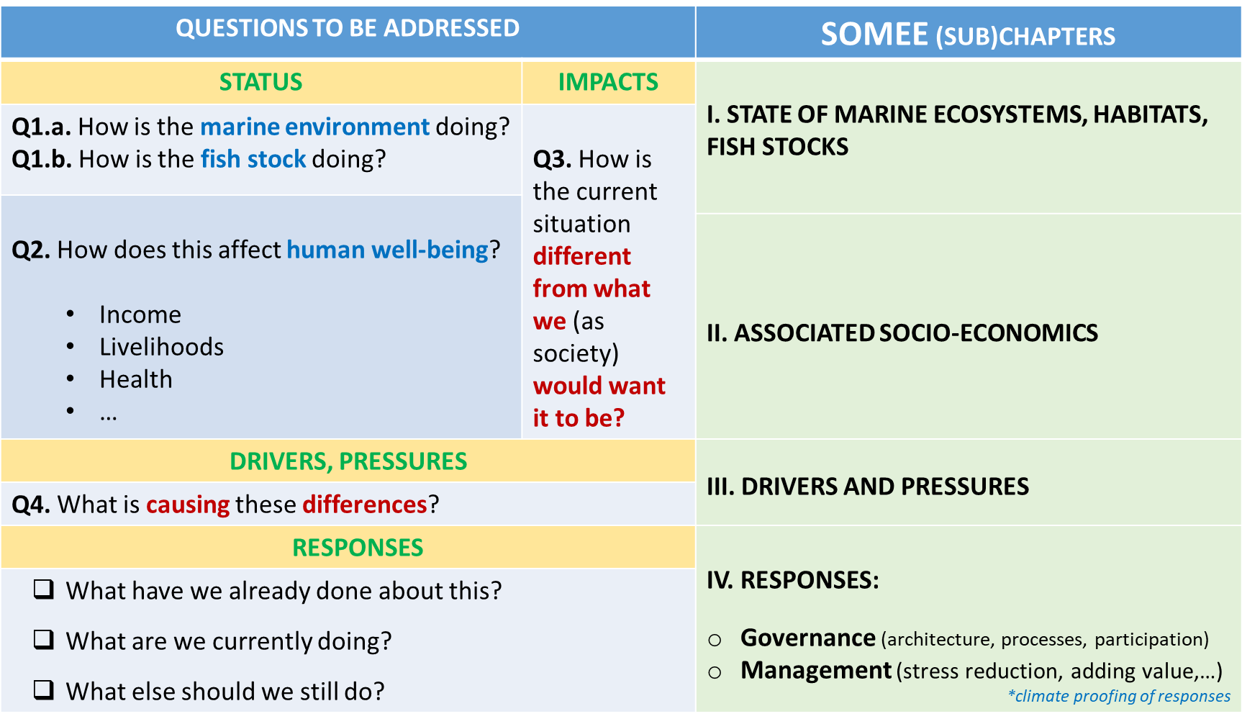
General Approach

Slide 10
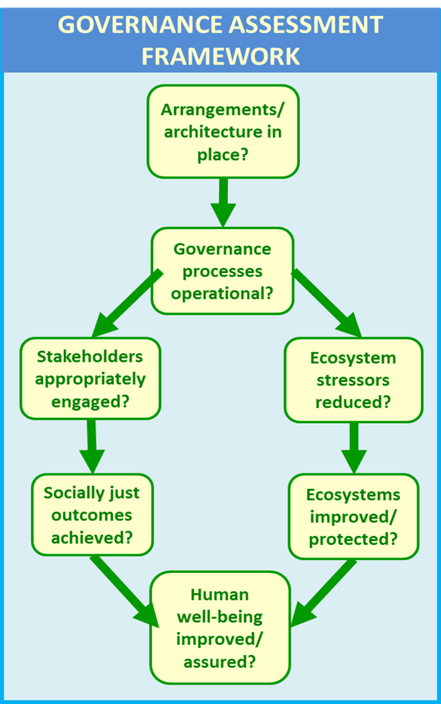
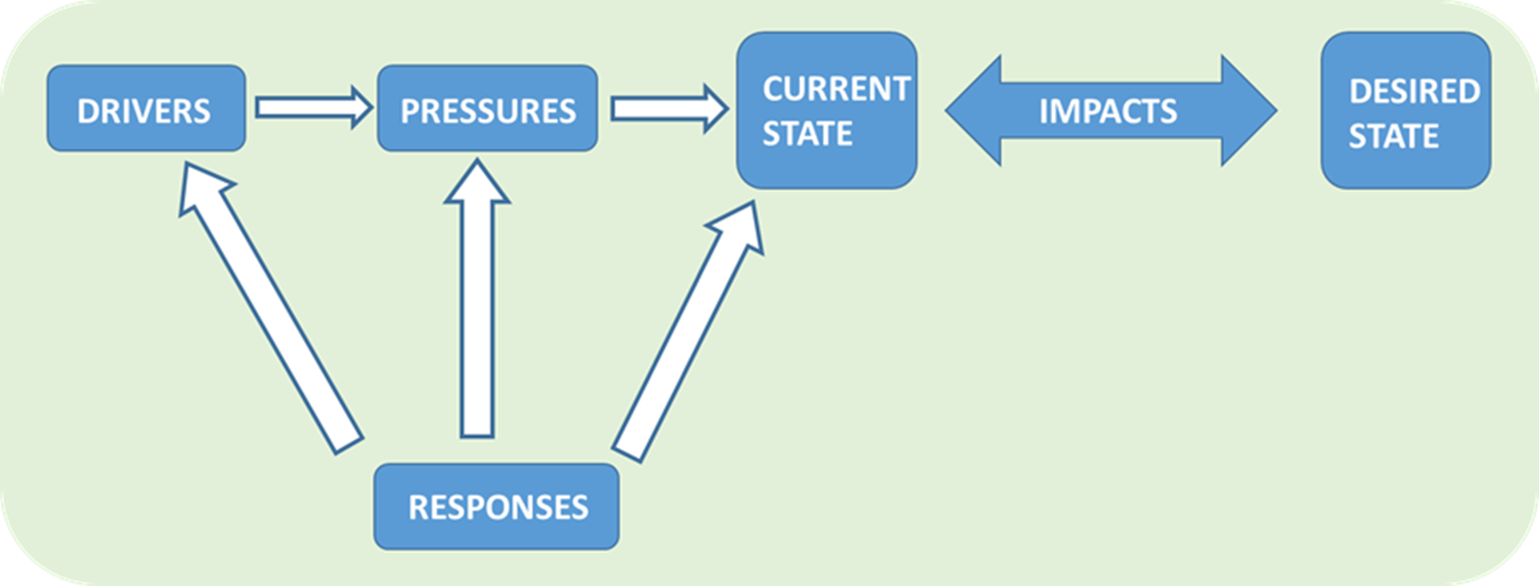
Assessment frameworks
DPSIR FRAMEWORK
Good governance
Distance between the current state and the state that we as society desire. Aim is to minimize this distance
Effective governance

Slide 11
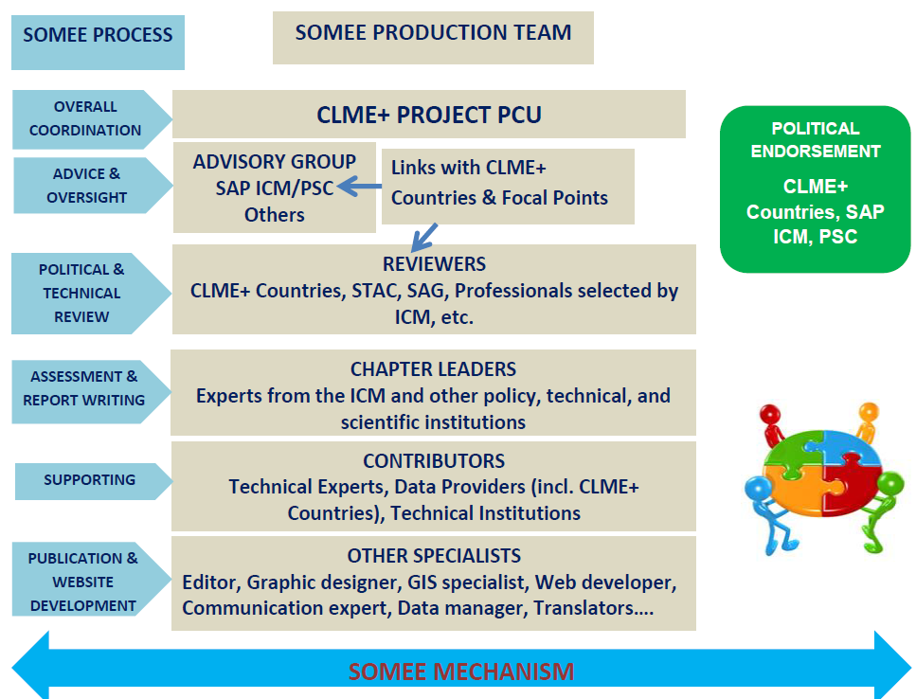
SOMEE Process & Production Team

Slide 12
SOMEE Report Outline
CHAPTER 3
Sub-ecosystem: coral reefs, mangroves and seagrass beds
3.1 Ecosystem-based Management for the Reefs Sub-Ecosystem
3.1.1 Status and trends of the reef sub-ecosystem
3.1.2 Drivers and pressures
3.1.3 Responses
3.2 Ecosystem Approach to Fisheries on the reef sub-ecosystem (spiny lobster, queen conch & other reef fisheries)
CHAPTER 4
Sub-ecosystem: Pelagic
4.1 Ecosystem Approach to Fisheries for the Pelagic Sub-Ecosystem (pelagic, flying fish, large pelagic fisheries)
CHAPTER 5
Sub-ecosystem: Continental Shelf (sandy/muddy flats)
5.1 Ecosystem-based Management for the Continental Shelf Sub-Ecosystem
5.2 Ecosystem Approach to Fisheries for the Continental Shelf (shrimp and groundfish fisheries)
SYNTHESIS & CONCLUSIONS
CHAPTER 1
1 Introduction
1.1 Global importance of the oceans
1.2 Regional approaches to ocean governance
1.3 The CLME+ region
1.4 Towards a blue economy for the CLME+ region
1.5 Regional Governance Framework
1.6 The 10-year CLME+ Strategic Action Programme (SAP)
1.7 CLME+ SOMEE: purpose, mandate and approach
CHAPTER 2
General state of the marine environment & associated economies
2.1 State of the LMEs and their associated living resources
2.2 Associated socioeconomics
2.3 Drivers and pressures
2.4 Responses
2.4.1 Region-wide governance arrangements and processes for the protection of the marine environment
2.4.2 Region-wide governance arrangements and processes for Sustainable Fisheries
2.4.3 Region-wide arrangements and processes for Integrated Ocean Governance

Slide 13
SAP ICM Contribution to SOMEE Report
Report chapter | Proposed chapter leader | Contributors (among others)
Introduction | PCU | CERMES, UNDP
2. General state of the marine environment and associated economies | PCU, UN-E CEP, WECAFC | CERMES,…
3. Sub-ecosystem: Coral reefs, mangroves and seagrass beds | PCU, UN-E CEP, WECAFC | CERMES, JWG, TNC, WWF, IUCN, GCRMN,….
4. Sub-ecosystem: Pelagics | PCU, CERMES, WECAFC | IFCM, JWG
5. Sub-ecosystem: Continental Shelf | PCU, CERMES, UN-E CEP, FAO | JWG
Synthesis & Conclusions | PCU | ICM

Slide 14
Current Status, as at 2nd PSC Meeting (June 2018)
SOMEE approach & methodology developed (incl. GEAF & DPSIR)
The concept and report annotated outline have been developed in collaboration with key CLME+ partners
SOMEE inception workshop held in February 2018 (Cartagena), with SAP ICM and CLME+ Project Executive Group members and others, to elaborate the approach and methodology, define the initial proposal for report contents, prepare workplan, etc.
Pre-identification of key indicators, datasets, and information sources for SOMEE
Chapter 1 of the SOMEE report drafted and is under review by the CLME+ PCU
Senior Environmental Reporting Specialist (SERS) and Monitoring and Mapping Specialist (MMS) recruited
The report outline was presented for country endorsement in 2017 during intergovernmental meetings of the CLME+ SAP ICM members
OSPESCA, CRFM, OECS, FAO, UN Environment, and IOC-UNESCO constituents have endorsed the outline
(Endorsement by CARICOM and CCAD constituents expected this year)
Contributors (institutions and experts) have been identified
Workplan has been revised

Slide 15
Immediate Next Steps
Activity | Responsible
Finalize detailed workplan for completion of SOMEE (with country feedback & buy-in) | PCU
Detailed assessment with ICM and PEG members of current status of SOMEE contributors and their capacity and needs for preparing their contributions (stock taking); identify measures to address any issues | PCU, ICM, PEG
Discussion with ICM and PEG members to clarify and agree on expectations and next steps | PCU, ICM, PEG
Present the SOMEE outline and approach in CARICOM and CCAD meetings in 2018 for endorsement | PCU
Determine expertise required, develop Terms of Reference, and identify potential experts | PCU
Review/revisit the SOMEE outline, as required (adaptive management approach, throughout SOMEE development timeline) | PCU, others
Prepare proposal for institutionalizing and sustaining the SOMEE mechanism, including institutional needs and commitments, and financial requirements | PCU, ICM, PEG
Develop advocacy/awareness building materials on SOMEE mechanism | PCU

Slide 16
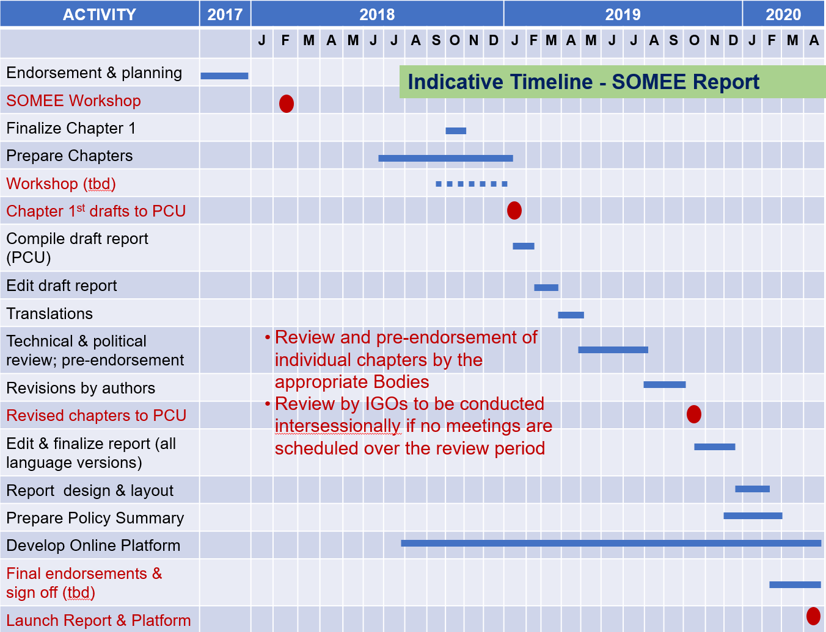
Notes:
Report & online platform production schedule

Slide 17
ACTIVITY |  | 2018 |  |  |  |  | 2019 |  |  |  |  |  |  |  |  |  |  |  | 2020
 | J | A | S | O | N | D | J | F | M | A | M | J | J | A | S | O | N | D | J | F | M | A
Consultation with CLME+ Countries, ICM, PSC, PEG, others
Prepare baseline analysis & draft proposal for institutionalizing SOMEE (PCU)
Review of proposal (CLME+ Countries, ICM, PSC, PEG, others)
Revise proposal
Pre-endorsement of proposal
Align proposal with PPCM & Sustainable Financing Plan option |  |  |  |  |  |  |  | *
Implement proposal (MOUs, expression of interest, id. Donors, etc) |  |  |  |  |  |  |  |  |  |  |  |  |  |  |  |  |  |  | *
Prepare draft report on institutionalizing SOMEE (PCU); translations
Review of draft report by CLME+ Countries, ICM, PSC, PEG
Finalize report
Indicative timeline- Institutionalizing SOMEE
* ICM Mtg 15-17 Aug
*Revised 2nd draft PPCM report due Feb 2019
*Final draft PPCM report due Jan 2020

Slide 18
Budget – not only from CLME+ Project!
AGENCY | BUDGET FROM CLME+ PROJECT | BUDGET FROM OTHER SOURCES
UNEP | Regional Action Plan Pollution Feasibility Studies & Investment Plan - Nutrients Regional Action Plan- Habitats; Feasibility Studies & Investment Plan -Habitats SOCAR (LBS) and State of Habitats report Subproject EBM NBSLME and CLME SAP M&E and SOMEE | IWEco MEA GCRMN State of Corals (SPAW-RAC)?
OSPESCA | Fisheries data infrastructure with harmonized data Common model for the evaluation of fisheries populations M&E framework with reference values in web portal
CRFM | Sub-regional data policy Contributions to FIRMS stocks data Flyingfish stock status; Contribution of Flyingfish to food security Communication strategy
FAO | Regional Action Plan IUU Feasibility Studies & Investment Plan – Fisheries Data + info repository – DSS iMarine and FIRMS System to track and evaluate progress towards EAF SAP M&E and SOMEE | State of World’s Fisheries and Aquaculture
OECS | Data communication and exchange SAP M&E and SOMEE | CROP

Slide 19
Budget (cont’d)
AGENCY | BUDGET FROM CLME+ PROJECT | BUDGET FROM OTHER SOURCES
IOC | SAP M&E and SOMEE | Ocean Science Report World Ocean Assessment
CARICOM |  | Caribbean Statistics Programme
CCAD |  | M2R
CERMES | GEAF indicators SOMEE subsections on governance architecture and processes | SocMon
GCFI | Research strategies
CANARI | C-SAP
World Bank |  | Mapping Ocean Wealth, Natural/Coastal Capital
IUCN |  | BIOPAMA - State of Protected Areas?

Slide 20
PSC Actions
The meeting is invited to:
acknowledge the SOMEE development approach, as presented
acknowledge its importance for consolidating the CLME+ Regional Framework for Ocean Governance, called for under the CLME+ SAP
endorse the proposal for its development and institutionalization, as presented or amended

Slide 21
Mid-Term Project Steering Committee Meeting, 18-20 June, Panama
Thank you! Gracias! Obrigado! Merci!
Sherry Heileman
CLME+ Senior Environmental Reporting Specialist (SERS)
SherryH@unops.org
Catalyzing implementation of the Strategic Action Programme for the Caribbean and North Brazil Shelf LME’s (2015-2020)

