Slide 1

Editable Text
SECOND MEETING OF THE UNDP/GEF CLME+ PROJECT STEERING COMMITTEE, 18-20 JUNE 2018
SUB-AGENDA ITEM 7.3 – Output 1.2. National intersectoral coordination mechanisms (NICs) in place (including science-policy interfaces)
Catalyzing implementation of the Strategic Action Programme for the Caribbean and North Brazil Shelf LME’s (2015-2020)

Slide 2
NICs improve
consultation and coordination processes at the national level
national level linkages with (sub-)regional marine governance
NICs are important to achieve full country ownership over CLME+ SAP and CLME+ Project implementation
NICs positively impact the effectiveness of SAP/project governance and implementation including EBM/EAF

Slide 3
NICs established and operationalized is a country responsibility
CLME+ Project support and guidance for institutionalising NICs
The target:
Sustainable NICs operating in at least 60% of
CLME+ participating countries by end of 2019
60% by 2019

Slide 4
What is the function of a a NIC?
NIC
Scaling up
Scaling down
Connecting actors
Integrating interests

Slide 5
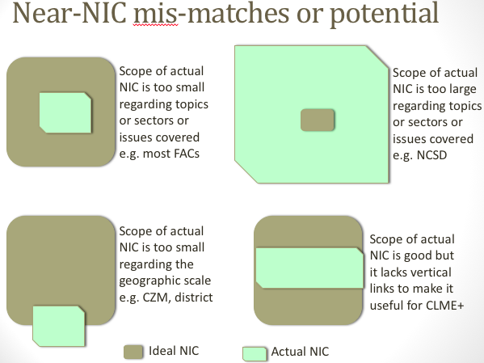
Nature of the NIC; Name the NIC
Mandate; legal/administrative
Sector and/or issue coverage
Stakeholder inclusion (and gender)
Documents; transparency; accountability
Enabling environment for participation
Institutionalised review (learn, adapt)
Scale rate: participation, transparency
Scale rate: accountability, responsiveness
NICs over time: past, present, planned
Can relax NIC criteria to reach 60%

Slide 6
2016 Report on the Survey of National Intersectoral Coordination Mechanisms (NICs)
2017 Good Practice Guidelines for Successful National Intersectoral Coordination Mechanisms (NICs)
[https://www.cavehill.uwi.edu/cermes/news/technical-reports.aspx]

Slide 7
NIC | Near NIC | No NIC
Brazil | Aruba | Anguilla
Cayman Islands | Bahamas | Antigua and Barbuda
Colombia | Belize | Barbados
French Guiana | Bonaire, St. Eustatius, Saba | British Virgin Islands
Grenada | Costa Rica | Cuba
Mexico | Curacao | Dominica
Puerto Rico/USVI | Guatemala | Dominican Republic
Nicaragua | Guyana | Guadeloupe
 | Jamaica | Honduras
 | Montserrat | Panama
 | Trinidad and Tobago | St. Barts
 |  | St Kitts and Nevis
 |  | Venezuela
Situation reported in 2016
Limited new information due to details not being easily obtained online or by interview. Difficult to validate interview data.
NIC + Near NIC about 60%

Slide 8
NIC | Near NIC | No NIC
Brazil | Aruba | Anguilla
Cayman Islands | Bahamas | Antigua and Barbuda
Colombia | Belize | Barbados
Cuba | Bonaire, St. Eustatius, Saba | British Virgin Islands
French Guiana | Costa Rica | Dominica
Grenada | Curacao | Dominican Republic
Mexico | Guyana | Guadeloupe
Puerto Rico/USVI | Jamaica | Guatemala
Nicaragua | Montserrat | Haiti
 | Trinidad and Tobago | Honduras
 |  | Panama
 |  | St. Barts
 |  | St Kitts and Nevis
 |  | St Lucia
 |  | St. Vincent and the Grenadines
 |  | Turks and Caicos
 |  | Venezuela
Situation in 2018 with a few more countries surveyed
New information acquired mainly added to No NIC. It remains difficult to validate data. Few gender data yet.
NIC + Near NIC about 53%

Slide 9
NICs status and trends are complex
Compiling NIC histories by country
Included in PhD research since 2017
Collaboration soon with OECS CROP
Collaboration through LME:LEARN
Will put validated info online soon
Challenges paying for country info
Importance of sub-projects
Need country collaborators
Seek governance researchers
Online transparency helpful

Slide 10
Way forward + next steps
UWI-CERMES will:
Continue to collect information on NICs through online searches, interviews, field visits, etc.
Provide information on NICs via an online platform when sufficiently complete and correct
Support NICs in at least 2 countries not supported through CLME+ sub-projects or partners
Analyze the governance, gender and other dimensions of NICs in ongoing doctoral research
Update NIC guidelines and share information on NIC successes through IW and LME:LEARN

Slide 11
Way forward + next steps
The CLME+ PSC and countries are expected to:
Provide information on NICs and in-kind support for research to enable UWI-CERMES work
Demonstrate uptake of NIC good practices and active use of NICs to achieve the 60% target

Slide 12
Second CLME+ Project Steering Committee Meeting
ditable Text
the end
Catalyzing implementation of the Strategic Action Programme for the Caribbean and North Brazil Shelf LME’s (2015-2020)

