Slide 1
2nd CLME+ Project Steering Committee
SUB AGENDA ITEM 7.1 – INTERIM COORDINATION MECHANISM FOR SUSTAINABLE FISHERIES
Second UNDP/GEF CLME+ Project Steering Committee Meeting
18- 20 June
Panama City
Catalyzing implementation of the Strategic Action Programme for the Caribbean and North Brazil Shelf LME’s (2015-2020)

Slide 2
Sustainable Fisheries Interim Coordination Mechanism
The Sustainable Fisheries Interim Coordination Mechanism:
Caribbean Regional Fisheries Mechanism (CRFM) – inclusive of OECS Member States
Organisation of the Central American Fisheries and Aquaculture Sector (OSPESCA)
Western Central Atlantic Fisheries Commission of the Food and Agriculture Organisation (WECAFC-FAO).

Slide 3
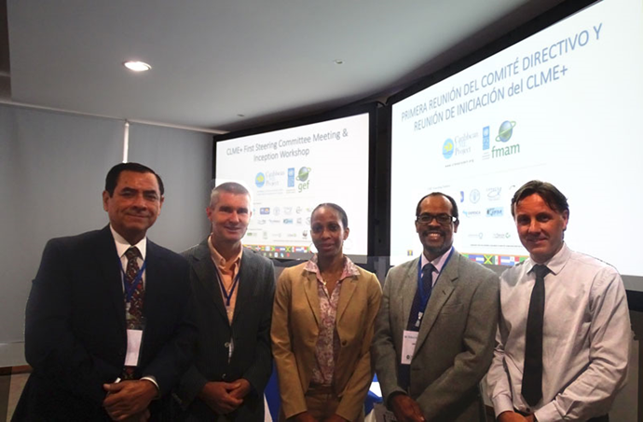
The Memorandum of Understanding(MOU) establishing the Interim Coordination Mechanism for Sustainable Fisheries was signed in January 2016 during the First CLME+ Project Steering Committee Meeting
MOU Objective: enhance regional governance for sustainable fisheries by formalizing an interim arrangement to facilitate, support and strengthen the coordination of actions among the Regional Fisheries Bodies in the Western Central Atlantic region.
Mario Gonzalez (OSPESCA), Raymon vanAnrooy (WECAFC), Laverne Walker (CLME+ PCU), Milton Haughton (CRFM), Patrick Debels (CLME+ PCU) - First CLME+ PSC 2016

Slide 4
Status Fisheries Interim Coordination Mechanism
Seven meetings of the Interim Coordination Mechanism for Sustainable Fisheries
Last Meeting: March 2018
Issues Discussed During Meetings:
Review and update of Fisheries ICM Work Plan including:
Queen Conch
Spiny Lobster
Sharks and Rays
Spawning Aggregations
Climate Change & Disaster Risk Reduction
Status 3 fisheries CLME+ sub-projects
Illegal Unreported and Unregulated Regional Strategy and Action Plan
Reorientation of WECAFC
Decision to launch process to establish an RFMO
Joint CRFM-OSPESCA Ministerial Meeting

Slide 5
Action Required
The CLME+ Project Steering Committee is invited to (a) acknowledge the work of the Interim Coordination Mechanism for Sustainable Fisheries and (b) express the continued support for the Interim Coordination Mechanism for Sustainable Fisheries

Slide 6
2nd CLME+ Project Steering Committee
Thank You
Catalyzing implementation of the Strategic Action Programme for the Caribbean and North Brazil Shelf LME’s (2015-2020)

