Slide 1

Second CLME+ Project Steering Committee Meeting
AGENDA ITEM 5 – OVERALL PROJECT IMPLEMENATATION STATUS :
TECHNICAL IMPLEMENTATION OVERVIEW
Second UNDP/GEF CLME+ Project Steering Committee Meeting
18- 20 June
Panama City
Catalyzing implementation of the Strategic Action Programme for the Caribbean and North Brazil Shelf LME’s (2015-2020)

Slide 2



CLME+ PROJECT
“Catalysing Implementation of the Strategic Action Programme
for the Sustainable Management of shared Living Marine Resources
in the Caribbean and North Brazil Shelf Large Marine Ecosystems”
CLME+ PROJECT (2015 – 2020)
Objective:
Facilitating EBM/EAF in the CLME+ region for the sustainable and climate-resilient provision of
goods and services from shared living marine resources, in line with the endorsed CLME+ SAP

Slide 3
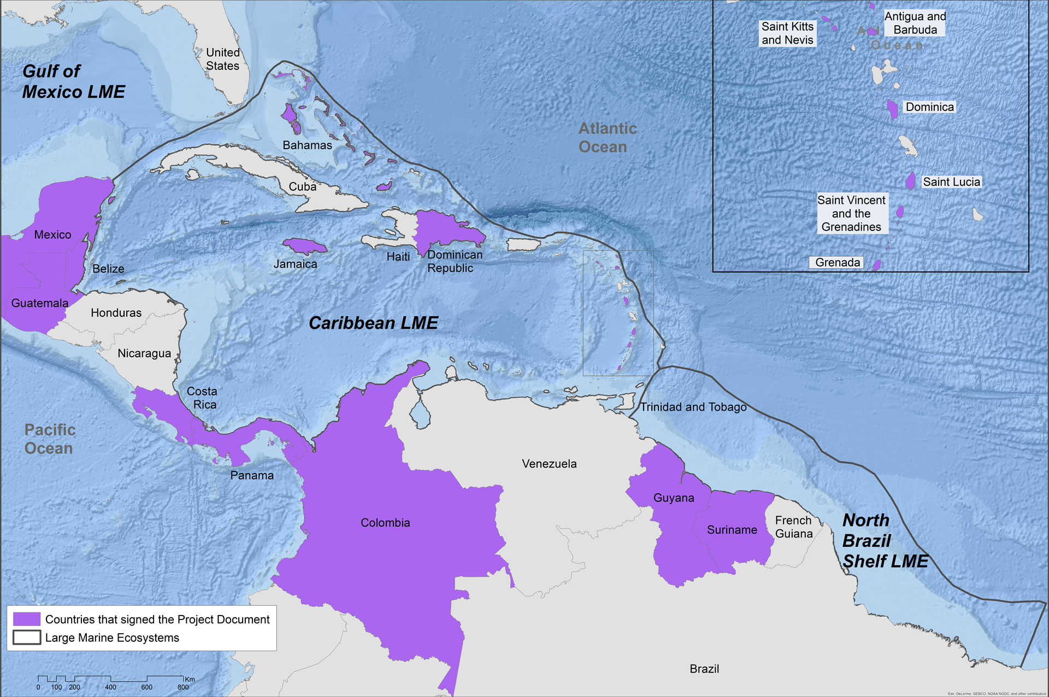
Participating Countries
Antigua and Barbuda
Bahamas
Barbados
Belize
Brazil
Colombia
Costa Rica
Dominica
Dominican Republic
Grenada
Guatemala
Guyana
Haiti
Honduras
Jamaica
Mexico
Panama
St. Kitts and Nevis
Saint Lucia
St. Vincent & the Grenadines
Suriname
Trinidad & Tobago
United States of America
Map shows countries which have signed the CLME+ Project Document

Slide 4
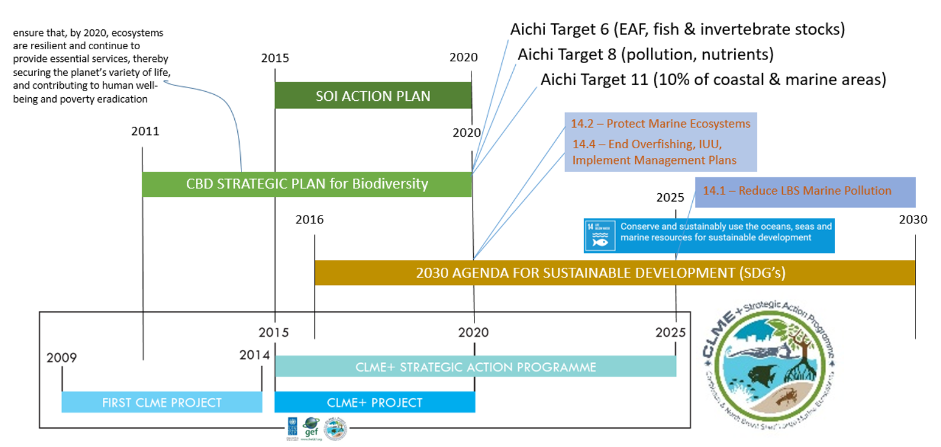
CLME+ Project ≠ stand-alone project but catalyst!
GEF-supported TDA-SAP process for the region = instrumental for achievement of regional & global commitments
CLME+ PROJECT (2015 – 2020)

Slide 5
COMPONENTS (“OUTCOMES”) OF THE CLME+ PROJECT
facilitate
C3
C4
ENHANCE THE GOVERNANCE ARRANGEMENTS
C1
DEMONSTRATE EBM/EAF
(prioritize/select – limited $) building on results from C1&2
FEASIBILITY STUDIES – INVESTMENT NEEDS FOR UPSCALING OF RESULTS
demonstrate
scale-up, replicate
C2
BUILD THE CAPACITY TO MAKE EFFECTIVE USE OF THE ENHANCED ARRANGEMENTS
CLME+ PROJECT (2015 – 2020)
enable
C5
REGION-WIDE
M&E OF SAP IMPLEMENTATION
track progress, foster synergies, avoid duplication, review/revise approach

Slide 6
Co-Executing Partner | Agreement/Contract | Status
UNEP-CEP | Inter-Agency Agreement | Signed June 2016
FAO-WECAFC | Inter-Agency Agreement | Signed July 2017
UNESCO-IOC | Inter-Agency Agreement | SIGNATURE PENDING
OSPESCA | Memorandum of Agreement | Signed August 2016
CRFM | Memorandum of Agreement | Signed April 2016
OECS Commission | Memorandum of Agreement | Signed April 2016
CANARI | Grant Agreement | Signed December 2016
UWI-CERMES | Grant Agreement | Signed December 2016
GCFI | Contract | Signed July 2016
CLME+ PROJECT (2015 – 2020)

Slide 7
Original Timeline
Project Start
End of Administrative Closure for CEAs
& end of PCU technical activities
Administrative Closure of CLME+ Project
& Project
Closure
End of Technical
Activities for most CEAs
CLME+ PROJECT (2015 – 2020)
May 2015
August 2019
December 2019
April 2020

Slide 8
Project Implementation Overview
Not including Component 3 Targets
Category | Ratio/Percentage Targets & Milestones
Completed | 12/64 19%
On track | 18/64 28%
Low risk of not completing on time | 25/64 39%
High risk of not completing on time | 9/64 14%
High risk of target not being achieved
CLME+ PROJECT (2015 – 2020)

Slide 9
PCU Responsible Activities | Status
O1.1 Interim Coordination Mechanism for Sustainable Fisheries | Target met – Update, Agenda Item 7.1
O1.1 CLME+ SAP Interim Coordination Mechanism | Target met – Update, Agenda Item 7.2
O1.1 & O1.5 Permanent Policy Coordination Mechanism and Sustainable Financing Plan | Ongoing – Update, Agenda Item 8
O2.2 Private Sector Action Programme | Delayed
O2.3 Identification of good practices & innovative technologies | Delayed
O2.4 Communications Strategy | Ongoing – Update, Agenda Item 14
O 5.1 CLME+ Partnership & Alliance | Ongoing – Update, Agenda Item 9
O5.2 SAP Monitoring & Evaluation | Ongoing – Update, Agenda Item 11.1
O5.3 State of Marine Environment and Associated Economies Reporting Mechanism | Ongoing – Update, Agenda Item 11.3
O5.3 CLME+ Website/Hub | Ongoing – Update, Agenda Item 15

Slide 10
Achievements
MoUs for Interim Coordination Mechanisms (CLME+ SAP and Sustainable Fisheries) signed and Interim Coordination Mechanisms functioning
Initial inventory of National Inter-sectoral Coordination mechanisms (NICs) undertaken, revised inventory being undertaken
Regional workshop to develop CLME+ Civil Society Action Programme held in January 2016
Online database on Projects, Programmes and Initiatives created and being populated
Outline for the “State of Marine Environment and associated Economies in the CLME+ region” reporting mechanisms endorsed by SAP ICM and through meetings of their constituents
CLME+ Hub under development/website developed
Conceptual design of CLME+ Partnership & Alliance and formalization & expansion underway
CLME+ PROJECT (2015 – 2020)

Slide 11
High Risk Activities
PCU responsible activities with potential additional Risks for Delay
Output 1.1 - Permanent Policy Coordination Mechanism
Output 1.5 – Sustainable Financing Plan
Output 2.2 – Private Sector Action Programme
FLAGSHIP CLME+ PROJECT OUTPUT- limited buy-in from and participation by CLME+ countries in this process would make it very difficult to achieve the consensus on the PPCM at the last CLME+ PSC slated for first trimester 2020
CLME+ PROJECT (2015 – 2020)
Delays on the PCU end in relation to commencing the procurement process for this due to limitations in PCU capacity and staff turnover/recruitment/procurement challenges

Slide 12
High Risk Activities
Activities with potential additional Risks for Delay
Output 5.2 and 5.3 – CLME+ SAP Implementation M&E and State of Marine Environment and Associated Economies Reporting Mechanism
CLME+ PROJECT (2015 – 2020)
FLAGSHIP CLME+ PROJECT OUTPUT. Initial recruitment did not lead to expected progress. Some additional challenges with new recruitment processes further increased risks. Buy-in and ownership demands that the development process is aligned with the timeline of established governance processes. Further delays detrimental to successful delivery

Slide 13
Challenges
Unforeseen delays
  Finalizing the co-executing agreements with co-executing partners (esp. inception phase & year 1)
  In the execution of project activities
    A result of limited (human) capacity within the PCU and co-executing agencies
    Staff turnover
    Amount of time taken to recruit staff within the PCU and co-executing agencies
    Steep learning curve & time required to obtain a clear understanding of the scope of activities
Impact of Delays
  Has resulted in the reduction of the timeline of the execution of some project activities by as much as 50% of original time line in some instances
  Increases the risk of unsuccessful/timely completion of some project activities
  Increases the risk that there will not be ownership of project outputs, affecting in turn sustainability

Slide 14
Challenges
Absence of a Communications Specialist, for months, within the PCU made it difficult to implement the CLME+ Communications Strategy; project requiring non-traditional approach (internal vs external communication)
Delays with the recruitment of a Communications Specialist made it difficult to communicate regularly with National Focal Points.
Many different focal points (CLME+ Project, Project Partners) involved in the implementation and endorsement of CLME+ Project activities & outputs
Insufficient communication occurring inter-sectorally at the national level
Languages and translation of technical language
Perceived limited awareness (or interest) in the CLME+ SAP and its implementation
Bureaucracy and administrative complications

Slide 15
Responses
De facto pre-agreement by PEG on 4 month extension to respond to delays in finalizing co-executing agreements (to be endorsed by PSC)
  However de facto extension not formalized
  Change in UNDP and UNOPS administrative policies allow for only one no-cost extension
  Understood CLME+ Project end date August 2020
  Analysis of Project activity delays with PEG
  Before formally processing extension: first confirm that this extension is sufficient
Introduction by CLME+ Project Coordination Unit of an online project planning and implementation monitoring tool based on “Smartsheet” project management software
  Project Steering Committee, PCU, and PEG can continuously monitor progress with project implementation

Slide 16
“Existing” Timeline
Start of Project
End of Administrative Closure for CEAs & end of PCU technical activities
Administrative Closure of CLME+ Project
& Project
Closure
End of Technical
Activities for CEAs
CLME+ PROJECT (2015 – 2020)
May 2015
December 2019
April 2020
August 2020

Slide 17
Recommendations
Ensure enhanced communications on CLME+ Project and SAP to CLME+ NFPs and other stakeholders to ensure increased awareness, buy-in and ownership
Expedite project execution and intensify tracking and monitoring on project activities (from 6-monthly to 3-monthly)
Flag developing and new risk immediately
Re-evaluate implementation progress by year end, and
Evaluate and submit for approval by the PSC (inter-sessionally) any corrective measures that may become necessary (and that require PSC approval)
CLME+ PROJECT (2015 – 2020)

Slide 18
Second CLME+ Project Steering Committee Meeting
THANK YOU
Catalyzing implementation of the Strategic Action Programme for the Caribbean and North Brazil Shelf LME’s (2015-2020)

