Slide 1



Second CLME+ Project Steering Committee Meeting
Presentation to
Second Meeting, UNDP/GEF CLME+ Project Steering Committee, Panama City, Panama, 18-20 June 2018
Catalyzing implementation of the Strategic Action Programme for the Caribbean and North Brazil Shelf LME’s (2015-2020)

Slide 2
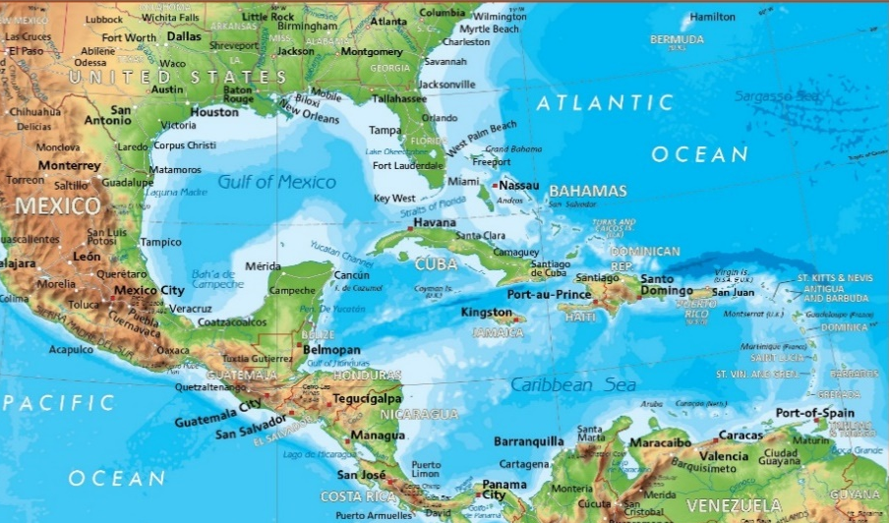







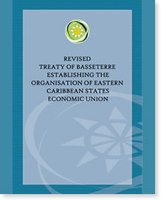




Introduction
An inter-governmental organisation dedicated to goals of:
Economic harmonisation and integration;
Protection of human and legal rights; and,
Encouragement of good governance between countries and dependencies in the Eastern Caribbean.
7 Full Member States
3 Associate Member States

Slide 3
Introduction
Component 1, Outputs:
1.1 Decisions on coordination & cooperation arrangements and institutional mandates, in line with SAP Strategies 1 (environment), 2 (fisheries) and 3 (cross-sectoral policy coordination)
1.2 National Inter-sectoral Coordination (NIC) mechanisms (including science-policy interfaces) in place
1.4 Data management, access & exchange arrangements support adaptive management and implementation of the CLME⁺ Project and SAP

Slide 4
Introduction
Components 2 & 5 - Outputs:
2.4 Overarching CLME⁺ Communication Strategy
5.2 CLME⁺ ecosystem status and SAP implementation M&E mechanism
5.3 Communication, twinning and knowledge exchange activities targeting the CLME⁺ Partnership and global LME Community of Practice (COP)

Slide 5
Status technical implementation:
Status financial expenditure
On Track | Moderate Delays | Major Delays
1 of 6 | 4 of 6 | 1 of 6
 | *** OVERALL MODERATE ***
On Track | Moderate Delays | Major Delays
4 of 6 | 1 of 6 | 1 of 6
*** OVERALL ON TRACK ***

Slide 6
Project Implementation Overview
Category | Ratio
Completed
On track | 1 of 6
Low risk of not completing on time | 3 of 6
High risk of not completing on time | 2 of 6
High risk of target not being achieved

Slide 7
Achievements to Date
OP1.1
OECS [Regional] Ocean Governance Team (OGT) established;
Revised OGT Terms of Reference with enhanced vertical linkages adopted by OECS Council of Ministers for Environmental Sustainability (COMES);
Caribbean Regional Oceanscape Project (CROP), (2017–2021), supports:
Alignment of OECS Eastern Caribbean Regional Ocean Policy (ECROP) with 2030 Development Agenda and MEAs;
National Ocean Strategies/Policies aligned with ECROP.

Slide 8
Achievements to Date
OP1.1
OECS Council of Ministers of Agriculture and Fisheries (COMAF 5), 29th Nov 2017, inter alia:
Reaffirmed support for CLME+ SAP and CLME+ Project;
Supported and endorse work of the Interim Coordination Mechanism;
Endorsed the concept and preliminary outline of the SOMEE report and role of the Commission in its development and institutionalization.

Slide 9
Achievements to Date
OP1.2
NICs/National Ocean Governance Committees (NOGCs) recommended for establishment by COMES, based Model/draft Cabinet Memorandum with terms of reference, 27th April 2017;
CROP will support establishment of NOGCs in five Member States;
Activities to foster implementation of NOGCs have commenced.

Slide 10
Achievements to Date
OP1.4
Hosted Regional Course on the Conduct of Marine Research under the UN Convention on the Law of the Sea, May 2017;
Identified opportunity for a regional marine data infrastructure in coordination with CROP through Regional Training Workshop on Marine Data Management, hosted Feb 2018.
OP2.4
The requisite communication platform and infrastructure to support the decentralized component of CLME+ Strategy was established by April 2017 (EU 10th EDF Project and OECS Member State core funding).

Slide 11
Achievements to Date
OP5.2
COMES 4 endorsed TOC for the SOMEE and support its proposed institutionalization, 27 April 2017.
OP5.3
Identified the need to strengthen OECS Marine Research Strategy and related policies to achieve CLME+ targets and instutionalisation of the SOMEE. (April/May 2017).

Slide 12
High Risk Targets
Output | High risk of not completing on time | High risk of target not being achieved
Output # 5.2 | Report and associated web portal; Approval/adoption of M&E Sustainability Plan by OECS governance mechanisms
Output # 5.2 | Inputs to relevant sections of SOMEE; Baseline, target and “current status” values for the indicators under the SAP M&E framework.

Slide 13
Challenges Being Experienced
# | Challenge | Mitigative Measure | By When
1 | Outputs 5.2 & 5.3 Targets. Preliminary works related to SOMEE chapters and M&E framework to be completed by CLME+ PCU are delayed with implications for timely implementation of OECS targets | CLME+ PCU accelerates: Recruitment of new staff; and, Completion of works related to SOMEE chapters and M&E Framework. | 31 August 2018?
2

Slide 14
Financial Implementation
Agency name | 2018 Budget | Amount spent up to April 2018 | 2019 Budget | Risk of not achieving budget objective | Proposed remedial actions
OECS | $40,000.00 | $46,507.00 | $73,493.00 |  | Transfer of $10,000 to 1.2 from 2.4, 5.2 & 5.3

Slide 15
Crosscutting Recommendations for Successful Project Implementation
Prioritizing establishment of functioning NICs (National Ocean Governance Committees) as ocean implementing and coordinating mechanisms.
Collaboration between/among Co-executing Agencies, to the extent practicable, especially to achieve Targets for Outputs 5.2 and 5.3.
Co-financing is vital for achievement CLME+ targets, optimization of outputs and impacts, institutionalisation of SOMEE and coordinating mechanisms.

Slide 16
Second CLME+ Project Steering Committee Meeting
Thank you
Catalyzing implementation of the Strategic Action Programme for the Caribbean and North Brazil Shelf LME’s (2015-2020)

