Slide 1

2nd PSC meeting, sub-agenda item 13.2
Agenda Item 13.2: Proposed Budget Revision
Catalyzing implementation of the Strategic Action Programme for the Caribbean and North Brazil Shelf LME’s (2015-2020)

Slide 2
Budget implementation of GEF funds per year
As the CEAs were signed later than expected, work on the project activities were also delayed from 2015 to 2017.
Expected formalization of inter-agency agreements
2015 2016 2017 2018 2019 2020
Initial expected budget
implementation
4% 34% 60% 80% 96% 100%
16% gap : 2 MM
Real + current
expected budget
implementation
3% 24% 44% 64% 89 % 100%
2015 2016 2017 2018 2019 2020
Real formalization of inter-agency agreements
Implementation longer than anticipated
Turn over of human resources

Slide 3
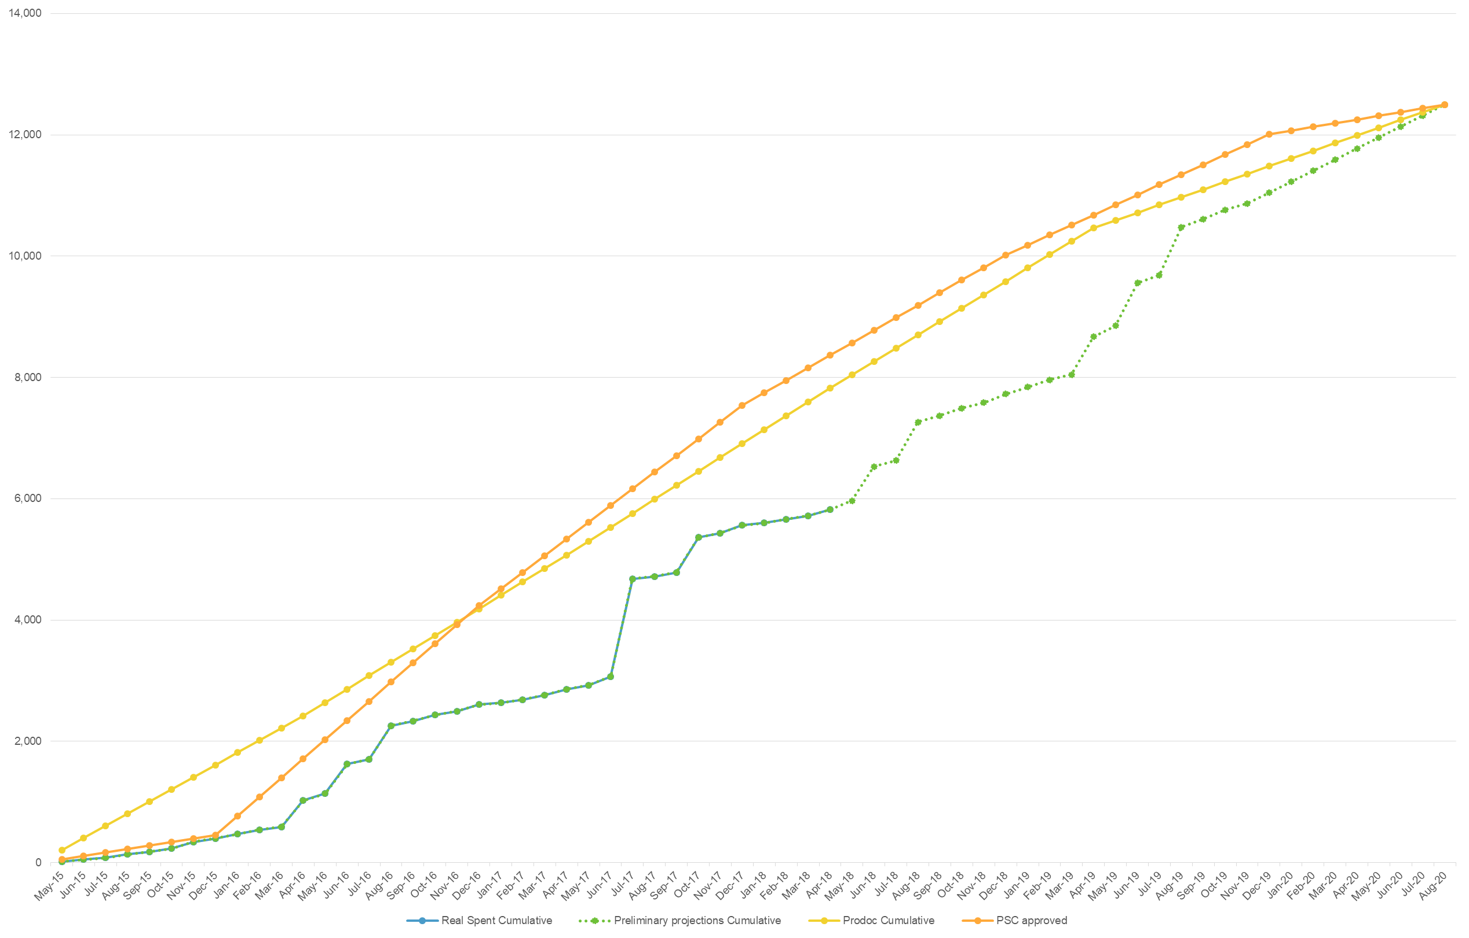
Main PCU expenditures 2015-2018
We’re here
5.5 MM
in 18 months:
2.6MM Co-execution
agreements
1.3 MM HR &
consultancies
(committed)
1.1 MM Events with
countries,
workshops,
meetings

Slide 4
Project’s performance 2016-2017

Slide 5
Project’s performance 2018-2020
The slower-than-expected project implementation rates during the 2016-2017 biennium, leading to under-expenditures for the PSC-approved 2016-2017 budget, now demand a reallocation of funds to the 2018-2020 period to ensure that all project outputs can be successfully delivered by project end.

Slide 6
Total Revised Budget 2016-2020
The anticipated increase in expenditure levels under Contractual Services in the last three years of the project compensates the initial delays of the first two years, the initial difference gap is significantly reduced to an anticipated USD 50K deviation by project end.

Slide 7


Total Revised Budget 2015-2020
The proposed budget reprogramming which is now being submitted for approval by the PSC does not increase the total budget value which was approved at PSCM1, and is done in such a way that full use of the available funds is anticipated by project end.
Communication Specialist contract through CRFM
Savings in Staff salaries
Meetings and events through UN LTA’s and contracts

Slide 8
Financial recommendations
regarding budget monitoring
-Continue and enhance the use of online project planning tools and progress dashboards on the CLME+, specially for
thePartners with high implementation risks
-Strength the use of periodic reporting model (good practices) adopted by the co-executing agencies UNEP and FAO
-While monitoring, link the technical implementation of milestones with financial implementation and expenditure level performance

Slide 9
Project “no-cost” extensión context
Project extension
Initial timeline PEG pre-agreement
Initial project closure: April 2020
New project closure: August 2020
In February 2017, as a pre-agreement, the PEG proposed a 4 months no-cost extension to compensate delays in the inception phase
This pre-agreement is pending to be approved by the SCM and processed by UNDP/UNOPS
Budget requirements: already incorporated in proposed revised 2018-2020 budget
Initial Co-execution agreement closure: August 2019
New Co-execution agreement closure: December 2019

Slide 10
Project extensión scenario
Project extension
PEG pre-agreement With project extension
Possible Actions :
Option 1: Decide to extend the project based on current risks
Option 2: Decide to postpone the decision until end of year/Q1 2019 and condition the extension to partner’s performance by Dec 2018 (to then be authorized inter-sessionally by SCM).
Current project closure: August 2020
Potential project closure: December 2020
USD 174 839*
Approximate cost of a 4-month extension (personnel costs, office costs and UNOPS fees)
Current Co-execution agreement closure: December 2019
Potential co-execution agreement closure: April 2020
*Includes UNOPS fee of 6.5%
*No need to increase UNOPS fee due to HR costing provided that no major reallocation of personnel occurs (e.g. new RPC)

Slide 11
Project extensión scenario:
Collaboration of partners with
higher implementation risks
-In case the extension is approved, the PCU and co-executive partners should fund the entire cost of it
-Partners with higher implementation risks (like PCU, UNEP and FAO) should maintain reserves (funds not committed under legal agreements) until final decision regarding the extension
-PCU suggests maintain reserves of 60-70K per partner

Slide 12
2nd PSC meeting, sub-agenda item 13.2
Thank you
Catalyzing implementation of the Strategic Action Programme for the Caribbean and North Brazil Shelf LME’s (2015-2020)

