Slide 1

Reef Biodiversity and Fisheries Pilot Project
UNEP-CEP/RCU

Slide 2
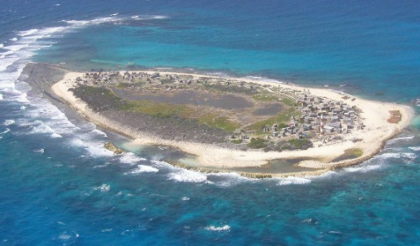
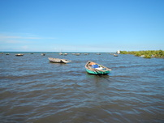
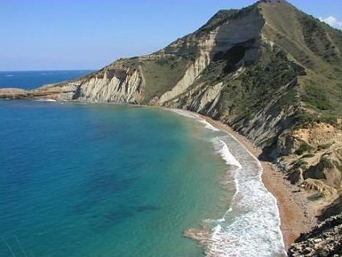
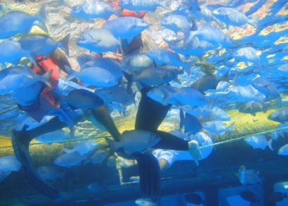
Overall Project Management
Activities completed at 4 project sites:
18 months
Management and Conservation of Reef Biodiversity and Reef Fisheries Pilot Project – Seaflower Marine Protected Area (MPA), Colombia
Partner – Corporation for the Sustainable development of the Archipelago of San Andres, Old Providence and Santa Catalina (CORALINA)
Management and Conservation of Reef Biodiversity and Reef Fisheries Pilot Project – Montecristi National Park; Dominican Republic
Partner – Ministry of Environment and Natural Resources
Management and Conservation of Reef Biodiversity and Reef Fisheries Pilot Project – Pedro Bank and Cays
Partner – The Nature Conservancy (TNC) Jamaica Office
6 months:
Management and Conservation of Reef Biodiversity and Reef Fisheries Pilot Project – Caracol Bay, Haiti
Partner – Fondation pour la Protection de la Biodiversité Marine (FoProBiM)
Project activities completed
Assistance provided for governance assessments in all 3 active sites (CERMES)

Slide 3
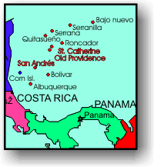
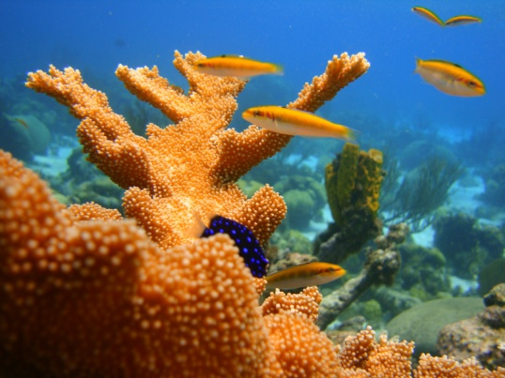
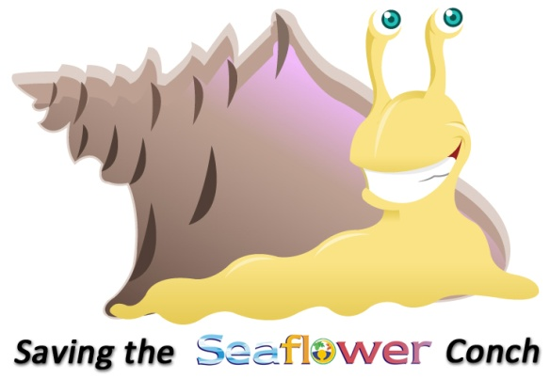
Seaflower MPA San Andres, Colombia
Project Partner: CORALINA
Budget: GEF: $260,000 (TOTAL: $471,500)
Integrated ecosystem-based management
3 research expeditions to the MPA northern section
information on key species and ecosystem conditions gathered and analyzed.
Erosion Control (cleaned gully beds, removed obstacles to water flow, and built natural pools and roman arches allowing higher water retention)
In total 18 pools and roman arches were constructed, utilizing rocks removed from the main watercourse
Beach Monitoring at San Andres and Providence.
At least 3 monitoring exercises conducted along 30 different beaches annually
Regulations analyzed/enforcement mechanisms identified
Legal Fishing Framework analysed to improve regulations and reduce illegal fishing
Shark fishing regulation underway, others still under investigation
Seaflower recognised and included in national initiatives
Training (NOAA, Nat’l Marine Estuaries, MPA)

Slide 4
Seaflower MPA San Andres, Colombia
Cont’d
Public Awareness, Education & Outreach
Queen Conch curriculum updated and circulated
500 students; 30 teachers; Book published
Key species campaigns for 5 species: Spiny Lobster, Snappers, Sharks, Lionfish and Parrotfish
Booklets, field trips (500 students), play (250 students)
MPA Awareness/Sensitisation
Signs (20), 1 17-minute video (10 video clips)
Best Practices recorded and shared
1 regional workshop for exchange experiences and 1 international workshop for spiny lobster stock assessment.
Adaptive Management
Coral Reef Fish Recovery Pilot Project (SSW) – executed and extended
1 national plan for lionfish produced

Slide 5
Seaflower MPA San Andres, Colombia
Feedback on project
highly productive
reached the entire representation of our local community
generated products that can be utilized long after the project ends
Data analysis done quickly, with quality control procedures and international advisors
generated the scientific bases needed to adjust or implement management policies and regulations.
Inter-institutional dynamics improved by various educational activities.
Need for broader communication and interaction among several partners at a regional basis.
The recent decision of the International Court addressing the dispute between Colombia and Nicaragua happened at the end of the project, and created more conflicts that previously envisioned, thus governance analysis need more work and perhaps international mediation, in order to keep resource sustainable use of coral reef biodiversity.

Slide 6
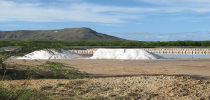
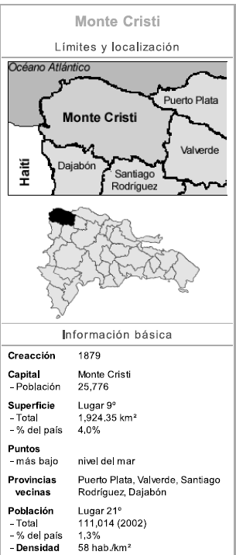
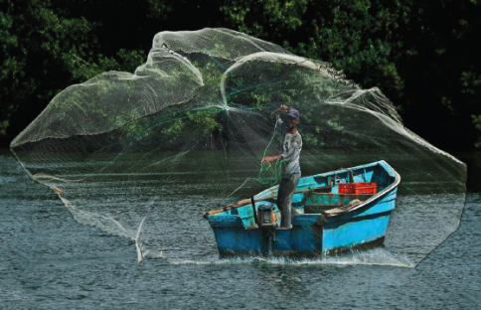
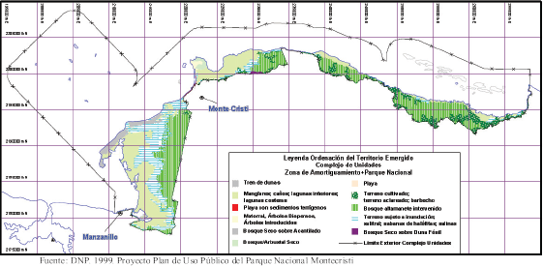
Project Partner: Ministry of Environment
Budget: GEF: $200,000 (TOTAL: $400,000)
Montecristi MPA Dominican Republic
Integrated ecosystem-based management
Zoning and Fisheries Management & Strategic Plan completed
Publicly accessed Management Information System based on GIS
Regulations analyzed/enforcement mechanisms identified
National policy framework reviewed
Manual of good practices completed
Training for public officials and stakeholders on laws conducted
Public awareness and education outreach enhancement
Monitoring and Evaluation mechanism designed and in use
Training for Fishermen on best practices conducted
Documentation and distribution of Lessons Learnt

Slide 7
Lessons Learnt
Montecristi MPA Dominican Republic
Very slow start to Project Activities, and other non-technical and bureaucratic delays, Including a change in administration The Project team and the consulting team Particularly Assigned to the project Were Able to focus on the goals of the project and corrected MOST CLME issues of delays by the last quarter of the project.
Financial Losses due to bank charges for U.S. $ exchange Absorbed by project. Project Activities Not Affected
Weak and late Caracol project in collaboration with Haiti. The Haiti Project Began in September 2012 only Both UNEP and partners Efforts made to work all the time constraints Within. One joint meeting was possible and the follow-up is promising collaboration.

Slide 8
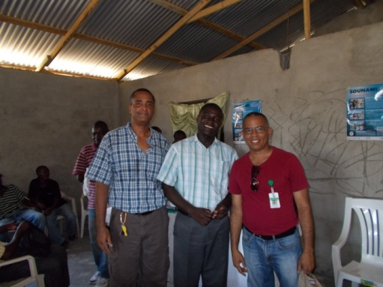
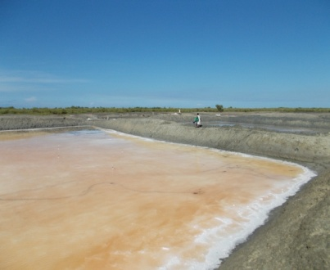
Caracol Bay MPA Haiti
Project Partner: The Nature Conservancy (TNC)
Budget: GEF: $336,850 (TOTAL: $528,693)
Integrated ecosystem-based management needs assessed and management frameworks strengthened
1.1 Introductory consultations and discussions on priorities for ecosystem management held
1.2 Compilation and analysis of the status of the eco-system in Caracol Bay based on stakeholder feedback and literature completed
1.3 Development of a participatory community process for the management, follow-up and application of a management plan initiated

Slide 9
Caracol Bay MPA Haiti
Cont’d
Existing regulations reviewed & enforcement mechanisms identified
2.1 Completed analysis and identification of gaps in the existing legislative framework related to MPAs
Public awareness, education, and outreach
3.1 Improved sensitisation of the value of mangroves, the marine protected area (500 flyers) and management plan
3.2 Established Steering Committee of key stakeholders with a view to long-term collaboration for the monitoring and evaluation of the transboundary site

Slide 10
Caracol Bay MPA Haiti
Next Steps
Determine the condition of resources and management needs
Strengthen the newly formed steering committee
Strengthen local law enforcement capabilities
Ensure that ecosystem based approaches are embraced for protection and management of resources
Develop sustainable activities for alternative income generation
Strengthen all activities within the target site
Enhance the monitoring, assessment and reporting capacity for area resource management

Slide 11
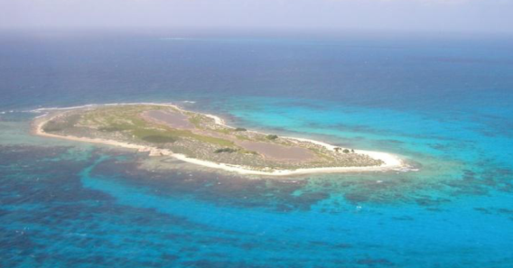
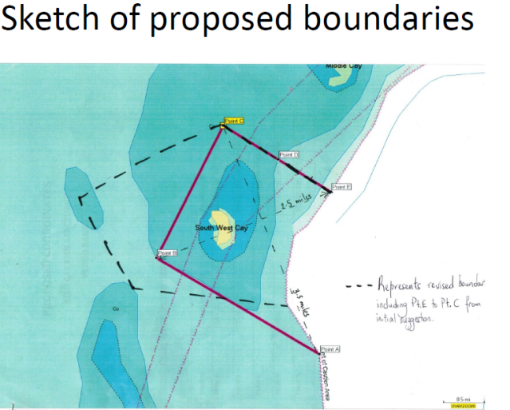
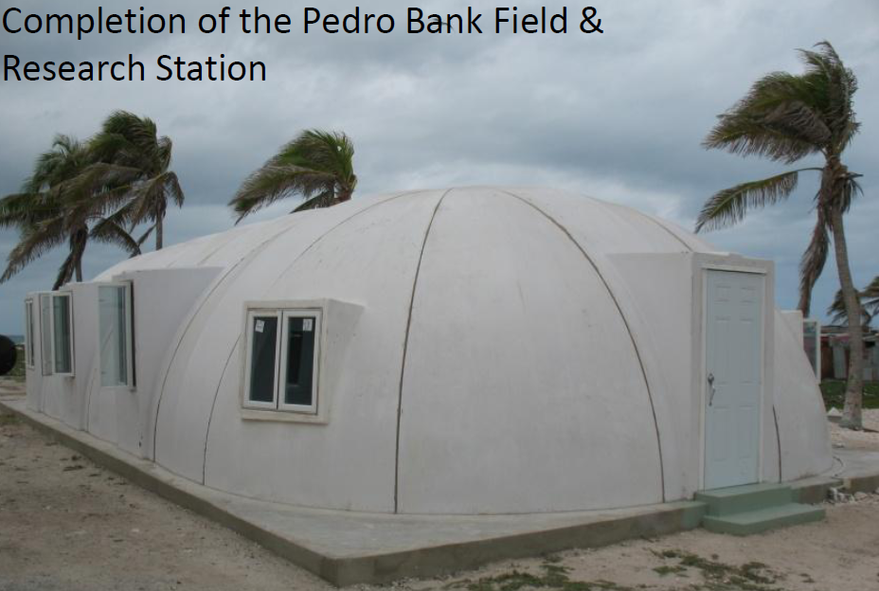
Project Partner: The Nature Conservancy (TNC)
Budget: GEF: $336,850 (TOTAL: $528,693)
Pedro/SW Cay Jamaica
Integrated ecosystem-based management needs assessed and management frameworks
Management plan created with input from community
Field Station operational and has hosted many groups
Biological survey data collected
Existing regulations analysed
Training: Fish Sanctuary and Seabird Workshops for GOJ and NGO stakeholders
Individual training and conference participation
Regulations analyzed/enforcement mechanisms identified
500 DVDs of Pedro Cays and Fisher training produced and posted and distributed.
SW Cay declared Special Fish Conservation Area

Slide 12
Pedro/SW Cay Jamaica
Lessons Learnt
Best practices transferred between partners
Marine Protected Area workshop for wardens of the SW Cay SFCA and those of the Galleon Beach Fish Sanctuary.
Seabird workshop on the Pedro Cays for local partners
Seabird workshop on the Pedro Cays for regional personnel.
Adaptive management improved
Monitoring plan delayed; however, aspects have been completed in the Management plan and the Seabird Conservation and Monitoring Plan.

Slide 13
Pedro/SW Cay Jamaica
Use of Outputs
Management Plan
Forming part of national discussions on governance of the Pedro Bank.
Used by partners to inform management decisions on the Pedro Cays (e.g. waste disposal and carrying capacity)
Guides work on the ground (research, monitoring, management and enforcement activities)
Field Station
Used by TNC and other partners for research, conservation and management activities (NEPA, Fisheries Division, NSWMA, JDF, seabird experts ,UWI)
AGRRA Survey
Gave value of area around South West Cay for protection
Benthic mapping of the MPA and areas
Establish Fish Sanctuary
Designed to serve as replenishment area for fish, lobster, conch, coral and other marine resources
Used as Pilot in order to show at local and regional level how an offshore MPA can be managed successfully
.

Slide 14
Pedro/SW Cay Jamaica
Use of Outputs
Training of Enforcement Personnel
To improve Resource Management
Organizing the Pedro Cays Community
Enabled cleanup efforts
Increased awareness and care
Public Awareness material
Reminders of the regulations and the role stakeholders play
Promotion of project locally and internationally
Conservation Measures Framework and Monitoring and Evaluation Plan
Tracks progress and records success

