Slide 1






CASE STUDY FOR THE SHARED STOCKS OF THE SHRIMP AND GROUNDFISH FISHERY OF THE GUIANAS-BRAZIL SHELF
CLME Steering Committee
Cartagena, 4-6 March 2013

Slide 2
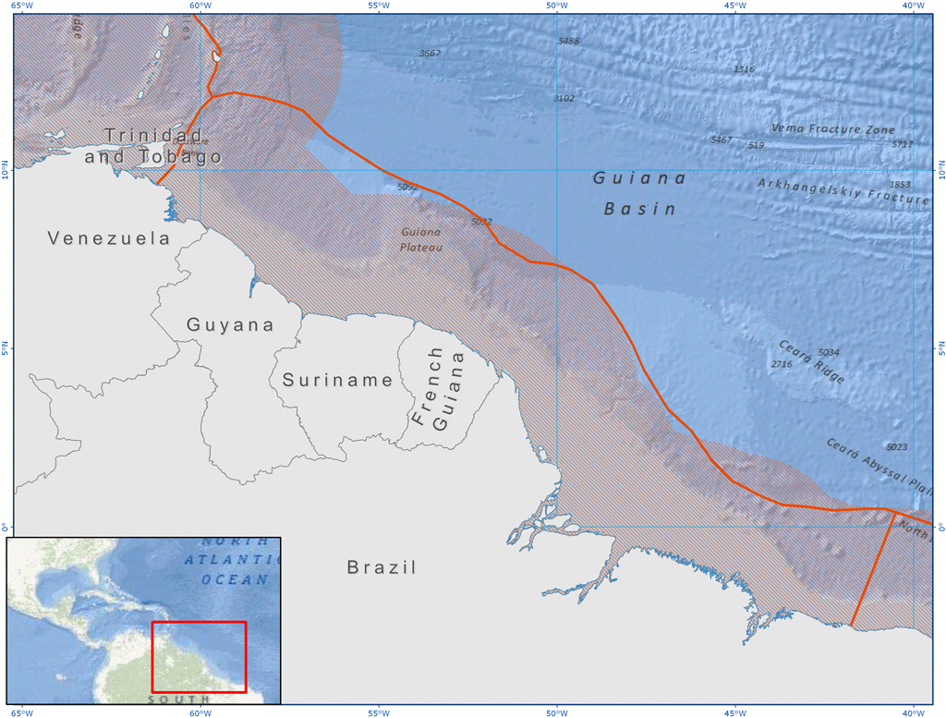
Case study on shrimp and groundfish
6 countries (North Brazil Shelf):
Brazil
France (F. Guiana)
Guyana
Suriname
Trinidad & Tobago
Venezuela

Slide 3
General information
Implementing agency
Food and Agriculture Organization of the United Nations, FAO Fisheries and Aquaculture Division
G. Bianchi, T. Bahri, A. Alleyne, N. Franz, R. Van Anrooy, M. Vasconcellos
Caribbean Natural Resources Institute, CANARI
N. Leotaud, K. Sandy
Centre for Resource Management and Environmental Studies, CERMES
R. Mahon, P. McConney
Caribbean Regional Fisheries Mechanism, CRFM
T. Phillips
Collaborating organizations
Time frame and budget
16 months (completion date December 2012)
USD 253,000 US $

Slide 4
Objectives of the case study
To fill knowledge gaps and contribute to the preparation of the CLME Strategic Action Programme (SAP), with priority actions for the sustainable management of the shrimp and groundfish fisheries
Approach
Mainstreaming the Ecosystem Approach to Fisheries (EAF) in the management of shrimp and ground fish fisheries, through this case study → with participation of stakeholders and following some of the key steps of the planning process under an EAF framework

Slide 5
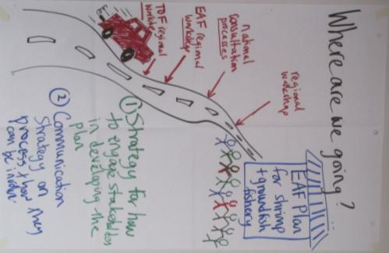
Roadmap (1)
SAP
Specific studies

Slide 6
Roadmap (2)
Brazil
Priorities
F. Guyana
Priorities
Surinam
Priorities
Guyana
Priorities
Trinidad & Tobago
Priorities
Venezuela
Priorities
Present results of national/regional activities for validation and provide recommendations for inclusion in the SAP
Regional Workshop
(Port of Spain, October 2012)
CLME SAP (Strategic Action Programme)
that will be submitted to policy makers for endorsement
legal, policy and institutional reforms to achieve sustainable transboundary living marine resources management

Slide 7
Activities & outputs
1 Final workshop
(POS, Oct. 2012)
Outputs of the workshops, consultations / draft SAP
(Dec. 2012)
SAP
4 National consultations
(Apr.-Sept. 2012)
Specific studies
1 on Stock status
1 Bioec. analysis
1 Regional training workshop on EAF
(Paramaribo, Oct. 2011)
1 Stakeholder analysis
1 Regional training workshop on facilitation
(Port of Spain, July 2011)
1 Communication strategy

Slide 8
Results
National focal points trained on facilitation techniques and on EAF;
Preliminary mapping of national, sub-regional and regional stakeholders;
Preliminary report on existing institutional arrangements for the management of S&GF stocks;
Available information on bio-economic analysis and on stock status of the S&GF fisheries in the sub-region collated;

Slide 9
Results
List of issues and potential solutions negotiated and discussed (4 national consultations) (ex. declining stocks, lack of social security, poor enforcement, pollution, …);
Increased awareness and involvement of stakeholders;
Basis for a sub-regional EAF management plan laid by the case study ;
TDA refined/validated through a hands-on process;
Priorities for the CLME Strategic Action Plan developed and agreed through a bottom-up process (1 sub-regional workshop).

Slide 10
Lessons learned
Stakeholders concerned about sustainability;
High interest of stakeholders to engage in an inter-sectoral dialogue;
Good bottom-up mechanism can contribute to keep stakeholders engaged;
Need to identify carefully all stakeholders to be engaged and avoid “comfort zones”;
Leadership by the fisheries authorities is key to the success of the process;
Need for a sub-regional (Guiana – Brazil) decision mechanism;
Piracy appears to be an immediate problem which could be reduced with effective Monitoring, Control and Surveillance (Navy/coast guard; marine police, judiciary, fisheries authorities).

Slide 11
Best practices
International cooperation on management of shared fisheries resources;
EAF provided an appropriate framework for Sustainable Development;
Wide stakeholder consultations & fostering inter-sectoral dialogue;
Cooperation between institutions running the case study (CANARI, CERMES, CRFM, FAO) (joining resources, skills & networks);
SAP is based on the outputs of bottom-up consultations (conveying ground problems and potential solutions from stakeholders to policy makers).

