Slide 1
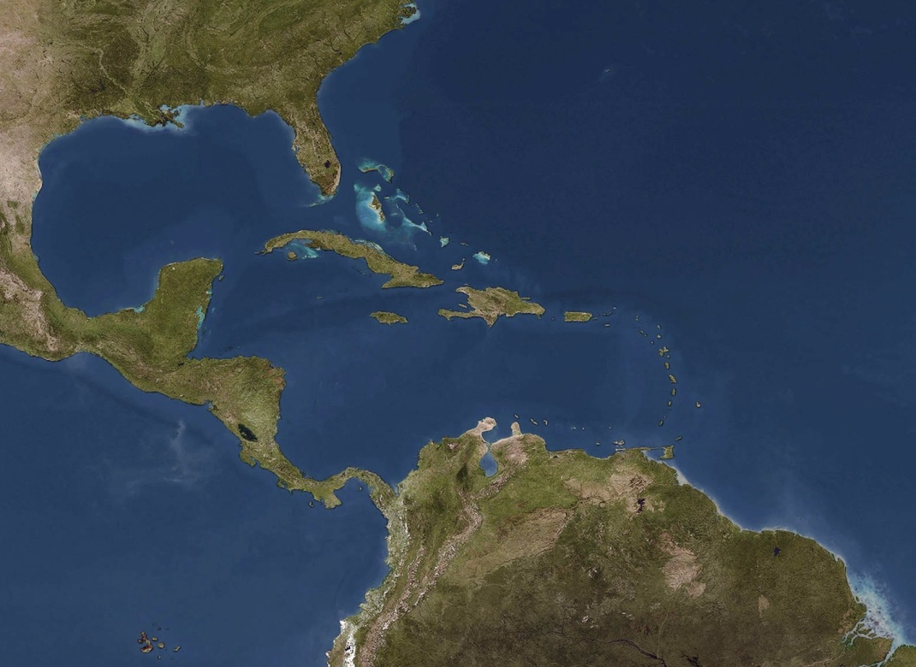
Regional Governance Framework for the Wider Caribbean Region
Centre for Resource Management and Environmental Studies (CERMES), University of the West Indies, Cave Hill Campus, St. Michael, Barbados
Marine Affairs Program, Dalhousie University, Halifax, Nova Scotia, Canada
Fourth CLME Steering Committee Meeting
Cartagena, Colombia, 5 -6 March, 2013

Slide 2
Three areas in ToRs
Pilot the development of regional science-policy interface for ocean governance
Assess ocean governance arrangements and functionality in the WCR with specific reference to the three fishery ecosystems
Propose appropriate regional ocean governance framework options for input to the SAP

Slide 3
Major outputs
Valuation of marine ecosystem goods and service
Assessment of perspective on and needs for a regional science policy interface
Governance analyses in pilot projects and case studies
Assessment of regional organisations in ocean governance
Proposal for a Regional Governance Framework

Slide 4
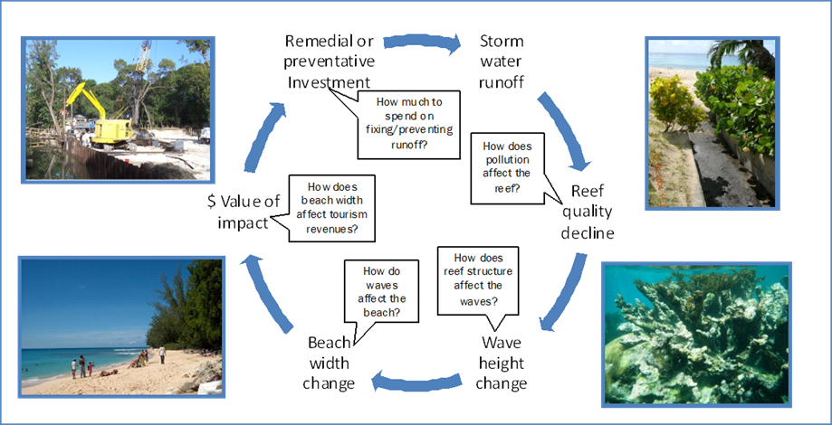
Valuation of marine ecosystem goods and services
  Some findings
    200+ studies for 3 fisheries ecosystems in WCR
    Focused on limited number of benefits, mainly
      recreation opportunities in near-shore protected areas
      easily measured market value real estate and capture fisheries
  Mainly reefs - little on pelagic or continental shelf
  Economic impacts of overfishing remain largely unexplored
  Proposed an approach to comprehensive valuation for WCR

Slide 5
Regional science policy interface
  Survey of decision-makers and advisors
  73 interviews of 103 respondentsfrom 20 countries and 4 regional organisations
  Some findings
  Limited experience of regional marine policy meetings
  Few examples where science had influenced policy
  Perception of a large gap between marine science and marine policy
  Lack of access to regional level science information
  Some recommendations
  Need focus on culture of evidence-based decision making
  Draw on experience in international fora to build regional
Notes:
5

Slide 6
Governance analyses in pilot projects and case studies
  Governance assessment methodology adapted and refined
    Identify the system to be governed
    Identify the issues to be governed
    Identify and evaluate the arrangements for each issue
    Assess extent of integration and linkage of arrangements
  Systems assessed for governance
    North-Brazil shelf ecosystem
    Large pelagics
    Flyingfish
    Central America lobster
    Pedro Bank, Jamaica
    Seaflower MPA, Colombia
Notes:
6

Slide 7
Governance analyses in pilot projects and case studies
  Some findings and conclusions
  Completeness of arrangements 15% - 50%, average 43%
  >> need to focus on building and enhancing governance architecture.
  Integration 0% (North Brazil Shelf LME) - 100% for large pelagic fisheries
  >> considerable scope for improvement in the integration needed for ecosystem approach.
  Assessments of performance and principles
  >> considerable scope for interventions to improve presence of fundamental and process principles in LMR governance processes.
  Overall conclusion - Many weaknesses in governance arrangements that can be:
  diagnosed using these methods and
  addressed by specific interventions.
Notes:
7

Slide 8
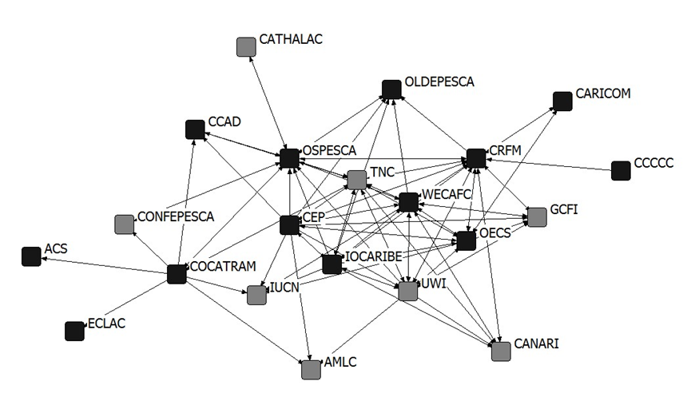
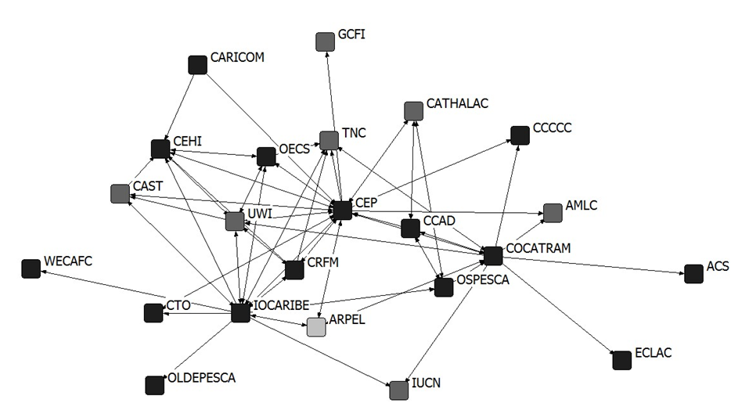
Assessment of regional organisations in ocean governance
Fisheries
  Based on:
  Mandates
  Actual work
  Interactions
  More than 25 organisations
  Gaps and overlaps identified and areas of weak interaction
Pollution
Notes:
8

Slide 9
Proposal for a Regional Governance Framework
  Based on LME Governance Framework
  conceptual model developed in PDF-B
  “Increasingly, the debate turns toward what we describe as the overarching architecture of global environmental governance, that is, the entire interlocking web of widely shared principles, institutions, and practices that shape decisions by stakeholders at all levels.”
  Bierman and Pattberg 2012 (see notes)
Notes:
9
Biermann, F. and P. Pattberg. 2012. Conclusions. Pp. 265-280 In: Biermann, F. and P. Pattberg. Global environmental governance revisited. MIT Press, Cambridge Massachusetts.

Slide 10
Characteristics of the Regional Governance Framework
Consists of linked nested ‘governance arrangements’.
Must have a clear arrangement for each actual or potential issue.
Arrangements must have:
  A complete policy process that can (1) take up data and information, (2) generate advice, (3) make decisions, (4) implement and (5) review and adapt
  Capacity for (1) Policy advice and decision-making, (2) Management planning and decision-making, (3) Day-to-day action for implementation.
Arrangements must be:
  Linked for the integration needed for efficiency and to achieve EBM.
  Nested as appropriate to achieve subsidiarity
Similar issues may be covered by similar arrangements and overseen by a common organization for efficiency.
Entire framework will involve multiple organizations at several geographical and institutional scale levels.
Several arrangements may share a common process at the level of policy development and decision making.
Notes:
10

Slide 11
REGIONAL GOVERNANCE FRAMEWORK FOR LIVING MARINE RESOURCES
REGION-WIDE OCEAN POLICY LEVEL
Regional ocean governance policy mechanism
(Caribbean Sea Commission, or equivalent, with membership of all relevant regional IGOs and NGOs)
PLANNING AND OPERATIONAL LEVELS
Fisheries
Reef fisheries ecosystem
Pelagic fisheries ecosystem
(CRFM/OESPESCA/FAO)
Lobster
Large pelagics
CA lobster
(OSPESCA)
Ocean- wide
Regional
Reef fisheries and biodiversity
(UNEP)
Flyingfish (CRFM)
Other lobster
(CRFM/
WECAFC)
Continental shelf fisheries ecosystem (CRFM/FAO)
North Brazil Shelf ecosystem
Other continental shelf
Habitat destruction
(UNEP-SPAW)
Pollution
(UNEP-LBS/OSP, MARPOL IMO)
Notes:
11
Interpretive notes:
• Likely lead organizations for arrangements are shown in parentheses;
• Nesting implies that there are vertical linkages with the overarching entity;
• Nesting implies integration and coordination but not necessarily control;
• Lower level entities are expected to engage in the work of higher level entities within which they are nested;
• The diagram is not comprehensive. Resources and sub-issues not included here must be added as the framework is developed;
• The final system may include too many arrangements to be diagrammed in two dimensions.

Slide 12
Key features of the Regional Governance Framework
  Overarching regional ocean governance policy coordination mechanism for the entire framework to;
    Develop regional science-policy interface for oceans governance with focus on LMR
    Take up regional data and information system;
    Promote ocean governance in general and EAF/EBM in particular;
    Develop a regional ocean governance policy;
    Promote use of valuation information in regional decision-making and policy setting
  Overarching sub-arrangements for (a) fisheries, (b) marine pollution, (c) coastal/marine habitat degradation to;
    Develop regional approaches and plans of action;
    Institutionalize policy processes for developing these plans and tracking their implementation
Notes:
12

Slide 13
Building the RGF
  First step is for countries and organizations of the WCR to accept and adopt the network approach to regional ocean governance.
  Should be a turning point in the regional conversation about ocean governance from sectoral and organisation focused to holistic and ecosystem-based
  Next steps are building and strengthening activities involving engaging organisations to plan how they will proceed with:
  Maintaining current roles
  Expanding mandate and activities to take up appropriate functions within the framework
  Developing interactions and linkages essential for framework function as an effective regional ocean governance framework
Notes:
13

