Slide 1


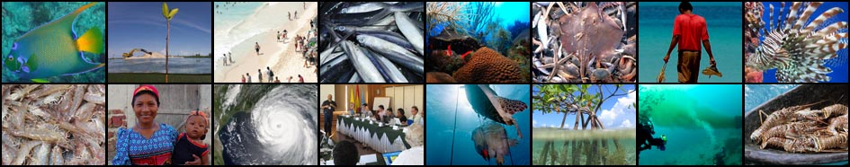
+
1st CLME+ Steering Committee Meeting & Inception Workshop
26 – 28 January 2016, Cartagena, Colombia
Agenda # 9
CLME+ Project Work Plan & Budget
2015-2016-2017

Slide 2
CLME+
“ANNUAL” AND TOTAL BUDGET
as in PRODOC
YR1 YR2 YR3 YR4 YR5
19.3% 40.5% 62.5% 83.6% 100%
3.6% 33.9% 60.3% 80.1% 96.0 % 100%
2015 2016 2017 2018 2019 2020
Budget revision during the Inception Phase
(adaptation from project years to Calendar Years + revised project planning)

Slide 3
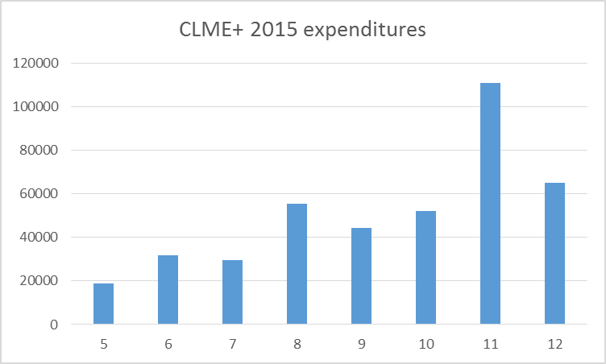
CLME+
IMPLEMENTATION PROGRESS
payments possible till mid-Dec
only
admin staff hired
Total (gross): US$ 456K

Slide 4
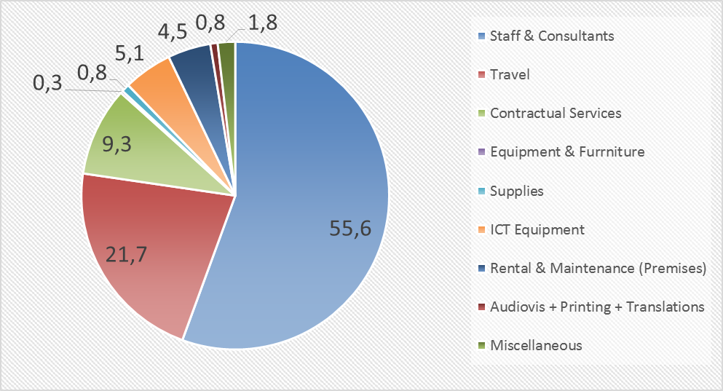
CLME+
IMPLEMENTATION PROGRESS
net expenditures 2015

Slide 5
BI-ANNUAL WORK PLAN
& BUDGET
2016-2017

Slide 6
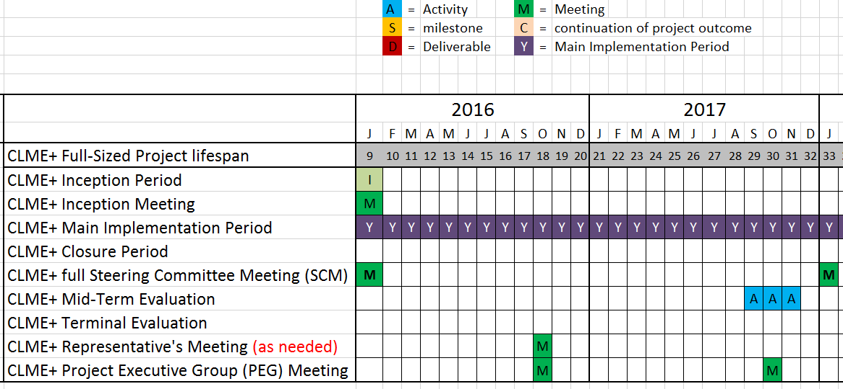
BI-ANNUAL WORK PLAN & BUDGET – 2016-2017

Slide 7
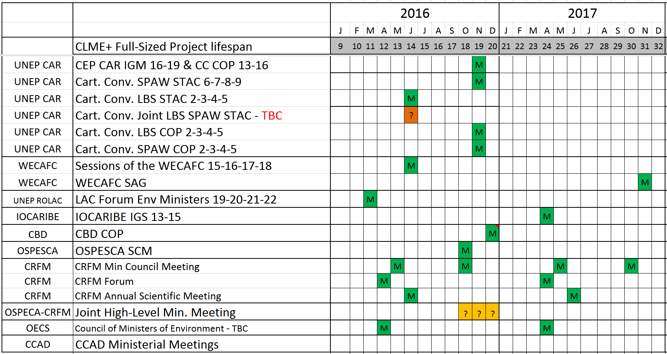
BI-ANNUAL WORK PLAN & BUDGET – 2016-2017

Slide 8
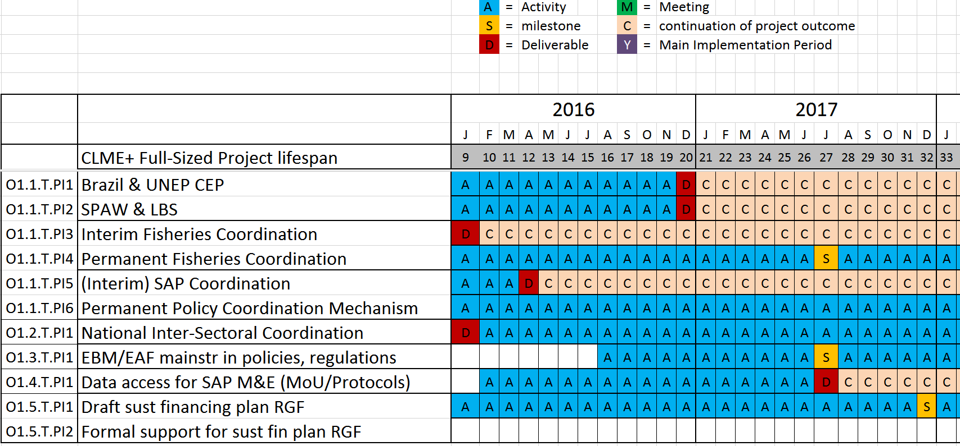
BI-ANNUAL WORK PLAN & BUDGET – 2016-2017
COMPONENT 1

Slide 9
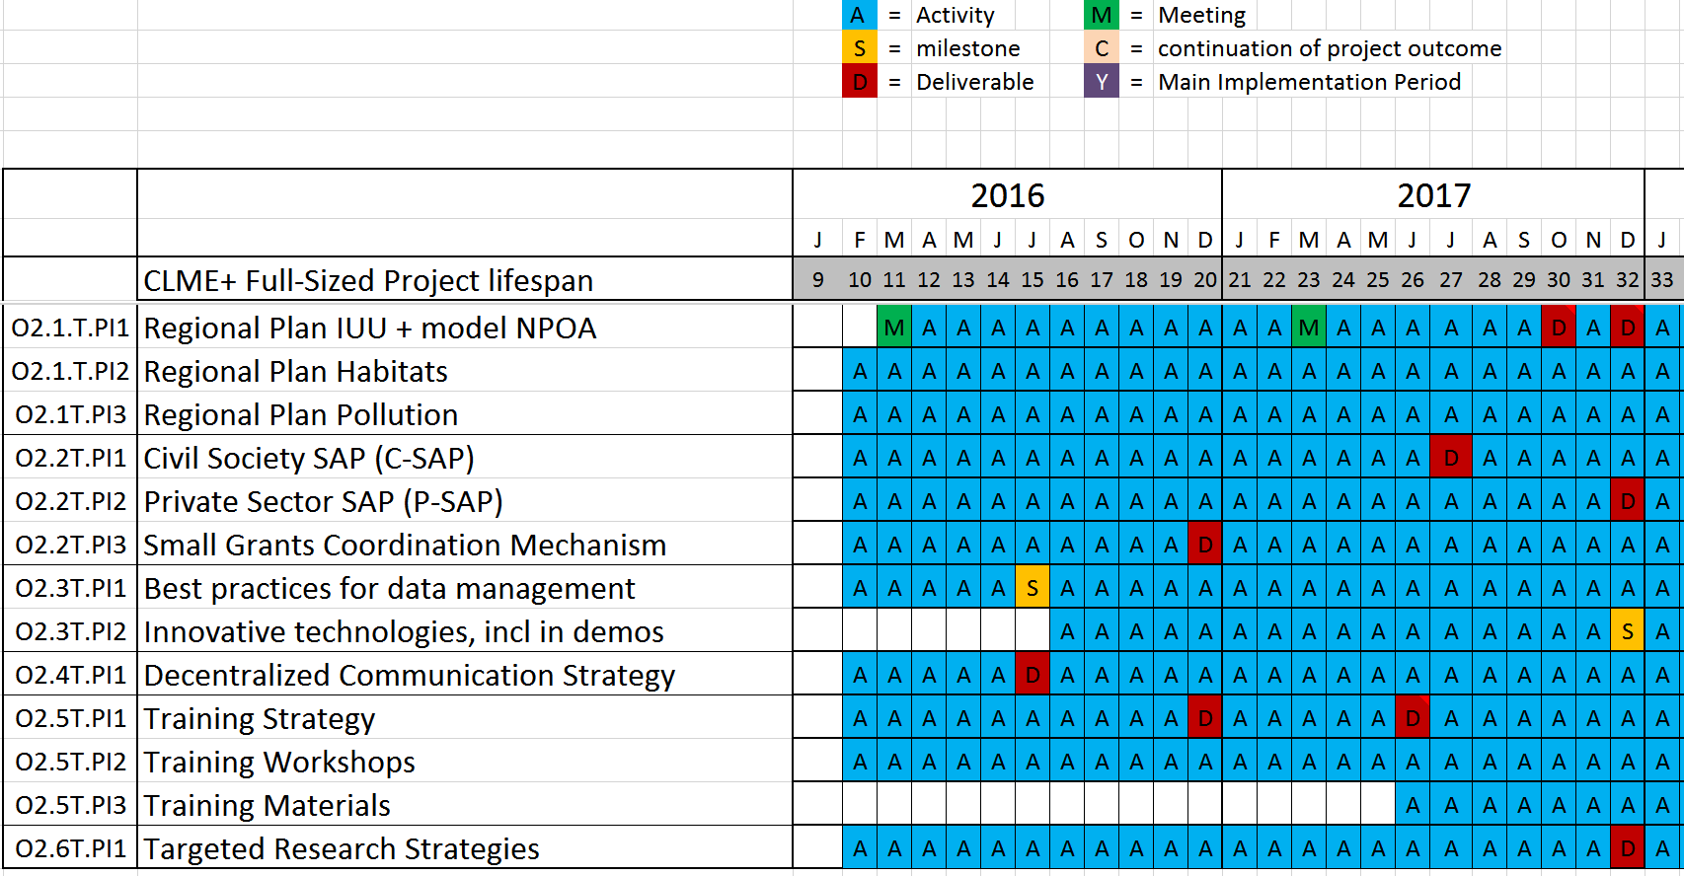
BI-ANNUAL WORK PLAN & BUDGET – 2016-2017
COMPONENT 2

Slide 10
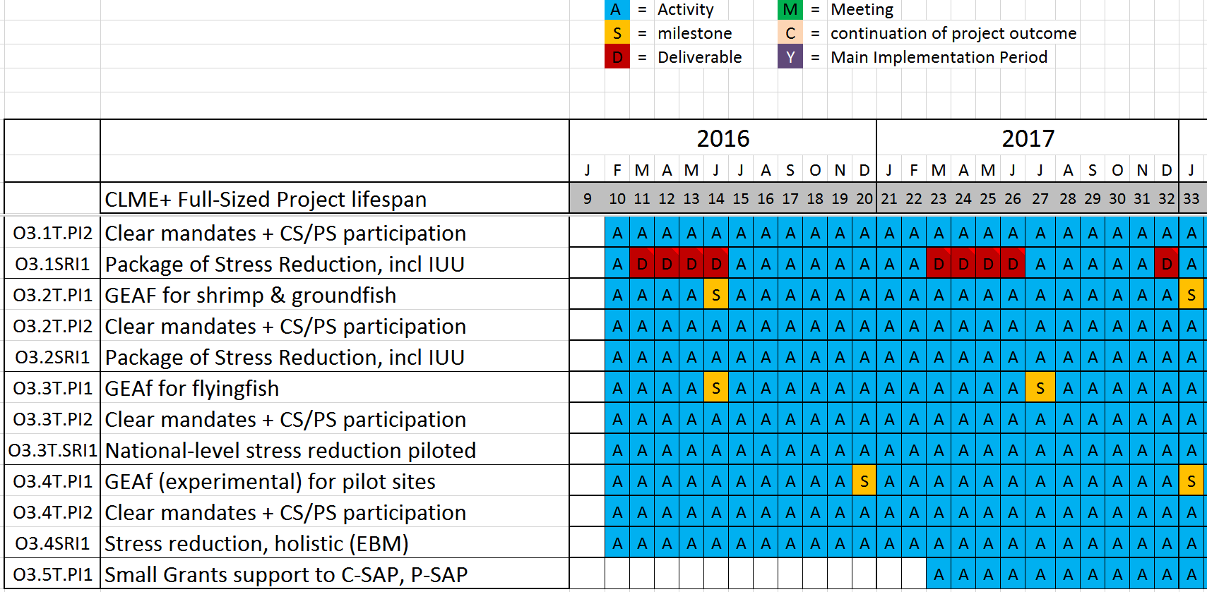
BI-ANNUAL WORK PLAN & BUDGET – 2016-2017
COMPONENT 3

Slide 11
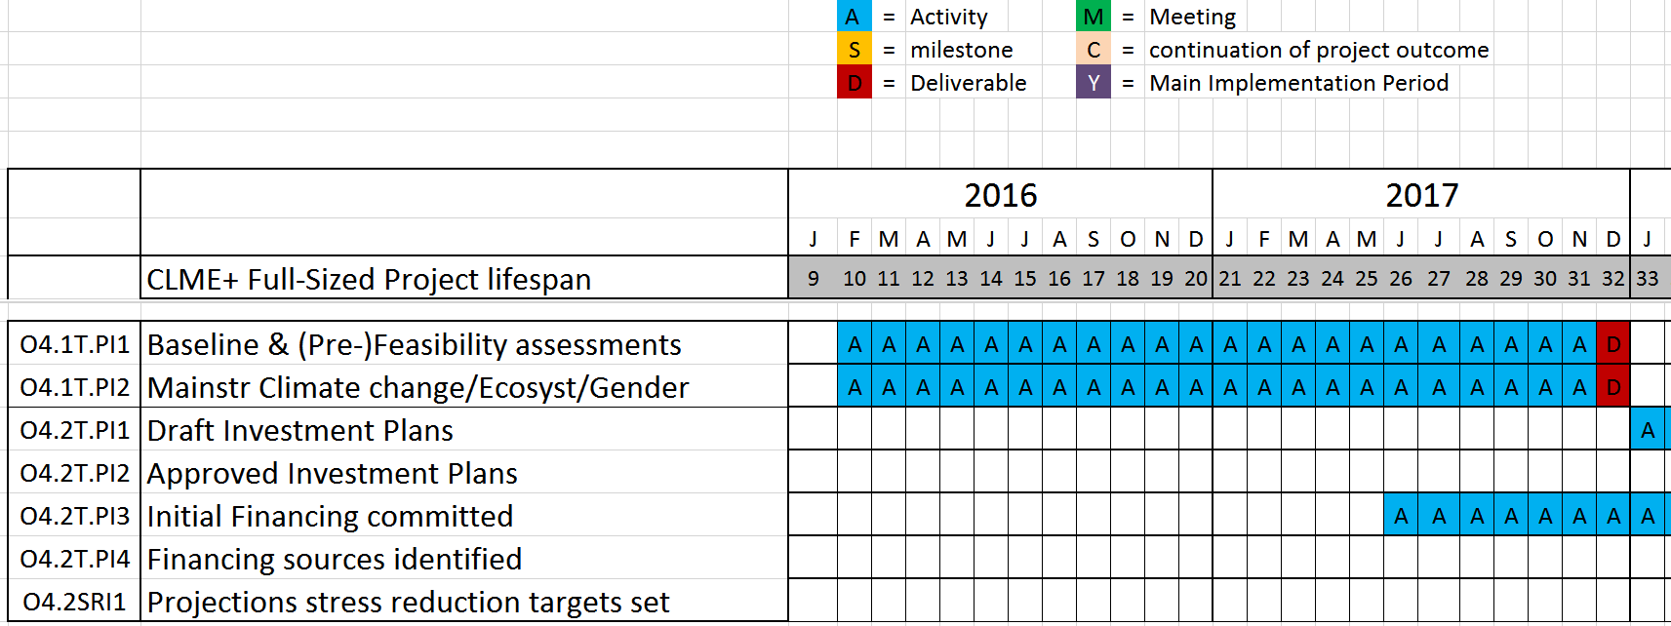
BI-ANNUAL WORK PLAN & BUDGET – 2016-2017
COMPONENT 4

Slide 12
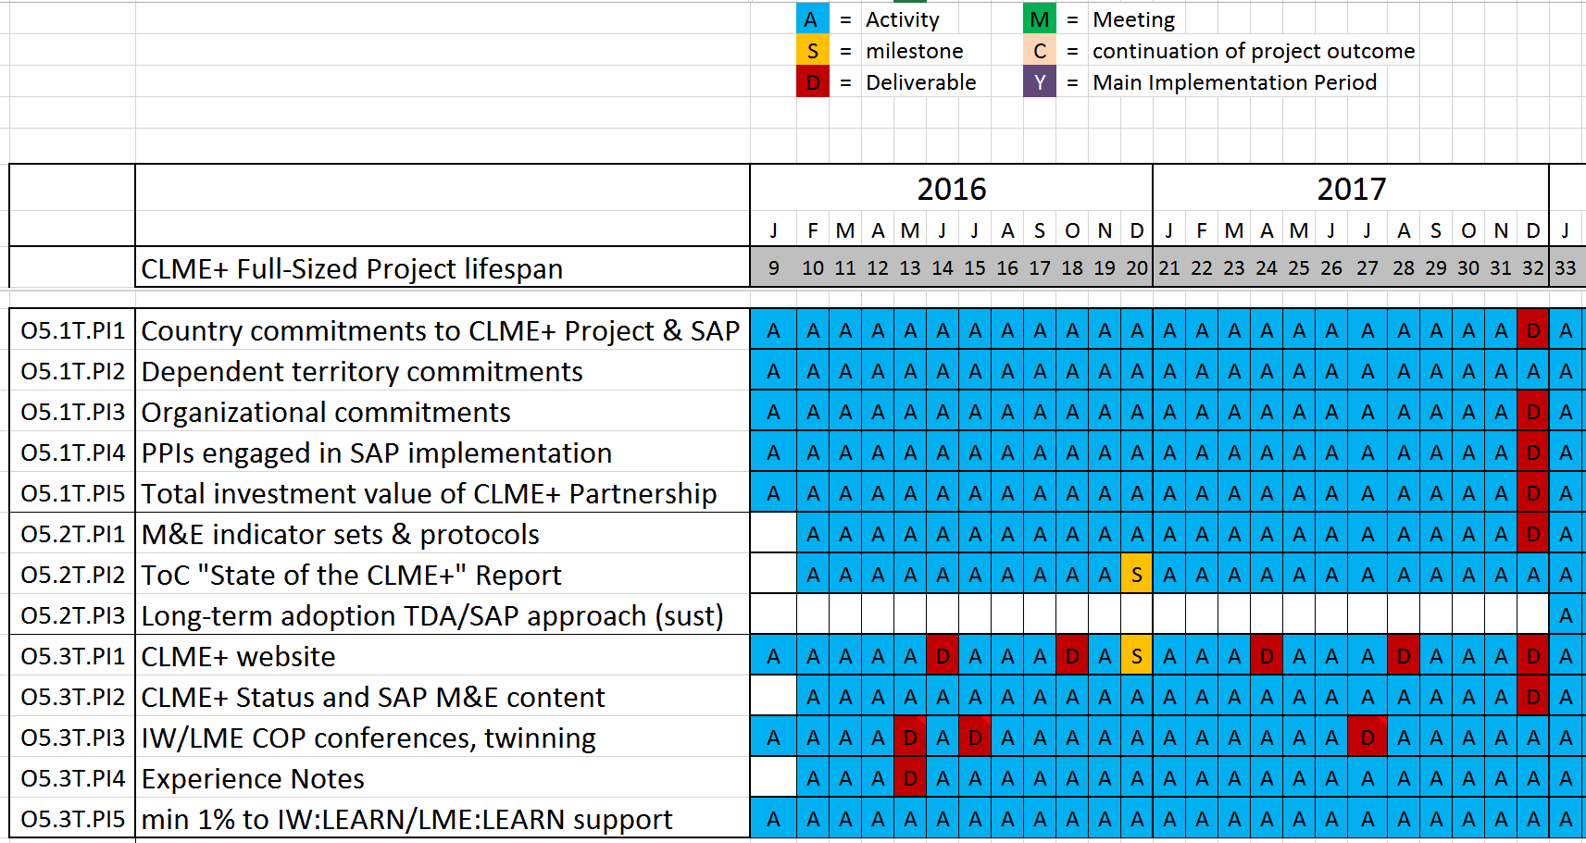
BI-ANNUAL WORK PLAN & BUDGET – 2016-2017
COMPONENT 5

Slide 13
…Just some of the key meetings planned for 2016
Caribbean Marine Atlas – Steering Committee & Planning Meeting
CLME+ Communication Strategy Workshop
CLME+ “State of the Marine Environment” 1st Workshop
SAP M&E Indicators 1st Workshop
EBM Sub-project development Workshop
NatureServe EBM Training
WECAFC Session
GEF International Waters Conference
LBS STAC (TBC)
SPAW STAC (TBC)
GCFI
CLME+ PEG & SAP Interim Coordination Mechanism
LME Consultative Group Meeting
LBS COP – SPAW COP – Cartagena Convention IGM (TBC)
Joint CRFM-OSPESCA Ministerial Meeting (2017?)
Joint LBS-SPAW STAC
IUU, Flyingfish, Spiny Lobster Working Group Meetings?
Green = organized by CLME+ co-executing partners
Blue = organized by PCU

Slide 14
CO-EXECUTING ARRANGEMENTS
(“responsible parties”)
REVISED/FURTHER SPECIFIED - FOR APPROVAL BY PSC
RESPONSIBLE PARTY: |  |  | UNEP CEP | 2016 | 2017* | (total 2016-19)
C1 | O1.1.T.PI1 | Coll agreement Brazil & Cartagena Convention Secretariat |  | 59 | 27 | (100)
C1 | O1.1.T.PI2 | SPAW-LBS coordination & collaborative action
C2 | O2.1.T.PI2 | Regional Action Plan – Habitats |  | 95 | 117 | (240)
C2 | O2.1.T.PI3 | Regional Action Plan – Pollution
C3 | O3.4 | EBM sub-project |  | 195 | 150 | (510)
C4 | O4.2 | Feasib study + Investment Plan – Habitats |  | 97 | 172 | (360)
C4 | O4.2 | Feasib study + Investment Plan – Pollution
C5 | O5.2.T.PI2 | SAP M&E |  | 40 | 35 | (75)
C5 | O5.3.T.PI2 | State of the Marine Environment (perpet. TDA/SAP)
*30% of resources needed for 2018 paid to Co-executing partner in 2017
(Amounts in 1000s of USD)

Slide 15
CO-EXECUTING ARRANGEMENTS
(“responsible parties”)
REVISED/FURTHER SPECIFIED - FOR APPROVAL BY PSC
RESPONSIBLE PARTY: |  |  | FAO WECAFC | 2016 | 2017* | (total 2016-19)
C1 | O1.1.T.PI3 | Interim Fisheries Coordination Mechanism |  | 22 | 28 | (50)
C1 | O1.1.T.PI4 | Permanent Fisheries Coordination Mechanism
C2 | O2.1.T.PI1 | Regional Action Plan – IUU |  | 24 | 56 | (80)
C3 | O3.4 | Shrimp & Groundfish sub-project |  | 408.4 | 342.8 | (950)
C4 | O4.2 | Feasib study + Investment Plan – Fisheries |  | 103.5 | 66.5 | (170)
C5 | O5.2.T.PI2 | SAP M&E |  | 26 | 14 | (40)
C5 | O5.3.T.PI2 | State of the Marine Environment (perpet. TDA/SAP)
*30% of resources needed for 2018 paid to Co-executing partner in 2017
(Amounts in 1000s of USD)

Slide 16
CO-EXECUTING ARRANGEMENTS
(“responsible parties”)
REVISED/FURTHER SPECIFIED - FOR APPROVAL BY PSC
RESPONSIBLE PARTY: |  |  | OSPESCA | 2016 | 2017 | (total 2016-19)
C1 | O1.1.T.PI3 | Interim Fisheries Coordination Mechanism |  | 10 | 0 | (10)
C3 | O3.4 | Spiny Lobster sub-project |  | 343.2 | 260 | (950)
RESPONSIBLE PARTY: |  |  | CRFM | 2016 | 2017 | (total 2016-19)
C1 | O1.1.T.PI3 | Interim Fisheries Coordination Mechanism |  | 10 | 0 | (10)
C2 | O2.4 | Communications Strategy / CS |  | 100.9 | 80.1 | (322.3)
C3 | O3.4 | Flyingfish sub-project |  | 328.4 | 233.5 | (825)
*30% of resources needed for 2018 paid to Co-executing partner in 2017
(Amounts in 1000s of USD)

Slide 17
CO-EXECUTING ARRANGEMENTS
(“responsible parties”)
REVISED/FURTHER SPECIFIED - FOR APPROVAL BY PSC
RESPONSIBLE PARTY: |  |  | CERMES | 2016 | 2017 | (total 2016-19)
C1 | O1.2.T.PI1 | National Inter-sectoral Coordination: baseline, recommendations, tracking progress |  | 20 | 10 | (40)
C1 | O1.3.T.PI1 | Mainstreaming EBM in policies (incl. baseline) |  | 0 | 35 | (70)
C5 | O5.1.T.PI1-4 | Updating of inventory on Programmes, Projects & Initiatives relevant to the CLME+ SAP (repository) |  | 20 | 10 | (50)
C5 | O5.2.T.PI1 | Indicators for SAP M&E / protocols |  | 25 | 20 | (65)
C5 | O5.3.T.PI4 | CLME+ experience notes (IW:LEARN) |  | 3 | 0 | (10)
*30% of resources needed for 2018 paid to Co-executing partner in 2017
(Amounts in 1000s of USD)

Slide 18
REVISED/FURTHER SPECIFIED - FOR APPROVAL BY PSC
RESPONSIBLE PARTY: |  |  | OECS | 2016 | 2017 | (total 2016-19)
C1 | O1.1.T.PI5 | Interim Mechanism to support coordinated SAP implementation |  | 7.5 | 0 | (15)
C1 | O1.2.T.PI1 | National Inter-sectoral Coordination (NICs) |  | 5 | 5 | (20)
C1 | O1.4.T.PI1 | MoU data & information exchange |  | 10 | 5 | (15)
C2 | O2.4.T.PI1 | Communication Strategy – decentralized comp. |  | 7.5 | 7.5 | (20)
C5 | O5.2.T.PI2 | SAP M&E |  | 20 | 10 | (50)
C5 | O5.3.T.PI2 | State of the Marine Environment (perpet. TDA/SAP) |  | 10 | 10 | (40)
RESPONSIBLE PARTY: |  |  | IOC of UNESCO | 2016 | 2017 | (total 2016-19)
C2 | O2.5.T.PI1 | Training Strategy -> Portal/Gateway |  | 30 | 15 | (60)
C2 | O2.5.T.PI3 | Training Materials -> repository |  | 0 | 9 | (25)
C5 | O5.3.T.PI2 | State of the Marine Environment (perpet. TDA/SAP) |  | 0 | 0 | (40*)
*2016-2017: co-financing through CMA2
(Amounts in 1000s of USD)

Slide 19
REVISED/FURTHER SPECIFIED - FOR APPROVAL BY PSC
RESPONSIBLE PARTY: |  |  | GCFI | 2016 | 2017 | (total 2016-19)
C2 | O2.6.T.PI1 | Annual GCFI meetings |  | 10 | 10 | (40)
C2 | O2.6.T.PI1 | Research Strategies to support policy/management |  | 25 | 25 | (50)
RESPONSIBLE PARTY: |  |  | CANARI | 2016 | 2017 | (total 2016-19)
C2 | O2.2.T.PI1 | Civil Society SAP (C-SAP) |  | 37 | 35 | (80)
C2 | O2.2.T.PI3 | Small Grants Coordination Mechanism |  | 24 | 10 | (50)
C3 | O3.5 | Small Grants – min 1 supporting C-SAP & 1 supporting P-SAP implementation |  | 0 | 20 | (120)
C3 | O3.5 | Demo/Alternative Livelihoods– seamoss (SKN) |  | 60 | 40 | (100)
(Amounts in 1000s of USD)

Slide 20
CO-EXECUTING ARRANGEMENTS
REVISED/FURTHER SPECIFIED - FOR APPROVAL BY PSC
RESPONSIBLE PARTY: |  |  | COMPETITIVE SELECTION | 2016 | 2017 | (total 2016-19)
C2 | O2.2.T.PI2 | Private Sector SAP (P-SAP) |  | 40 | 25 | (110)
(Amounts in 1000s of USD)

Slide 21
AWP/BUDGET (1000s of USD) for approval by SCM | 2016 | 2017 | (2018)
 |  |  | pre-approval SCM budget
Staff & Consultants (GEF grant) | 575.8* | 575.7* | +85K
Travel (incl. SCM, PEG,…) | 321.5 | 271.0 | Budget allocated to 2016
Contractual Services | 2,535.6 | 2,080.4
Rental & Maintenance (Premises, Meeting Rooms) | 28.0 | 101.0
Equipment & Furniture (incl ITC) | 29.0 | 7.0
Audiovisuals, Printing & Translations | 20.0 | 30.0
Supplies | 16.0 | 16.0
Miscellaneous | 12.0 | 12.0
Management Costs | 241.6 | 208.9
TOTAL (net) | 3,538.0 | 3,093.1
TOTAL | 3,779.6 | 3,302.0
management costs (% of total) | 6,4% | 6,3%
*includes buffer for (re-)recruitment/EOS entitlements

