Slide 1



+
1st CLME+ Steering Committee Meeting & Inception Workshop
26 – 28 January 2016, Cartagena, Colombia
Agenda # 8
Revision (updating) of:
Project Logframe, Timeline, Budget & Responsible Parties

Slide 2
ROLE OF THE PROJECT STEERING COMMITTEE
Annex 8 – Draft TORs for the Project Steering Committee
Specific functions will include:
Provide overall strategic policy and management direction to the project
Review and approve the Project Work Plan and Budget and any changes thereto, in accordance with GEF, UNDP and UNOPS guidelines
Provide strategic direction on the Work Plan
Assist in identifying and allocating Project support for activities consistent with Project objectives
The PRODOC does not fully specify how all $ resources available for the different activities/outputs will be allocated to Responsible Parties. The PCU and co-executing partners give more content to those areas where the ProDoc falls short on detail/specifications, and present the revision to the PSC for comments & approval

Slide 3
UNDP POPP on Budget Tolerance
Tolerance is the permissible deviation from a plan (in terms of time and cost) without bringing the deviation to the attention of the next higher authority.
In this process, the Project Steering Committee may agree with the Project Manager on tolerance levels under the overall Annual Work Plan.
If there is a forecast that the tolerance is to be exceeded, the project manager must refer the matter to the project board, and this may result in a revision.
However, within the agreed tolerances, the project manager can operate without intervention from the project board.
For example, if the project board sets a budget tolerance of X% for a plan, the project manager can expend up to X% beyond the approved project budget amount for the year without requiring a revision from the project board.
for consideration by the SCM

Slide 4
CLME+ BUDGET:
As in the PRODOC
TOTAL GEF CONTRIBUTION: US$ 12.500.000
GEF CAP on management (10%*): US$ 1.136.363
NET GEF GRANT: US$ 11.363.637
*on top of net expenditures

Slide 5
CLME+ PRODOC
BUDGET ALLOCATIONS
COMPONENTS OF THE CLME+ PROJECT
ENHANCE THE GOVERNANCE ARRANGEMENTS
facilitate
C1
C3
C4
DEMONSTRATE EBM/EAF
(prioritize/select – limited $) building on results from C1&2
FEASIBILITY STUDIES – INVESTMENT NEEDS FOR UPSCALING OF RESULTS
BUILD THE CAPACITY TO MAKE EFFECTIVE USE OF THE ENHANCED ARRANGEMENTS
demonstrate
C2
scale-up, replicate
enable
REGION-WIDE
M&E OF SAP IMPLEMENTATION
C5
track progress, foster synergies, avoid duplication, review/revise approach

Slide 6
CLME+ PRODOC
BUDGET
ALLOCATIONS
C1: Governance – C2: Capacity B. – C3: Sub-projects – C4: Investm Plans – C5: Partnerships, SAP M&E

Slide 7
CLME+ PRODOC
BUDGET
ALLOCATIONS
C1: Governance – C2: Capacity B. – C3: Sub-projects – C4: Investm Plans – C5: Partnerships, SAP M&E

Slide 8
UNDP/GEF TOLERANCES
±10%
ON THE CUMMULATIVE BUDGET VALUE FOR EACH PROJECT COMPONENT

Slide 9
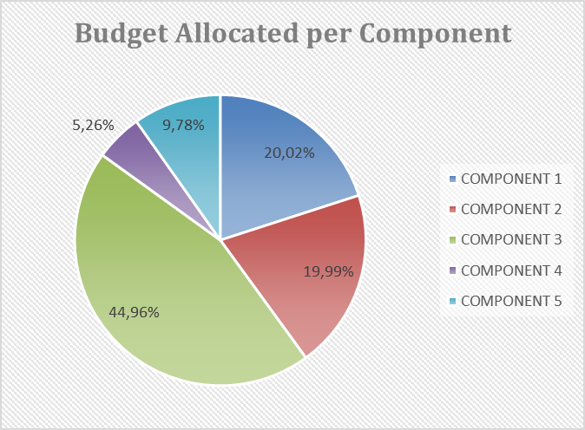
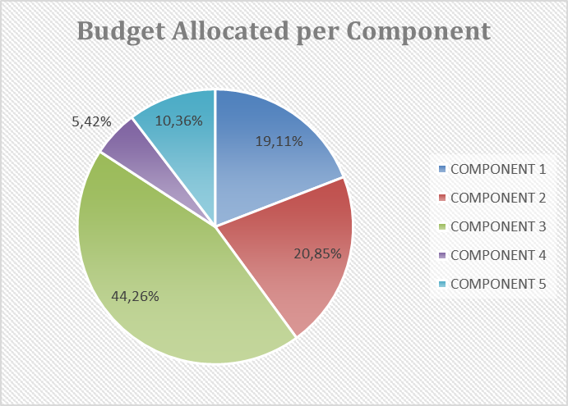
CLME+ REVISED
BUDGET
ALLOCATIONS
as in PRODOC
INCEPTION PHASE REVISION
% of net budget
% of net budget
C1: Governance – C2: Capacity B. – C3: Sub-projects – C4: Investm Plans – C5: Partnerships, SAP M&E

Slide 10
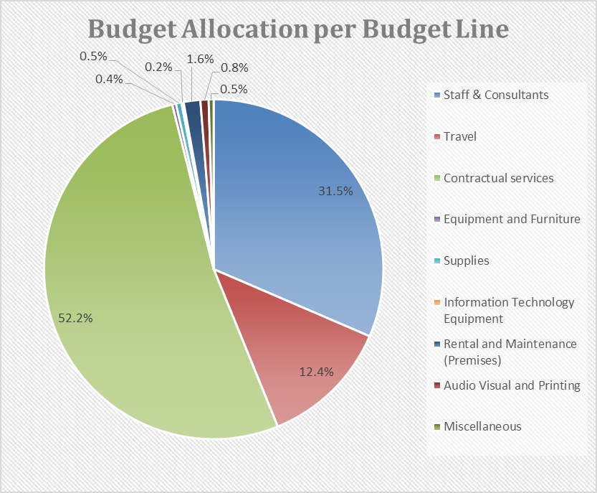
CLME+ PRODOC
BUDGET ALLOCATIONS

Slide 11
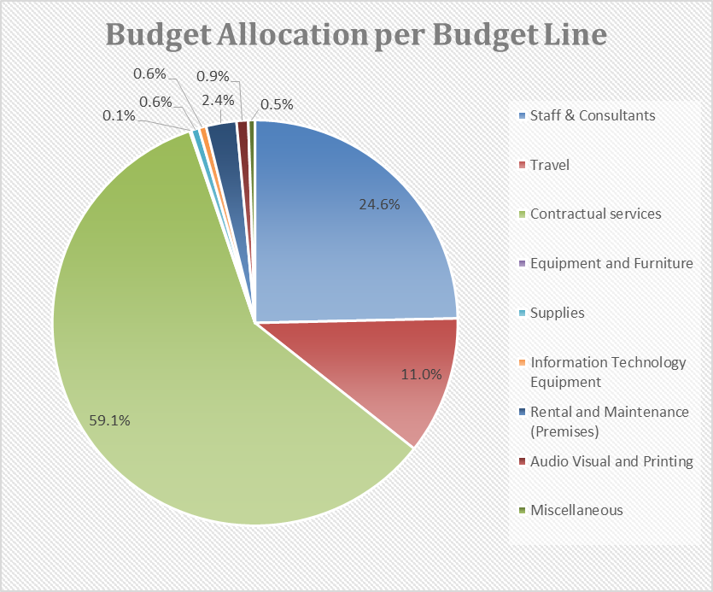
CLME+ REVISED
BUDGET ALLOCATIONS
as in PRODOC
INCEPTION PHASE REVISION

Slide 12
CLME+
“ANNUAL” AND TOTAL BUDGET
as in PRODOC
 | Amount in 1000s of USD and as % of total
Project YR | YEAR 1 | YEAR 2 | YEAR 3 | YEAR 4 | YEAR 5 | TOTAL
Calendar YR | 2015 | 2016 | 2017 | 2018 | 2019 | 2020 | TOTAL
Inception phase revision
(adaption from project years to Calendar Years + revised project planning)

Slide 13
CLME+
“ANNUAL” AND TOTAL BUDGET
as in PRODOC
 | Amount in 1000s of USD and as % of total
Source | YEAR 1 | YEAR 2 | YEAR 3 | YEAR 4 | YEAR 5 | TOTAL
GEF | 2,417.1 | 2,653.7 | 2,755.5 | 2,635.1 | 2,038.6 | 12,500.0
 | 19.3% | 21.2% | 22,0% | 21,1% | 16,3% | 100%
Source | 2015 | 2016 | 2017 | 2018 | 2019 | 2020 | TOTAL
GEF | 456.0* | 3,779.6 | 3,302.0 | 2,479.2 | 1,988.5 | 494.8 | 12,500.0
 | 3.6% | 30.2% | 26.4% | 19.8% | 15.9% | 4.0% | 100%
Inception phase revision
(adaption from project years to Calendar Years + revised project planning)
*Not yet certified

Slide 14
CLME+
“ANNUAL” AND TOTAL BUDGET
as in PRODOC
YR1 YR2 YR3 YR4 YR5
19.3% 40.5% 62.5% 83.6% 100%
3.6% 33.9% 60.3% 80.1% 96.0% 100%
2015 2016 2017 2018 2019 2020
Inception phase revision
(adaption from project years to Calendar Years + revised project planning)

Slide 15
OVERVIEW – THEMATIC ALLOCATIONS
PCU staffing
PCU – offices & operations
Project Governance
UNDP/GEF M&E requirements
GEF IW:LEARN / LME:LEARN
Project Co-executing arrangements

Slide 16
CLME+ PROJECT TIMELINE & PCU STAFFING
as per the ProDoc:
Regional Project Coordinator
Senior Project Officer
Operations & Finances Manager
Operations & Finances Assistant
Communications Specialist
Environmental Mapping &
Reporting Analyst
(“CMA2 Liaison Person”)

Slide 17
PCU STAFFING
Acronym | Title | Level | Status | # months
RPC | Regional Project Coordinator | P5 | On board | 60
2. SPO | Senior Project Officer | IICA2 | On board | 59
3. OFM | Operations & Finances Manager | IICA1 | On board | 56
4. OFA | Operations & Finances Assistant | LICA5 | On board | 57
5. EMRA | Environmental Mapping & Reporting Analyst | IICA1 | VA closed, selection process | 46
6. CS | Communications Specialist | Sub-contract CRFM | VA to be launched | 46
 | Interns | On a Opportunity/Needs-base

Slide 18
COSTS PCU STAFFING
(1000s of US$)
PRODOC Budget Notes:
c1.1-c5.1: includes (i) the share of technical coordination/support activities in the total costs of PCU staff (RPC, SPO, communications specialist); (ii) other international consultants that will support delivery of CLME+ Outputs
c1.2-c5.2: share of technical & operational support activities of PCU staff (OFM, OFA)
Total allocated for staff/consultants in ProDoc
Budget lines 71200&71300 | USD 3,574.5
REVISED PCU STAFFING BUDGET ALLOCATIONS FOR PSC APPROVAL
Source & Budget lines |  | 2015 | 2016 | 2017 | 2018 | 2019 | 2020 | TOTAL
GEF | 71200 & 71300* | 207.3 | 452.8 | 490.7 | 514.9 | 584.4 | 316.3 | 2,566.4
FUST | 71200 | 0.0 | 53.0 | 50.5 | 48.0 | 0.0 | 2.5 | 154.0*
GEF | 72100 | 0.0 | 77.0 | 79.4 | 81.7 | 84.2 | 0.0 | 322.3
 | TOTAL | 207.3 | 582.8 | 620.6 | 644.6 | 668.6 | 318.8 | 3,042.7
71200 International Staff
71300 Local Staff
72100 Contractual Services
*excl. $ for (re-)recruitment/EOS entitlements
*FUST = EMRA co-financing contribution

Slide 19
COSTS PCU STAFFING
Now called “Environmental Mapping & Reporting Analyst” (EMRA)
Budget Note c5.2. includes costs for FUST/IOC of UNESCO Caribbean Marine Atlas (CMA2) – UNDP/GEF CLME⁺ liaison person; role of CMA2/CLME⁺ liaison person: coordinate the efforts on the development of a CLME⁺ SAP decision-support/M&E platform (cost sharing: contribution from Flanders Unesco Science Trust Fund (FUST) will finance first 2.5-3 years; CLME⁺ contribution will cover consultancy fees during remaining part of CLME⁺ Project
ACKNOWLEDGEMENT
71200 International Staff
71300 Local Staff
72100 Contractual Services
FUST = EMRA co-financing contribution

Slide 20
PCU: office space & operations
IOCARIBE/IOC of UNESCO: Office Space for the CLME+ PCU
at the IOCARIBE OFFICES:
co-financing contribution: office space + basic services
payment: reinstatement of original office conditions after Project end
USD 6.500

Slide 21
PCU: office space & operations
ALL VALUES GIVEN AS 1000s of USD
 | ALLOCATED IN PRODOC | PROPOSED REVISION
 | Total | Total
PCU Office space | 180.0 | 66.5*
Furniture & equipment (incl. IT, softw.), Office Supplies, Translation Services | 204 | 199.2**
**includes GIS software: ± 20
*contingency buffer

Slide 22
PROJECT GOVERNANCE
Acronym | Mechanism | Frequency of Meetings
PSC | Project Steering Committee: country reps, co-executing partners, co-financers, observers | 3 full PSC meetings: (1) inception, (2) mid-term, (3) project end Possibility of inter-sessional virtual meetings, as needed
PEG | Project Executive Group: UNDP, UNOPS and major co-executing partners | Annual PEG meeting
RC | Representative’s Committee: PEG members + Chair of IGO’s | As needed*
Consideration for the efficient use of Project resources:
make optimal use of existing regional governance arrangements
(scheduled meetings of relevant RGBs)
for any matters related to technical/political outputs of the project

Slide 23
UNDP/GEF
M&E REQUIREMENTS

Slide 24
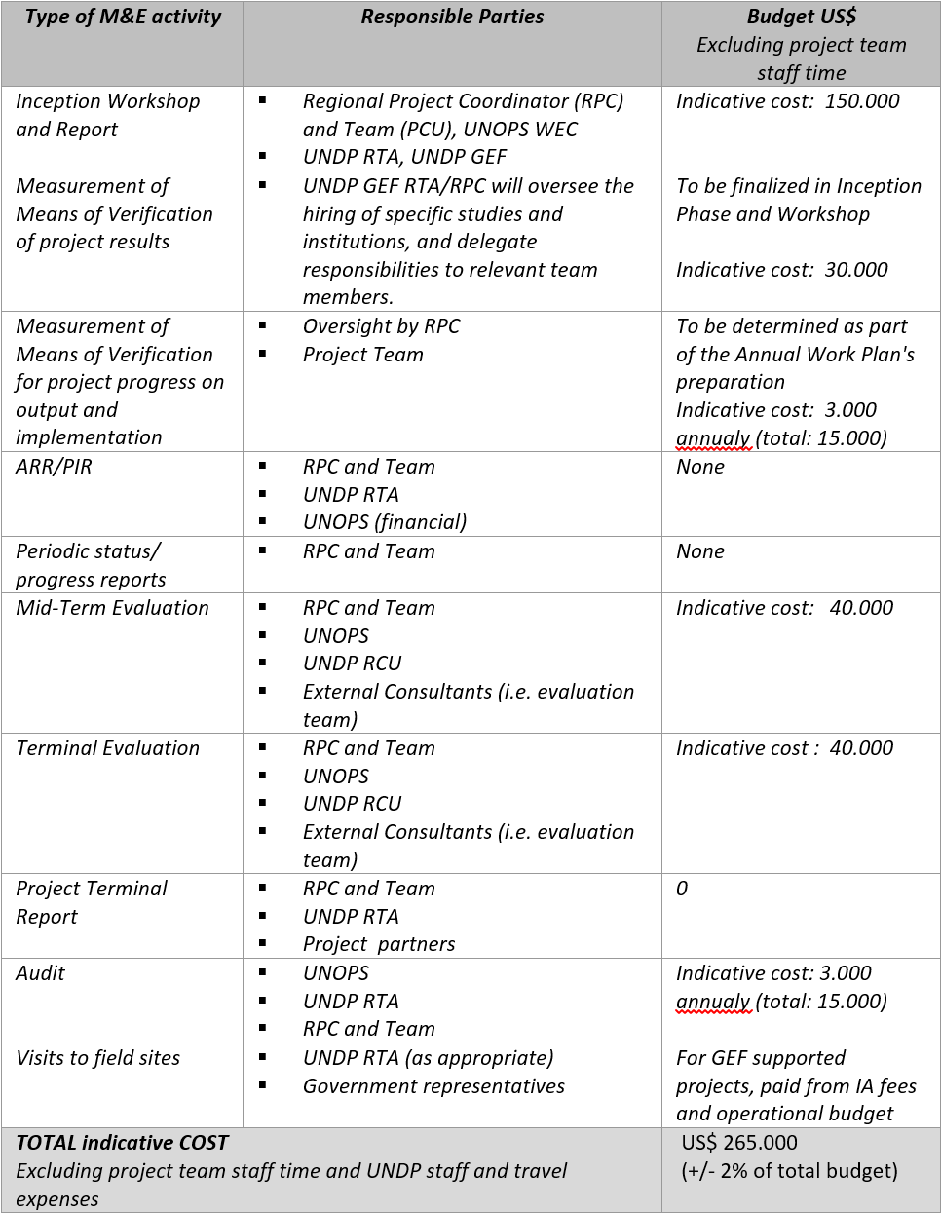
ProDoc
Section 6
(Table 20)
88K
80K
N/A
At least – 77K

Slide 25
COSTS - PROJECT GOVERNANCE & M&E
71600 = travel / 72100 = contractual services / 73100 = Rental of Office Space & Meeting rooms

Slide 26
COSTS - PROJECT GOVERNANCE & M&E
ITEM | PRODOC | PROPOSED REVISION | DIFFERENCE
3 Steering Committee Meetings | 666 | 388.1 | -132.5
5 PEG meetings |  | 145.4
Rep Committee meetings | 0 | 0 | 0
MTE & TE | 80 | 80 | 0
MoV, Audits | 60 | 45 | -15
 | 806 | 658.5 | -147.5

Slide 27
GEF IW:LEARN / LME:LEARN SUPPORT
The Project shall allocate min. 1% of the GEF grant to IW:LEARN and LME:LEARN related activities:
Biennial GEF International Waters Conference
2016 and 2018
RPC + country representatives
LME:LEARN anual meeting
annual
LME LAC COP meetings
annual?
Twinning
114K allocated

Slide 28
PROJECT INCEPTION PROGRESS:
THE PROPOSED CO-EXECUTING ARRANGEMENTS
ORGANIZATION | TYPE OF AGREEMENT
UNEP CEP | UN2UN
FAO – WECAFC | UN2UN
IOC of UNESCO | UN2UN
OSPESCA/SICA | MOA
CRFM/CARICOM | MOA
CANARI | Grant Agreement
GCFI | Grant Agreement
CERMES - UWI | Grant Agreement
OECS | MOA
All these orgs are specifically referred to as Responsible Parties in the ProDoc, but their responsibilities in project execution is not always described in full detail in the ProDoc (to become more fully determined during project inception phase, always departing from “their formal mandates and/or long-term, well-recognized role in the region and/or comparative advantages”)
(Note: all these organizations are co-financing the implementation of the CLME+ Project)

Slide 29
CO-EXECUTING ARRANGEMENTS
Already specified in the PRODOC:
RESP PARTY | C1 | C2 | C3 | C4 | C5
UNEP |  | 540 (contracts) + 160 (travel) | 510 | 530
FAO |  |  | 950
OSPESCA |  |  | 950
CRFM |  |  | 750
Small Grants - TBD |  |  | 150

Slide 30
CO-EXECUTING ARRANGEMENTS
(“responsible parties”)
REVISED/FURTHER SPECIFIED - FOR APPROVAL BY PSC
RESPONSIBLE PARTY: |  |  | UNEP CEP
C1 | O1.1.T.PI1 | Coll agreement Brazil & Cartagena Convention Secretariat |  | 50
C1 | O1.1.T.PI2 | SPAW-LBS coordination & collaborative action |  | 50
C2 | O2.1.T.PI2 | Regional Action Plan – Habitats |  | 120
C2 | O2.1.T.PI3 | Regional Action Plan – Pollution |  | 120
C3 | O3.4 | EBM sub-project |  | 510
C4 | O4.2 | Feasib study + Investment Plan – Habitats |  | 180
C4 | O4.2 | Feasib study + Investment Plan – Pollution |  | 180
C5 | O5.2.T.PI2 | SAP M&E |  | 75
C5 | O5.3.T.PI2 | State of the Marine Environment (perpet. TDA/SAP) |  | 80
(Amounts in 1000s of USD)
1,365

Slide 31
CO-EXECUTING ARRANGEMENTS
(“responsible parties”)
REVISED/FURTHER SPECIFIED - FOR APPROVAL BY PSC
RESPONSIBLE PARTY: |  |  | FAO WECAFC
C1 | O1.1.T.PI3 | Interim Fisheries Coordination Mechanism |  | 10
C1 | O1.1.T.PI4 | Permanent Fisheries Coordination Mechanism |  | 40
C2 | O2.1.T.PI1 | Regional Action Plan – IUU |  | 80
C3 | O3.4 | Shrimp & Groundfish sub-project |  | 950
C4 | O4.2 | Feasib study + Investment Plan – Fisheries |  | 170
C5 | O5.2.T.PI2 | SAP M&E |  | 40
C5 | O5.3.T.PI2 | State of the Marine Environment (perpet. TDA/SAP) |  | 80
(Amounts in 1000s of USD)
1,370

Slide 32
CO-EXECUTING ARRANGEMENTS
(“responsible parties”)
REVISED/FURTHER SPECIFIED - FOR APPROVAL BY PSC
RESPONSIBLE PARTY: |  |  | OSPESCA
C1 | O1.1.T.PI3 | Interim Fisheries Coordination Mechanism |  | 10
C3 | O3.4 | Spiny Lobster sub-project |  | 950
960
RESPONSIBLE PARTY: |  |  | CRFM
C1 | O1.1.T.PI3 | Interim Fisheries Coordination Mechanism |  | 10
C2 | O2.4 | Communications Strategy – Communications Specialist |  | 322.3
C3 | O3.4 | Flyingfish sub-project |  | 825
1,157.3
(Amounts in 1000s of USD)

Slide 33
CO-EXECUTING ARRANGEMENTS
(“responsible parties”)
REVISED/FURTHER SPECIFIED - FOR APPROVAL BY PSC
RESPONSIBLE PARTY: |  |  | CERMES
C1 | O1.2.T.PI1 | National Inter-sectoral Coordination: baseline, recommendations, tracking progress |  | 67.6
C1 | O1.3.T.PI1 | Mainstreaming EBM in policies (incl. baseline) |  | 70
C5 | O5.1.T.PI1-4 | Updating of inventory on Programmes, Projects & Initiatives relevant to the CLME+ SAP (repository) |  | 50
C5 | O5.2.T.PI1 | Indicators for SAP M&E / protocols |  | 65
C5 | O5.3.T.PI4 | CLME+ experience notes (IW:LEARN) |  | 10
(Amounts in 1000s of USD)
262.6

Slide 34
REVISED/FURTHER SPECIFIED - FOR APPROVAL BY PSC
RESPONSIBLE PARTY: |  |  | OECS
C1 | O1.1.T.PI5 | Interim Mechanism to support coordinated SAP implementation |  | 15
C1 | O1.2.T.PI1 | National Inter-sectoral Coordination (NICs) |  | 20
C1 | O1.4.T.PI1 | MoU data & information exchange |  | 15
C2 | O2.4.T.PI1 | Communication Strategy – decentralized comp. |  | 20
C5 | O5.2.T.PI2 | SAP M&E |  | 50
C5 | O5.3.T.PI2 | State of the Marine Environment |  | 40
160
RESPONSIBLE PARTY: |  |  | IOC of UNESCO
C2 | O2.5.T.PI1 | Training Strategy -> Portal/Gateway |  | 60
C2 | O2.5.T.PI3 | Training Materials -> repository |  | 25
C5 | O5.3.T.PI2 | State of the Marine Environment (perpet. TDA/SAP) |  | 40
125
(Amounts in 1000s of USD)

Slide 35
REVISED/FURTHER SPECIFIED - FOR APPROVAL BY PSC
RESPONSIBLE PARTY: |  |  | GCFI
C2 | O2.6.T.PI1 | Annual GCFI meetings |  | 50
C2 | O2.6.T.PI1 | Research Strategies to support policy/management |  | 100
150
RESPONSIBLE PARTY: |  |  | CANARI
C2 | O2.2.T.PI1 | Civil Society SAP (C-SAP) |  | 80
C2 | O2.2.T.PI3 | Small Grants Coordination Mechanism |  | 50
C3 | O3.5 | Small Grants – min 1 supporting C-SAP & 1 supporting P-SAP implementation |  | 120
C3 | O3.5 | Demo/Alternative Livelihoods – Seamoss (SKN) |  | 100
350
RESPONSIBLE PARTY: |  |  | COMPETETIVE SELECTION
C2 | O2.2.T.PI2 | Private Sector SAP (P-SAP) |  | 110
(Amounts in 1000s of USD)

Slide 36
REVISED/FURTHER SPECIFIED - FOR APPROVAL BY PSC
RESPONSIBLE PARTY | C1 | C2 | C3 | C4 (budget note c4.4) | C5 | TOTAL
UNEP | 100 | 240 | 510 | 360 | 155 | 1,365.0
FAO | 50 | 80 | 950 | 170 | 120 | 1,370.0
OSPESCA | 10 |  | 950 |  |  | 960
CRFM | 10 | 322.3 | 825 |  |  | 1,157.3
OECS | 15 | 55 |  |  | 90 | 160.0
CERMES | 137.6 |  |  |  | 125 | 262.6
GCFI |  | 150 |  |  |  | 150
IOC of UNESCO |  | 85 |  |  | 40 | 125
CANARI |  | 130 | 220 |  |  | 350
P-SAP |  |  | 110 |  |  | 110
 |  |  |  | GRAND TOTAL |  | 6,009.9
black = unchanged / blue = further specified / green = revisions/increases/additions through cost-savings

Slide 37
PARTNER ORGANIZATIONS ANNUAL BUDGETS

Slide 38
ADAPTIVE MANAGEMENT & TOLERANCES
PROPOSED PROCEDURE TO REALLOCATE FUNDS, OR TOP-UP EXISTING IAA, MOA AND GRANT AGREEMENTS WHERE COST-SAVINGS ON OTHER ITEMS CAN BE ACHIEVED:
LESS THAN 10% OF EXISTING GRANT: PCU
BETWEEN 10% AND 25%: 2-WEEKS CIRCULATION TO NFPs/SCM – NO OBJECTION?
> 25%: APPROVAL AT SCM OR REPRESENTATIVE’S COMMITTEE SESSION OR INTER-SESSIONAL (VIRTUAL) SCM
DECISION

