Slide 1
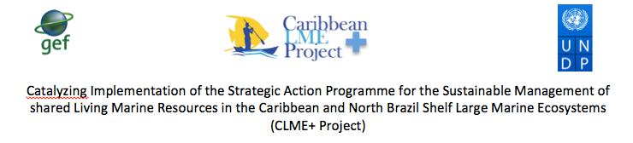

Report on the Survey of
National Inter-sectoral
Coordination Mechanisms
(NICs)
Centre for Resource Management and Environmental Studies, UWI
P. McConney
I. Monnereau
B. Simmons
R. Mahon

Slide 2
Content
Introduction
NIC features and functions
Part 1: Rapid Survey of Mechanisms for National Inter-sectoral Coordination (NIC) in other LME Projects
Part 2: Survey of NICs in the CLME+ region
Learning, successes and best practices
Recommendations

Slide 3
introduction

Slide 4
About NICs
Key roles in national and regional ocean governance
Permanent multi-stakeholder components of RGF
  Connect vertically the national to local governance levels
  Connect laterally national sectors in (sub-)regional matters
Facilitate
  National integration required for successful EAF/EBM
  Linkages with international entities and processes
Features and functions reflect good governance?
Monitoring NICs is part of assessing governance!

Slide 5
NICs scale, connect and integrate
NIC
Scaling up
Scaling down
Connecting actors
Integrating interests
Notes:
T.

Slide 6
Strengthening NICs for CLME+ and beyond
Aim is to have functional, sustainable NICs
Scaling up national level successes — regionally
Scaling down regional successes — nationally
Connecting actors vertically and laterally
CLME+ Project to pursue NIC strengthening
Approach to adopt a ‘learning by doing’ mode
Countries share experiences and best practices

Slide 7
Our activities
Rapidly screen lessons from other LMEs
Outline NIC functions related to CLME+
Develop a survey programme
Conduct the survey (phone, Skype)
Monitor and report on NICs trends
Early draft report presented to the PEG (Oct)
Final draft submitted to the CLME+ PCU (Dec)
Present to PSC; Phase 2 to monitor NICs (Jan)

Slide 8
nic Features and functions

Slide 9
Features and functions
Involve stakeholders comprehensively :
  State actors - government agencies, parastatal bodies
  Non-state actors - NGOs, CBOs and academia
  Private sector - from small to large enterprises
Promote an enabling environment that ensures opportunity and support for stakeholder participation and encourages change agents such as individual leaders and champions

Slide 10
Have a clear mandate that is at least administrative (politically endorsed) but preferably legal (for legitimacy, accountability)
Have well documented processes that are available to all stakeholders (for transparency, accountability) to ensure
  Internal communication among stakeholders
  Provision of national input to regional projects and organizations
  Receipt and distribution of input from regional projects and organizations
  Appropriate national representation at regional level

Slide 11
Have a system for documentation of activities, contributing to institutional memory, with outputs easily available to all stakeholders (for transparency and responsiveness)
Have an institutionalized mechanism for regular review, evaluation, learning and adaptation (for efficiency, effectiveness and responsiveness)
Serve to integrate sectors and actors involved in marine affairs at the national level; link national to local and regional governance processes

Slide 12
Part 1: Rapid Survey of Mechanisms for National Inter-sectoral Coordination (NIC) in other LME Projects

Slide 13
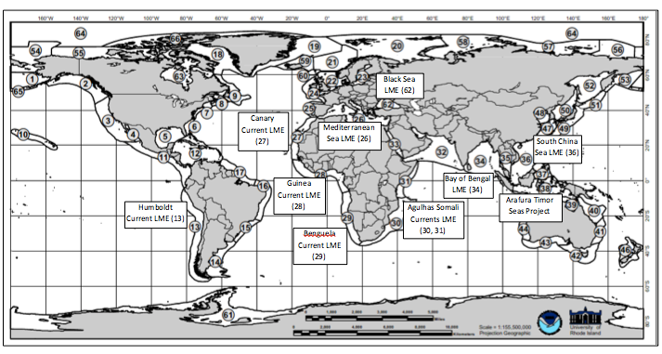


Slide 14
Methods
Review online LME project documents
  Project Identification Forms (PIFs)
  Project Documents (ProDocs)
  Strategic Action Programmes (SAPs)
  Terminal Evaluations (TEs)
Review journal articles on LME projects
Email key informants in LME projects
Limitations
Insufficient or incomplete documentation on NICs
GEF has not paid attention to learning from IW NICs

Slide 15
Summary
Few LME projects have focused much on NICs
Information difficult to obtain and incomplete
Little monitoring or reporting on performance
Some inseparable from project implementation
Increasingly prominent LME project requirement
Countries, project management avoided them
Often seen as long-term governance structures
Some countries only want at highest policy level
Issues of funds, capacity, will to champion, etc.

Slide 16
Part 2: Survey of NIC in the CLME+ region

Slide 17
Survey elements
Agencies and sectors
Fisheries
Environment
Tourism
Foreign Affairs
Transportation
Energy
Mandates to look for
All marine matters
Sustainability matters
Climate change/DRR
Sampling
CLME+ countries = 44ish
Snowballed respondents
Methods
Make contact list
Email intro and call
Snowball and call
Instruments
Features and functions
Interview guide

Slide 18
Survey process

Slide 19

Interview guide
Nature of the NIC; Name the NIC
Mandate; legal/administrative
Sector and/or issue coverage
Stakeholder inclusion (membership)
Documents; transparency; accountability
Enabling environment for participation
Institutionalised review (learn, adapt)
Scale rate: participation, transparency
Scale rate: accountability, responsiveness
NICs over time: past, present, planned

Slide 20
Limitations
Little online or paper documentation on NICs
Restricted access to existing documentation
Pre-interview preparation on NICs was difficult
Knowledgeable respondents not easily located
Response quality depends on knowing concepts
Concepts in NIC interview guide hard to explain
Respondents relied much on incomplete recall
Biases towards positive and negative responses
High variability of responses within countries

Slide 21
Learning, successes and best practices

Slide 22
Establishment and clear mandate
Evolving NICs: ICZM, EEZ, MSP, EBM, SDG
Expectations — performance — inactivity
Legal versus administrative — adaptive
Capacity — human and other resources
Legal, political status — policy influence
Ministerial and other useful affiliations
Cost of NIC establishment and operation
Mobilising NIC champions and leaders

Slide 23
Covering sectors and stakeholders
Connect and integrate economic sectors
Connect and integrate stakeholder interests
Good representation of state, non-state actors
Type of representative — delegate, expert etc.
Stakeholder inclusion and also engagement
Problem-solving and conflict management
Size and composition change with issues
Networks connecting NICs and members

Slide 24
Near-NIC mis-matches or potential
Scope of actual NIC is too small
regarding topics or sectors or issues covered e.g. most FACs
Scope of actual NIC is too large
regarding topics or sectors or issues covered e.g. NCSD
Scope of actual NIC is too small
regarding the geographic scale e.g. CZM, district
Scope of actual NIC is good but it lacks vertical links to make it useful for CLME+
Ideal NIC
Actual NIC

Slide 25
Well documented processes and institutional memory
Internal administration and communication
Little inclination to share documents online
Public information policy of the country
Managing confidential or sensitive information
Important roles of communications brokers
Interaction with regional projects, organizations
NICs were short-lived and largely undocumented
Institutional memories suffer from many gaps

Slide 26
Enabling environment and success
Unsure extent to which NICs provided enabling environments for multi-level good governance
Mandates constrain aspirations of members
  integrate across economic sectors
  utilize an ecosystem-based approach
Internal and external drivers of enabling
Ability to self-organise is a critical feature
No single success story, but best practices

Slide 27
Recommendations

Slide 28
Recommendations 1/2
Clarify the specification of NICs to determine more precisely what are or are not NICs
Set out the several types and stages of NICs that are of interest and potential for CLME+
Obtain more detailed information from countries to identify successes and best practices
Provide activity incentives for CLME+ project countries to establish or strengthen NICs

Slide 29
Recommendations 2/2
Promote NICs as critical mechanisms for marine governance beyond the CLME+ project
Assist progressive countries to advance their NICs as models of success to be replicated
Develop a handbook of guidelines for establishing and operating NICs in CLME+ countries
In the CLME+ region no existing NIC
perfectly fit the NIC ideal type

Slide 30


