Slide 1

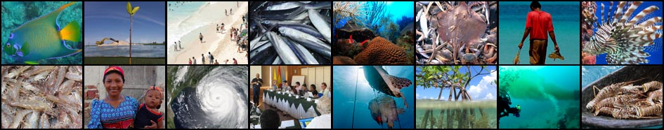
Proposed National Focal Points (NFPs) for the CLME+ Project
CLME+ Project Inception Workshop and First Steering Committee Meeting, Cartagena, Colombia
26 – 28 January, 2016

Slide 2
CLME+ Project National Focal Points
CLME+ National Focal Point:
A CLME+ country’s official representative to the CLME+ Project
Represent their country’s interest during CLME+ Project execution
NFPs are expected to actively prepare for, attend, participate/communicate and make decisions on behalf of their country at the CLME+ Project Steering Committee Meetings

Slide 3
CLME+ Project National Focal Points
NFPs should be tied to a senior technical position within a relevant government Ministry
NFPs are expected to have a good understanding of their country’s policies and strategies/action plans as they relate to (a) fisheries and (b) the protection of the marine environment

Slide 4
CLME+ Alternate NFPs and Liaison Persons
Alternate NFP
CLME+ Project – cross sectoral (focuses on fisheries and marine environmental issues)
As such, countries are encouraged to appoint an alternate/deputy NFP to supplement and support the expertise/background of main NFP to support the cross sectoral nature of the CLME+ Project

Slide 5
CLME+ Alternate NFPs and Liaison Persons
CLME+ Liaison Person
If deemed necessary, NFPs may also nominate a liaison person to support them in the execution of CLME+ Project duties
Individuals designated as liaison persons should be given authority by the NFP, or alternate NFP, to directly communicate with CLME+ PCU on matters of relevance to the project

Slide 6
Responsibilities CLME+ NFPs/Alternates and Liaisons
Share information & decisions from CLME+ SCMs with relevant national stakeholders through relevant national inter-sectoral and coordination mechanisms
Share information & decisions from CLME+ SCMs with the country Focal Points of the CLME+ Sub-Projects
Ensure coordination between activities at national level to avoid duplication & to optimize use of financial & human resources
Liaise with the CLME+ PCU as needed to ensure successful implementation of CLME+ Project

Slide 7
Responsibilities CLME+ NFPs/Alternates and Liaisons
Disseminate in a timely manner requests for support from the CLME+ PCU
Facilitate feedback & communication from between national stakeholders and the CLME+ PCU
Promote enhanced coordination & synergies among the CLME+ Project and related national and local level activities
Promote adoption of EAF/EBM approach
Provide the CLME+ PCU with periodic reports on the status of their country’s NIC
Support the monitoring & evaluation of the implementation of the CLME+ Project

Slide 8
Experience & Skills of a NFP
Basic understanding of role & functioning of the GEF and its international waters focal areas
Familiarity with the objectives, scope and content of the CLME+ SAP and Project Document
Good understanding of the state of fisheries and/or status if the marine environment national and regionally
Familiarity with the concepts of EBM/EAF

Slide 9
Experience & Skills of a NFP
Good understanding of their country’s policies and strategies/action plans related to the marine environment
Supportive of principle of interactive participatory governance & be involved in country-level inter-sectoral consultation & coordination mechanisms/processes
Ability to promote the CLME+ Project nationally, regionally & internationally
Entitled to take decisions on behalf of their country, or to communicate on decisions taken by corresponding authorities of their countries at CLME+ SCMs

Slide 10
Status of CLME+ Project NFP Designation

Slide 11
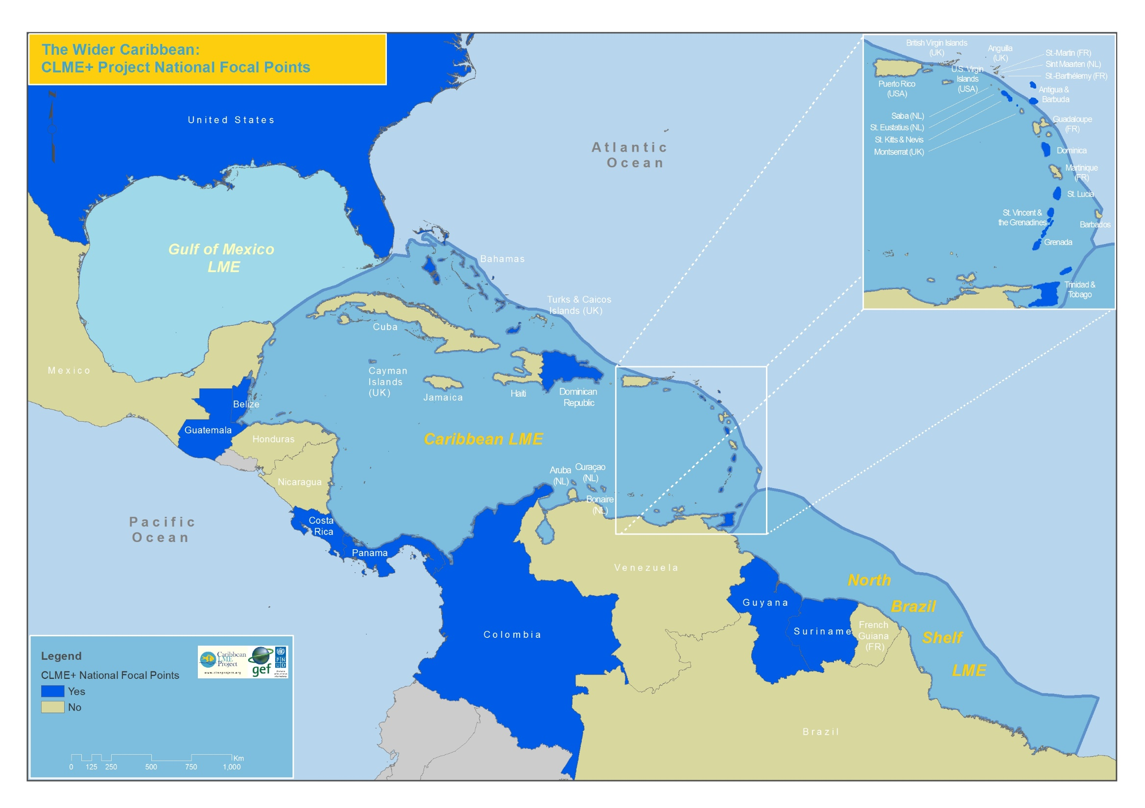

Slide 12
National Focal Points Identified
Antigua & Barbuda
Bahamas
Belize
Colombia
Costa Rica
Dominica
Dominica Republic
Grenada
Guatemala
Guyana
Jamaica
Panama
St. Kitts & Nevis
Saint Lucia
St. Vincent & the Grenadines
Suriname
Trinidad and Tobago
United States of America

Slide 13
National Focal Points Not Identified
Barbados
Brazil
Cuba
Haiti
Honduras
Mexico
Nicaragua
Venezuela

Slide 14
Comparison - NFPs from Ministries of Fisheries & Environment

Slide 15
Status of Alternates/Deputies
Colombia
Dominican Republic
Panama

Slide 16
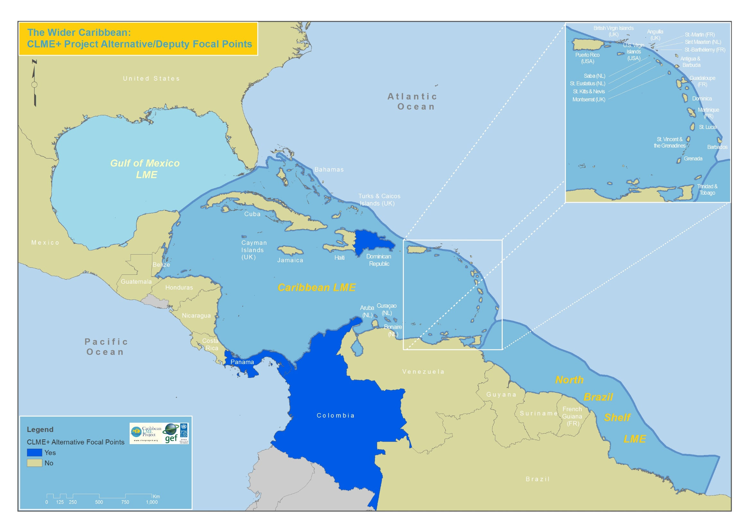

Slide 17
Actions for Consideration
Countries that have not designated National Focal Points should do so as soon as possible
Countries (particularly the larger ones) should give consideration to nominating an Alternative/Deputy Focal Point
If NFP is from ministry with responsibility for Environment, alternative should be from Fisheries and vice versa

Slide 18
Thank you
http://clmeproject.wordpress.com
CLME Project Coordination Unit
Cartagena, Colombia
(57) (5) 664 09 14
info@clmeproject.org

