Slide 1
MONITORING & EVALUATION OF
UNDP/GEF PROJECTS
UNDP/GEF Catalysing Implementation of the Strategic Action Programme for the Sustainable Management of shared Living Marine Resources in the Caribbean and North Brazil Shelf Large Marine Ecosystems
(CLME+ Project)
José Vicente Troya
Regional Technical Advisor for International Waters

Slide 2
OVERVIEW
Background:
What is GEF?
UNDP/GEF projects implementation responsibilities
Monitoring and Evaluation Requirements:
Adaptive Management
Tools to monitor progress
Report on progress
Budget
Risk Management
UNDP Risk Management Module

Slide 3
What is GEF?
Established to forge international co-operation and finance actions to address critical threats to the global environment:
Biodiversity loss (in response to the Convention on Biological Diversity)
Climate change (in response to the U.N. Framework Convention on Climate Change)
Chemicals and Waste
International waters (no Global conventions)
Land degradation (in response to the UN Convention to Combat Desertification)
Sustainable Forest Management
Mechanism for financing “incremental costs” of new “global environment” actions by developing countries
Trust Fund

Slide 4
UNDP/GEF project implementation responsibilities
GEF
Formal delegation of authority to implement the GEF project
M&E responsibilities
Reporting responsibilities
UNDP (HQ & Regional Center in Panama) (Implementing Agency)
Coordination
UNOPS
(Executing Agency)
Countries/ CLME+/
PSC
Regional PCU

Slide 5

II. MONITORING AND EVALUATION REQUIREMENTS FOR UNDP/GEF PROJECTS

Slide 6
1. ADAPTIVE MANAGEMENT - What is it?
Focus on “results”:
  Progress towards impact indicators
  Achieving sustainable change
The “process” should change to take account of:
  New risks or change in risk rating
  Monitoring results (current strategy not working)
  Situation changes
  New opportunities

Slide 7
ADAPTIVE MANAGEMENT - What changes are allowed?
Objective level:
  Clearance from GEF in Washington D.C.
  Revised Project Document – very difficult process
  It is basically a new project – so not recommended, as you will need to resubmit
Outcome level:
  Clearance from UNDP-GEF, reported to GEF
  Revised Project Document
  Not recommended , resubmission might be necessary
Output/Activity level:
  Clearance from UNOPS, reported to Regional Technical Advisor
  Revised Workplan, Budget Revision
Input level:
  Agreement with UNDP-Regional Technical Advisor
  Substantive Budget Revisions cleared by Regional Tech. Advisor

Slide 8
2. Tools to monitor Progress
2.1. Logframe:
Developed during the project design
Refined and finalized at Inception Workshop
Include result-oriented SMART indicators
2.2. Annual Work Plan
2.3. Field visits from UNOPS and UNDP/GEF RCU
2.4. Evaluations (Mid-term and Final)

Slide 9
3. REPORTING ON PROGRESS
3.1. Inception report – progress in the inception stage, revisions made on the logframe, total budget and work plan, monitoring framework, etc.
3.2. Quarterly operational and financial reports – reporting progress & challenges each quarter, updating risks & management responses, lessons learned, financial delivery against approved Annual Work Plan
3.3. Project Implementation Reviews /Annual Project Report – project progress for the year (July – June) rated in terms of achieving project objective and project implementation, lessons learned & best practices, co-financing

Slide 10

III. UNDP/GEF Risk Management System
GEF - funded projects are complex and therefore likely to face risks and challenges

Slide 11
7 RISK CATEGORIES – all projects should monitor
ENVIRONMENTAL
FINANCIAL
OPERATIONAL
ORGANIZATIONAL
POLITICAL
REGULATORY
STRATEGIC

Slide 12
TYPES OF RISKS
STANDARD - 7
historically associated with unsatisfactory outcomes
Ensures key risks are not overlooked and allows portfolio aggregation of results
CRITICAL
higher potential for causing damage
medium or high impact
probability of occurrence above 50%

Slide 13
FOR EACH RISK IDENTIFIED WE NEED A MANAGEMENT RESPONSE
Strengthened supervision – modified DoA; more field visits; more frequent reporting;
Adjustments to project strategy
Changes to implementation arrangements
Changes in budget allocation
Temporary interruption
Termination

Slide 14
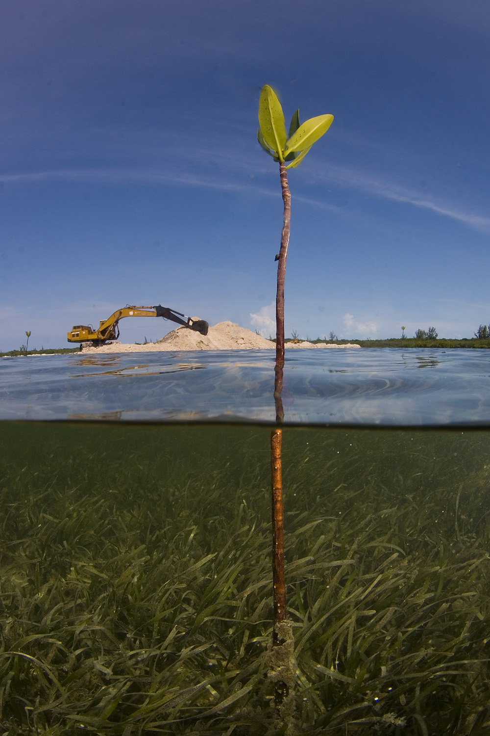
Thank you!

